Slide 1
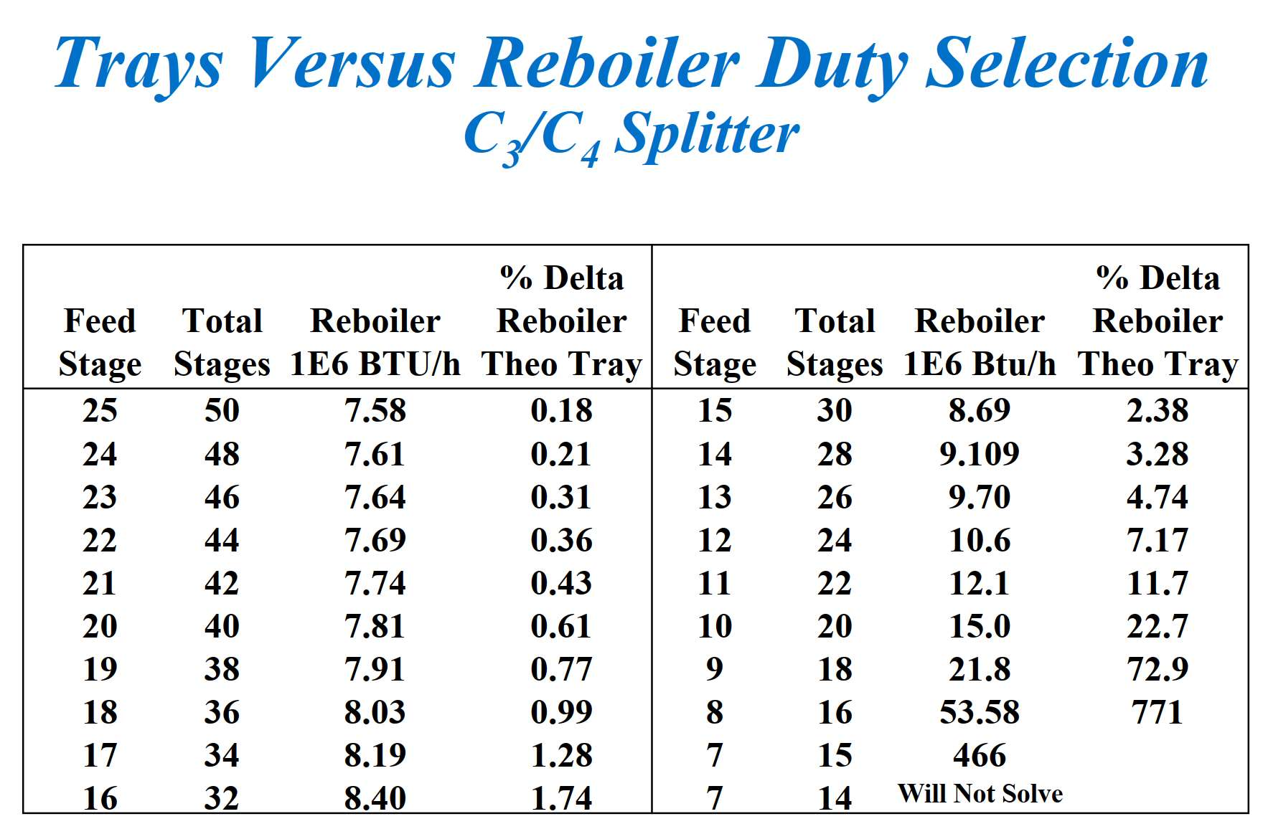
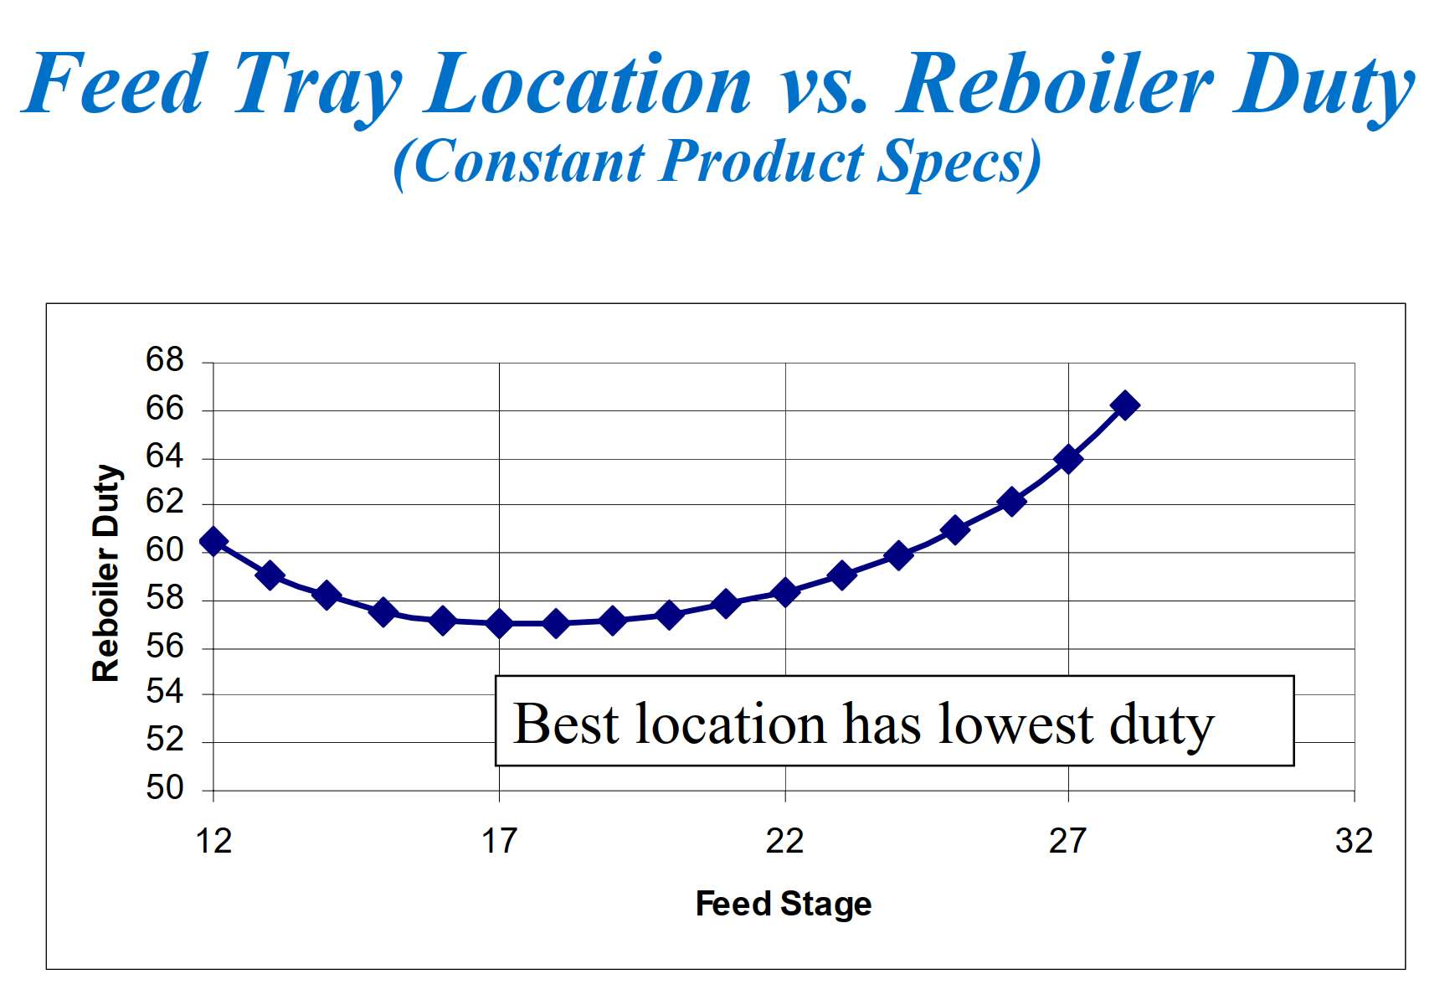
Feed Tray Location

Slide 2
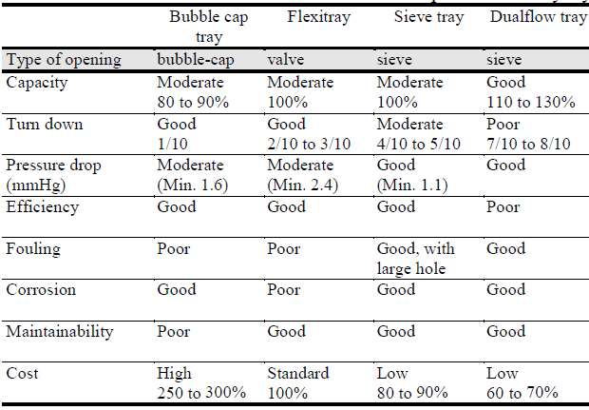
Trey Selection and Spacing
Spacing is generally assumed to be 45 cm for diameters of less than 1.2 m and 60 or 75 cm for more
than 1.2 m. Spacing of 90 cm is only seldom necessary in zones where there is a high liquid flow rate
(circulating reflux zone, for example).

Slide 3
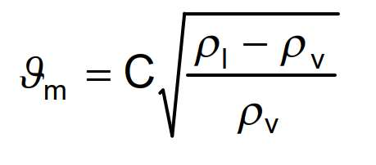
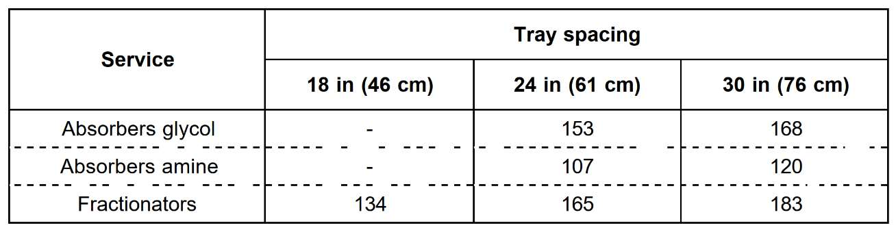
Tower ID Sizing
1. Use C-factor method or Koch-Glitsch diagram for first estimation of Diameter
Vm = maximum acceptable vapor velocity in the space below one tray, (m/h),
ρl = liquid density at operating temp. and pressure of the tray (kg/m3),
ρv = vapor density at operating temp. and pressure of the tray (kg/m3),
C = Souders-Brown factor given by figure 12, in m/h versus tray spacing in cm and liquid surface tension in N/m,

Slide 4
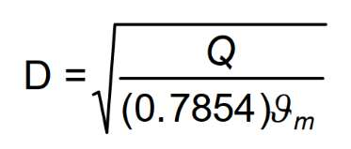
D = inside diameter of the column in meters,
Q = vapor flowrate at actual tray conditions (m3/h),
This method was originally developed for bubble cap trays and gives a rough diameter value,
especially for other types of tray.

Slide 5
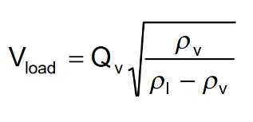
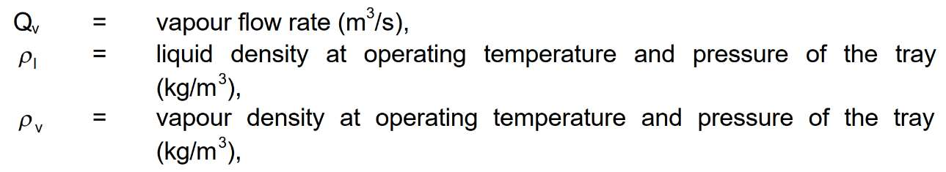
Koch-Glitsch diagram

Slide 6
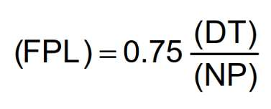
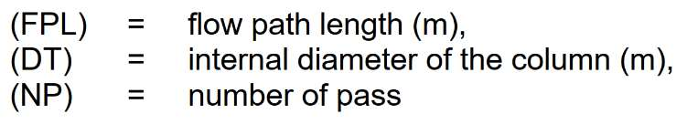
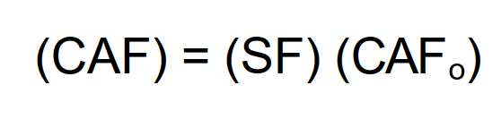
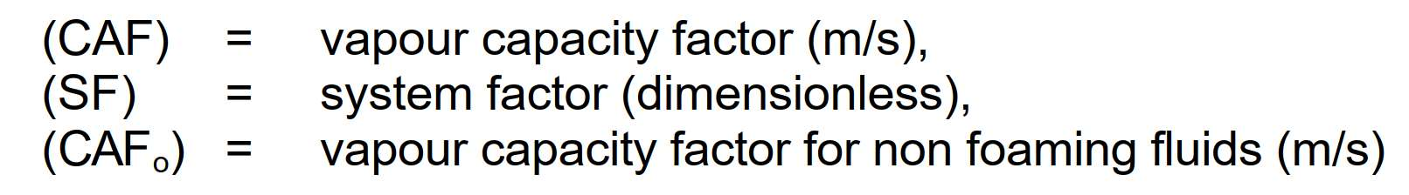
2. Determine Flow Path Length
3. Determination of Vapor Capacity Factor (CAF)
Figure 14 allows to determine the vapour capacity factor (CAFo) in meter per second, versus vapor
density and tray spacing for nonfoaming fluids. For foaming fluids this vapour capacity factor must
be corrected by the system factor value indicated in the table of figure 15.

Slide 7
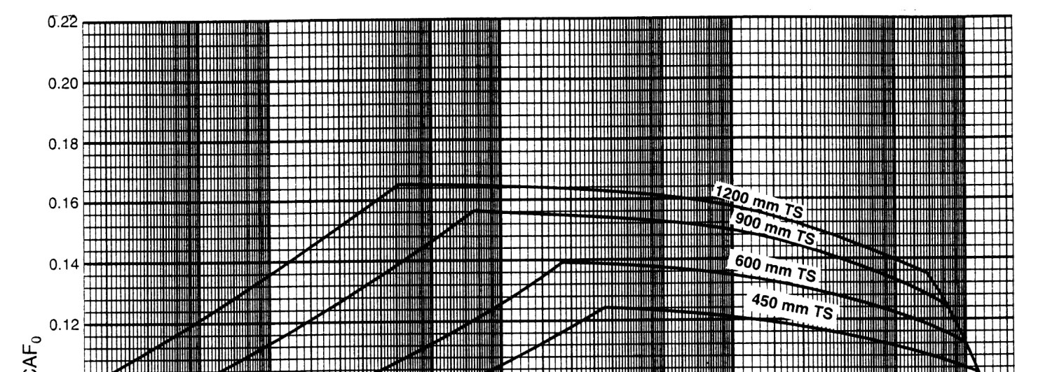
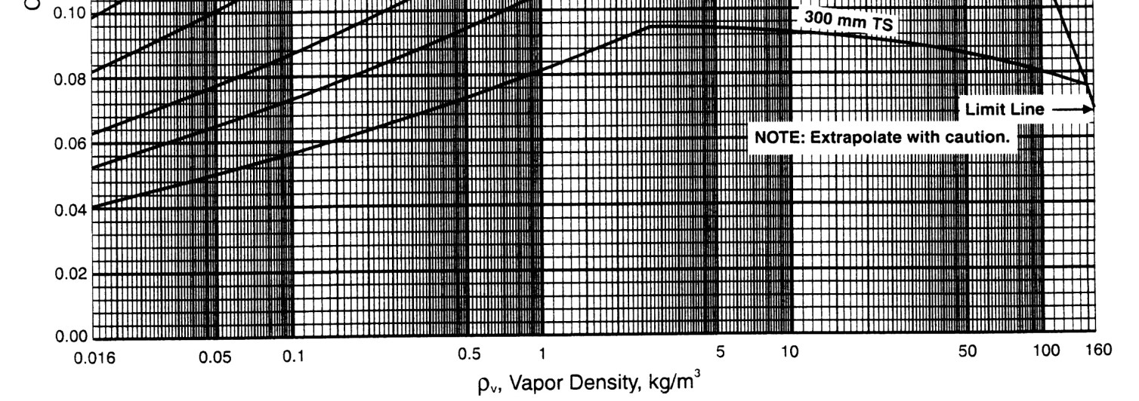

Slide 8
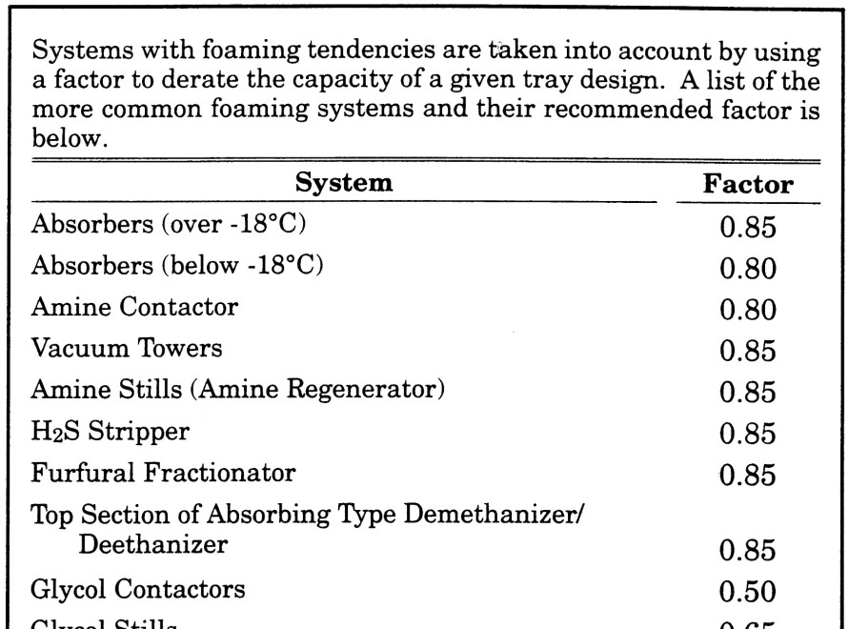
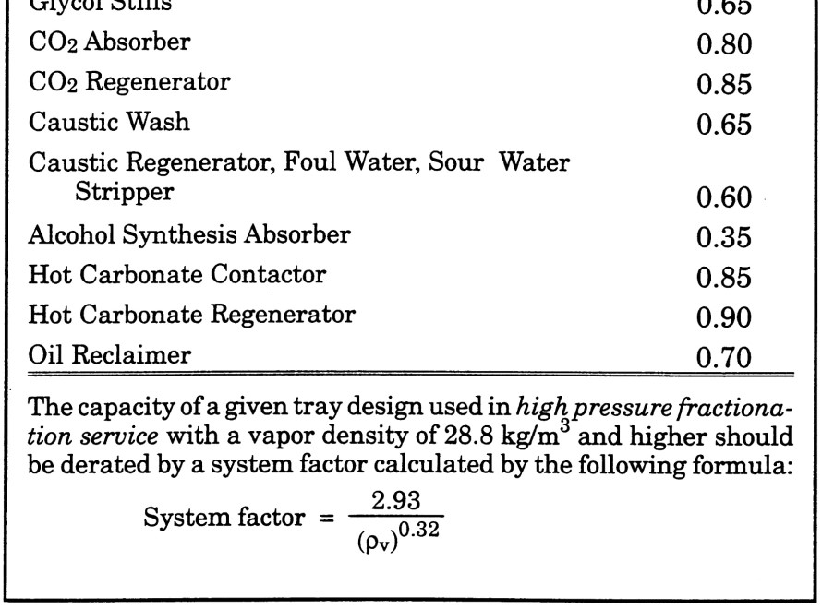

Slide 9
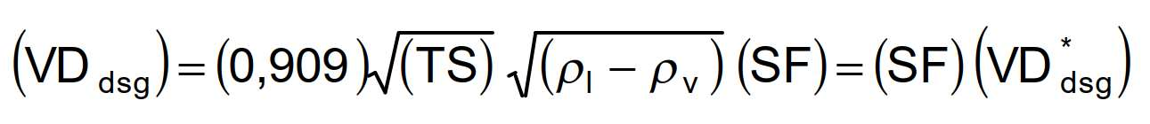
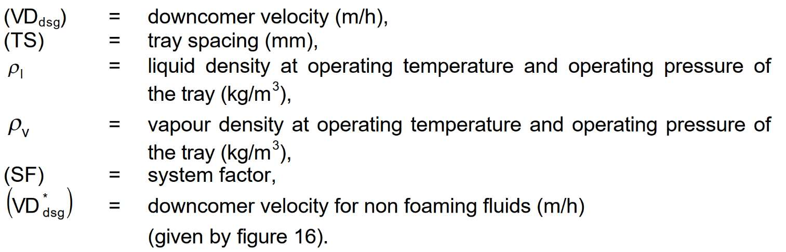
3. Determination of the Downcomer Velocity (VDdsg)
The procedure used in this method for establishing downcomer area is based on a "design“ velocity in
meter per hour given by figure 16 for non foaming fluid or by equation as follows:

Slide 10
4. Determination of Active Area (AAM)
The minimum active area is a function of vapor and liquid loads, system properties, flood factor and
flow path length.
The flood factor (FF) is used in certain equations for purpose of estimating column size. It is the
"design percent of flood" expressed as a fraction.
A value of not more than 0.77 is normally used for vacuum columns and a value not more than 0.82 is
used for other services.
For demethanisers and near critical point values, it is recommended to adopt a value in the range 0.6 to 0.7.
These values are intented to give not more than approximately 10 % entrainment.
Higher flood factors may result in excessive entrainment and/or a column sized too small for effective operation.
Flood factor of 0.65 to 0.75 should be used for column diameters under 36" (90 cm).

Slide 11
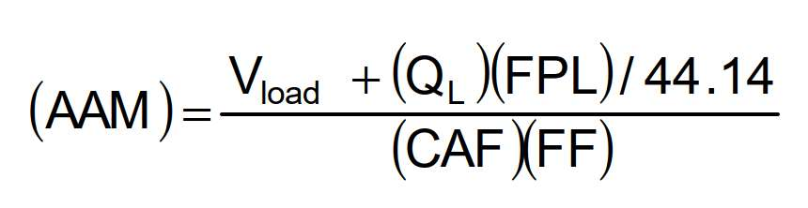
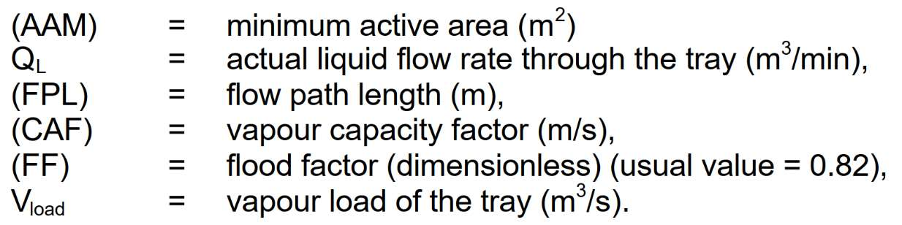
The minimum active area is determined with equation as follows:

Slide 12
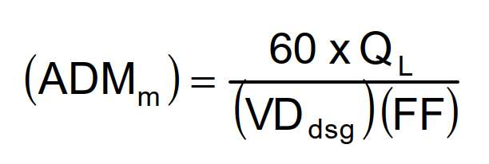
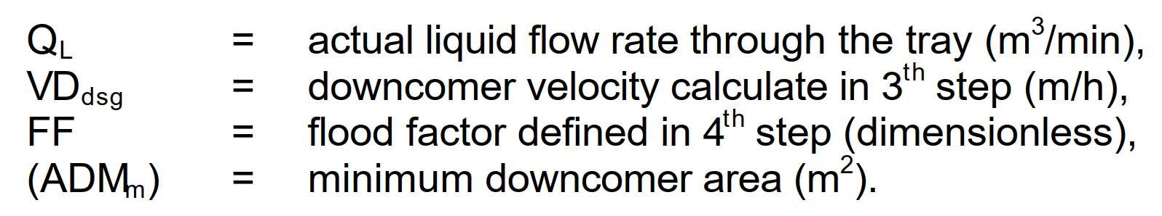
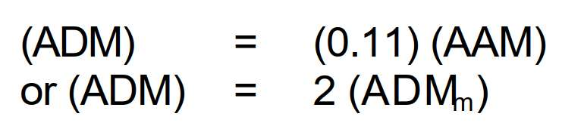
5. Determination of the Downcomer area (ADM)
The minimum downcomer area is a function of liquid rate, downcomer design velocity and flood factor.
If the downcomer area calculated by this equation is less than 11 % of the active area (AAM) adopt for
(ADM) the smaller value of relations as follows:

Slide 13
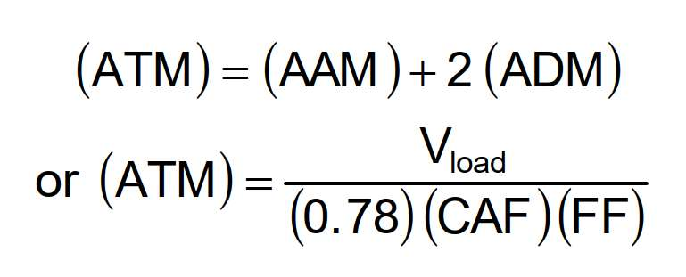
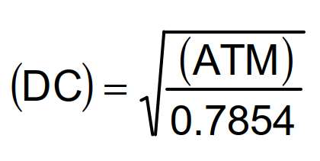
6. Determination of the minimum inside diameter (DC) of the column
The approximate column cross sectional area is calculated by equations as follows:
The higher value is adopted.
Minimum inside diameter of the column (DC) in meters is calculated with relation:

Slide 14
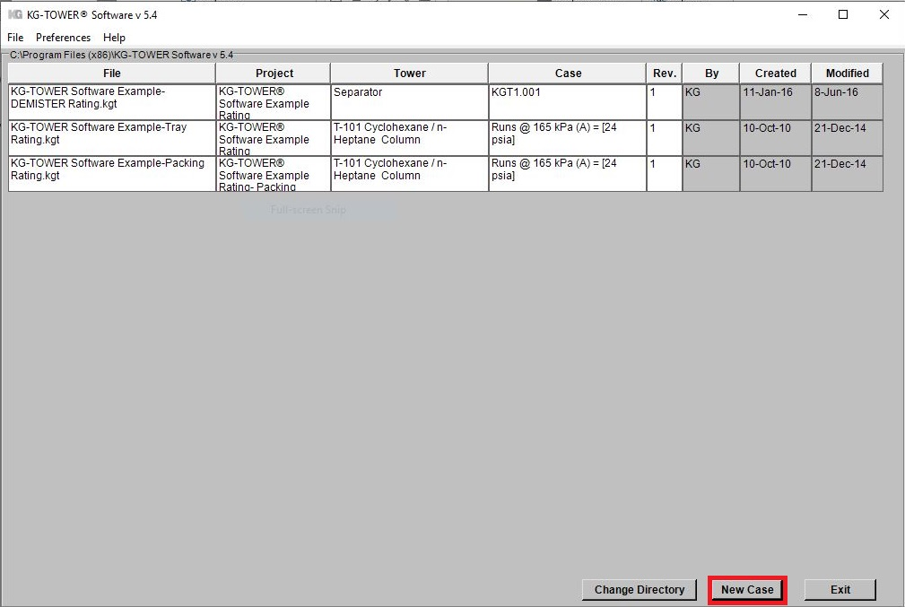
7. KG TOWER Confirmation
Open the software and select a new case

Slide 15
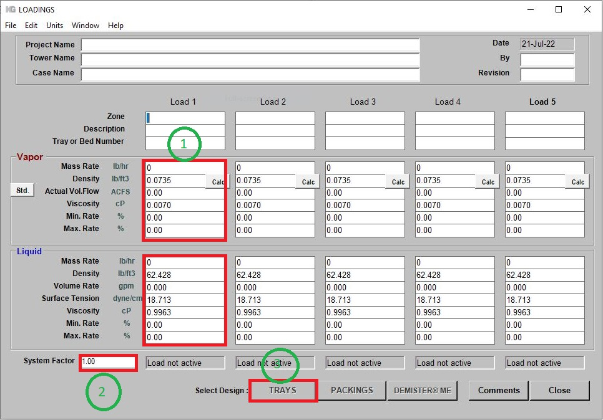
Fill-up box 1 and 2 and then click Tray

Slide 16
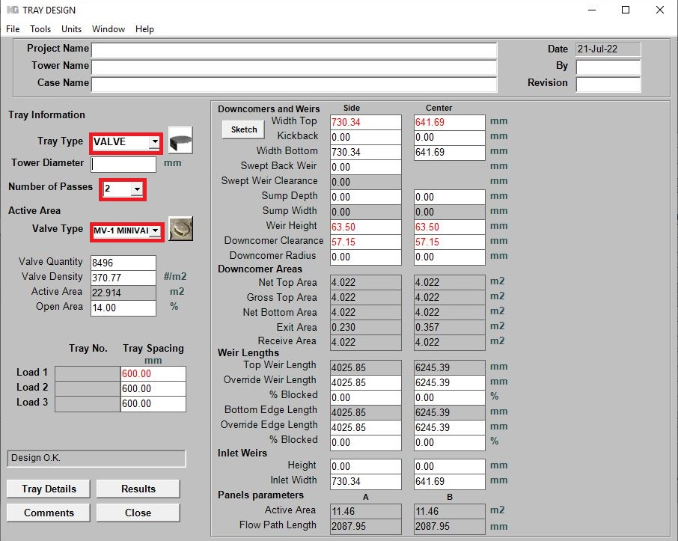
Fill-up tray type, number of passes and Koch valve type

Slide 17
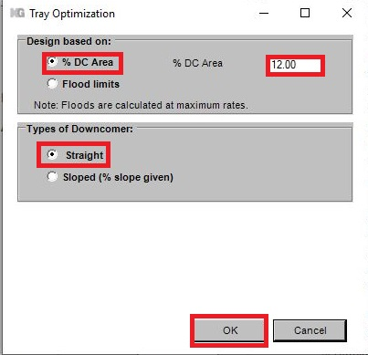
Go to TOOL and select “ Estimate Tower Diameter”

Slide 18
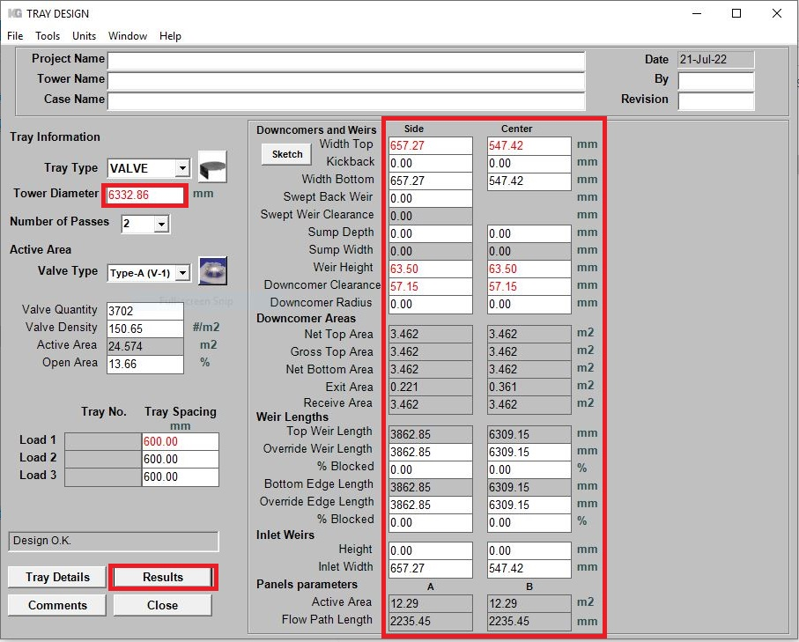
Check the Results

Slide 19
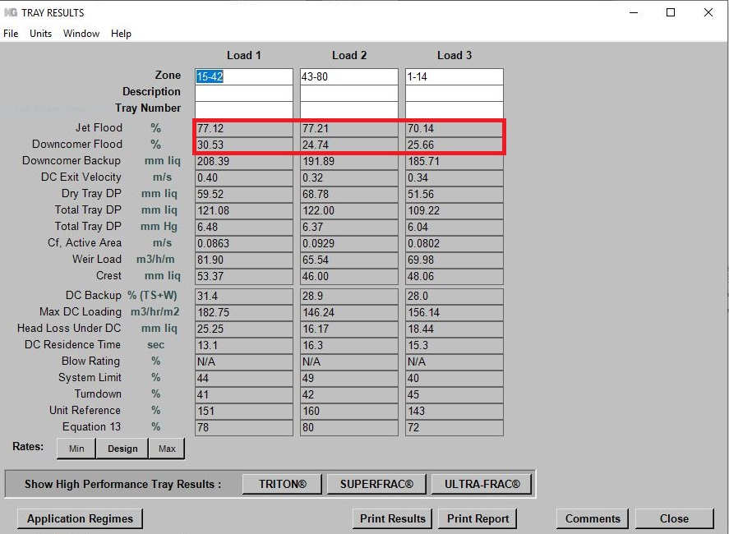

Slide 20
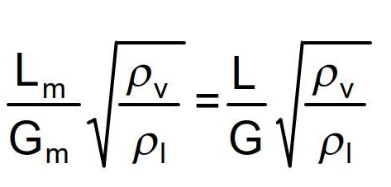
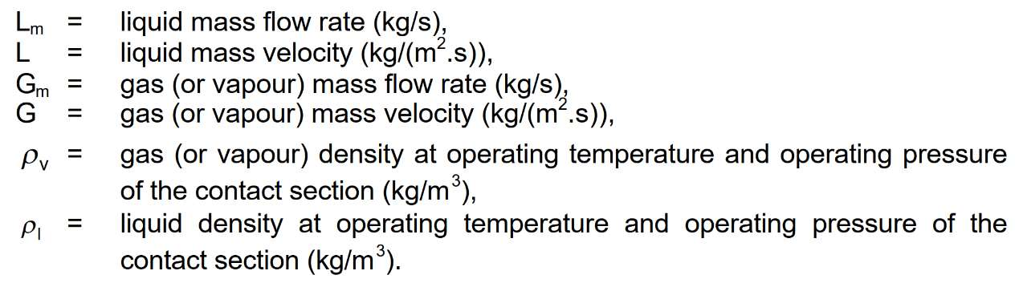
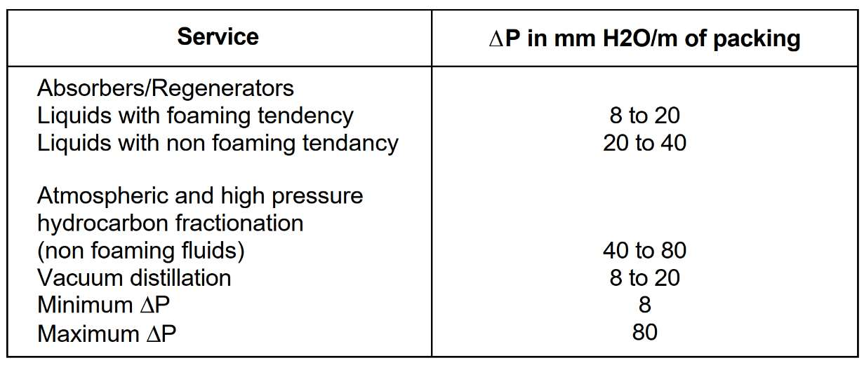
Packed Tower ID Sizing
1.Determine the capacity term value
Choose a ΔP value and calculate the flow parameter

Slide 21
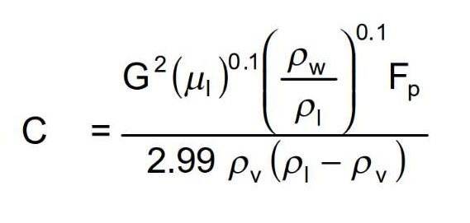
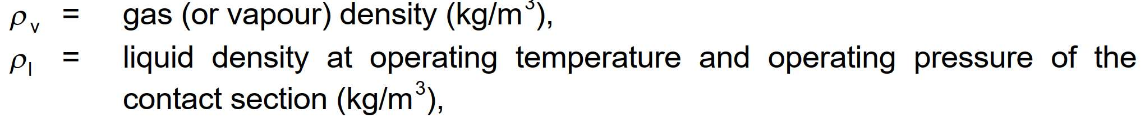
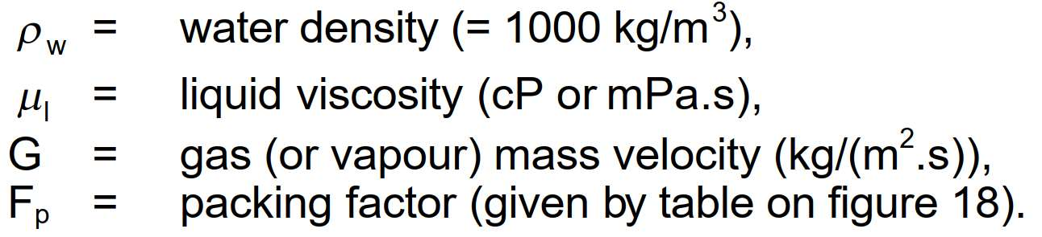
2. Determine Capacity term or C from diagram below

Slide 22
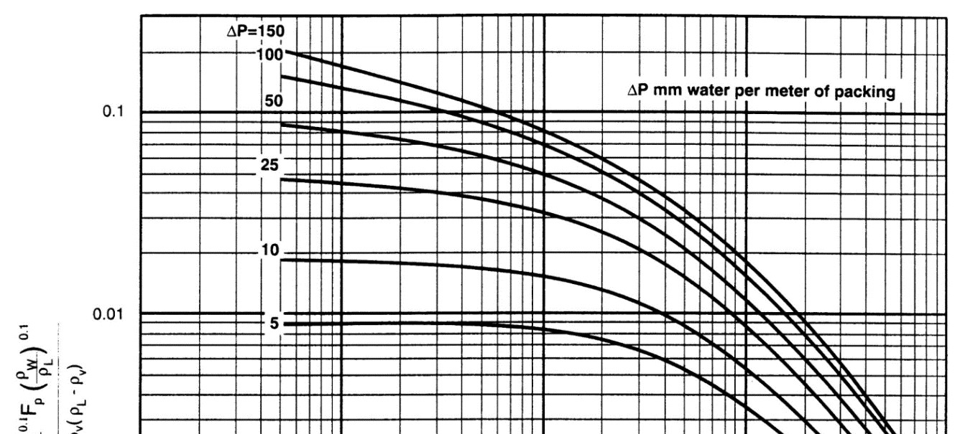
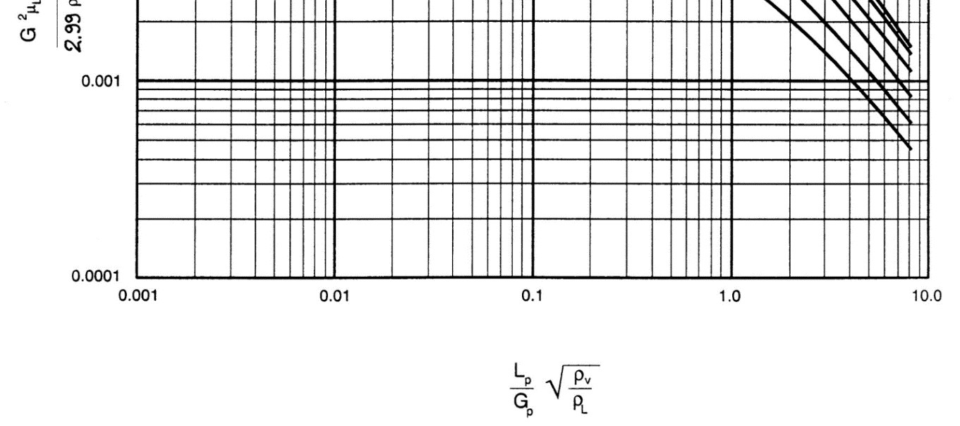
Packed Column Pressure Drop Correlation

Slide 23
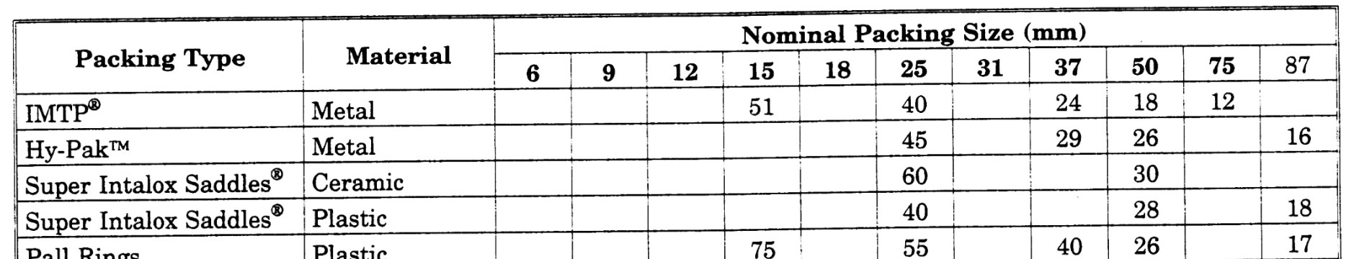
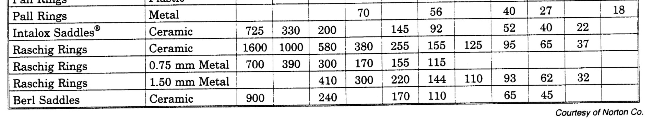
3. Choose a packing type and determine the packing factor (Fp)
The packing factors for various packings are shown in figure 18.
Usually packings smaller than 25 mm (1 in) size are intended for column diameters of 300 mm or
smaller, packings of 25 mm to 37 mm (1 in to 1½ in) in size for column diameters from 300 mm to 900
mm, and packings from 50 mm to 75 mm (2 in to 3 in) in size for columndiameters of 900 mm and
more.

Slide 24
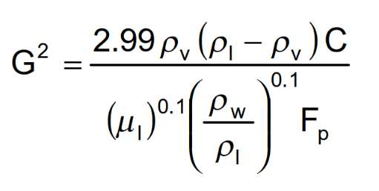
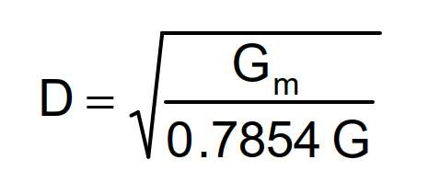
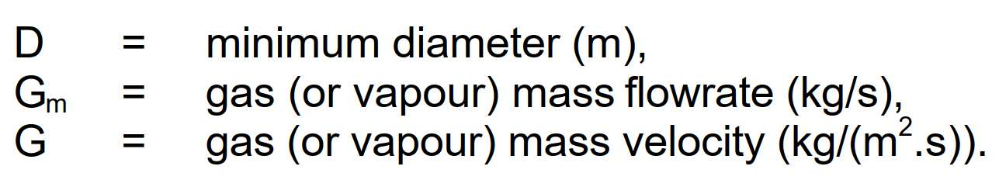
4. Calculate the gas (or vapour) mass velocity G with the capacity term C value determined in previous step.
5. Determine minimum inside diameter using following formula

Slide 25
6. KG TOWER Confirmation
Open the software and select a new case

Slide 26
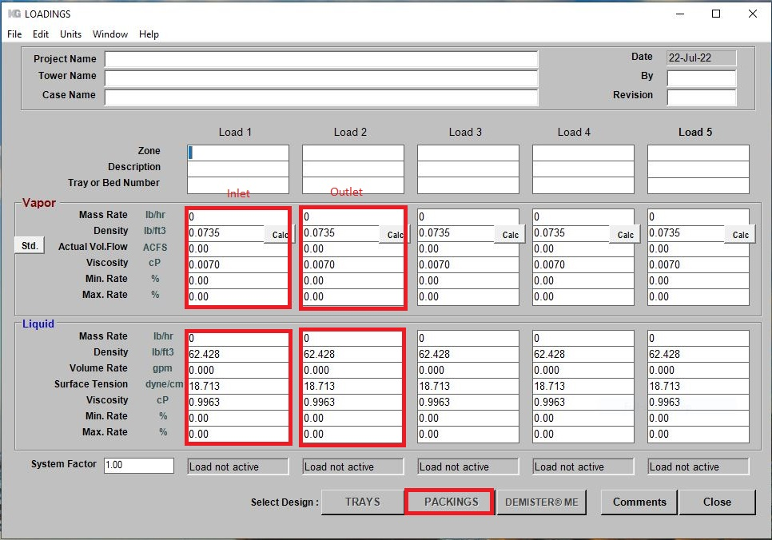
Fill-up box 1 and 2 and then click Packing

Slide 27
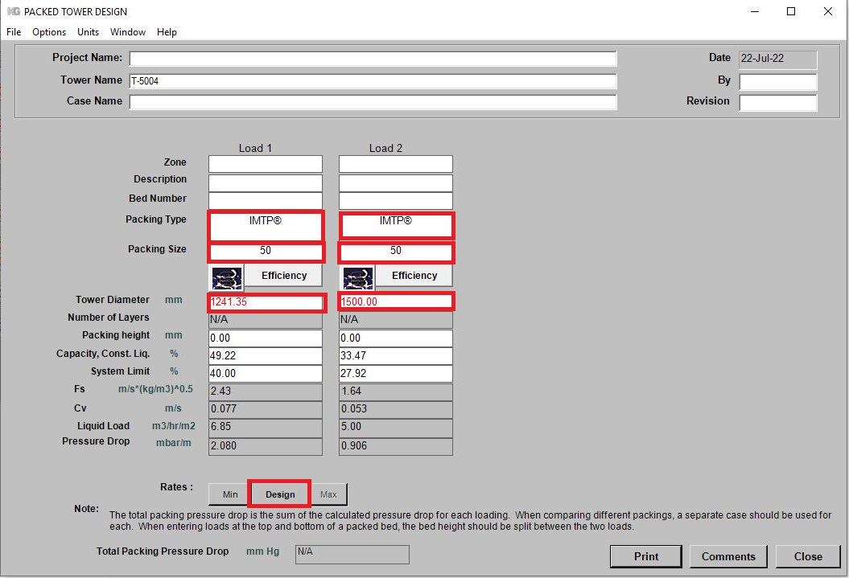
Fill-up the box accordingly and Click Options and select Constant liquid
Note that please check pressure drop

Slide 28
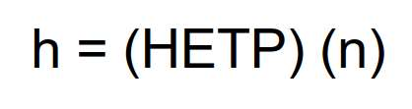
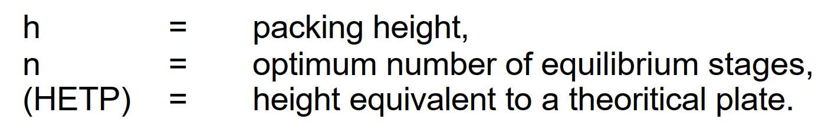
Packed Tower Height Sizing
To determine the height of a packed column bed, when the number of equilibrium stages is fixed, the
height of packing to achieve the same separation as one equilibrium stage is required. This height is
called HETP (Height Equivalent to a Theoretical Plate).
The HETP is determined experimentally in laboratory or pilot plant tests. It is a function, among
others, of packing type, vapor and liquid densities, liquid viscosity and surface tension, vapor and
liquid loading. Generally HETP values range from 300 to 900 mm but can be as high as 1500 mm

Slide 29
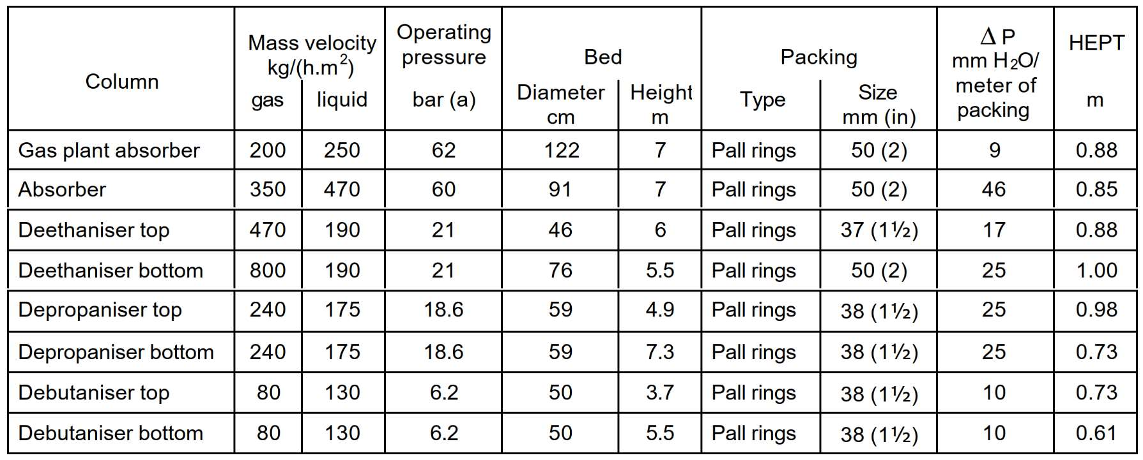
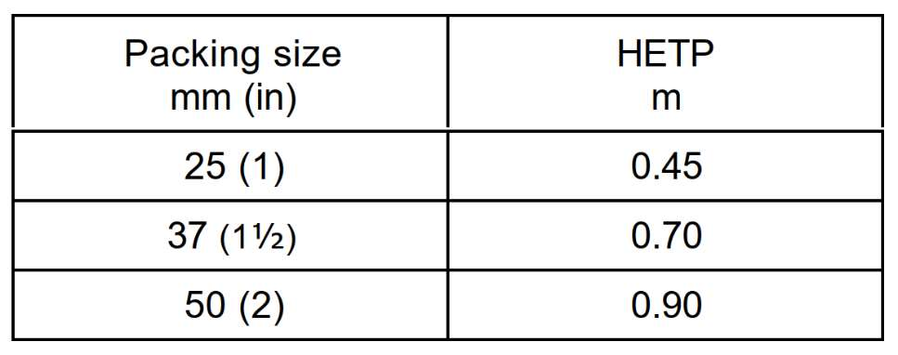
HETP values for hydrocarbon systems in gas processing industry
For preliminary sizing calculations the following values could be adopted.

Slide 30
Random Packing
There are numerous process advantages that can be realized by using random packing in various
applications. The predominant reasons to use tower packings are to:
1. Reduce pressure drop through the column
2. Increase the capacity compared to trays at the same efficiency and/or
3. Reduce liquid holdup in the column

Slide 31
IMTP® Packing
Provides low pressure drop and high efficiency.
Developed in the late 1970s, IMTP® random packing combines the advantages of the saddle shape
packing with that of modern high performance ring type packings. The inherent shape provides a
lower pressure drop at the same vapor and liquid loads compared to previous generation packings.
IMTP random packing has been applied in numerous distillation and absorption columns around the
world. For demanding applications, combining IMTP random packing with state-of-the-art INTALOX
Packed Tower Systems column internals is recommended.

Slide 32


Slide 33

The height of a packed column takes account of :
The distance between inlet distributor and tangent line or H1
The inlet distributor height or H2
The disengagement Zone or H3
The Packing Height or H4
The support grid Height plus the distance between grid to tangent

Slide 34



Slide 35



Standard Liquid Distributor
Note that each distributor has a specific properties and they are selected based on their applicability.

Slide 36




Slide 37
Support Plate
Every packed bed will need a support. Two critical factors to be considered in the design of a packing
support are:
1. The ability to physically retain and support the packed bed under column operating conditions.
2. A high percentage of open area to allow unrestricted countercurrent flow of down coming liquid
and upward flowing vapor so the packing capacity is not limited.
Koch-Glitsch has three types of support grids, namely Model 802 , Model 804 , Model 814, among which
804 and 814 are suitable for random packing and since 814 is not suitable for diameter above 900 mm,
Model 804 is selected.

Slide 38


