Slide 1
Design your Packed Tower
By KG TOWER
In Just 5 minutes!

Slide 2
Packed Tower Data Input
Vapor inlet Vapor Outlet
Liquid Inlet Liquid Outlet

Slide 3
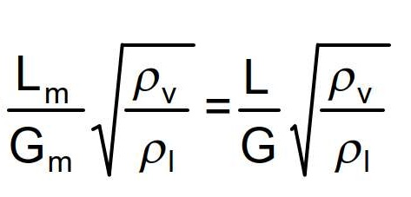
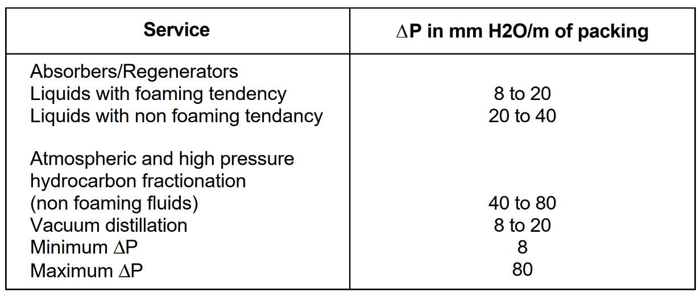
Packed Tower ID Sizing
1.Determine the capacity term value
Choose a ΔP value and calculate the flow parameter

Slide 4
Calculation for this step
Inlet | Value
L | 8197
G | 11332
Lm | 2.2769
Gm | 3.14
F | 0.024
Outlet | Value
L | 8524
G | 11004
Lm | 2.36
Gm | 3.05
F | 0.026

Slide 5
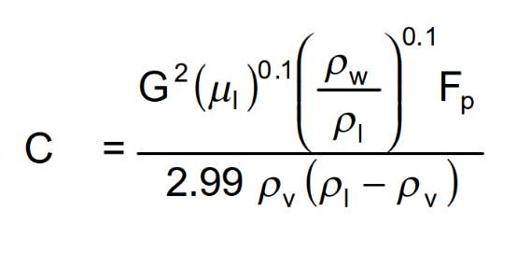
2. Determine Capacity term or C from diagram below

Slide 6
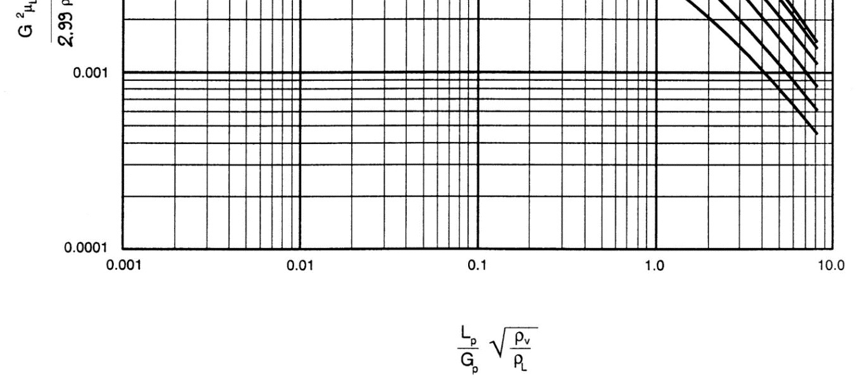
Packed Column Pressure Drop Correlation

Slide 7
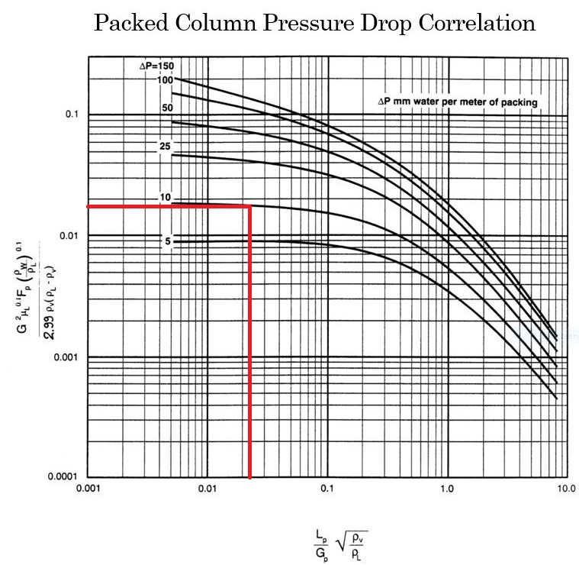
Calculation for this step
Note that according to licensor requirement a dp of 10 mbar is chosen

Slide 8
3. Choose a packing type and determine the packing factor (Fp)
The packing factors for various packings are shown in figure 18.
Usually packings smaller than 25 mm (1 in) size are intended for column diameters of 300 mm or
smaller, packings of 25 mm to 37 mm (1 in to 1½ in) in size for column diameters from 300 mm to 900
mm, and packings from 50 mm to 75 mm (2 in to 3 in) in size for column diameters of 900 mm and
more.

Slide 9
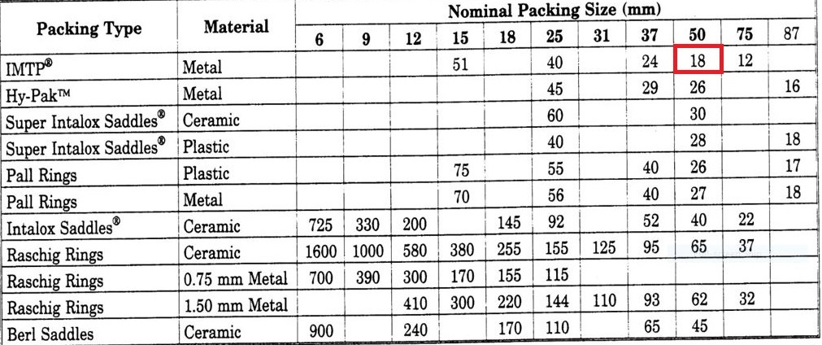
Calculation for this step
We select IMTP because of its wide applicability and suppose that ID is more than 900mm; as a result,
a 2 inch (50mm) IMPT is selected with packing factor of 18 according to the table below.

Slide 10
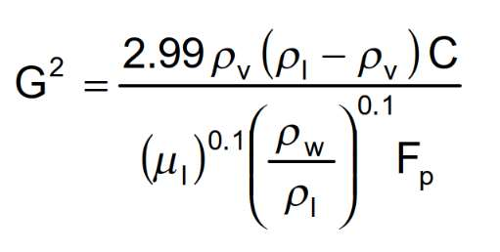
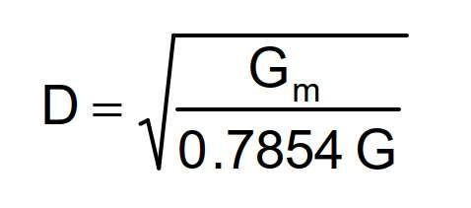
4. Calculate the gas (or vapour) mass velocity G with the capacity term C value determined in previous step.
5. Determine minimum inside diameter using following formula

Slide 11
Calculation for this step
Inlet Parameter | Value
ρl | 989 kg/m3
ρv | 1.15 kg/m3
C | 0.0175
Fp | 18
G^2 | 3.49
G | 1.86
D | 1464 mm
Outlet Parameter | Value
ρl | 964kg/m3
ρv | 1.11 kg/m3
C | 0.0175
Fp | 18
G^2 | 3.27
G | 1.81
D | 1466 mm

Slide 12
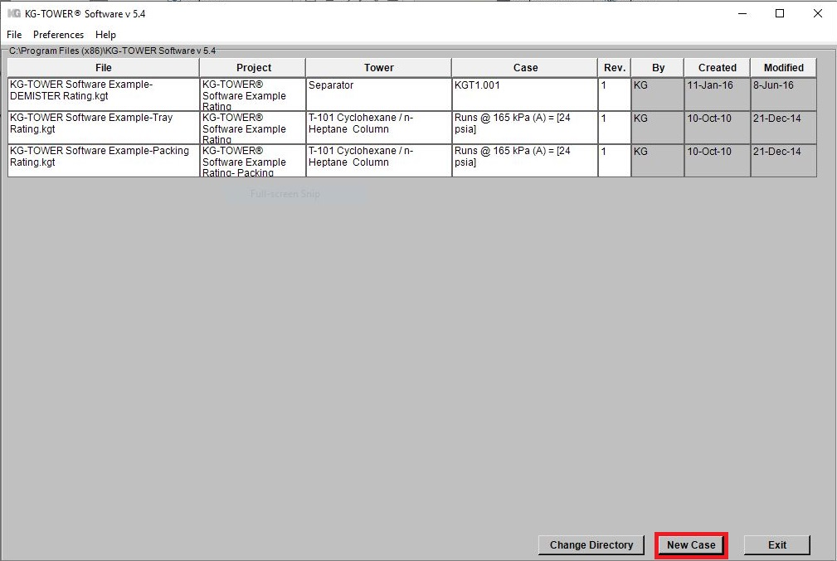
6. KG TOWER Confirmation
Open the software and select a new case

Slide 13
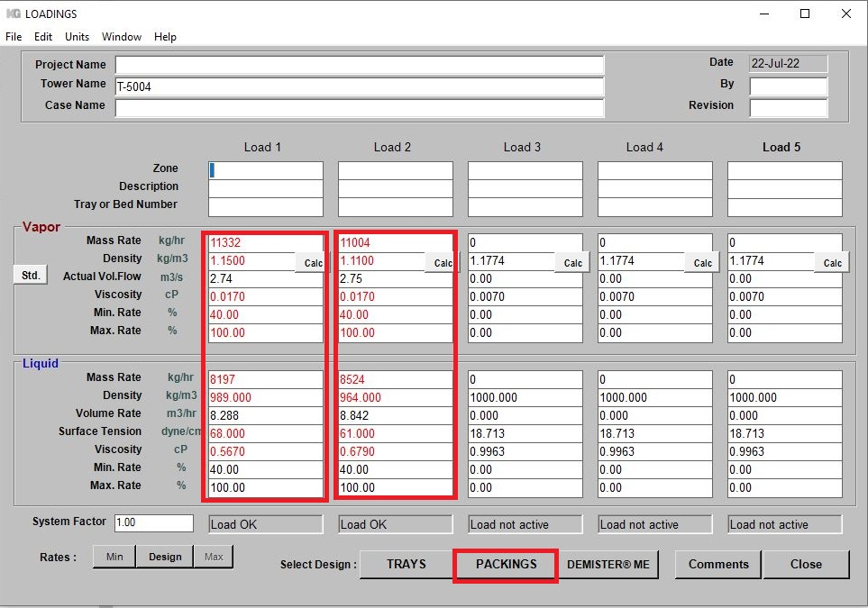
Fill-up box 1 and 2 and then click Packing

Slide 14
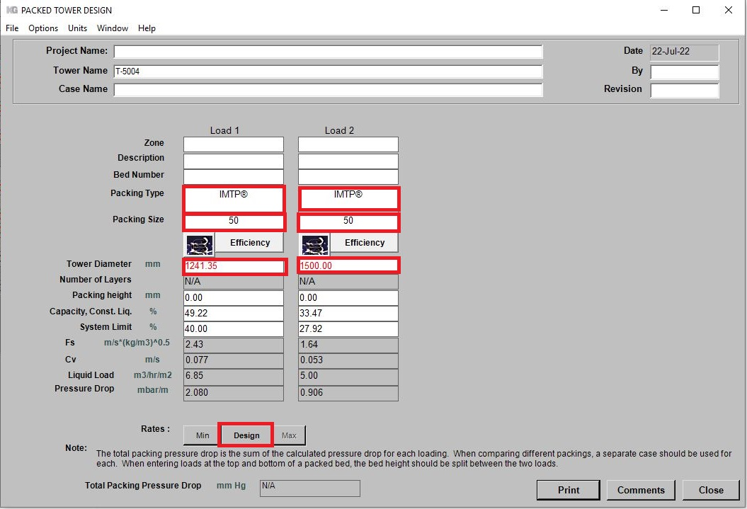
Fill-up the box accordingly and Click Options and select Constant liquid Note that please check pressure drop

Slide 15
Comparison
Notice that if the height of the tower is 5 m then the total dp according to KG Tower is 10 mbar it means that the minimum ID for the packed tower is 1250.
Haldor Topsoe | Excel Sheet | KG Tower
1500 | 1465 | 1250

Slide 16
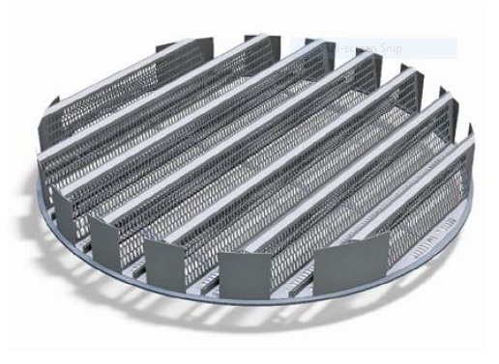
Mechanical features
Support Plates
Every packed bed will need a support. Two critical factors to be considered in the design of a packing
support are:
The ability to physically retain and support the packed bed under column operating conditions.
A high percentage of open area to allow unrestricted countercurrent flow of down coming liquid
and upward flowing vapor so the packing capacity is not limited.
Koch-Glitsch has three types of support grids, namely Model 802 , Model 804 , Model 814, among which
804 and 814 are suitable for random packing and since 814 is not suitable for diameter above 900 mm,
Model 804 is selected.

Slide 17
Thank you for your attention
Educational Institute for Equipment and Process Design
Mohammadreza Behrouzi
+989107884134

