Slide 1
Design Your Tower
by KG TOWER
in Just 5 Minutes!!

Slide 2
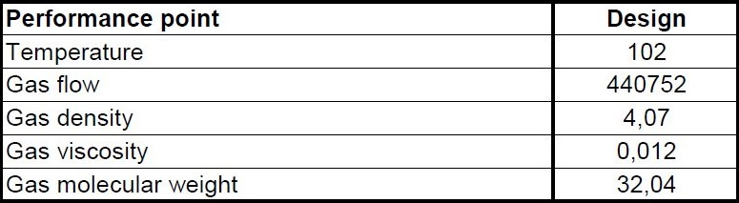
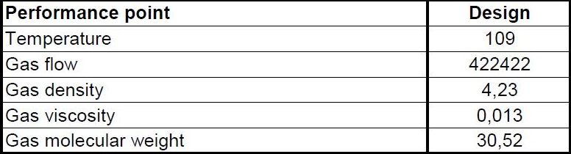
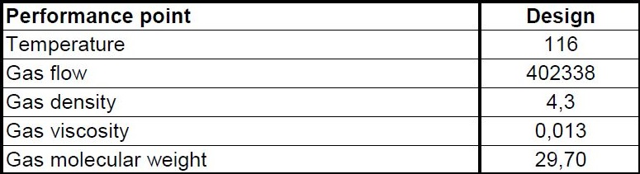
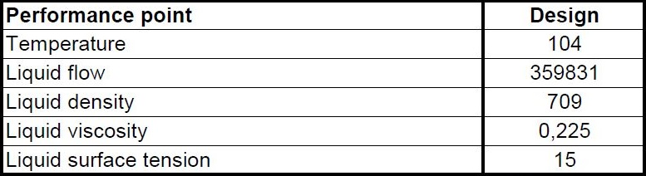
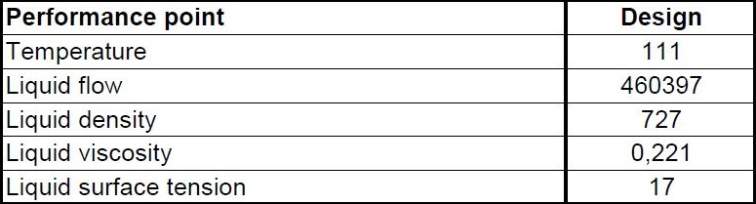
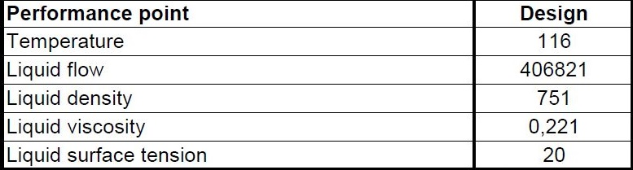
Tower Data Input
Maximum Load in different Zones
Vapor Load in Zone 1 Vapor Load in Zone 1 Vapor Load in Zone 1
Liquid Load in Zone 1 Liquid Load in Zone 1 Liquid Load in Zone 1

Slide 3
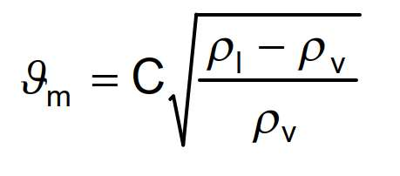
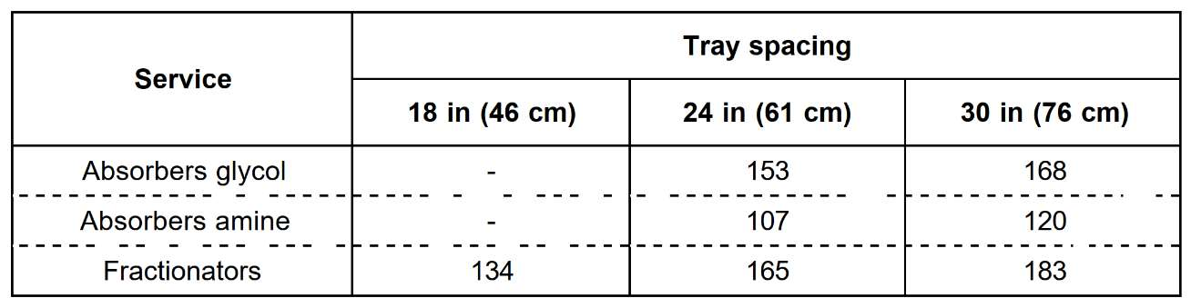
Tower ID Sizing
1. Use C-factor method or Koch-Glitsch diagram for first estimation of Diameter
Vm = maximum acceptable vapor velocity in the space below one tray, (m/h),
ρl = liquid density at operating temp. and pressure of the tray (kg/m3),
ρv = vapor density at operating temp. and pressure of the tray (kg/m3),
C = Souders-Brown factor given by figure 12, in m/h versus tray spacing in cm and liquid surface tension in N/m,

Slide 4
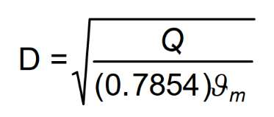
D = inside diameter of the column in meters,
Q = vapor flowrate at actual tray conditions (m3/h),
This method was originally developed for bubble cap trays and gives a rough diameter value,
especially for other types of tray.

Slide 5
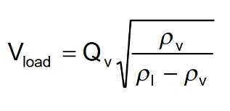
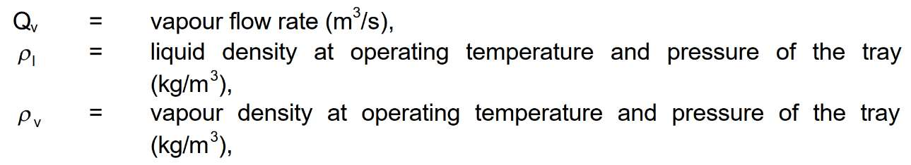
Koch-Glitsch diagram

Slide 6
Results for C-factor Method for T-5003
Tray Spacing | C | V-max | Diameter | V-Load | V-Liquid
600 mm | 165 | 2156.8 | 7.67 m | 2.12 | 10.54

Slide 7
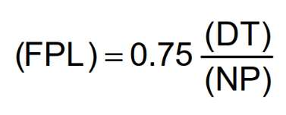
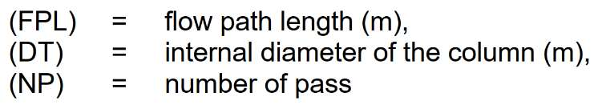
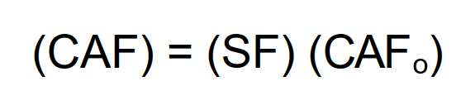
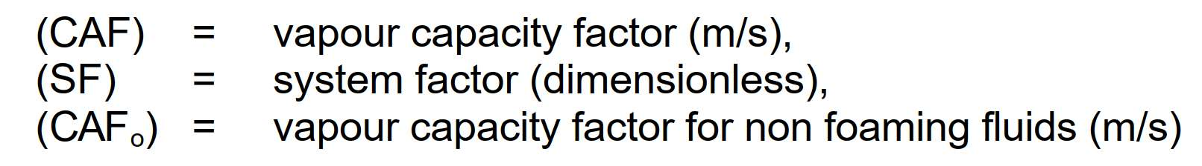
2. Determine Flow Path Length
3. Determination of Vapor Capacity Factor (CAF)
Figure 14 allows to determine the vapour capacity factor (CAFo) in meter per second, versus vapor
density and tray spacing for nonfoaming fluids. For foaming fluids this vapour capacity factor must
be corrected by the system factor value indicated in the table of figure 15.

Slide 8
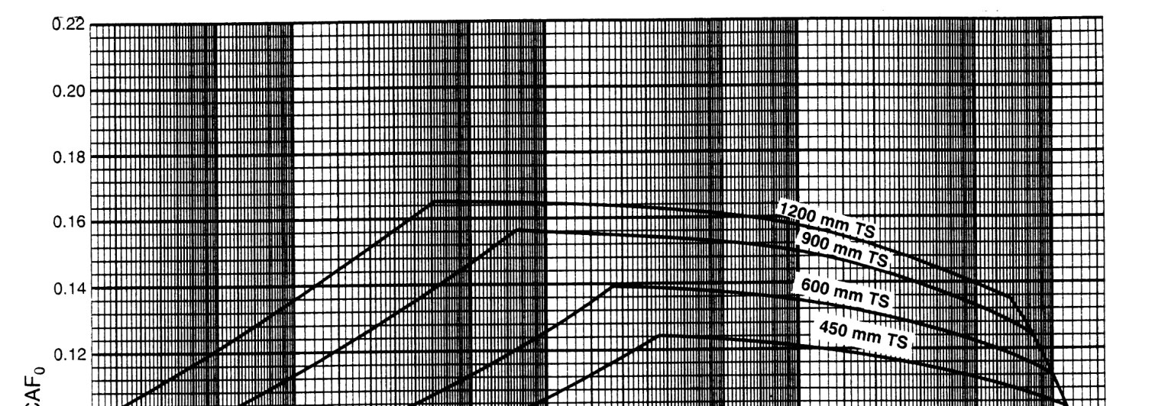
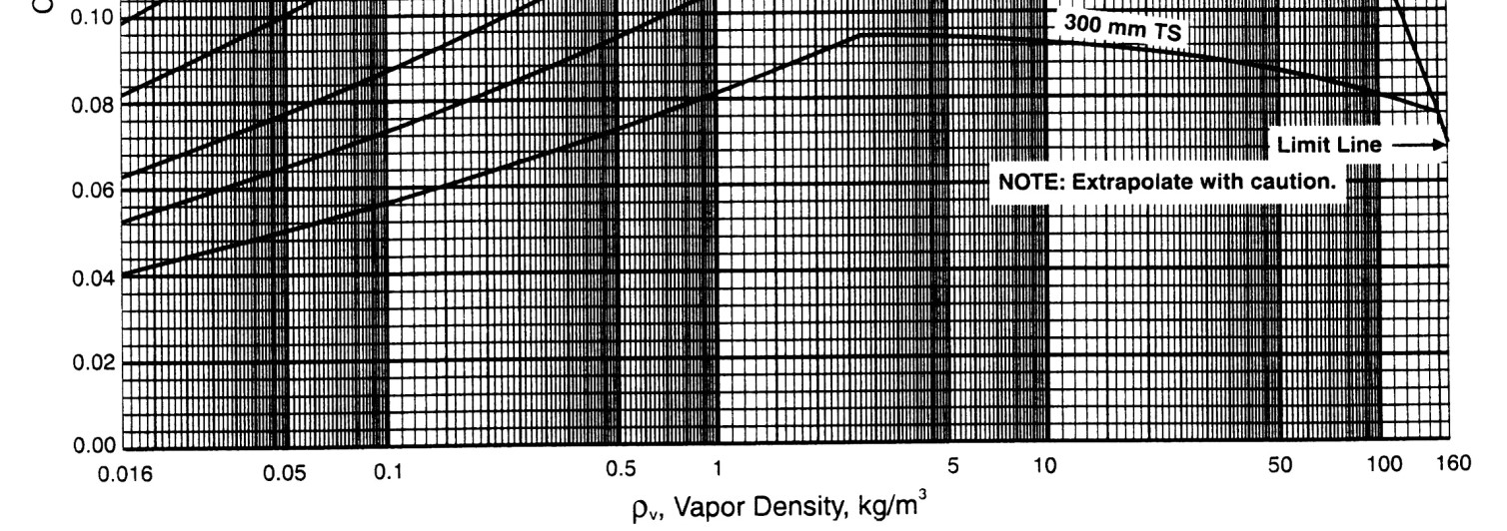

Slide 9
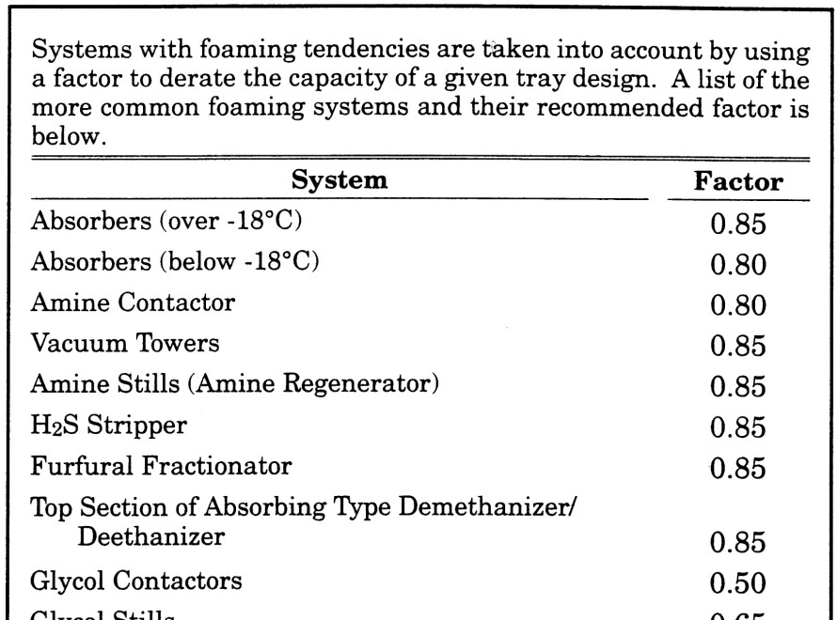
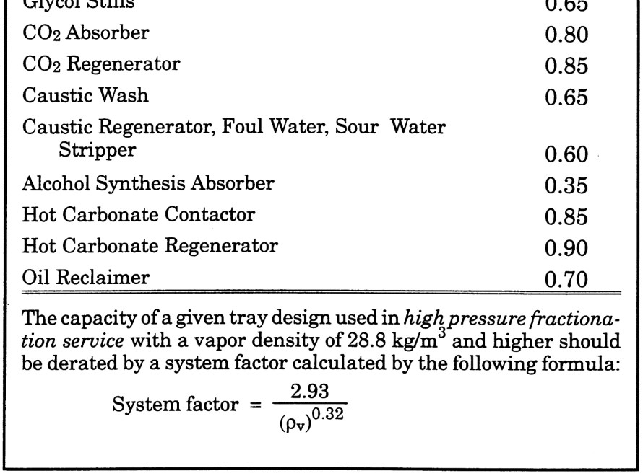

Slide 10
Results for FPL and CAF
FPL = 0.75 * 7.67 / 2 = 2.87
Note that 2 pass has been selected
CAF = CAF0 * SF = 0.14 * 1 = 0.14
Note that CAF0 is determined by Diagram on last page

Slide 11
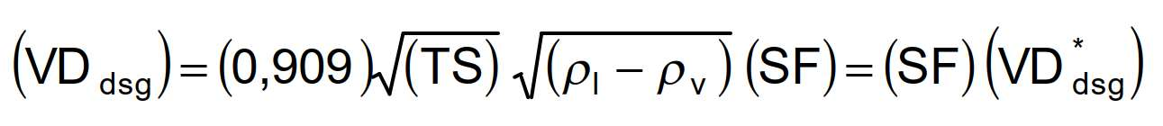
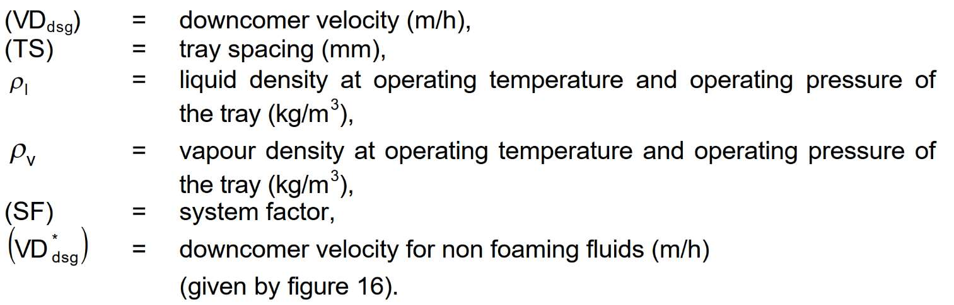
3. Determination of the Downcomer Velocity (VDdsg)
The procedure used in this method for establishing downcomer area is based on a "design“ velocity in
meter per hour given by figure 16 for non foaming fluid or by equation as follows:

Slide 12
4. Determination of Active Area (AAM)
The minimum active area is a function of vapor and liquid loads, system properties, flood factor and
flow path length.
The flood factor (FF) is used in certain equations for purpose of estimating column size. It is the
"design percent of flood" expressed as a fraction.
A value of not more than 0.77 is normally used for vacuum columns and a value not more than 0.82 is
used for other services.
For demethanisers and near critical point values, it is recommended to adopt a value in the range 0.6 to 0.7.
These values are intented to give not more than approximately 10 % entrainment.
Higher flood factors may result in excessive entrainment and/or a column sized too small for effective operation.
Flood factor of 0.65 to 0.75 should be used for column diameters under 36" (90 cm).

Slide 13
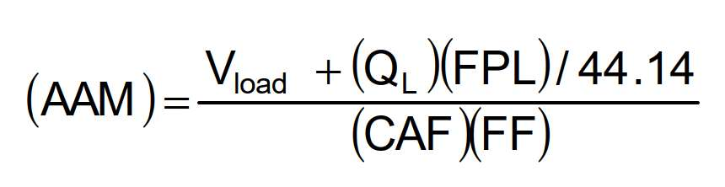
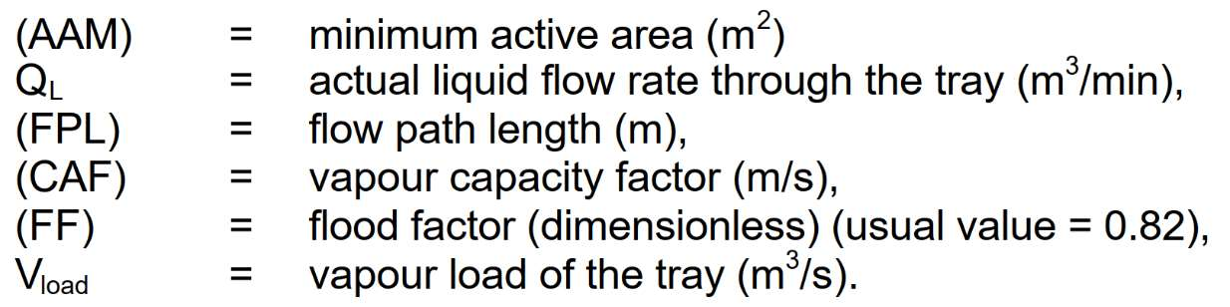
The minimum active area is determined with equation as follows:

Slide 14
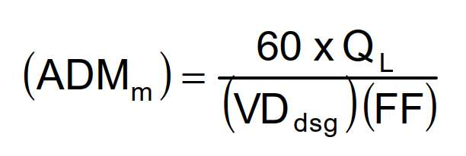
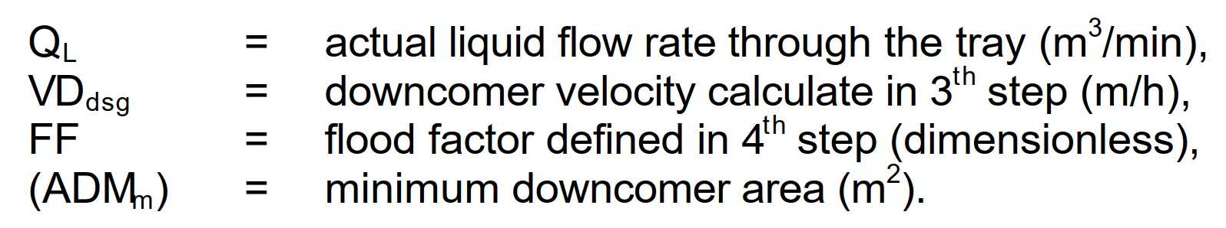
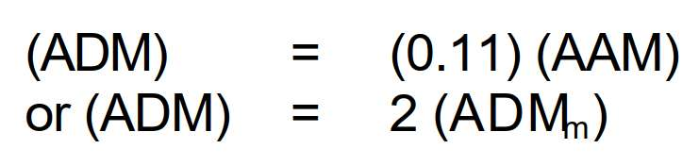
5. Determination of the Downcomer area (ADM)
The minimum downcomer area is a function of liquid rate, downcomer design velocity and flood factor.
If the downcomer area calculated by this equation is less than 11 % of the active area (AAM) adopt for
(ADM) the smaller value of relations as follows:

Slide 15
Results for Vd and AAM
Note that FF = 82%
Note that since ADMm is less than 11% AAM, 2.57 has been selected
Vd | AAM | ADMm | ADMsel
598.6 | 24.45 | 1.28 | 2.57

Slide 16
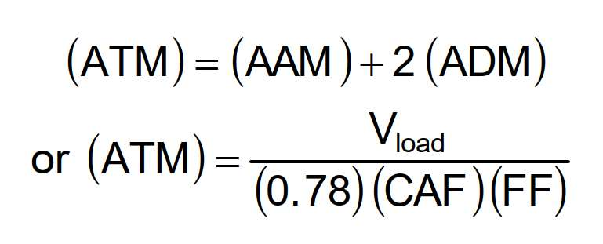
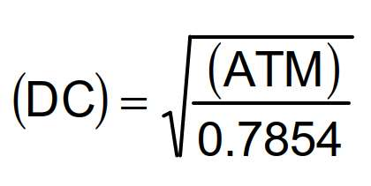
6. Determination of the minimum inside diameter (DC) of the column
The approximate column cross sectional area is calculated by equations as follows:
The higher value is adopted.
Minimum inside diameter of the column (DC) in meters is calculated with relation:

Slide 17
Results for calculated ATM and Tower Diameter
Note that 2 ATM are calculated and the higher one is selected
ATM | Diamater
29.61 | 6.15

Slide 18
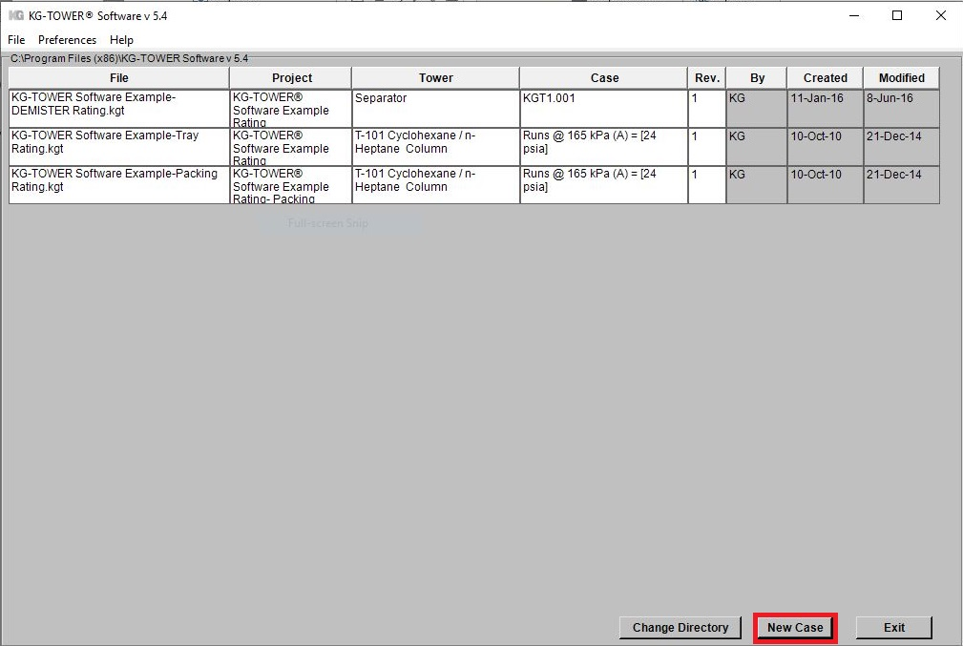
7. KG TOWER Confirmation
Open the software and select a new case

Slide 19
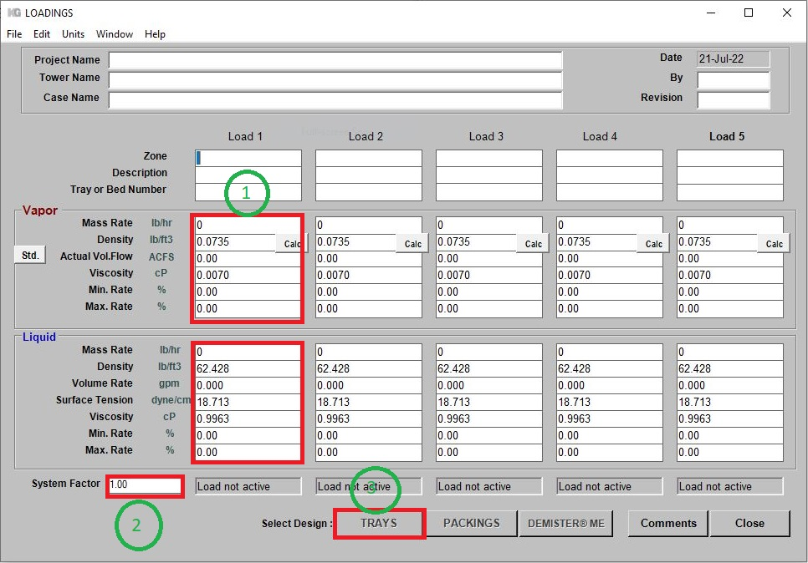
Fill-up box 1 and 2 and then click Tray

Slide 20
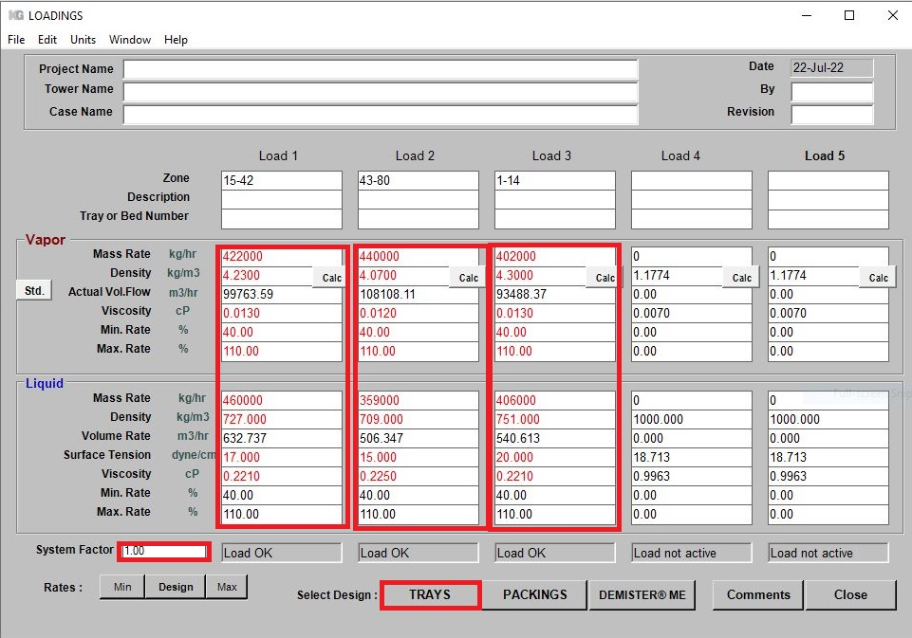
T-5003 Input

Slide 21
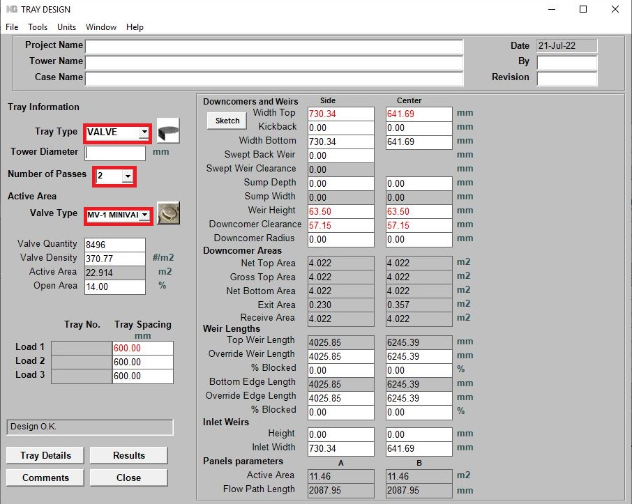
Fill-up tray type, number of passes and Koch valve type

Slide 22
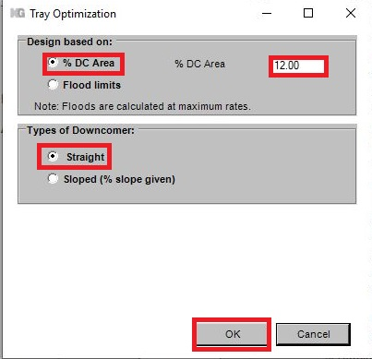
Go to TOOL and select “ Estimate Tower Diameter”

Slide 23
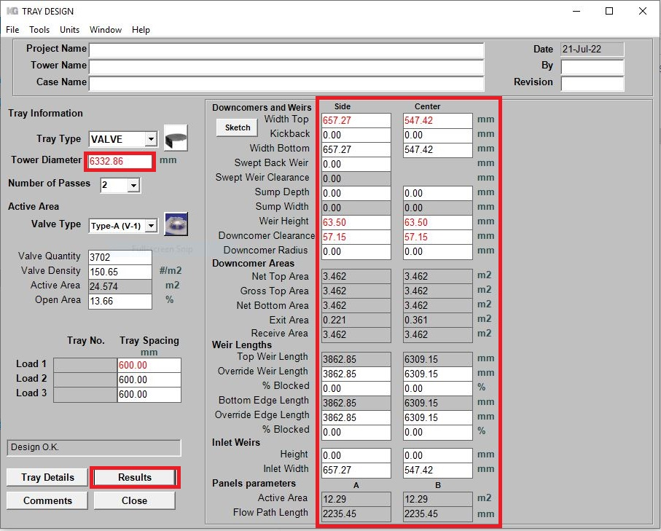
Check the Results

Slide 24
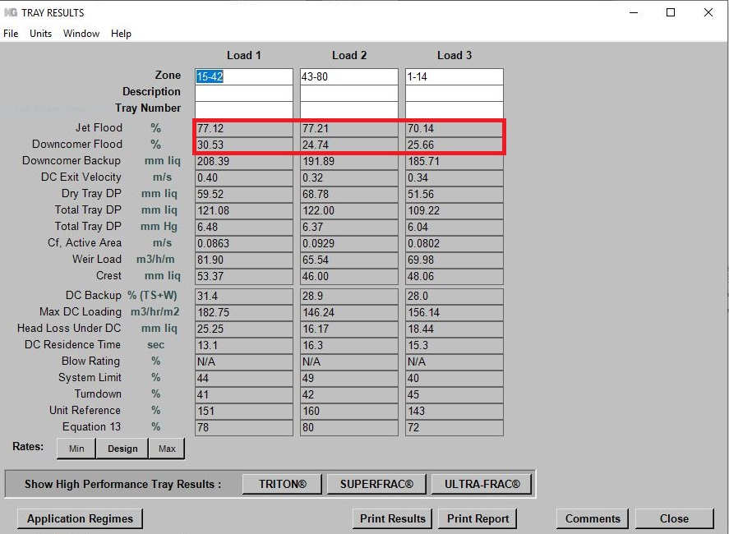

Slide 25
Comparison
Haldor Topsoe | Koch-Glitsch Excell | KG Tower
6350 mm | 6140 mm | 6332 mm

Slide 26
Thank you for your attention
Education Institute for Process and Equipment Design
Mohammadreza Behrouzi
+989107884134

