Slide 1
TWO-PHASE AND THREE-PHASE SEPARATOR
DESIGN AND OPERATING
PRINCIPLES

Slide 2
TYPES OF COMMON GAS-LIQUID SEPARATORS
Vertical Separator — No Internals
A vertical knock-out drum (Fig. 7-20) provides bulk separation of gas and liquid. It has unlimited
turndown, very low pressure drop, can handle slugs well, and is tolerant of fouling.
Overall efficiency depends on the application but typically will be no more than 90%-95% when the
vessel diameter is sized for gas flow. Separation efficiency typically decreases at higher pressure due to
the presence of smaller droplets than at low pressure. Knock-out drums without internals are typically
used for applications where there is little liquid present and a vertical configuration is preferred, where
no internals are allowed due to the service (i.e. flare knock-out drums), fouling is a major consideration,
when efficiency of separation is not a major consideration and no internal are preferred They are not
recommended for applications where efficient separation is needed.

Slide 3
Vertical Separator with Mesh Pad
The addition of the mesh pad to the vertical separator improves the demisting capability of the
separator. Vertical separators with mesh pads have moderate capacity, high liquid droplet removal
efficiency, high turndown ratio, and low pressure drop. The overall efficiency of a separator with a mesh
pad is dependent on the liquid droplet size distribution and the liquid load at the pad. A supplier can
typically guarantee an overall efficiency of 99% at 7-10 microns for a conventional high efficiency wire
mesh mist eliminator. For material balance purposes, an overall liquid removal efficiency of greater
than 99% can be assumed for most applications. Vertical separators with mesh pads are recommended
for applications where vapor flow is the controlling condition. They can handle a moderate liquid load
to the pad in the form of droplets. The design K value can be affected by the liquid load to the device,
therefore proper selection of the feed inlet device is essential. Vertical wire mesh separators can be used
when limited upstream pipe slugs are present, if sufficient liquid surge volume is included. They are
not recommended for fouling service and for highly viscous liquids when the de-gassing requirement
determines the vessel diameter.

Slide 4
Typical applications for vertical separators with mesh pads are compressor suction scrubbers and
intermediate scrubbers in non-fouling service, general service separators of all types, production
separators, inlet and outlet scrubbers for glycol/ amine contactors, upstream of filter-separators, and
inlet scrubbers for gas export pipelines. Different styles of mesh elements are available metal,
plastic, composite (wire and fiber), compound (different wire diameter, and/or weave density, and
special drainage)], depending on the application. All of these factors will affect both the maximum gas
capacity and the droplet removal efficiency. For many gas treating applications, however, conventional
simple metal mesh mist eliminator are used. Mesh pads have a low pressure drop, typically about 249
Pa, depending on the pressure and liquid loading.

Slide 5
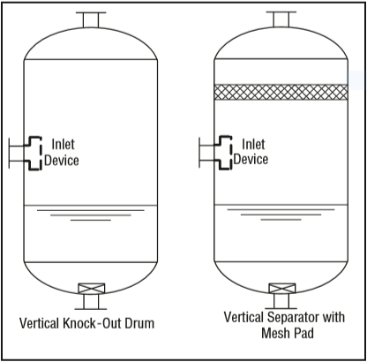

Slide 6
Vertical Separator with Vane Pack
Vertical separators with vane packs can be used instead of wire mesh for the following reasons: fear of
fouling of the wire mesh, where corrosion and life of the demisting device requires a more robust design
than mesh pads, to reduce separator size and cost compared to mesh, too high a liquid load for mesh.
Vertical separators with vane packs have a moderate turndown ratio, are suitable for slightly fouling
service (straight or some single-pocket vanes only). The typical droplet removal efficiency for vane
styles is provided in “Vane Separator Devices”, earlier in this Chapter. Vane separators are less
efficient overall than wire mesh in most applications. Vertical separators with vanes are best utilized
below 4825 kPa (ga). Higher efficiency can be obtained at pressures above 4825 kPa (ga) by using
double pocket vanes. Vanes can tolerate higher liquid load than mesh pads. However, they are sensitive
to slugs and require adequate bulk separation upstream, similar to mesh pads. Vane elements have a
relatively low pressure drop �typically 100 Pa to 1 kPa (ga)]. Vertical separators with vanes are a
common alternative to mesh mist eliminators for reciprocating compressors because of their more
robust mechanical design, which is advantageous in pulsating service.

Slide 7
Vanes packs may be supplied as part of a package which includes the pressure vessel and internals, or
as the vane element alone. Each supplier has proprietary vane pack styles and design correlations.
There are several styles available: straight vanes, single pocket vanes for vertical and horizontal flow,
and double pocket vanes for horizontal flow. Pocket vanes are, however, more prone to fouling. The
liquid collected by the vanes is typically drained by a pipe(s) to the sump of the separator and sealed.
The drain pipe(s) is submerged below the liquid level. Several different vane configurations may be
used in a vertical separator: vertical flow of gas through the vanes, horizontal flow, inline separator
with horizontal flow.
1.Vertical Flow Vane Separator
This configuration is similar to that of a vertical mesh separator. There is a liquid knockout section
below the vane section which can handle higher liquid loads during upsets or small slugs. Vertical flow
vane separators have the advantage that the gas flow path is vertical after the inlet and does not have
to change direction to pass through the vane pack.

Slide 8
Horizontal Flow Vane Separator
In this configuration the gas flows vertically up from the inlet section and then must make a turn to
flow horizontally through the vane pack, hence proper spacing must be allowed for good gas
distribution. Typically the height of the vane pack is larger than the width, which permits a smaller
vessel diameter than the vertical flow vane design. In horizontal flow the allowable K value is often
higher depending on the style of vane used. The horizontal flow vane separator is a common
configuration for reciprocating compressors since it is compact and lower in cost.
Horizontal Flow Vane Separator (In-Line)
This is the most compact vertical vessel using a vane pack. However, the design cannot handle
significant liquids or slugs during an upset.

Slide 10
Horizontal Separator — No Internals
Horizontal separators-without internals provide bulk separation of gas and liquid. The design is
typically used for liquid surge applications where the vapor flow is very low, for fouling services, or
where internals are not desirable. The equipment has unlimited turndown, low pressure drop, can
handle slugs and high liquid fractions, and is insensitive to fouling. The separation efficiency is
dependent on the inlet droplet size distribution and Stokes’ Law settling, based on the diameter, length,
and liquid levels in the separator. Where gas flow controls sizing knock-out drums are typically
designed to remove 250-500 micron droplets. Overall efficiency of 90-95% can be assumed. Where liquid
holdup controls the vessel size higher efficiency is possible. Separators-without internals are
recommended where internals must be kept to a minimum such as flare knock-out drums (no bolted
internals of any kind) and drums handling fouling fluids. They are not recommended where efficient
demisting is required.

Slide 11
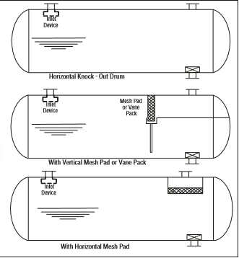
Horizontal Separator Configurations

Slide 12
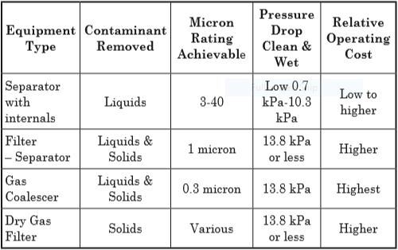
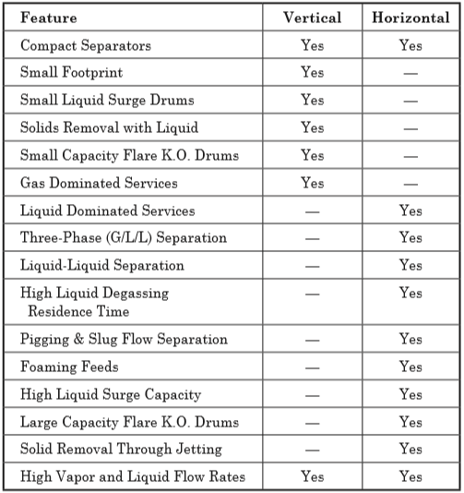
General Gas Separation Selection Factors that Determine Vessel Orientation

Slide 13
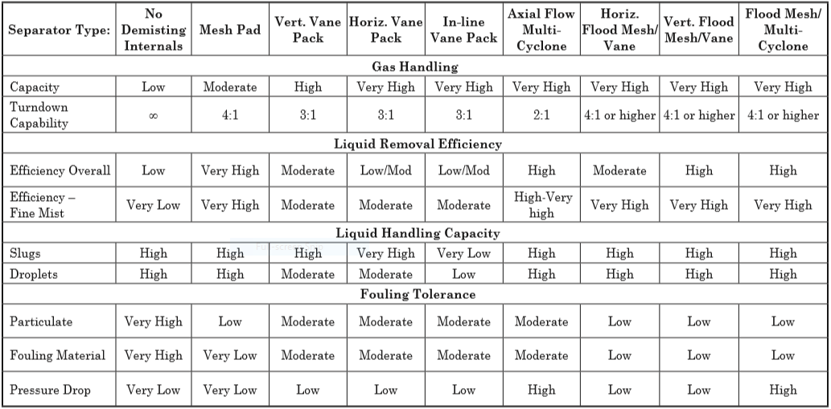
Vertical Gas-Liquid Separator Comparison Chart

Slide 14
Gas-liquid separation vessels can typically be divided into four general regions
• Inlet Section
• Gravity Separation
• Gas Polishing Section
• Liquid Accumulation Section (Outlet Section)
The first stage, primary separation, uses an inlet diverter so that the momentum of liquid entrained in
the vapor causes the largest droplets to impinge on the diverter and then drop by gravity. The next
stage , secondary separation , is gravity separation of smaller droplets as the vapor flows through
the disengagement area . The final stage is mist elimination where the smallest droplets are coalesced
so that larger droplets are formed which will separate by gravity. For secondary separation, the
allowable velocity must be calculated so that the disengagement area can be subsequently determined.
Performing a force balance on the liquid droplet settling out provides the necessary relationship. When
the net gravity force balances the drag force

Slide 15
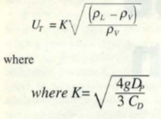
The heavier liquid droplets will settle at a constant terminal velocity . Equating these two forces
results in
Here as long as Uv < UT the liquid droplets will settle out. Typically the allowable vertical velocity Uv
is set between 0.75 UT and UT . This could be rearranged to a Saunders-Brawn equation.

Slide 16
In vessels with no internals, gravity settling is the only mechanism of separation. Thus, terminal
velocity of the minimum particle size desired for separation is critical. For vertical vessels, a liquid
droplet will settle out of the gas phase when the vertical gas velocity is less than the droplet’s terminal
velocity. The terminal droplet velocity can be obtained by using the appropriate settling law expression,
or an industry experience K value. The K value can be calculated by assuming a minimum droplet size
that must be removed and equating Equation 7-11 and Equation 7-12. The target droplet diameter, or
K value, is selected to prevent excessive entrainment based on experience. In either case a target
droplet size of about 250 to 500 microns is typically used for many gas-liquid gravity separator designs.
This approach has been found to be adequate to prevent substantial liquid carryover for most
applications. The maximum allowable K value used for design, for light hydrocarbon applications, is
frequently reduced further at elevated pressures from that calculated by Equation 7-11. This is
intended to account for the fact that as the pressure increases, the surface tension for light
hydrocarbons decreases, as well as the high gas density, resulting in a higher likelihood of a smaller
mean droplet size entering the separator.

Slide 17
If applied for a typical vessel L/D ratio of 3:1 or greater, would result in a effective axial flow K factors
(L/H *K) greater than 1.0. In practice, the effective K used has been limited by either calculation of
the incipient re-entrainment velocity, an empirical approach.
Liquid Gravity Separation Section For Vertical Separators with Downstream Mist Eliminators
The gravity separation section for a vertical separator should be designed to allow a majority of the
liquid to drop out upstream of the mist eliminator, to provide an even distribution of the gas to the gas
polishing section, and to minimize re-entrainment from the liquid surface below the feed. This can be
accomplished without over sizing the vessel diameter, if adequate space is provided above and below the
feed nozzle, and the Inlet Section is properly specified (appropriate inlet piping configuration/size, and
inlet device). In the past, it was common to oversize the vessel diameter compared to the mist
eliminator, in order to provide a more conservative and flexible design. The appropriate approach for a
new application depends on the risk tolerance of the owner, and the nature of the application.

Slide 18
Gas-Liquid Gravity Separation Section For Horizontal Separators with Downstream Mist Eliminators
The goal of the gravity separation section for a horizontal separator is to remove a majority of the liquid
droplets from the gas prior to the mist eliminator, to minimize surface re-entrainment due to waves and
droplet shear at the gas liquid interface, and to promote an even gas flow distribution to the mist
eliminator. To accomplish this, it is necessary to limit the gas velocity through the vapor space. For
most applications, an approach of applying Stokes’ Law to establish a vertical terminal vertical velocity,
and then designing for the gas flow velocity and length to drop out say a 250-500 micron droplet would
result in high horizontal velocity (greater than that typically used commercially). As an alternative
several different approaches have been used: 1) base the design on the maximum velocity which will
drop out a target drop size in the length available, yet is below the calculated incipient re-entrainment
velocity from the liquid surface (See “Surface Re-entrainment” section earlier in this Chapter)5, 2) use
an empirical equation for maximum gas velocity based on the density expression ((ρl-ρg)/ρg)0.5, times
an factor based on a length ratio, and the height to the interface 3) limit the maximum gas velocity
based the gas and liquid density function times a constant, 4) a combination of

Slide 19
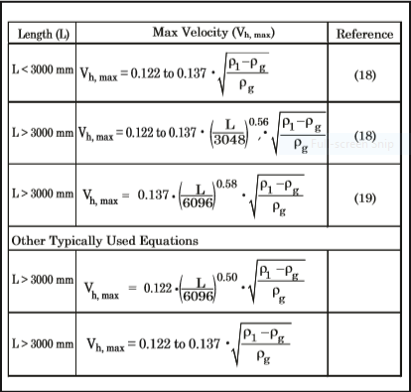
limiting maximum gas velocity based on an the density function times an empirical equation or a value,
combined with a check of incipient re-entrainment velocity. Several typical equations for the maximum
allowable horizontal velocity are provided in table below.
Typical Equations for Maximum Gas Velocity for Horizontal Separators with Mist Eliminators

Slide 20
Inlet Section
The efficiency of a gas-liquid separator or a gas-liquid-liquid separator can be affected significantly by
the flow regime and piping configuration upstream of the separator. Flow patterns that produce fine
liquid droplets which are more difficult to separate are not desirable. The inlet flow regime depends on
the flow rates and physical properties of the phases (including liquid surface tension), and on the feed
pipe characteristics (diameter, length, vertical/ horizontal, location of fittings). Certain flow regimes
cause more small droplets to form than others. Slug flow should be avoided and stratified-wavy and
annular flows can form small droplets in the feed pipe. The piping configuration to the separator should
not hinder the working of the separator. Piping bends should be avoided close to the inlet of separators
because they cause the flow to begin to rotate in the pipe. CFD modeling and field experience have
shown that generally the swirling flow cannot be effectively gravity separated until the swirling is
stopped, either by it dissipating with distance or by the use of straightening vane devices in the
separator inlet.

Slide 21
The following design considerations can greatly improve separator performance: avoid the following
configurations within 5-10 pipe diameters of the separator: elbows in the horizontal plane, two out of
plane elbows, valves and other flow disturbances, and high pressure drop which may cause flashing and
atomization. The inlet piping design upstream should minimize low points and pockets. In addition, it
is recommended that inlet piping diameter match the velocity requirement of the inlet to the separator
10 pipe diameters upstream of the separator to provide a flow regime which is fully developed before
entering the separator.
Inlet Devices — Proper selection of the inlet device is critical in separator design. Inlet devices should
reduce the momentum of the inlet stream, initiate gas-liquid separation with minimum creation of fine
droplets, and distribute gas flow evenly throughout the inlet and gravity separation section of the
vessel. Testing and CFD modeling have shown that if the fluid is distributed poorly separation
efficiency will suffer greatly. The use of inlet diffusers for vertical separators and for horizontal
separators with high gas flow has become common in recent years.

Slide 22
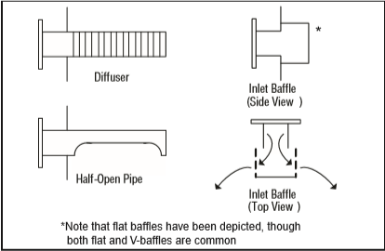
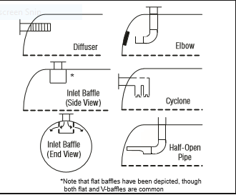
A diffuser reduces droplet fracture as well as providing improved gas distribution inside the separator.
A diffuser installed on separator feed with a high liquid to gas ratio can also help relieve the
downstream mist elimination device of more than 90% of the inlet liquid load.
There are several types of inlet devices used in the industry. The more common devices are shown
below.
Common vertical vessels inlet devices Common horizontal vessels inlet devices

Slide 23
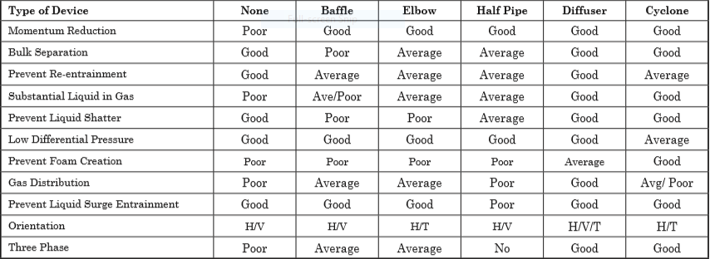
Typical inlet device performance

Slide 24
It is also necessary to maintain the inlet velocity head, J, within proper limits for the selected inlet
device to insure good gas distribution and minimum liquid shattering.
Where, J = (ρV²) .
The maximum mixed phase velocity head range used in the industry guidelines varies for the different inlet devices. Some typical maximums are:
•6000-9000 max. typ, up to 15 000 max kg/m s2 for diffuser distributor
•975-2250 max kg/m.s2 for no inlet distributor
•1500-3750 max kg/m.s2 for inlet half pipe or elbow distributor
•1500-3750 max kg/m.s2 for v-baffle or other simple inlet diverter designs
In addition, some users limit the inlet vapor phase velocity to 9 m/s or 18 m/s. The velocity should
always be below the erosion velocity for the service.

Slide 25
Gas Polishing Section
Selection of the appropriate device for gas polishing should be based on consideration of the
application, operating pressure, likely feed droplet size range, allowable downstream carryover
requirement, and the relative acceptability of the user for more compact and complex solutions..
Mechanism of Mist Carryover for Gas-Liquid Mist Eliminator Devices
Mist eliminators are commonly used in gas-liquid separation to aid gravity separation in the removal of
liquid so that more efficient, smaller separators may be used. To be effective, a mist eliminator must
accomplish two basic functions. First, it must have a means to capture liquid. Second, it must be able to
drain the captured liquid without allowing re-entrainment into the gas stream. There are two
mechanisms of liquid carryover from a mist eliminator. In the first mechanism, carryover is due to
droplets of mist which are simply not captured by the device. The droplets might be too small to be
captured or velocities are too low, causing low efficiency for impaction-type mist extractors. The second
is reentrainment of liquid after it has already been captured in the mist eliminator.

Slide 26
The majority of separator failures are caused by re-entrainment. This is the mechanism that occurs as
the gas throughput is increased beyond the tolerable limit. Gas moving through the mist extractor
exerts a drag force on the liquid film of the mist eliminator, causing it to be pulled toward the trailing
edge of the device. If the drag is excessive, the liquid will be torn off the element and carried away by
the gas stream. As flow rate increases, the contact efficiency of most mist eliminators improves.
Therefore, increasing gas flow yields improved droplet capture, but also increases re-entrainment
which results in liquid carryover and limits separation capacity.
The most common style of mesh mist eliminator used in gas processing is a 100 mm to 150 mm thick
crimped wire mesh pad with 144 to 192 kg/m3 bulk density. High droplet removal efficiency for droplets
10 microns and larger is common for the above design. Other designs include fiber mesh, mixed wire
and fiber mesh, multiple mesh density layers, and special drainage channels. The goals are either to
increase removal efficiency at lower droplet diameters, promote better drainage and in turn less
carryover, increase throughput for a given mist eliminator area, reduce fouling, or a combination of the
above. Manufacturers should be contacted for specific designs. Mesh pads are not recommended for
dirty or fouling service as they tend to plug easily and can dislodge at high differential pressure.

Slide 27
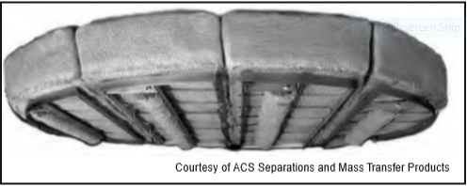
Proper drainage of the mesh mist eliminator is essential to the operation of the unit. As the gas velocity
increases at a given inlet liquid loading, the liquid continues to drain until a limiting load point is
reached, at which point substantial liquid will carry over with the gas flow. Most mesh mist eliminator
designs are based on the load point velocity. The load point will depend on the mist eliminator
orientation, since the drainage mechanism is different as the pad orientation changes.
Wire Mesh Mist Eliminator

Slide 28
Vane Mist Eliminators
Vane or chevron-type mist eliminators (vane-pack) use relatively closely spaced blades arranged to
provide sinusoidal or zig-zag gas flow paths. The changes in gas flow direction combined with the
inertia of the entrained liquid droplets cause impingement of the droplets onto the plate surface,
followed by coalescence and drainage of the liquid to the liquid collection section of the separator. Vane
packs may be installed in either horizontal or vertical orientations. Various vane styles are available,
including those with and without pockets (both single and double pockets) to promote liquid drainage.
Vanes with pockets, allow a higher gas throughput per flow area due to enhanced drainage, but are not
typically used in highly fouling service. Fig. 7-11 shows a horizontal, pocketed vane-type mist
eliminator. Vane capacity is reduced for vertical up flow applications relative to horizontal flow. Key
performance parameters for vanes are droplet removal efficiency and gas handling capacity. Capture
efficiency for a given droplet size depends on the vane design, gas velocity, gas viscosity and other
parameters. Simple vanes with no pockets are typically capable of capturing 40 microns droplets,
pocketed vanes are capable of 20 microns, and highly complex vanes of 10-20 microns at favorable

Slide 29
operating conditions. Maximum vane capacity is set to limit re-entrainment. The Souder-Brown
equation (Equation 7-11) and the load/sizing K factor are frequently used for describing the capacity of
vane-type mist eliminators. Manufactures provide typical K factors for the various styles. The capacity
for a particular vane service may be limited due to the liquid load to the device, liquid viscosity,
foaming tendency, liquid surface tension, gas mal-distribution, and flow surges. These factors are not
necessarily directly related to the Souders-Brown K value. Manufacturer guidance is necessary for a
Design.
Testing has shown that for mesh type mist eliminators the low pressure air-water droplet removal
efficiency experimental results correlate reasonably well with higher pressure gas-hydrocarbon liquid
systems. Vane packs on the other hand show a drop-off in removal efficiency as pressure increases. This
is primarily due to the decreased allowable design gas velocity caused by the increased gas density. As
gas velocity decreases, droplet inertia decreases, and the droplets tend to follow the gas streamlines
through the vane passages more easily. As a result, droplets are able to exit the vane pack without
being captured. Mesh pads also rely on velocity/droplet inertia to remove liquid droplets via

Slide 30
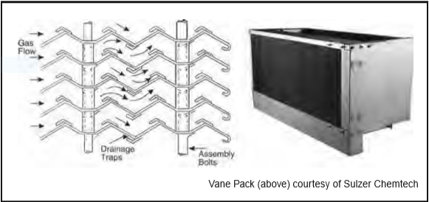
impingement, but they are less susceptible to efficiency reduction than vane packs because mesh pads
have far more collection “targets”, i.e. wire/fiber filaments.
Turndown is generally more of a concern with vane-packs than wire mesh, with droplet removal
efficiency decreasing measurably as velocity decreases from design. Vane packs are more tolerant to
dirt and fouling than mesh due to the large passage size.
Cross-Section of Vane Element Mist Extractor and Typical Vane Pack

Slide 31
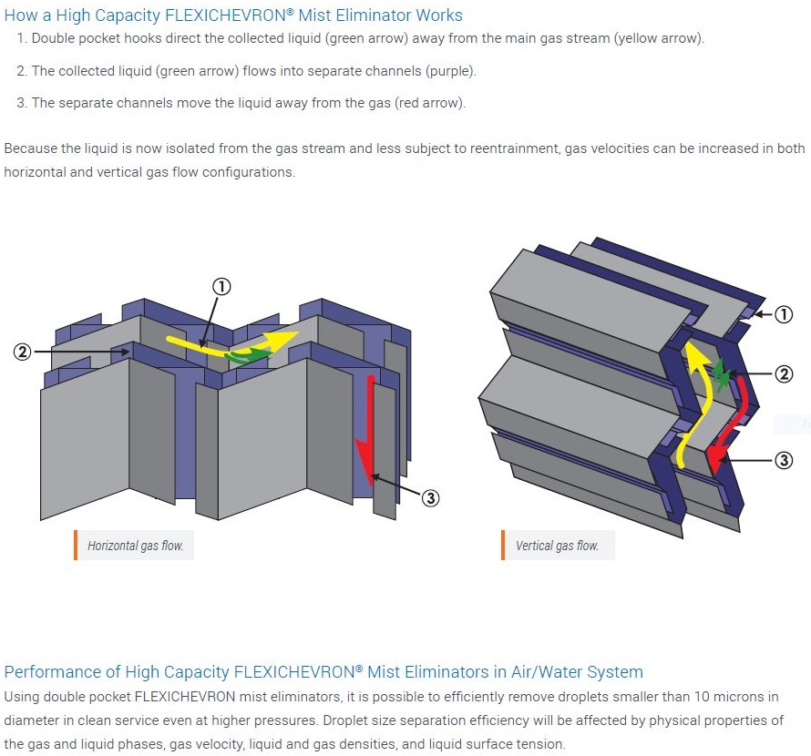

Slide 32
Separation Efficiency and Sizing Considerations For Wire Mesh Mist Eliminators — The work horse
mist eliminator of the process industry for more than 60 years has been the conventional crimped wire
mesh mist eliminator (single wire filament, and density). This design is still applicable for a wide
variety of gas processing applications. Today however, there is a wide variety of advanced designs using
the concept of composites (polymer fibers woven into the wire mesh), complex multi-layer (different
density and or filament size in layers), drainage channels, or other concepts. Each design will have its
own characteristic droplet removal efficiency at standard conditions, ability to tolerate liquid load, and
throughput capacity. Difficult applications in the gas treating industry are those with small droplet size
(low temperature treating separators, low surface tension high pressure light hydrocarbons), high
viscosity (glycols, sulfur) and stringent outlet specifications (low temperature treating, amines and
glycols). Internals suppliers should be consulted to provide the optimum alternatives for these
applications.

Slide 33
For any selected style, mist eliminator supplier can provide the d95 (droplet size for 95% removal
efficiency), and for a given an estimated inlet droplet size distribution, an overall separation efficiency.
Sizing for wire mesh mist eliminators is based on operating the mist eliminator at a maximum flow
rate which is a safe distance from the flood point at the operating conditions. The Souders-Brown K
value (Equation 7-11) has been found to be a good correlating factor for determining this velocity. A
conventional, 192 kg/m3, 0.3 mm filament, crimped wire mesh mist eliminator, will typically have a
design K value of 0.11 m/s, for vertical flow to the mist eliminator, at low pressure, low liquid/ gas load,
and liquid viscosity of 1.0 mPa.s or lower. In horizontal gas flow, a design K value of 0.13 is typical for
these conditions. At other conditions, the design K value may be lower, due to the liquid/gas flow
parameter(Φ) to the device(Φ=Wg/Wl(ρg/ ρl)0.5), liquid viscosity, foaming tendency, liquid
surface tension, gas mal-distribution, and flow surges. Note, that the average droplet size to the
separator, the type of inlet distributor, and the device spacing in the vessel can affect the gas/liquid flow
parameter at the mist eliminator for a given set of inlet conditions to the separator.

Slide 34
For gas treating applications, liquid viscosity is important mainly for high viscosity fluids, such as
glycols and sulfur. Surface tension is important for low surface tension light hydrocarbon fluids,
typically found in low temperature gas processing.
Fabian10 proposed that it is prudent to de-rate mist eliminators at pressures above 690 kPa (ga). This
de-rating is not for pressure per se, but rather for the potential for local high velocity areas, as the mist
eliminator becomes more compact at higher pressures. These de-rating factors are shown in Fig. 736.
Systems known to foam, such as amines and glycols should be de-rated, in a similar manner to a
system factor for trays or packing in these services. In addition, it is common to apply a system factor to
the gas design flow rate, which can vary from 1.05 to 1.2 depending on the application (i.e. inlet
production, steady state gas processing, gas compression). For many services in the gas treating
industry that handle light hydrocarbons gases and liquids at low liquid load, with a conventional wire
mesh mist eliminator, use of a K value of 0.11, de-rated per Fig. 7-36, will provide an acceptable design.

Slide 35
The addition of the mesh pad to the vertical separator improves the demisting capability of the
separator. Vertical separators with mesh pads have moderate capacity, high liquid droplet removal
efficiency, high turndown ratio, and low pressure drop. The overall efficiency of a separator with a mesh
pad is dependent on the liquid droplet size distribution and the liquid load at the pad. A supplier can
typically guarantee an overall efficiency of 99% at 7-10 microns for a conventional high efficiency wire
mesh mist eliminator. For material balance purposes, an overall liquid removal efficiency of greater
than 99% can be assumed for most applications. Vertical separators with mesh pads are recommended
for applications where vapor flow is the controlling condition. They can handle a moderate liquid load
to the pad in the form of droplets. The design K value can be affected by the liquid load to the device,
therefore proper selection of the feed inlet device is essential. Vertical wire mesh separators can be used
when limited upstream pipe slugs are present, if sufficient liquid surge volume is included. They are
not recommended for fouling service and for highly viscous liquids when the de-gassing requirement
determines the vessel diameter.

Slide 36
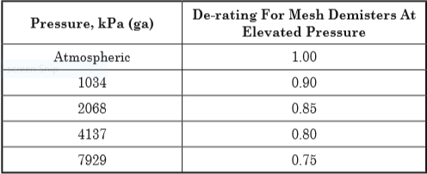
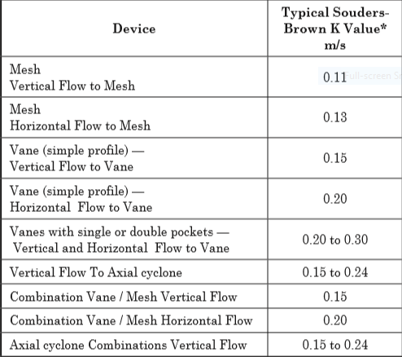
De-rating factor to K-value for pressure Typical Saunders Brown K values for mist
eliminator devices

Slide 38
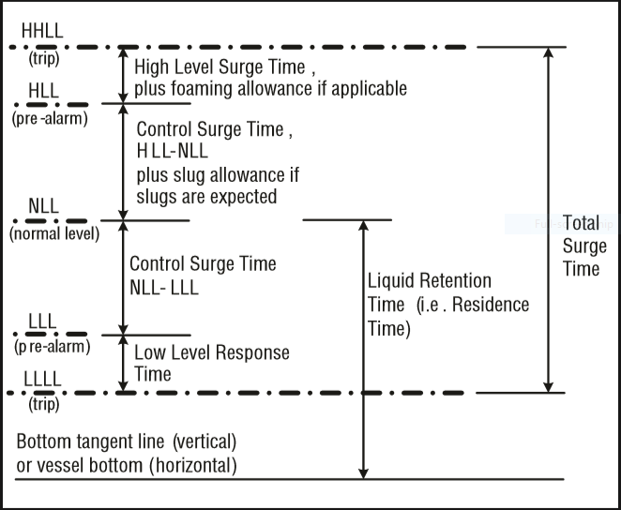
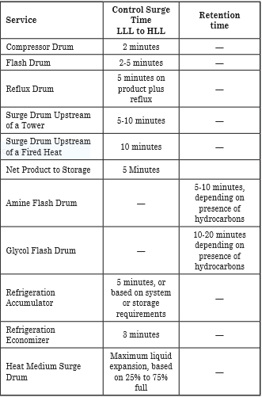
Height Calculation

Slide 40
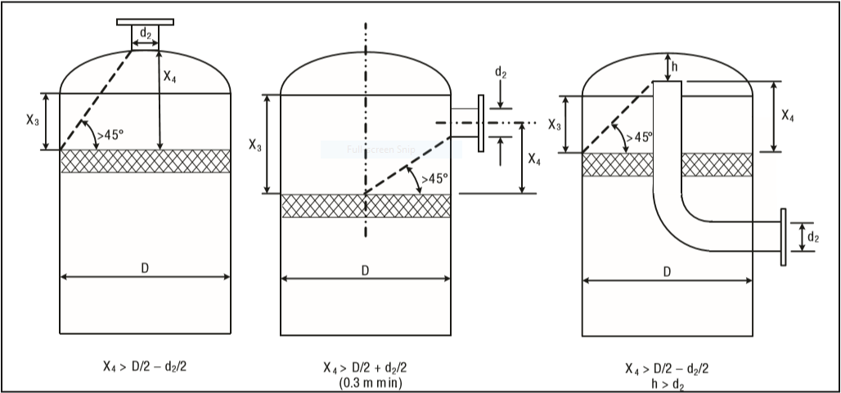
Vapor Outlet Section
The sizing of the vapor outlet nozzle should be such that given the above placement of the mesh pad,
the velocity is not high enough to cause channeling of the gas through the mesh pad. The nozzle outlet
size is typically based on the lesser of that required for piping pressure drop, or a maximum velocity
head criteria. Typical ranges for the maximum velocity head allowed for the vapor outlet are 4500–5400
kg/m • s2. In addition some users limit the absolute velocity to 18 m/s. The pipe size can be decreased
to the appropriate size based on pressure drop considerations, 5-10 pipe diameters downstream of the
separator, as required.

Slide 41
Liquid Outlet Nozzle
Many users limit the liquid outlet nozzle velocity based on pump suction line criteria (i.e. 11 kPa/100 m
for fluid at or near boil, 22 kPa/100 m otherwise) or other line sizing criteria. For three phase
separators, the velocity may be further reduced. Other users set a maximum outlet nozzle velocity (i.e.
0.9–1.5 m/sec) regardless of the service.
The liquid accumulation section collects liquid from the inlet, gravity separation and the gas polishing
sections. This liquid accumulation section allows gas trapped in the liquid to escape by providing
sufficient liquid residence time. This is particularly important if the system is foaming or highly
viscous. The liquid accumulation section also provides sufficient volume to allow for fluctuations in the
liquid flow rate or to accommodate slugs of liquid in the inlet flow

Slide 42
Additional Notes
Liquid Carry-Over Specification for Gas-Liquid Separators
•0.0134 m3 / MMSm3 (absolute reference)
•Supplier guarantee based on % removal for a specified droplet size, (i.e. d95, or 99% removal efficiency at 10 microns)
•98% overall liquid recovery
Gas Carry-Under Specification
A typical requirement for light hydrocarbons is minimal carry-under for gas bubbles 200 micron and
larger. This is particularly important when the liquid is being pumped downstream of the separator,
since pumps are only tolerant of dispersed dissolved gas to a limited extent. Gas volumes above 2%
should be checked by the pump manufacturer.

Slide 43
Vertical Vessel Diameter and Height Sizing Procedure
Calculate the volumetric flow in m3/s
Select a proper K-value and de-rate it according to its pressure by using the table on 11th slide .
Calculate UT and Uv . For Uv calculation, multiply UT by a correction factor between 0.75-1.
Calculate D by using . The reported D should be the calculated D + 150 mm
Calculate vessel Height according to Height Calculation Sheet -37

Slide 44
Vertical Separator Without Internals Sizing Procedure
A vertical separator without mist eliminating internals can be sized in a similar manner to that used
for separators with internals. For applications that are gas controlled, the diameter is based on a
maximum allowable terminal gas velocity. The K value used should be selected to insure massive
entrainment does not occur, and a reasonable separation efficiency is achieved. The design terminal
velocity can be based on the appropriate Stokes’ Law, and is based on a droplet size of 250-500 micron,
the gas and liquid properties, and the calculated drag coefficient, plus a safety factor. An alternative
approach which is common in the industry is to base the design on a K value of approximately 0.046
m/s. For fluids with low surface tension at high pressure, or in other circumstances where small
droplets are expected, either the target droplet size, or the design K, depending on the approach used,
should be further reduced.

Slide 45
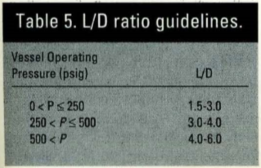
Horizontal Separator Without Internals Sizing Procedure
Calculate the vapor volumetric flow rate.
Calculate the liquid volumetric flow rate.
Calculate the vertical terminal velocity.
Calculate the Hold-up volume, VH
Calculate the Surge volume ,VS
Obtain an estimation of L/D ratio, using following table and subsequently calculate D by following
equation.

Slide 46
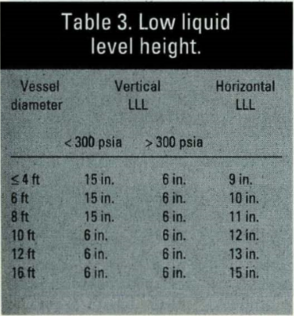
7. Calculate the total cross-sectional area
8. Calculate the low liquid level height using following table or HLLL = 0.5D + 7 in.
9. Calculate HLLL/D and use Goal-Seek function in Excel to find ALLL/AT and subsequently ALLL.

Slide 47
10. Set HV to 0.2D or 1 ft. if there is no mist pad eliminator and set it to 0.2D or 2 ft. if there is a mist
pad eliminator . Then calculate HV/D and by using Goal-Seek function calculate AV/AT
11. Calculate the minimum length to accommodate liquid holdup/surge, using following equation:
12. Calculate the liquid dropout time
13. Calculate the actual vapor velocity

Slide 48
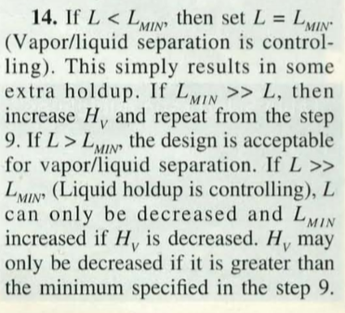
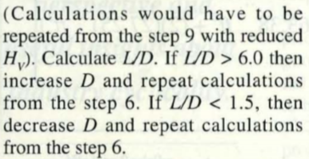
14. Calculate the minimum length required for vapor-liquid disengagement .

Slide 49
