Slide 1
Horizontal Vessel
Deaerator with Dome and Packing
D-7001
Design and Principles

Slide 2
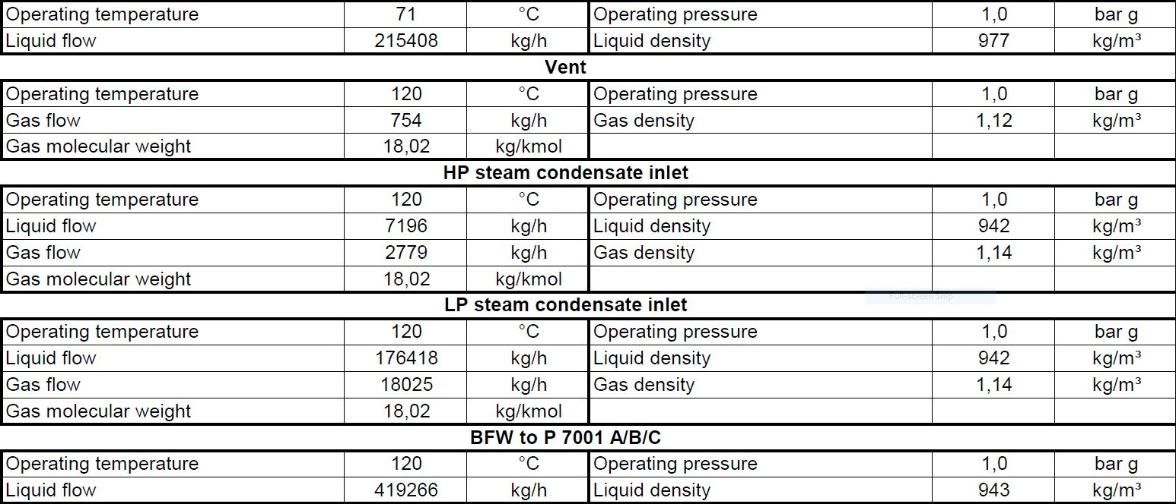
Operating Parameters

Slide 3
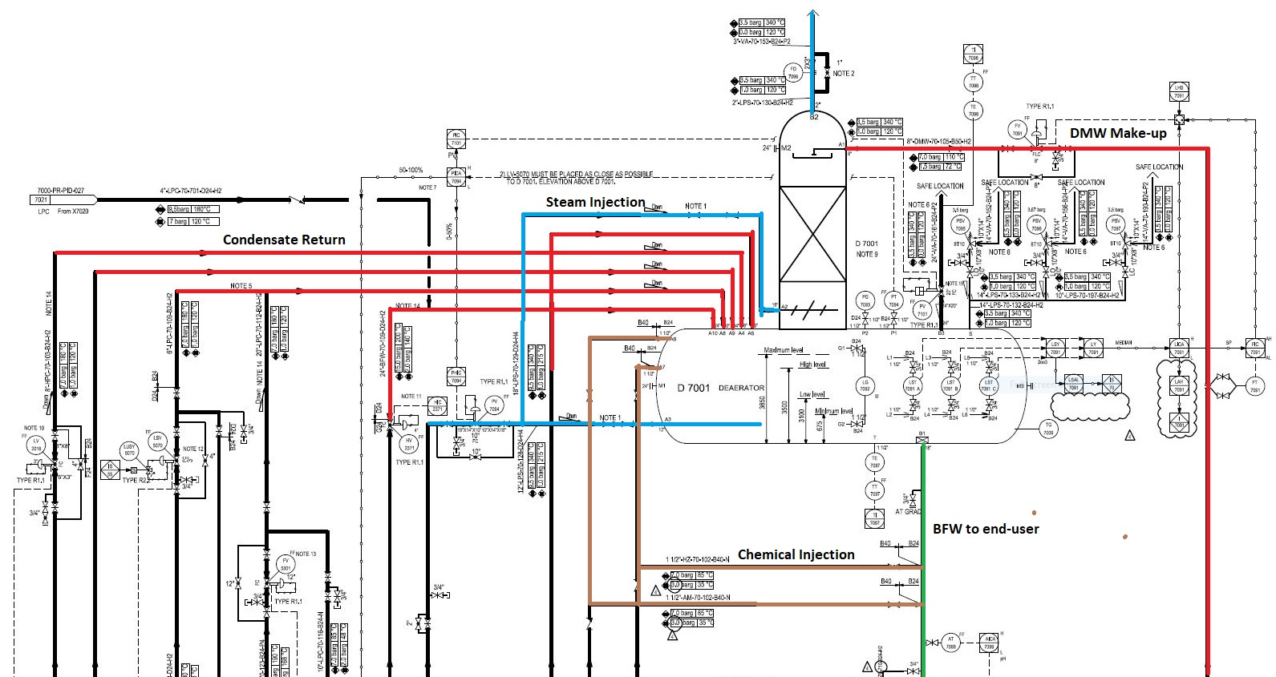

Slide 4
Design Procedure
1. Select proper Orientation
2. Select and Size proper Inlet Device, Inlet and Outlet ID
3.Calculate Vessel Diameter
4. Calculate Vessel Height
5.Select and Size Manholes, Vent, Drain, Vortex Breaker
6. Select a well-designed mist eliminator pad

Slide 5
1st Step: Select proper orientation
Since the application is liquid dominant a horizontal vessel is selected since it is used for
accumulation purposes.
Horizontal separators-without internals provide bulk separation of gas and liquid. The design is
typically used for Liquid surge applications where the vapor flow is very low, for fouling services, or
where internals are not desirable. The equipment has unlimited turndown, low pressure drop, can
handle slugs and high liquid fractions, and is insensitive to fouling. The separation efficiency is
dependent on the inlet droplet size distribution and Stokes’ Law settling, based on the diameter,
length, and liquid levels in the separator

Slide 6
2nd Step: Select and Size proper Inlet Device
It is also necessary to maintain the inlet velocity head, J, within proper limits for the selected inlet
device to insure good gas distribution and minimum liquid shattering.
Where,
J = (ρV²) .
The maximum mixed phase velocity head range used in the industry guidelines varies for the different
inlet devices. Some typical maximums are:
•6000-9000 max. typ, up to 15 000 max kg/m s2 for diffuser distributor
•975-2250 max kg/m.s2 for no inlet distributor
•1500-3750 max kg/m.s2 for inlet half pipe or elbow distributor
•1500-3750 max kg/m.s2 for v-baffle or other simple inlet diverter designs
In addition, some users limit the inlet vapor phase velocity to 9 m/s or 18 m/s. The velocity should
always be below the erosion velocity for the service.
However, in distillation section such rules does not apply.

Slide 7
3rd Step: Calculate Vessel Diameter
Each and every licensor and company has developed a design basis procedure for sizing vessels. In this
Article , a Svercek-method and the Licensor method will be
explored.

Slide 8
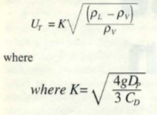
Svercek
1. Calculate the vapor volumetric flow rate , QV in m3/s
2. Calculate the liquid volumetric flow rate , QL in m3/min
3. Calculate the vertical terminal vapor velocity , UT and set UV = 0.75 UT

Slide 9
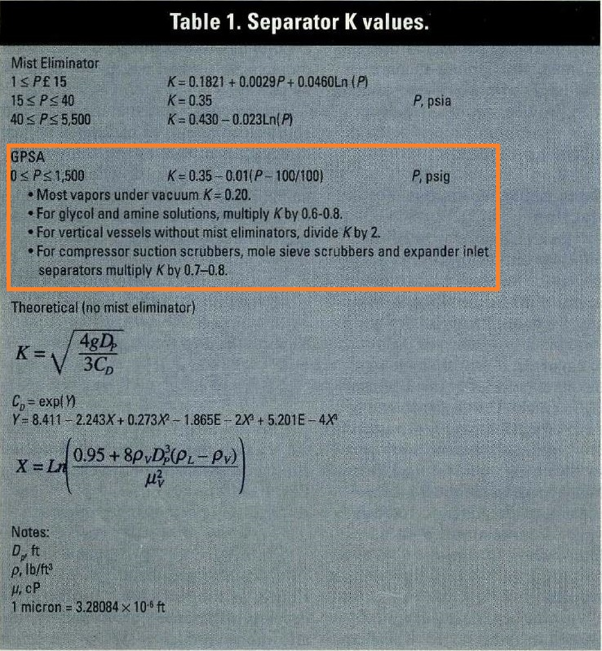

Slide 10
4. Select a hold-up time from next-page Table and calculate the hold-up volume, VH
5. Select a surge time from next-page Table and calculate the surge volume, VS
6. Estimate a L/D and initially calculate the diameter according to the following Equation:
7. Calculate the total cross sectional area.
8. Set HLLL and by using HLLL/D obtain ALLL/AT and calculate ALLL

Slide 11
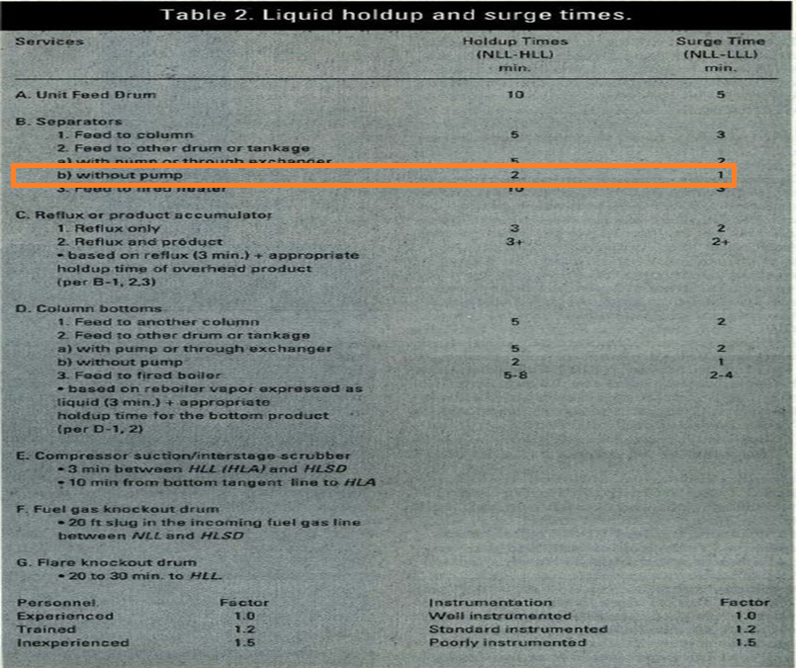

Slide 12
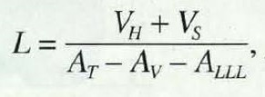
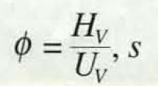
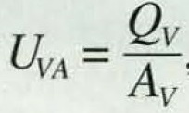
9. Set HV to 0.2D or 0.3048 m , whichever is greater; then by using HV/D, obtain AV/AT
10. Calculate the minimum length to accommodate the liquid hold-up/surge:
11. Calculate the liquid dropout time
12. Calculate the actual vapor velocity

Slide 13
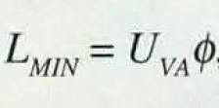
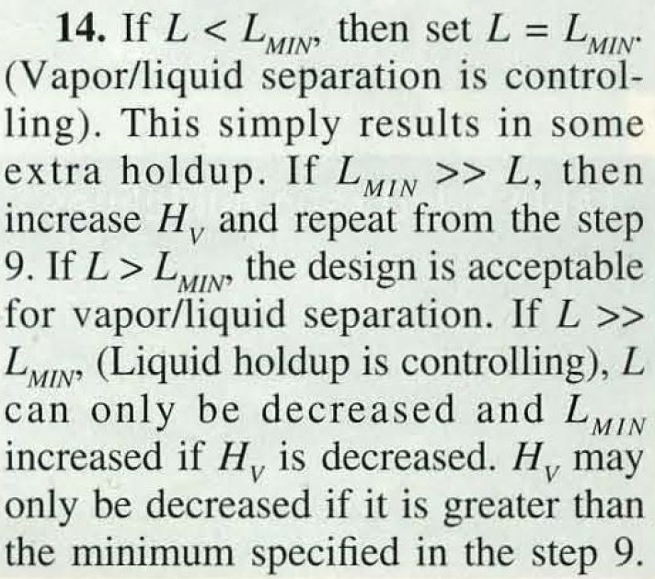
13. Calculate the minimum Length required for vapor-liquid disengagement, LMIN:

Slide 14
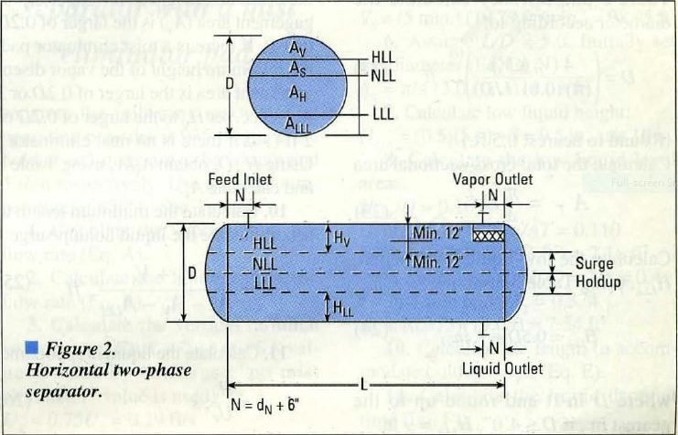

Slide 15
Steps
1 | QV = $\frac{754 }{1.12 × 3600}$ = 0.18 m3/s
2 | QL = $\frac{419266 }{943 × 60}$ = 7.41 m3/min
3 | UT $=0.21 \sqrt{\frac{943−1.12}{1.12}}$ = 6.08 m/s UV = 0.75 $×6.08=4.56 m/s$
4,5 | VH = 15 $×7.41=111.15 m3$
6 | L/D = 3 D${\text{=}(\frac{4 ×(111.15 )}{π ×0.6 ×3}\text{)}}^{\frac{1}{3}}$ = 4.28 m

Slide 16
Steps
7 | AT = $\frac{ π}{4}$ $×4.3 ×4.3$= 14.41 m2
8 | HLLL = $0.675$ m HLLL /D = 0.157 $Θ$ = 2$×$ACOS(1-2$×$0.157) = 1.63 ALLL/AT = (1.63-SIN(1.63))/2/$π$ = 0.1 ALLL = 0$.1×14.41=1.45 m2$
9 | HV = $0.2×4.3=0.85$ m more than 0.3048 m HV /D = 0.2 $Θ$ = 2$×$ACOS(1-2$×$0.2) = 1.85 AV/AT = (1.85-SIN(1.85))/2/$π$ = 0.14 AV = 0.14 $×14.41=2.05m2$

Slide 17
Steps
10 | L = $\frac{111.15}{14.41−1.45−2.05}$ = 10.2 m
11 | $φ$ = $\frac{0.85 }{4.56}$ = 0.187
12 | UVA = $\frac{0.187}{0.85}=0.21 m/s$
13 | LMIN = 0.187 $×0.21=0.05$

Slide 18
Step 14 : Hv is reduced to minimum specified which is 0.3048 m and in doing so, the vessel
length reduces from 10.2 m to 8.9 m . The final results are provided below:
Svercek D is 75 mm lower than that of the licensor but in return , Svercek L is 4350 mm
More than that of licensor.
Parameter | Svercek | Licensor
D | 4300 mm | 4375 mm
L | 8900 mm | 13350 mm

