Slide 1
Horizontal Vessel
Without Mist Eliminator
D-5003
Design and Principles

Slide 2
Operating Parameters
Description
The objective of this vessel is to accumulate purified methanol produced and reflux parts of it to the
MP Column.

Slide 3
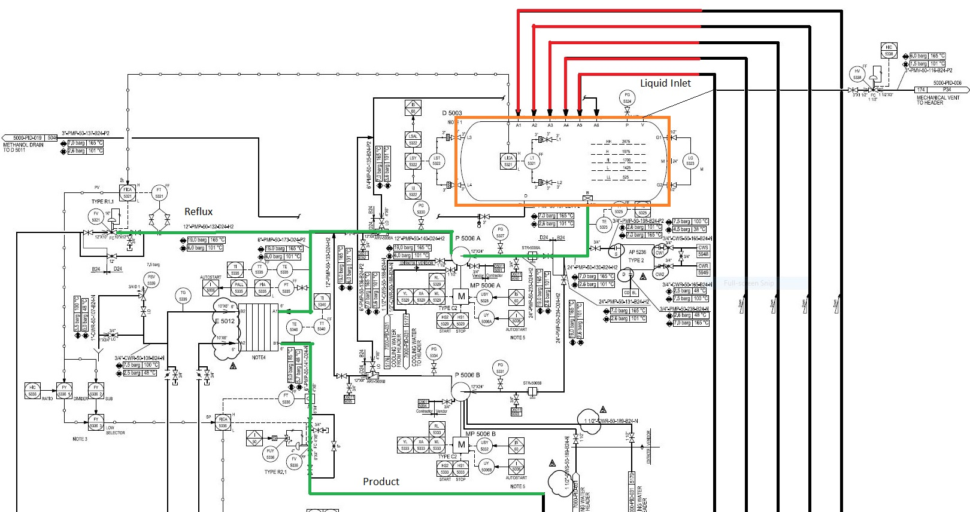

Slide 4
Design Procedure
1. Select proper Orientation
2. Select and Size proper Inlet Device, Inlet and Outlet ID
3.Calculate Vessel Diameter
4. Calculate Vessel Height
5.Select and Size Manholes, Vent, Drain, Vortex Breaker
6. Select a well-designed mist eliminator pad

Slide 5
1st Step: Select proper orientation
Since the application is liquid dominant a horizontal vessel is selected since it is used for
accumulation purposes.
Horizontal separators-without internals provide bulk separation of gas and liquid. The design is
typically used for Liquid surge applications where the vapor flow is very low, for fouling services, or
where internals are not desirable. The equipment has unlimited turndown, low pressure drop, can
handle slugs and high liquid fractions, and is insensitive to fouling. The separation efficiency is
dependent on the inlet droplet size distribution and Stokes’ Law settling, based on the diameter,
length, and liquid levels in the separator

Slide 6
2nd Step: Select and Size proper Inlet Device
It is also necessary to maintain the inlet velocity head, J, within proper limits for the selected inlet
device to insure good gas distribution and minimum liquid shattering.
Where,
J = (ρV²) .
The maximum mixed phase velocity head range used in the industry guidelines varies for the different
inlet devices. Some typical maximums are:
•6000-9000 max. typ, up to 15 000 max kg/m s2 for diffuser distributor
•975-2250 max kg/m.s2 for no inlet distributor
•1500-3750 max kg/m.s2 for inlet half pipe or elbow distributor
•1500-3750 max kg/m.s2 for v-baffle or other simple inlet diverter designs
In addition, some users limit the inlet vapor phase velocity to 9 m/s or 18 m/s. The velocity should
always be below the erosion velocity for the service.
However, in distillation section such rules does not apply.

Slide 7
3rd Step: Calculate Vessel Diameter
Each and every licensor and company has developed a design basis procedure for sizing vessels. In this
Article , a Svercek-method and the Licensor method will be
explored.

Slide 8
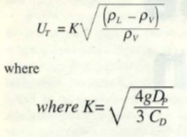
Svercek
1. Calculate the vapor volumetric flow rate , QV in m3/s
2. Calculate the liquid volumetric flow rate , QL in m3/min
3. Calculate the vertical terminal vapor velocity , UT and set UV = 0.75 UT

Slide 9
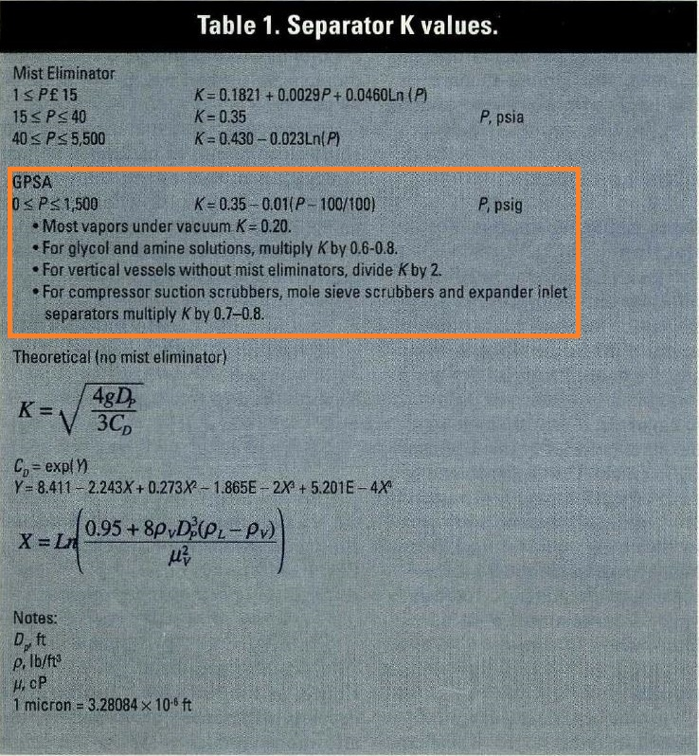

Slide 10
4. Select a hold-up time from next-page Table and calculate the hold-up volume, VH
5. Select a surge time from next-page Table and calculate the surge volume, VS
6. Estimate a L/D and initially calculate the diameter according to the following Equation:
7. Calculate the total cross sectional area.
8. Set HLLL and by using HLLL/D obtain ALLL/AT and calculate ALLL

Slide 11
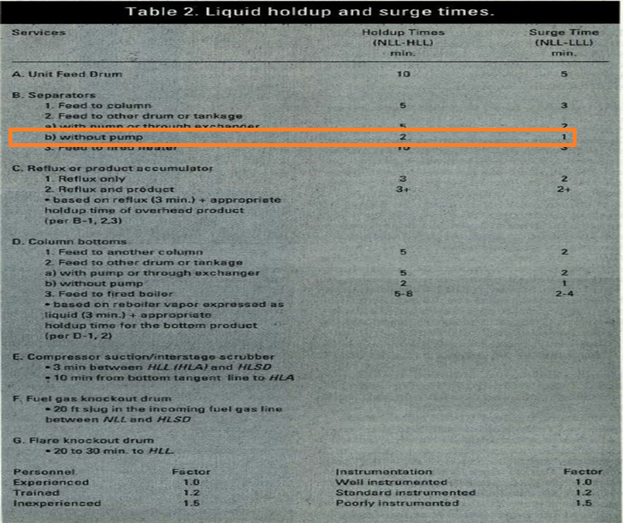

Slide 12
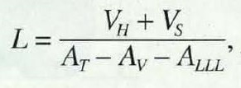
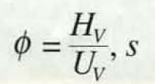
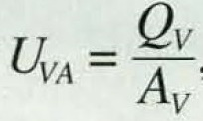
9. Set HV to 0.2D or 0.3048 m , whichever is greater; then by using HV/D, obtain AV/AT
10. Calculate the minimum length to accommodate the liquid hold-up/surge:
11. Calculate the liquid dropout time
12. Calculate the actual vapor velocity

Slide 13
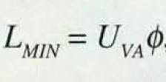
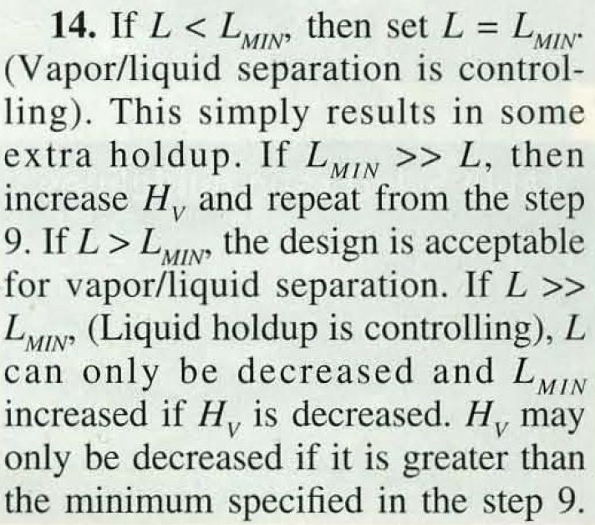
13. Calculate the minimum Length required for vapor-liquid disengagement, LMIN:

Slide 14
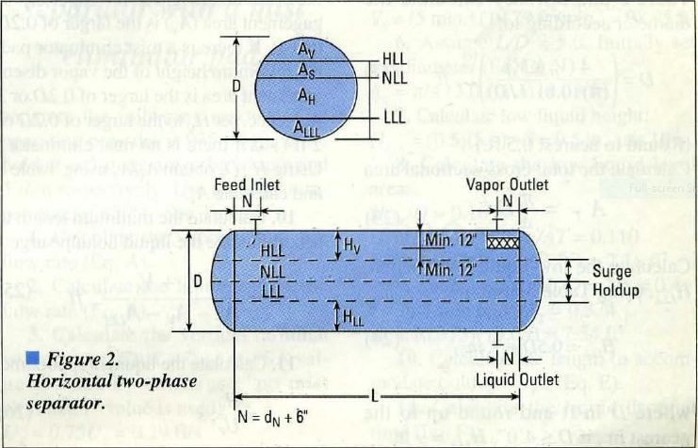

Slide 15
Steps
1 | QV = $0$
2 | QL = $\frac{440751 }{711 × 60}$ = 10.33 m3/min
3 | VH = 5 $×10.33=51.65 m3$
4 | L/D = 3 D${\text{=}(\frac{4 ×(51.65 )}{π ×0.6 ×3}\text{)}}^{\frac{1}{3}}$ = 3318 mm
5 | AT = $\frac{ π}{4}$ $×3.3 ×3.3$= 8.64 m2

Slide 16
Steps
6 | HLLL = $1.425$ m HLLL /D = 0.429 $Θ$ = 2$×$ACOS(1-2$×$0.429) = 2.85 ALLL/AT = (2.85-SIN(2.85))/2/$π$ = 0.41 ALLL = 0.41 $×8.64=3.54 m2$
7 | HV = $0.2×3.31=0.663$ m more than 0.3048 m HV /D = 0.2 $Θ$ = 2$×$ACOS(1-2$×$0.2) = 1.85 AV/AT = (1.85-SIN(1.85))/2/$π$ = 0.14 AV = 0.14 $×8.64=1.23 m2$
8 | L = $\frac{51.65}{8.64−3.54−1.23}$ = 13.35 m

Slide 17
Step 14 : Hv is reduced to minimum specified which is 0.3048 m and in doing so, the vessel
length reduces from 13.35 m to 10.98 m . The final results are provided below:
Svercek D is 100 mm lower than that of the licensor but in return , Svercek L is 700 mm
More than that of licensor which means both are correct . The volume for both are the
same.
A Question : do we really need to consider HV for vapor since we do not have actual vapor in
large amount ? The licensor has accommodated a space for such purpose. In next page the
relationship between Hv and vessel Length is shown.
Parameter | Svercek | Licensor
D | 3300 mm | 3400 mm
L | 11000 mm | 10250 mm

Slide 18
Hv | L
0.3048 | 11000
0.2 | 10600
0.1 | 10300
0.05 | 10200

Slide 19
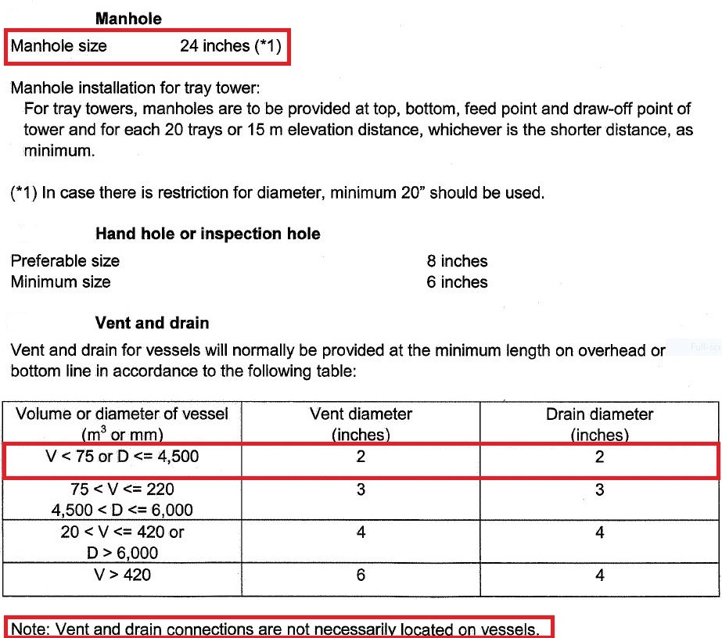
Licensor Criteria

Slide 20
Comparison
The size of manhole for licensor is 24’.
There is no need to have Vent on this drum since there is a control valve to flare system and if
purging is required then by use of these means the task could be performed.
The drain valve sized by licensor is 2’.
Parameter | Licensor
Manhole | 24
Vent | Not required
Drain | 2
Vortex Breaker | Yes

