Slide 1
In -Line Separator with
Horizontal Flow Vane Pack
D-3012
Design and Principles

Slide 2
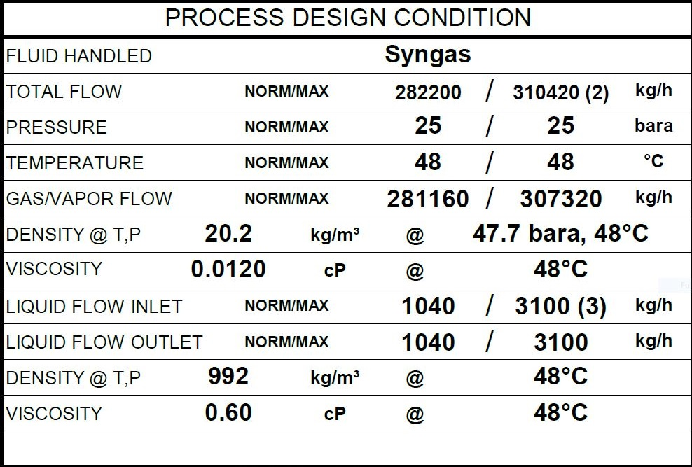
Operating Parameters
Max liquid flow rate at B.L. considered for separator design is equal to 1% of process gas flow rate in rated
condition
Description
The objective of this vessel is to separate liquid particle from the gas . The vessel is located at the
Suction of a compressor so that maximum droplet size contained in gas stream to
the section should be max 10 micron. Efficiency of vane pack to be 98% and overall dp ≤ 50 mbar

Slide 3
Design Procedure
1. Select proper Orientation
2. Select and Size proper Inlet Device, Inlet and Outlet ID
3.Calculate Vessel Diameter
4. Calculate Vessel Height
5.Select and Size Manholes, Vent, Drain, Vortex Breaker
6. Select a well-designed mist eliminator pad

Slide 4
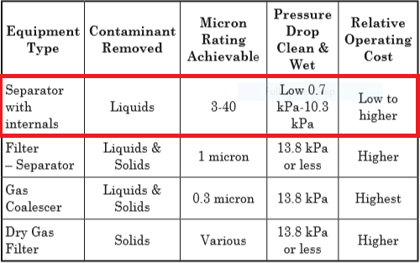
1st Step: Select proper orientation
Since the application is gas dominant a vertical vessel is selected .
Due to its being at the suction of a compressor, an internal eliminator should be installed.

Slide 5
Vertical Separator with Vane Pack
Vertical separators with vane packs can be used instead of wire mesh for the following reasons: fear of
fouling of the wire mesh, where corrosion and life of the demisting device requires a more robust design
than mesh pads, to reduce separator size and cost compared to mesh, too high a liquid load for mesh.
Vertical separators with vane packs have a moderate turndown ratio, are suitable for slightly fouling
service (straight or some single-pocket vanes only). The typical droplet removal efficiency for vane
styles is provided in “Vane Separator Devices”, earlier in this Chapter. Vane separators are less
efficient overall than wire mesh in most applications. Vertical separators with vanes are best utilized
below 4825 kPa (ga). Higher efficiency can be obtained at pressures above 4825 kPa (ga) by using
double pocket vanes. Vanes can tolerate higher liquid load than mesh pads. However, they are sensitive
to slugs and require adequate bulk separation upstream, similar to mesh pads. Vane elements have a
relatively low pressure drop �typically 100 Pa to 1 kPa (ga)]. Vertical separators with vanes are a
common alternative to mesh mist eliminators for reciprocating compressors because of their more
robust mechanical design, which is advantageous in pulsating service.

Slide 6
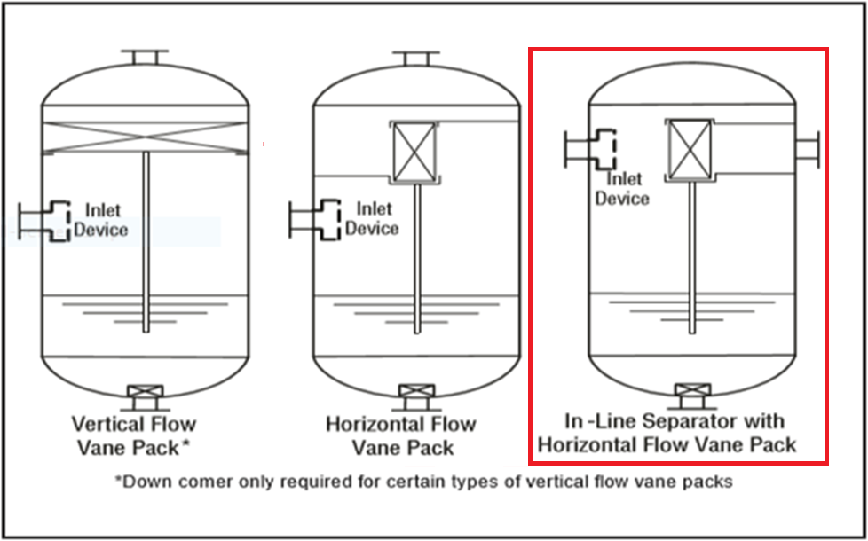

Slide 7
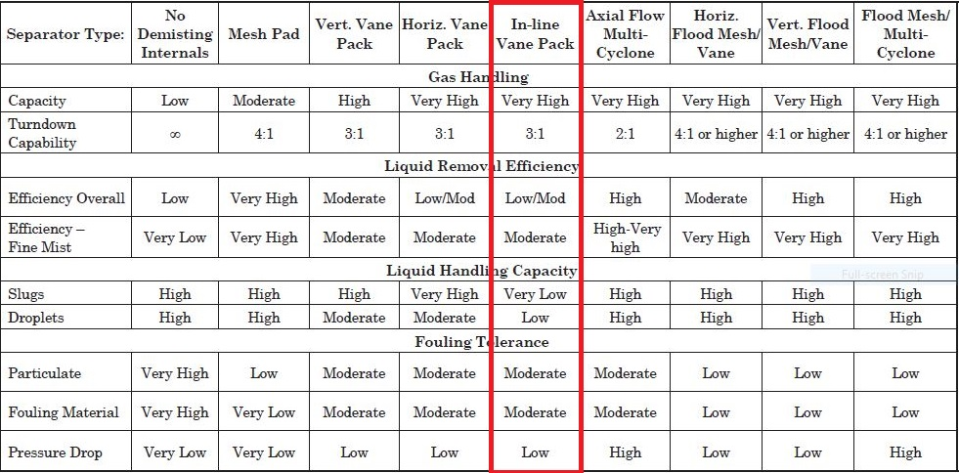
This is the most compact vertical vessel using a vane pack. However, the design cannot handle
significant liquids or Slugs during an upset.

Slide 8
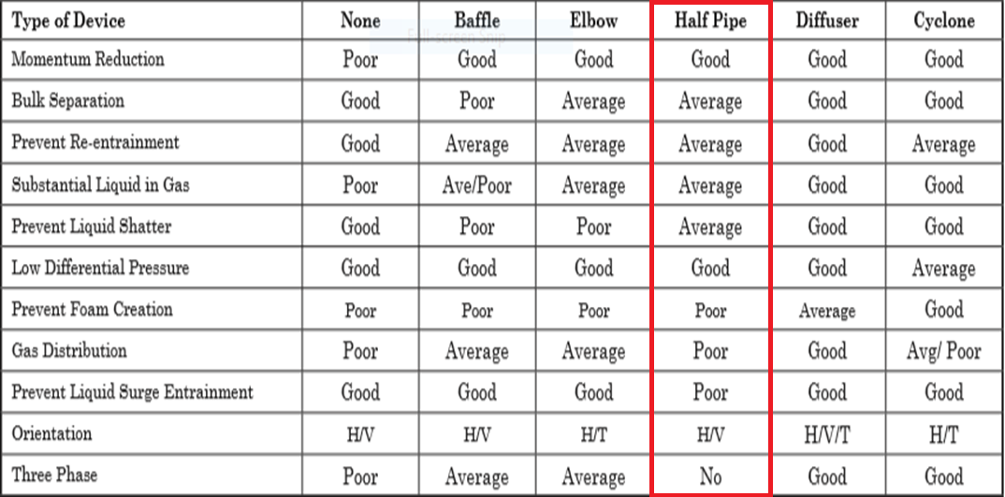
2nd Step: Select and Size proper Inlet Device
Half Pipe has proven itself to be not only effective in large capacities but cost-effective as well and in
many application is preferred to Diffuser whose performance is superior but too costly.

Slide 9
It is also necessary to maintain the inlet velocity head, J, within proper limits for the selected inlet
device to insure good gas distribution and minimum liquid shattering.
Where,
J = (ρV²) .
The maximum mixed phase velocity head range used in the industry guidelines varies for the different
inlet devices. Some typical maximums are:
•6000-9000 max. typ, up to 15 000 max kg/m s2 for diffuser distributor
•975-2250 max kg/m.s2 for no inlet distributor
•1500-3750 max kg/m.s2 for inlet half pipe or elbow distributor
•1500-3750 max kg/m.s2 for v-baffle or other simple inlet diverter designs
In addition, some users limit the inlet vapor phase velocity to 9 m/s or 18 m/s. The velocity should
always be below the erosion velocity for the service.

Slide 10
In order to calculate head velocity , at first, we need to perform the followings:
1. Estimation of inlet nozzle ID; Consider inlet pipe ID near the vessel as first and best estimation.
2. Calculate ρmixture and subsequently Vmixture
3. Calculate J by multiplying ρmixture $×$ (Vmixture)^2 and compare it with the last-page criterion.
So, the inlet device sizing should at least be 28 inch to meet the momentum requirement but the
vendor has chosen to reduce the momentum to help the separation and taken recommended
practice that inlet piping diameter match the velocity requirement of the inlet to the separator 10 pipe
diameters upstream of the separator to provide a flow regime which is fully developed before entering
the separator. Thus 30 inch has been selected by vendor.
Parameter | Value | Value | Value | Unit
Estimated ID | 26 | 28 | 30 | inch
Nozzle Area | 0.34 | 0.39 | 0.45 | m2
ρmixture | 20.39 | 20.39 | 20.39 | kg/m3
Vmixture | 12.34 | 10.64 | 9.26 | m/s
J | 3106 | 2309 | 1752 | kg/m.s2
Criterion | 2250 | 2250 | 2250 | kg/m.s2

Slide 11
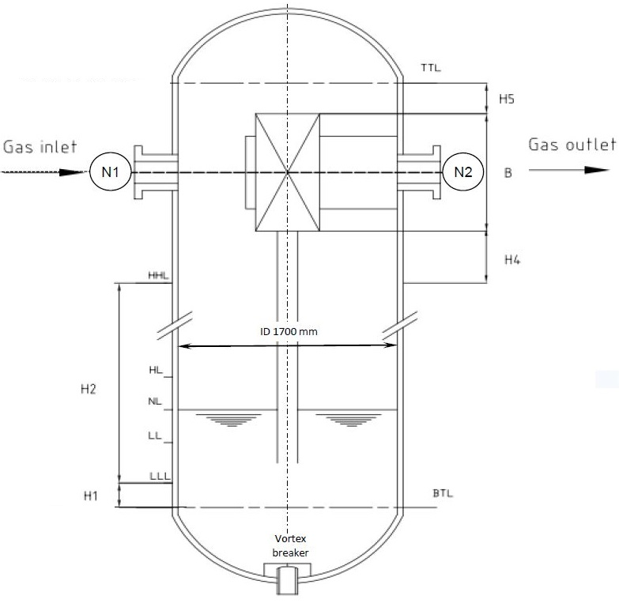

Slide 12
Vapor Outlet Section
The sizing of the vapor outlet nozzle should be such that given the above placement of the mesh pad,
the velocity is not high enough to cause channeling of the gas through the mesh pad. The nozzle outlet
size is typically based on the lesser of that required for piping pressure drop, or a maximum velocity
head criteria. Typical ranges for the maximum velocity head allowed for the vapor outlet are 4500–
5400 kg/m • s2. In addition some users limit the absolute velocity to 18 m/s. The pipe size can be
decreased to the appropriate size based on pressure drop considerations, 5-10 pipe diameters
downstream of the separator, as required. 30 inch is selected.
Parameter | Value | Value | Value | Unit
Estimated ID | 22 | 26 | 30 | inch
Area | 0.24 | 0.34 | 0.45 | m2
Vg | 17.23 | 12.33 | 9.26 | m/s
ρVg2 | 5998 | 3074 | 1734 | Kg/m.s2
Criterion | 5400 | 5400 | 5400 | Kg/m.s2

Slide 13
Liquid Outlet Nozzle
Many users limit the liquid outlet nozzle velocity based on pump suction line criteria
Suprizingly 3’ is selected
Parameter | Value | Value | Value | Unit
Estimated ID | 2 | 3 | 4 | inch
Area | 0.002 | 0.004 | 0.008 | m2
Vl | 0.42 | 0.19 | 0.1 | m/s
Criterion | Max 1.5 | Max 1.5 | Max 1.5 | m/s

Slide 14
3rd Step: Calculate Vessel Diameter
Each and every licensor and company has developed a design basis procedure for sizing vessels. In this
Article , a GPSA-based method, Foster-Wheeler-based method and the Licensor method will be
explored.

Slide 15
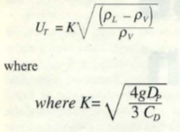
GPSA
1. Use the following equation and next-page K-values to calculate terminal velocity

Slide 16
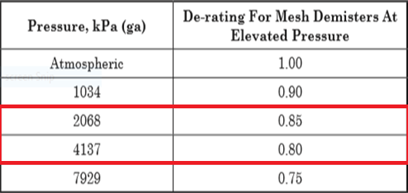
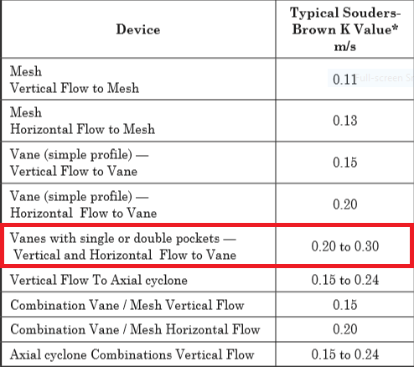
De-rating factor to K-value for pressure Typical Saunders Brown K values for mist
eliminator devices

Slide 17
According to Saunders-Brown K-value , thanks to the fact that a vertical vessel with demister pad has
been chosen, a K value of 0.3 is selected. Furthermore, since the performance of demister pad varies
According to operating pressure, the selected K should be de-rated in accord with last-page Table.
Kde-rated = 0.2 $×0.85=0.16$
Parameter | Value | Unit
ρl | 992 | kg/m3
ρv | 20.2 | kg/m3
Kselected | 0.16
Ug | 1.1 | m/s
Qg | 4.22 | m3/s
ID | 2202 | mm
Required-ID | 2200 | mm
Selected-ID | 2200 | mm

Slide 18
Notes
For ID calculation , the following equation has been utilized.
The vessel has been sized based on rated capacity and the resulting vessel diameter is 2200 mm . In
comparison to vessel sizing based on normal capacity , the resulting vessel diameter is 2100 mm.
The vendor has selected 1700 mm as vessel diameter which is due to in-line packed vane.

Slide 19
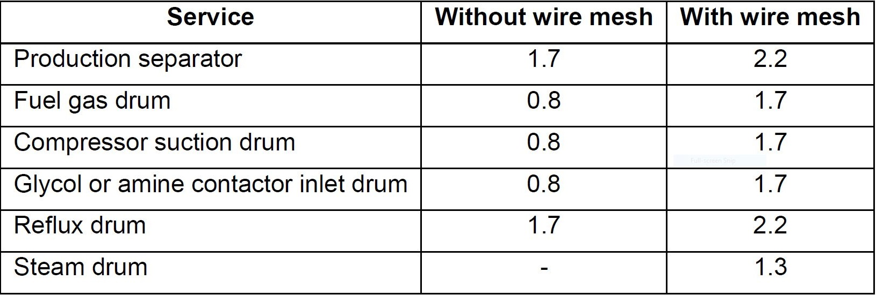
Foster-Wheeler
The basis of sizing is the critical velocity Vc (m/s)
The maximum gas velocity is K$×$Vc
K is a coefficient depending on the service, and the use or the absence of wire mesh.
Recommended K values are given hereafter for different services.
If a vane pack internal is used, the recommended K value is 3.3.

Slide 20
Parameter | Value | Unit
ρl | 992 | kg/m3
ρv | 20.2 | kg/m3
Kselected | 3.3
Vc | 0.33 | m/s
Vmax | 1.09
Qg | 4.22 | m3/s
ID | 2215 | mm
Required-ID | 2215 | mm
Selected-ID | 2200 | mm

Slide 21
4th Step: Height Calculation
Each and every licensor and company has developed a design basis procedure for sizing vessels. In this
Article , a GPSA-based method, Foster-Wheeler-based method and the Licensor method will be
explored.

Slide 22
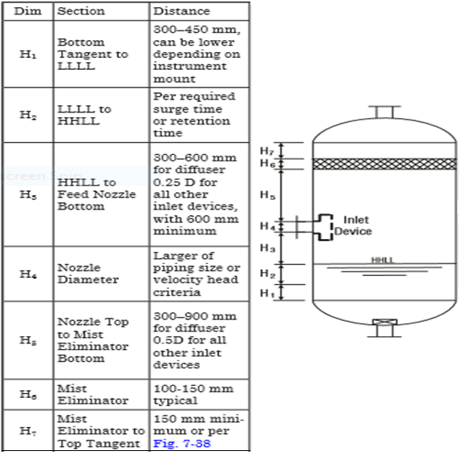
GPSA

Slide 23
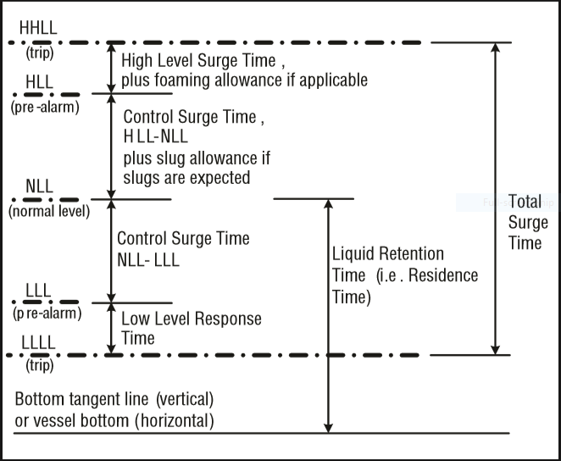
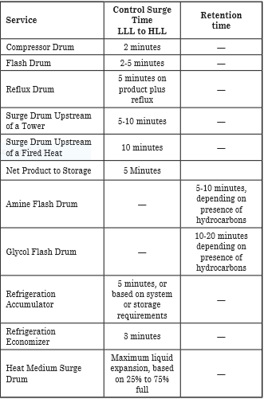
Retention/Surge Time

Slide 24
Height Elements | GPSA | Vendor | Unit
H1 | 450 | 150 | mm
H2 | 150 | 650 | mm
H4 | 425 | 500 | mm
B | 2400* | 2400 | mm
H5 | 150 | 100 | mm
 |  |  | mm
 |  |  | mm
HT | 3600 | 3800 | mm

Slide 25
Calculation, Explanation, and Discussion
H1 mostly depends on instrument mount position and the number of instrument devices used . The
Licensor for most of his vertical vessel has selected 500 mm in accord with his FCS and ESD Control
System, whereas in GPSA 450 mm is selected as the basis.
H2 is a function of retention time . . Likewise, in GPSA a retention time of 2-5 minutes has been
selected for Flash drums.
H3 in GPSA for Half Open pipes is 0.25D and has been the basis for calculation.
H4 is the size of inlet Half Open pipe which is the same size of upstream pipe for both vendor and
GPSA.
H5 in GPSA for Half Open pipes is 0. 5D and has been the basis for calculation.
H6 is the Vane pack length, which is based on vendor data and varies vendor by vendor.
H7 in GPSA is minimum 150 mm but in other sketch in GPSA there is a formula for X4 which connects
the upper part of demister pad to outlet nozzle which can not be used for comparison here.

Slide 27
Manholes
Foster-Wheeler
Size of manholes
For vessel diameter < 1000 mm
Flanged vessel shall be considered if equipment contains internals
Otherwise, size of manholes = 18”
For vessel diameter ≥ 1000 mm
Toxic service size of manholes = 24”
Non-toxic service size of manholes = 20”
(or up to 24” if internals need to be removable through
manhole.)

Slide 28
Drain and Vents
The drain of the vessel shall always be at the lowest point of a vessel. For vertical vessels they
shall be connected to the bottom outlet line at the low point. For horizontal vessels the drain point
shall be directly on the bottom of the drum at the lowest point ensured through vessel slope (1:100).

Slide 29
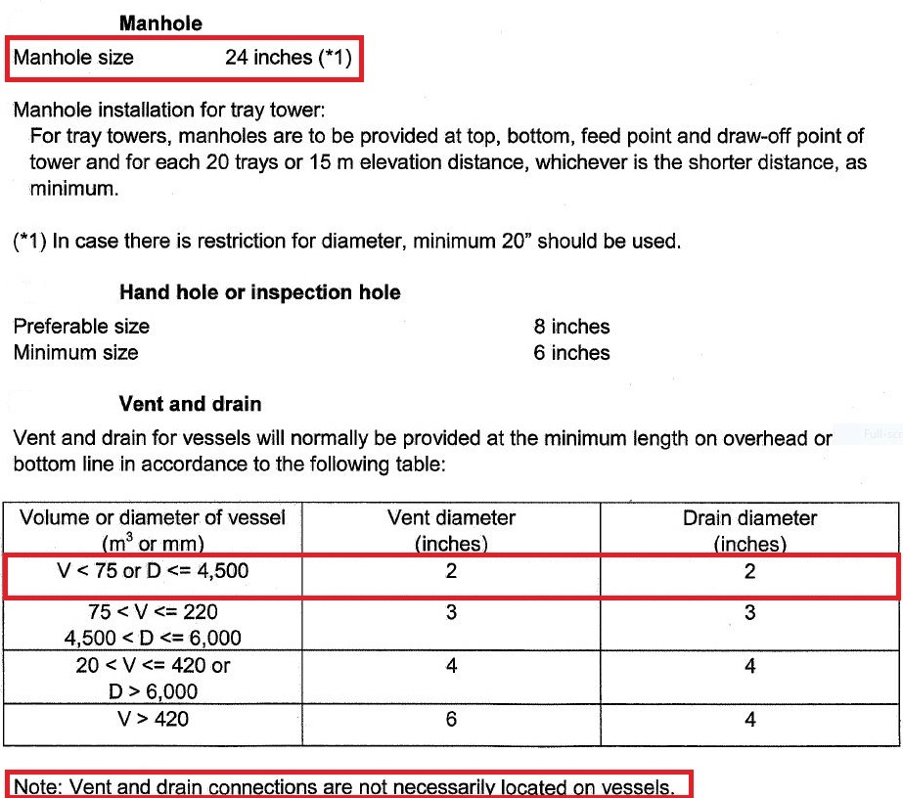
Vendor Criteria

Slide 30
Comparison
The size of manhole for both Vendor and FW is 24’.
In site both vent and drain size are set to 3’
The Inspection handhole is sized to 8’ in site.
Vent sizing in site is 2’.
Parameter | FW | Vendor
Manhole | 20-24 | 24
Vent | 2 | 2
Drain | 2 | 2
Vortex Breaker | Yes | Yes
Inspection |  | 8

