Slide 1
Horizontal Vessel
Without Mist Eliminator
D-3002
Design and Principles

Slide 2
Operating Parameters
Description
The objective of this vessel is to accumulate raw methanol produced and at the same time create the
space/area for dissolved gas to be separated.

Slide 3
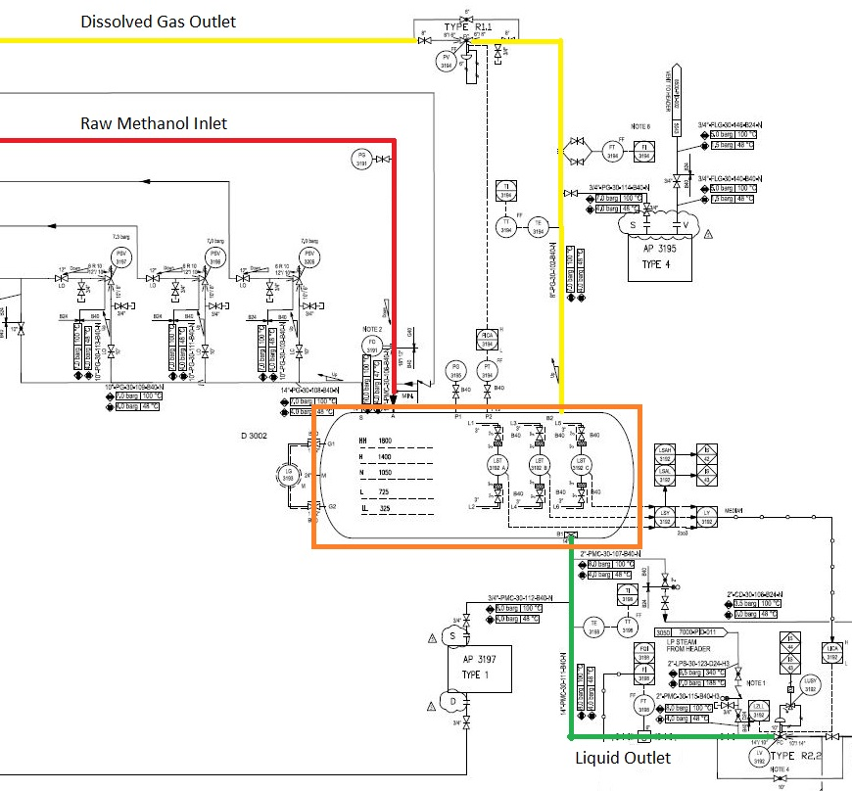

Slide 4
Design Procedure
1. Select proper Orientation
2. Select and Size proper Inlet Device, Inlet and Outlet ID
3.Calculate Vessel Diameter
4. Calculate Vessel Height
5.Select and Size Manholes, Vent, Drain, Vortex Breaker
6. Select a well-designed mist eliminator pad

Slide 5
1st Step: Select proper orientation
Since the application is liquid dominant a horizontal vessel is selected since it provides more surface
area or spacing for dissolved gas to separate.
Horizontal separators-without internals provide bulk separation of gas and liquid. The design is
typically used for Liquid surge applications where the vapor flow is very low, for fouling services, or
where internals are not desirable. The equipment has unlimited turndown, low pressure drop, can
handle slugs and high liquid fractions, and is insensitive to fouling. The separation efficiency is
dependent on the inlet droplet size distribution and Stokes’ Law settling, based on the diameter,
length, and liquid levels in the separator

Slide 6
2nd Step: Select and Size proper Inlet Device
It is also necessary to maintain the inlet velocity head, J, within proper limits for the selected inlet
device to insure good gas distribution and minimum liquid shattering.
Where,
J = (ρV²) .
The maximum mixed phase velocity head range used in the industry guidelines varies for the different
inlet devices. Some typical maximums are:
•6000-9000 max. typ, up to 15 000 max kg/m s2 for diffuser distributor
•975-2250 max kg/m.s2 for no inlet distributor
•1500-3750 max kg/m.s2 for inlet half pipe or elbow distributor
•1500-3750 max kg/m.s2 for v-baffle or other simple inlet diverter designs
In addition, some users limit the inlet vapor phase velocity to 9 m/s or 18 m/s. The velocity should
always be below the erosion velocity for the service.

Slide 7
In order to calculate head velocity , at first, we need to perform the followings:
1. Estimation of inlet nozzle ID; Consider inlet pipe ID near the vessel as first and best estimation.
2. Calculate ρmixture and subsequently Vmixture
3. Calculate J by multiplying ρmixture $×$ (Vmixture)^2 and compare it with the last-page criterion.
So, the minimum sizing should at least be 16 inch to meet the requirement . The licensor has chosen 18
inch to not only better control its momentum and as a result help the bulk separation but also be more
conservative and on the safe side.
Parameter | Value | Value | Value | Unit
Estimated ID | 14 | 16 | 18 | inch
Nozzle Area | 0.1 | 0.13 | 0.16 | m2
ρmixture | 168 | 168 | 168 | kg/m3
Vmixture | 4.1 | 3.14 | 2.48 | m/s
J | 2831 | 1659 | 1036 | kg/m.s2
Criterion | 2250 | 2250 | 2250 | kg/m.s2

Slide 8
Vapor Outlet Section
The sizing of the vapor outlet nozzle should be such that given the above placement of the mesh pad,
the velocity is not high enough to cause channeling of the gas through the mesh pad. The nozzle outlet
size is typically based on the lesser of that required for piping pressure drop, or a maximum velocity
head criteria. Typical ranges for the maximum velocity head allowed for the vapor outlet are 4500–
5400 kg/m • s2. In addition some users limit the absolute velocity to 18 m/s. The pipe size can be
decreased to the appropriate size based on pressure drop considerations, 5-10 pipe diameters
downstream of the separator, as required.
Parameter | Value | Unit
Estimated ID | 28 | inch
Area | 0.39 | m2
Vg | 18.44 | m/s
ρVg2 | 3639 | Kg/m.s2
Criterion | 4500 | Kg/m.s2

Slide 9
Liquid Outlet Nozzle
Since it is going to be discharged to another vessel , the maximum velocity should be 3 m/s and the
average velocity should be 2 m/s.
The minimum sizing is 8 and 10, 12 and 14 are all acceptable but the licensor has selected 14 inch . The
Licensor could have selected 12 inch but since there is a Coriolis flowmeter downstream the drum the
Licensor has selected 14 to control the velocity.
Parameter | Value | Value | Value | Unit
Estimated ID | 8 | 12 | 14 | inch
Area | 0.032 | 0.07 | 0.099 | m2
Vl | 2.63 | 1.17 | 0.85 | m/s
Criterion | Max 3 | Max 3 | Max 3 | m/s

Slide 10
3rd Step: Calculate Vessel Diameter
Each and every licensor and company has developed a design basis procedure for sizing vessels. In this
Article , a Svercek-method and the Licensor method will be
explored.

Slide 11
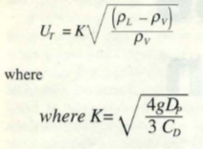
Svercek
1. Calculate the vapor volumetric flow rate , QV in m3/s
2. Calculate the liquid volumetric flow rate , QL in m3/min
3. Calculate the vertical terminal vapor velocity , UT and set UV = 0.75 UT

Slide 12
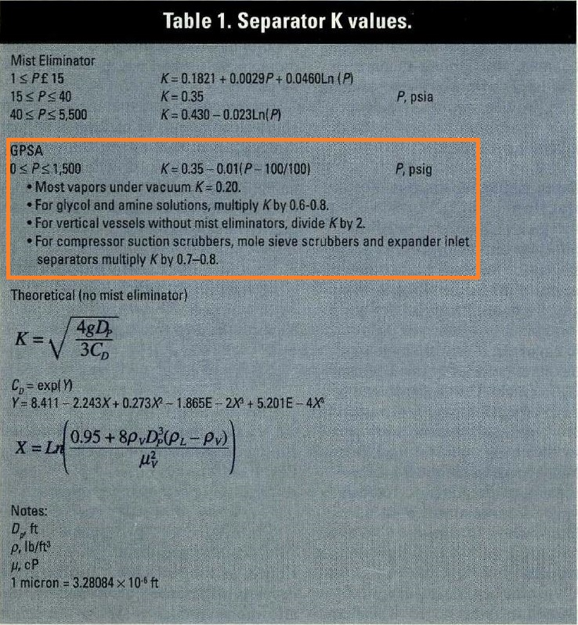

Slide 13
4. Select a hold-up time from next-page Table and calculate the hold-up volume, VH
5. Select a surge time from next-page Table and calculate the surge volume, VS
6. Estimate a L/D and initially calculate the diameter according to the following Equation:
7. Calculate the total cross sectional area.
8. Set HLLL and by using HLLL/D obtain ALLL/AT and calculate ALLL

Slide 14
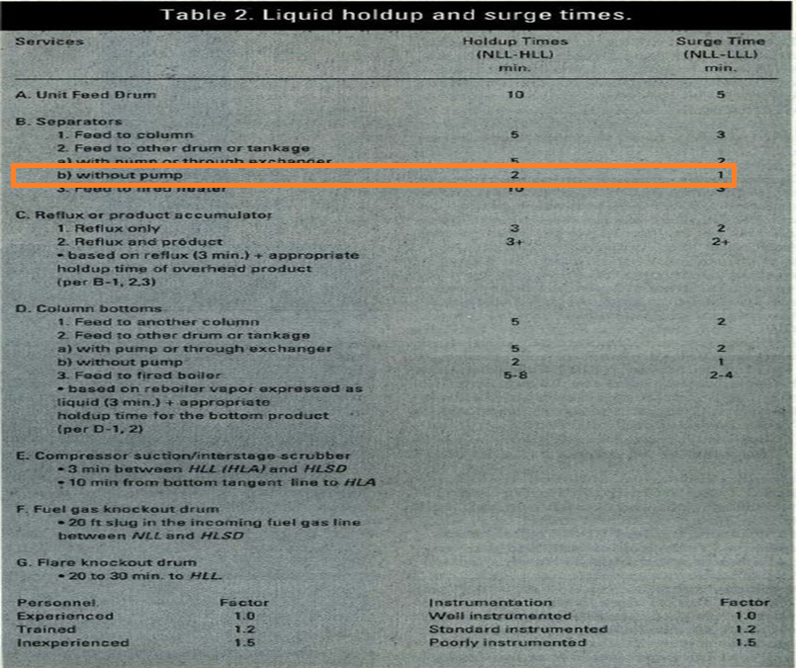

Slide 15
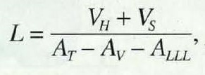
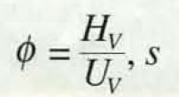
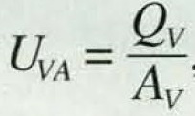
9. Set HV to 0.2D or 0.3048 m , whichever is greater; then by using HV/D, obtain AV/AT
10. Calculate the minimum length to accommodate the liquid hold-up/surge:
11. Calculate the liquid dropout time
12. Calculate the actual vapor velocity

Slide 16
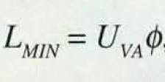
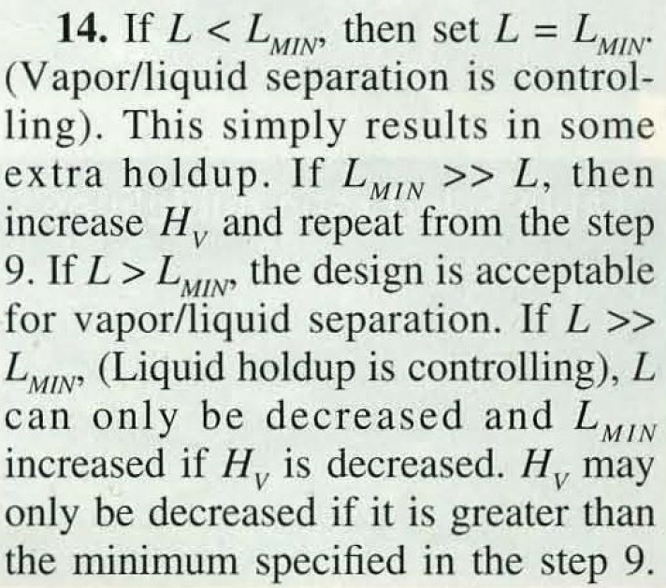
13. Calculate the minimum Length required for vapor-liquid disengagement, LMIN:

Slide 17
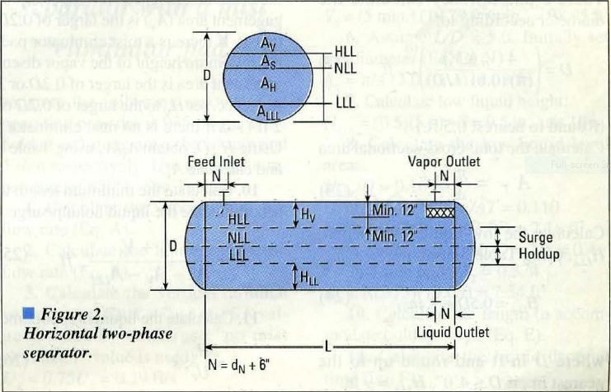

Slide 18
Steps
1 | QV = $\frac{6599}{5.69 ×3600}$ = 0.322 m3/s
2 | QL = $\frac{240105 }{781 × 60}$ = 5.12 m3/min
3 | UT $=0.05 \sqrt{\frac{781−5.69 }{5.69}}$ = 0.58 m/s UV = 0.75 $×0.58=0.43 m/s$
4,5 | VH = 2 $×5.12=10.24 m3$ VS = 1 $×5.12=5.12 m3$
6 | L/D = 3 D${\text{=}(\frac{4 ×(10.24+5.12 )}{π ×0.6 ×3}\text{)}}^{\frac{1}{3}}$ = 2.21 m

Slide 19
Steps
7 | AT = $\frac{ π}{4}$ $×2.215 ×2.215$= 3.85 m2
8 | HLLL = $0.725$ m HLLL /D = 0.327 $Θ$ = 2$×$ACOS(1-2$×$0.327) = 2.43 ALLL/AT = (2.43-SIN(2.43))/2/$π$ = 0.284 ALLL = 0.28 $×3.85=1.09 m2$
9 | HV = $0.2×2.215=0.443$ m more than 0.3048 m HV /D = 0.2 $Θ$ = 2$×$ACOS(1-2$×$0.2) = 1.85 AV/AT = (1.85-SIN(1.85))/2/$π$ = 0.14 AV = 0.14 $×3.85=0.54 m2$

Slide 20
Steps
10 | L = $\frac{10.24+5.12}{3.85−1.09−0.54}$ = 6.95 m
11 | $φ$ = $\frac{0.44 }{0.43}$ = 1.01
12 | UVA = $\frac{0.32}{0.54}=0.58 m/s$
13 | LMIN = 1.01 $×0.58=0.59$

Slide 21
Step 14 : It is clear that L >> LMIN so Hv is reduced to minimum specified which is 0.3048 m and
in doing so, the vessel length reduces from 6.95 m to 6.3 m . The final results are provided
below:
Parameter | Svercek | Licensor
D | 2215 mm | 2125 mm
L | 6300 mm | 6450 mm

Slide 22
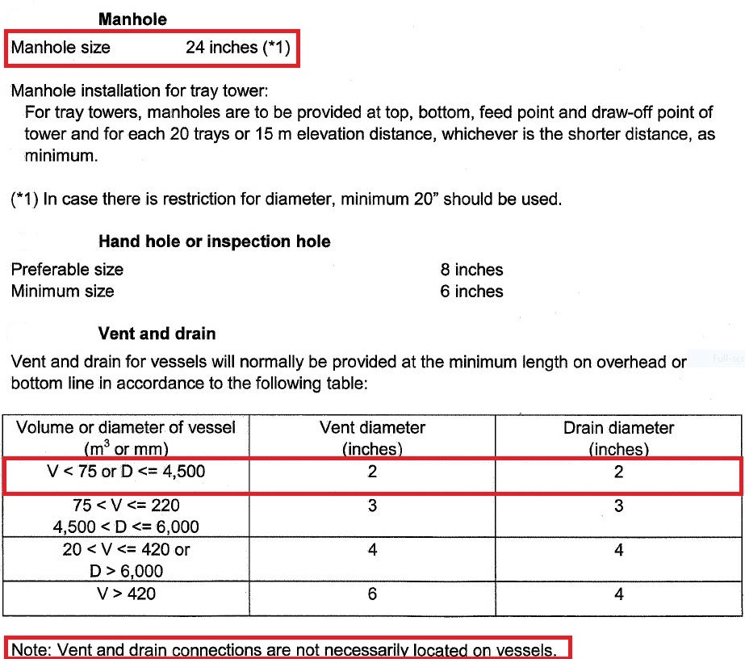
Licensor Criteria

Slide 23
Comparison
The size of manhole for licensor is 24’.
There is no need to have Vent on this drum since there is a control valve to flare system and if
purging is required then by use of these means the task could be performed.
The drain valve sized by licensor is 2’.
Parameter | Licensor
Manhole | 24
Vent | Not required
Drain | 2
Vortex Breaker | Yes

