Slide 1
Vertical Vessel
With Mesh Mist Eliminator
D-2005
Design and Principles

Slide 2
Operating Parameters
Description
The objective of this vessel is to separate liquid particle from the gas . The vessel is located after
Heat exchanger to separate condensate produced from gas stream.

Slide 3
Design Procedure
1. Select proper Orientation
2. Select and Size proper Inlet Device, Inlet and Outlet ID
3.Calculate Vessel Diameter
4. Calculate Vessel Height
5.Select and Size Manholes, Vent, Drain, Vortex Breaker
6. Select a well-designed mist eliminator pad

Slide 4
1st Step: Select proper orientation
Since the application is gas dominant a vertical vessel is selected .
Since no downstream requirement is emphasized no de-mister pad is needed

Slide 5
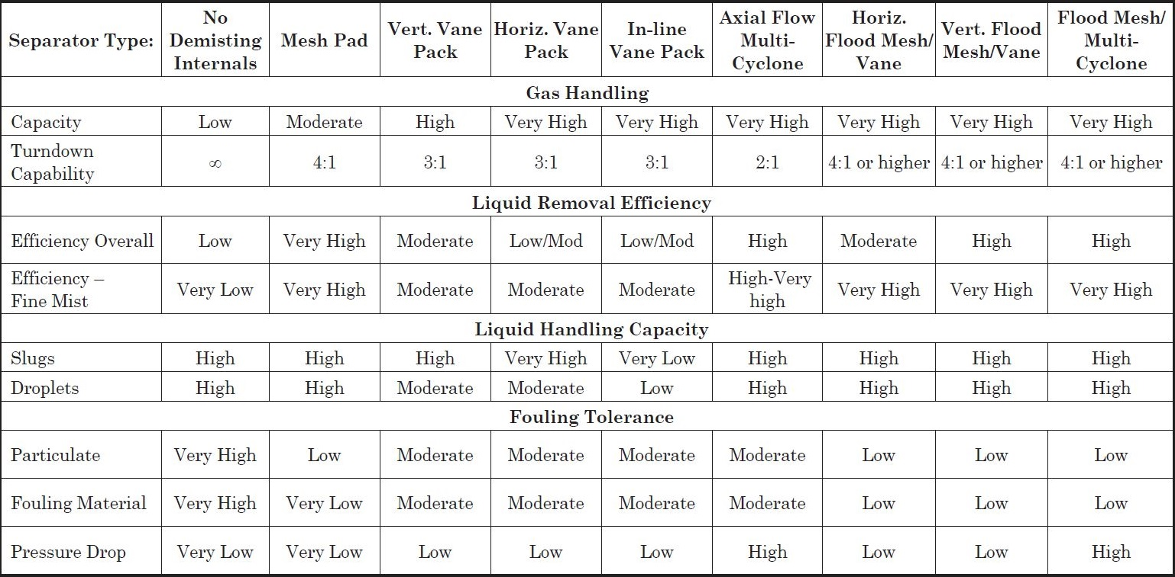

Slide 6
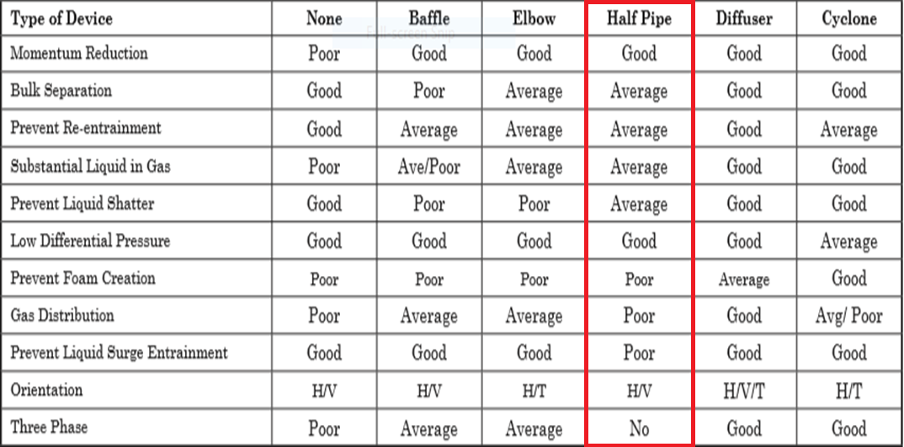
2nd Step: Select and Size proper Inlet Device
Half Pipe has proven itself to be not only effective in large capacities but cost-effective as well and in
many application is preferred to Diffuser whose performance is superior but too costly.

Slide 7
It is also necessary to maintain the inlet velocity head, J, within proper limits for the selected inlet
device to insure good gas distribution and minimum liquid shattering.
Where,
J = (ρV²) .
The maximum mixed phase velocity head range used in the industry guidelines varies for the different
inlet devices. Some typical maximums are:
•6000-9000 max. typ, up to 15 000 max kg/m s2 for diffuser distributor
•975-2250 max kg/m.s2 for no inlet distributor
•1500-3750 max kg/m.s2 for inlet half pipe or elbow distributor
•1500-3750 max kg/m.s2 for v-baffle or other simple inlet diverter designs
In addition, some users limit the inlet vapor phase velocity to 9 m/s or 18 m/s. The velocity should
always be below the erosion velocity for the service.

Slide 8
In order to calculate head velocity , at first, we need to perform the followings:
1. Estimation of inlet nozzle ID; Consider inlet pipe ID near the vessel as first and best estimation.
2. Calculate ρmixture and subsequently Vmixture
3. Calculate J by multiplying ρmixture $×$ (Vmixture)^2 and compare it with the last-page criterion.
So, both 34 and 36 inch are accepted but it is recommended that inlet piping diameter match the
velocity requirement of the inlet to the separator 10 pipe diameters upstream of the separator to
provide a flow regime which is fully developed before entering the separator. Thus, 34 inch is accepted.
Parameter | Value | Value | Unit
Estimated ID | 34 | 36 | inch
Nozzle Area | 0.58 | 0.65 | m2
ρmixture | 11.64 | 11.64 | kg/m3
Vmixture | 17.95 | 16 | m/s
J | 3750 | 2983 | kg/m.s2
Criterion | 3750 | 3750 | kg/m.s2

Slide 9
Vapor Outlet Section
The sizing of the vapor outlet nozzle should be such that given the above placement of the mesh pad,
the velocity is not high enough to cause channeling of the gas through the mesh pad. The nozzle outlet
size is typically based on the lesser of that required for piping pressure drop, or a maximum velocity
head criteria. Typical ranges for the maximum velocity head allowed for the vapor outlet are 4500–
5400 kg/m • s2. In addition some users limit the absolute velocity to 18 m/s. The pipe size can be
decreased to the appropriate size based on pressure drop considerations, 5-10 pipe diameters
downstream of the separator, as required.
Parameter | Value | Value | Value | Unit
Estimated ID | 28 | 30 | 34 | inch
Area | 0.39 | 0.45 | 0.585 | m2
Vg | 26.4 | 23 | 18 | m/s
ρVg2 | 6470 | 4909 | 2975 | Kg/m.s2
Criterion | 5400 | 5400 | 5400 | Kg/m.s2

Slide 10
Liquid Outlet Nozzle
Many users limit the liquid outlet nozzle velocity based on pump suction line criteria
It sounds between 6 and 8 inch only 8 inch is acceptable. The licensor has chosen 8 inch as the
Outlet pipe size for liquid to pump suction. When performing velocity calculation for 6 inch max
velocity exceeds 1.2 m/s which is set for 6inch.
Parameter | Value | Value | Unit
Estimated ID | 6 | 8 | inch
Area | 0.018 | 0.032 | m2
Vl | 1.47 | 0.83 | m/s
Criterion | Max 1.5 | Max 1.5 | m/s

Slide 11
3rd Step: Calculate Vessel Diameter
Each and every licensor and company has developed a design basis procedure for sizing vessels. In this
Article , a GPSA-based method, Foster-Wheeler-based method and the Licensor method will be
explored.

Slide 12
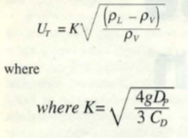
GPSA
1. Use the following equation and next-page K-values to calculate terminal velocity

Slide 13
According to GPSA , thanks to the fact that a vertical vessel without demister pad has
been chosen, a K value of 0.046 is selected.
Parameter | Value | Unit
ρl | 928 | kg/m3
ρv | 9.29 | kg/m3
Kselected | 0.046
Ug | 0.45 | m/s
Qg | 10.48 | m3/s
ID | 5400 | mm
Required-ID | 5400 | mm
Selected-ID | 5400 | mm

Slide 14
Notes
For ID calculation , the following equation has been utilized.
The selected ID is not in harmony with the Licensor selected ID, which is 3350 mm.
The higher ID value calculated by GPSA results in lower Height value for the vary separator.

Slide 15
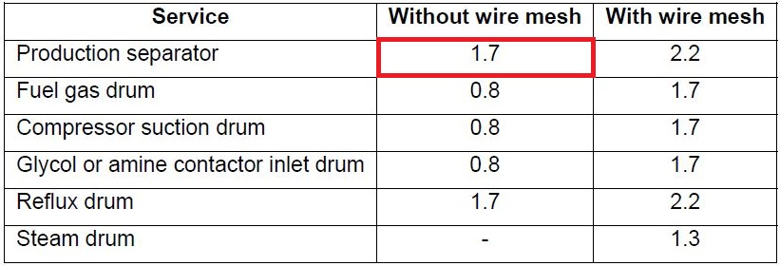
Foster-Wheeler
The basis of sizing is the critical velocity Vc (m/s)
The maximum gas velocity is K$×$Vc
K is a coefficient depending on the service, and the use or the absence of wire mesh.
Recommended K values are given hereafter for different services.
If a vane pack internal is used, the recommended K value is 3.3.

Slide 16
Parameter | Value | Unit
ρl | 928 | kg/m3
ρv | 9.29 | kg/m3
Kselected | 1.7
Vc | 0.47 | m/s
Vmax | 0.81
Qg | 10.48 | m3/s
ID | 4056 | mm
Required-ID | 4056 | mm
Selected-ID | 4000 | mm

Slide 17
Svercheck-Method
1. Use the following equation and next-page K-values to calculate terminal velocity

Slide 18
Notes
For ID calculation , the following equation has been utilized.
Uv = 0.75 UT

Slide 19
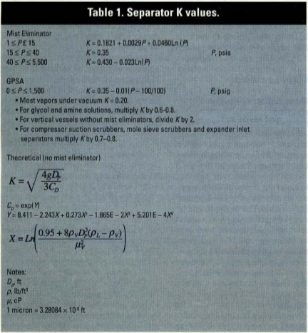
Svercheck Method-K value
K = 0.35 – 0.01 (364.5-100/100) = 0.3235
For vertical vessel without mist eliminator
Kselected = 0.32/2 = 0.16

Slide 20
Parameter | Value | Unit
ρl | 928 | kg/m3
ρv | 9.29 | kg/m3
Kselected | 0.16
Ug | 1.59 | m/s
Uv | 1.19
Qg | 10.48 | m3/s
ID | 3345 | mm
Required-ID | 3345 | mm
Selected-ID | 3350 | mm

Slide 21
Explanation , Comparison and Discussion
Different criteria have been used to size the vary separator and the difference in diameter results stem
From the selected K that each licensor or criterion has set based on their experience. The following
table provides the K value and diameter calculated.
Method | GPSA | FW | Svercheck | Licensor
K-Value | 0.046 | 0.0816 | 0.12 | 0.12
Diameter | 5400 | 4000 | 3445 | 3445

Slide 22
4th Step: Height Calculation
Each and every licensor and company has developed a design basis procedure for sizing vessels. In this
Article , a GPSA-based method, Foster-Wheeler-based method and the Licensor method will be
explored.

Slide 23
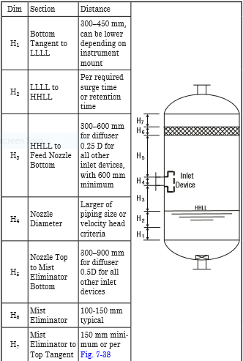
GPSA

Slide 24
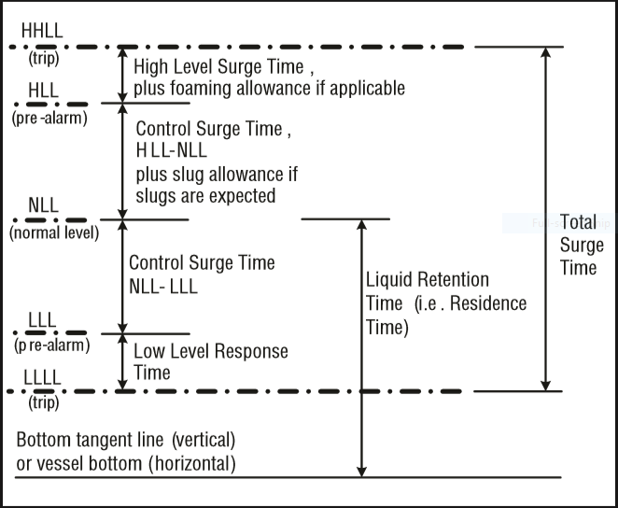
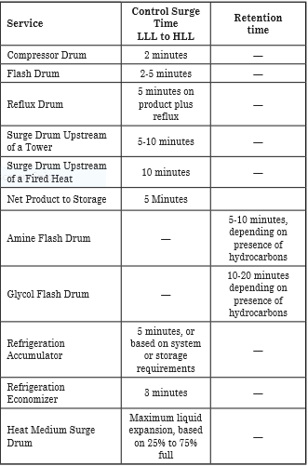
Retention/Surge Time

Slide 25
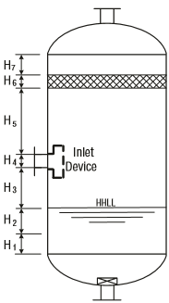
Height Elements | GPSA | LICENSOR | Unit
H1 | 450 | 500 | mm
H2 | 350 | 775 | mm
H3 | 1350 | 594 | mm
H4 | 865 | 865 | mm
H5 | 2700 | 2095 | mm
H6 | - | - | mm
H7 | - | - | mm
HT | 5715 | 4825 | mm

Slide 26
Calculation, Explanation, and Discussion
H1 mostly depends on instrument mount position and the number of instrument devices used . The
Licensor for most of his vertical vessel has selected 500 mm in accord with his FCS and ESD Control
System, whereas in GPSA 450 mm is selected as the basis.
H2 is a function of retention time . It seems from the back-calculation that the licensor has selected 5
minutes for retention time . Likewise, in GPSA a retention time of 2-5 minutes has been selected for
Flash drums. The licensor general retention time table is given in next-page
H3 in GPSA for Half Open pipes is 0.25D and has been the basis for calculation.
H4 is the size of inlet Half Open pipe which is the same size of upstream pipe for both licensor and
GPSA.
H5 in GPSA for Half Open pipes is 0. 5D and has been the basis for calculation.
H6 is the demister pad thickness which is 150 mm for both licensor and GPSA.
H7 in GPSA is minimum 150 mm but in other sketch in GPSA there is a formula for X4 which connects
the upper part of demister pad to outlet nozzle which can not be used for comparison here.

Slide 27
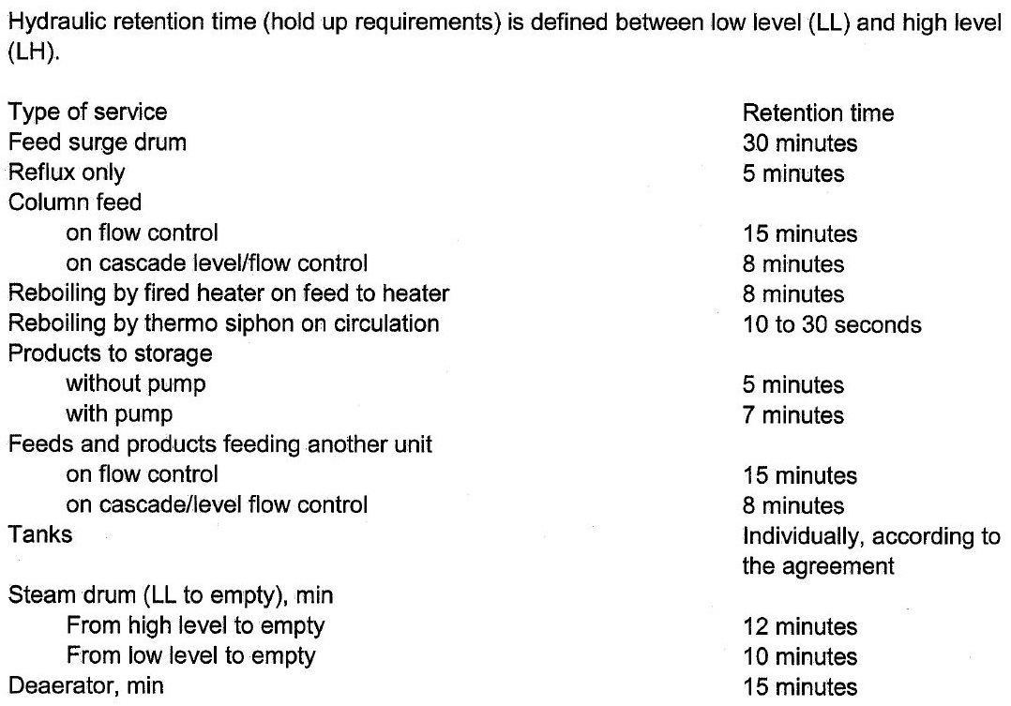
Retention Time provided by the licensor

Slide 29
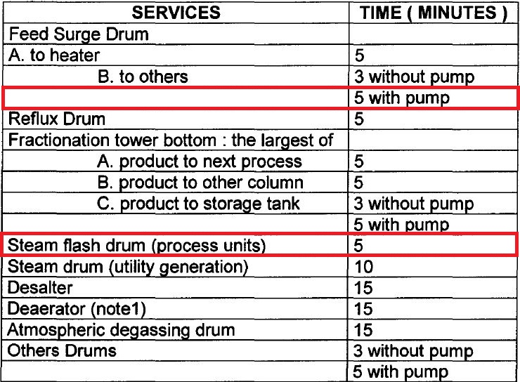
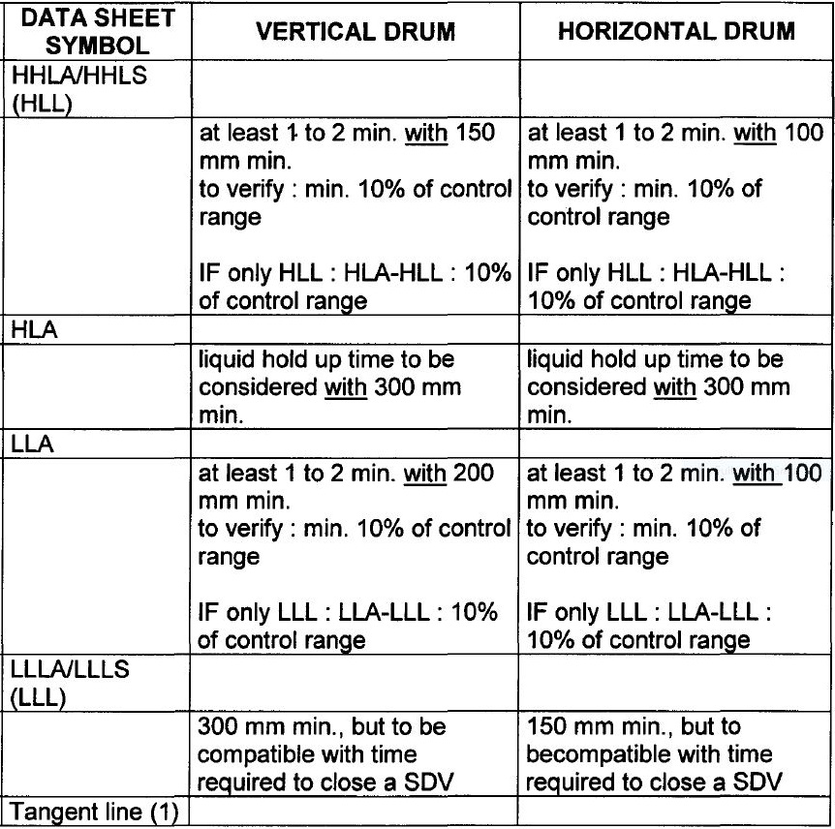
Foster-Wheeler

Slide 30
Height Elements | FW | LICENSOR | Unit
H1 | 300 | 500 | mm
H2 | 625 | 775 | mm
H3 | - | 594 | mm
H4 | 865 | 865 | mm
H5 | - | 2095 | mm
H6 | - | - | mm
H7 | - | - | mm
HT | - | 4825 | mm

Slide 31
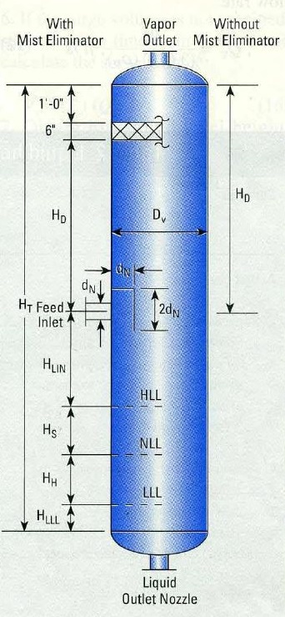
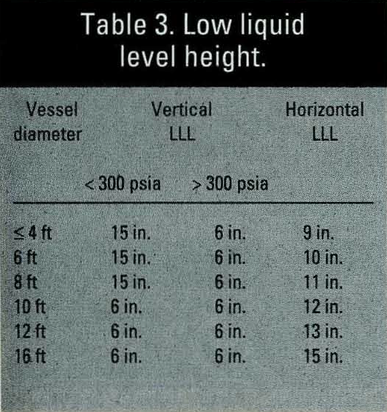
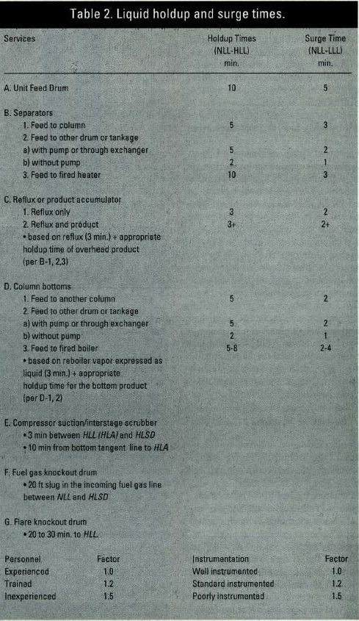
Svercek Method

Slide 32
Height Elements | Svercek | LICENSOR | Unit
HLLL | 180 |  | mm
HH | 370 |  | mm
Hs | 920 |  | mm
HLIN | 740 |  | mm
HD | 1675 |  | mm
H6 | - |  | mm
H7 | - |  | mm
HT | 3885 | 4825 | mm

Slide 33
Method | GPSA | FW | Svercek | Licensor
Height | 5715 |  | 3815 | 4825
Diameter | 5400 | 4000 | 3445 | 3445
Volume

Slide 34
Manholes
Foster-Wheeler
Size of manholes
For vessel diameter < 1000 mm
Flanged vessel shall be considered if equipment contains internals
Otherwise, size of manholes = 18”
For vessel diameter ≥ 1000 mm
Toxic service size of manholes = 24”
Non-toxic service size of manholes = 20”
(or up to 24” if internals need to be removable through
manhole.)

Slide 35
Drain and Vents
The drain of the vessel shall always be at the lowest point of a vessel. For vertical vessels they
shall be connected to the bottom outlet line at the low point. For horizontal vessels the drain point
shall be directly on the bottom of the drum at the lowest point ensured through vessel slope (1:100).

Slide 36
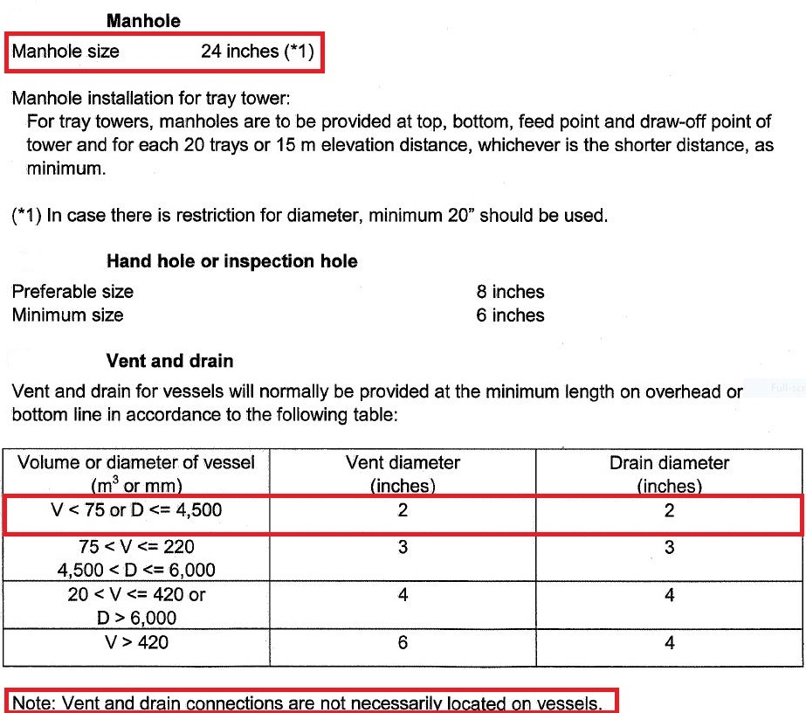
Licensor Criteria

Slide 37
Comparison
The size of manhole for both licensor and FW is 24’.
There is no need to have Vent on this drum since there is a control valve to flare system and if
purging is required then by use of these means the task could be performed.
The drain valve sized by licensor is 2’ and but by Foster-Wheeler is 3’
Parameter | FW | Licensor
Manhole | 20-24 | 24
Vent | 2 | 2
Drain | 3 | 2
Vortex Breaker | Yes | Yes

