Slide 1
A Stepwise
E-7001 thermal Design
by HTRI
In 5 minutes!!

Slide 2
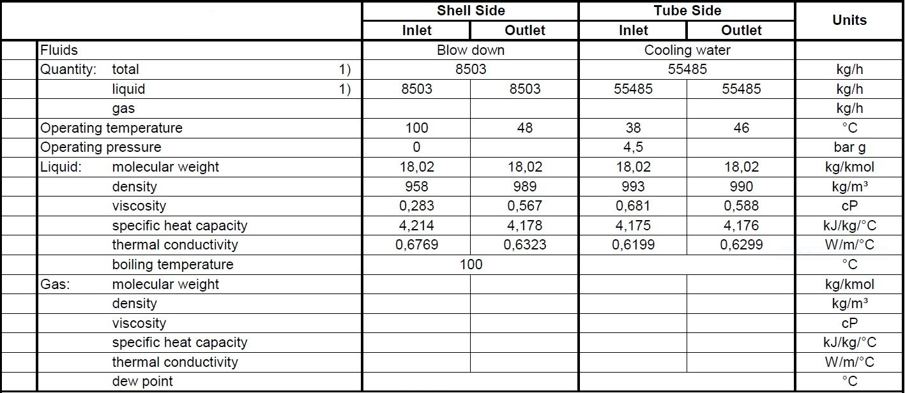
Process data

Slide 3
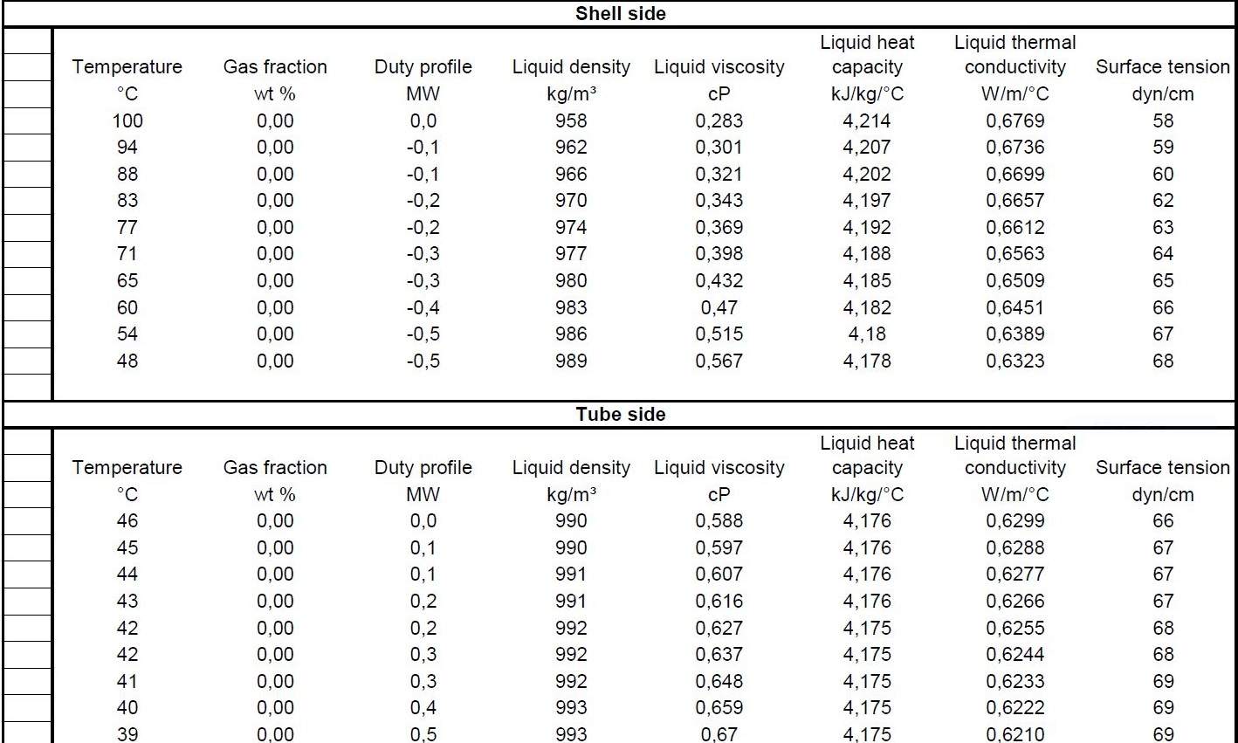
Heating and Cooling Table

Slide 4
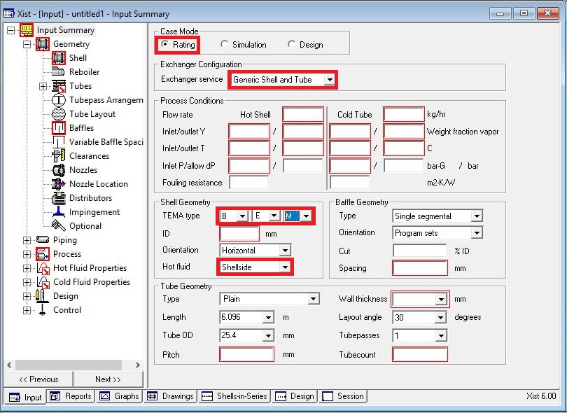
Open HTRI and Input Summery sheet and enter data in red areas

Slide 6
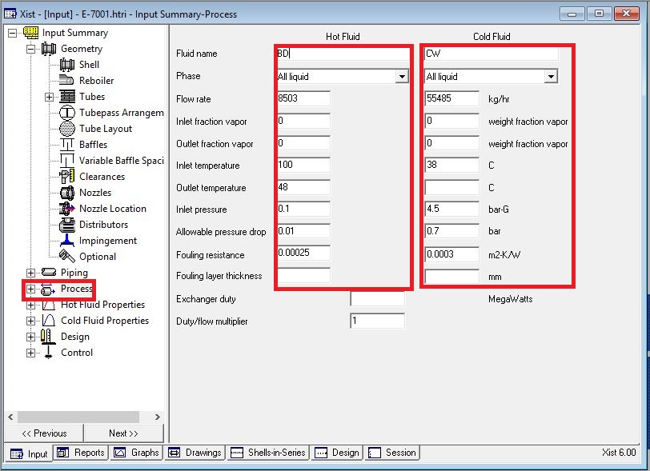
Enter operating data in process sheet in red areas

Slide 7
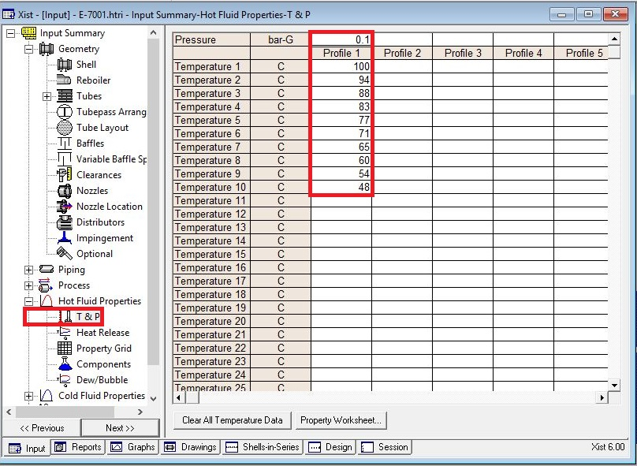
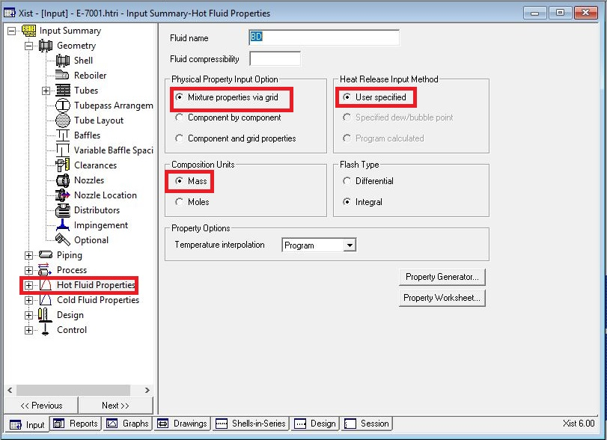
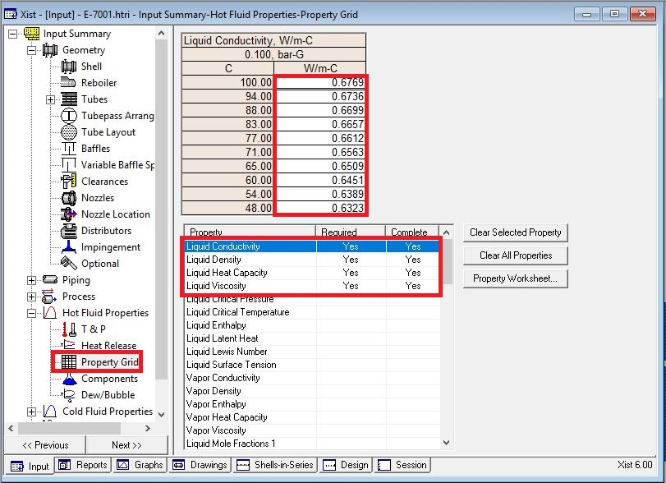
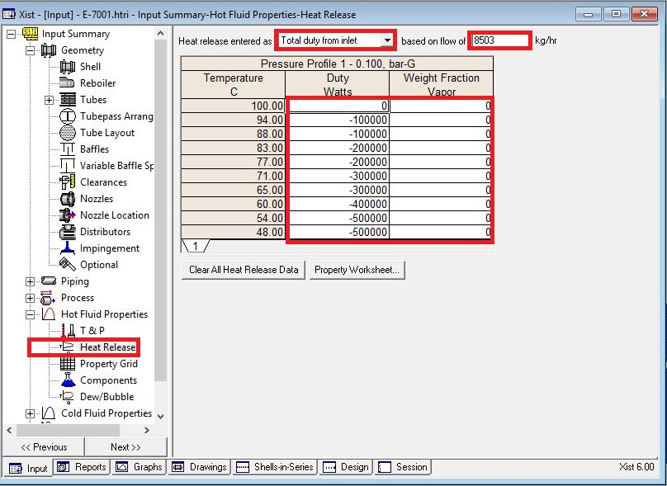
Enter heating and cooling table data in hot and cold fluid properties in red areas

Slide 8
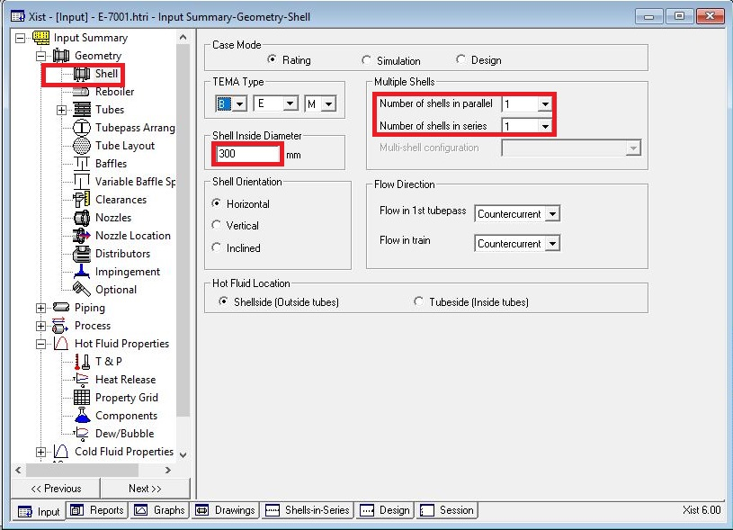
Put shell info in shell sheet in red areas
Note :
1. Initially estimate shell ID between 1.5-3 times tube-side pipeline ID, here it is 4 inch so first estimation would be 300mm

Slide 9
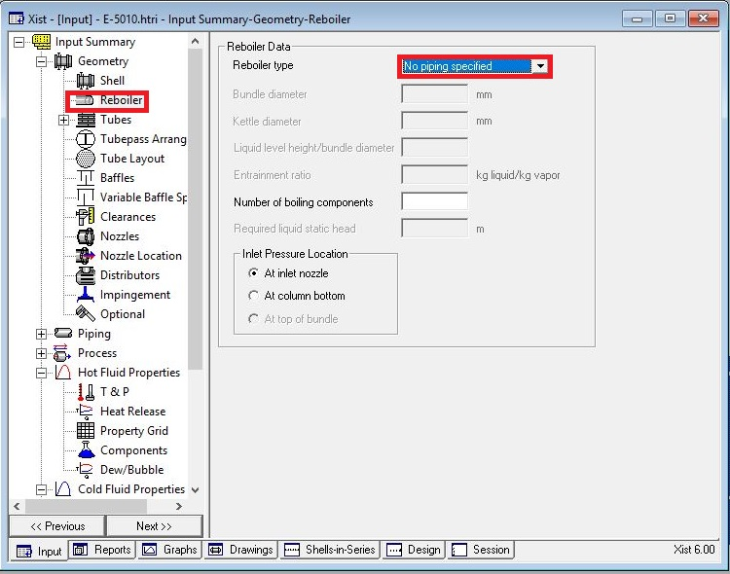
In Reboiler Sheet do not enter an input

Slide 10
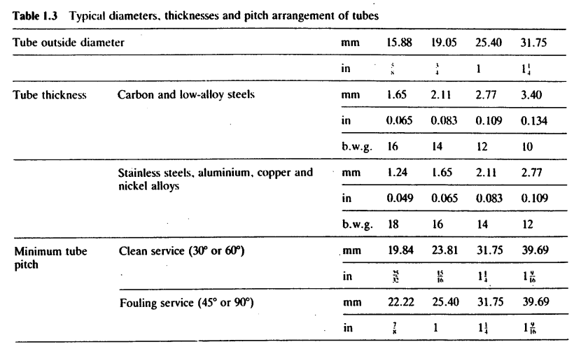
Put Tube mechanical data
Since it is water, due to velocity criteria , 19.05 is selected and since it is the water without CO2,CS is
selected.
According to table below tube thickness of 2.11 is chosen.

Slide 11
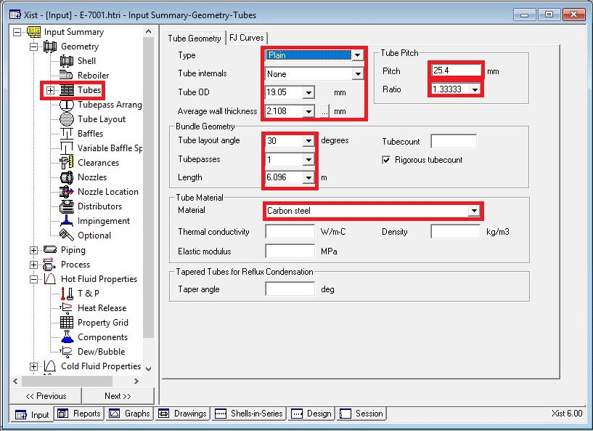

Slide 12
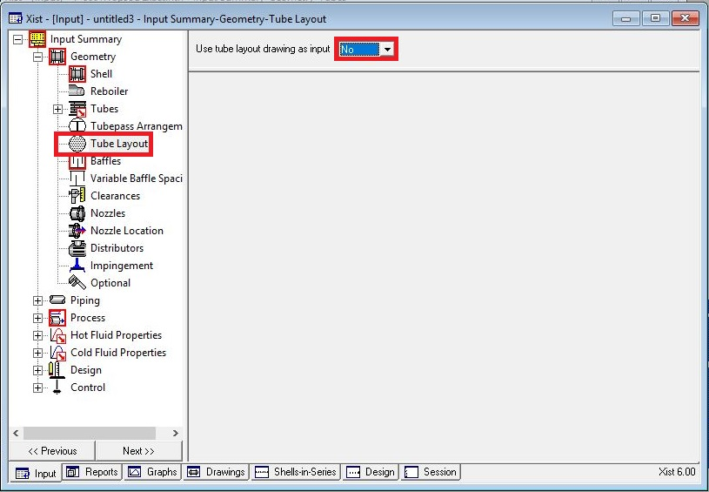
Act like below

Slide 13
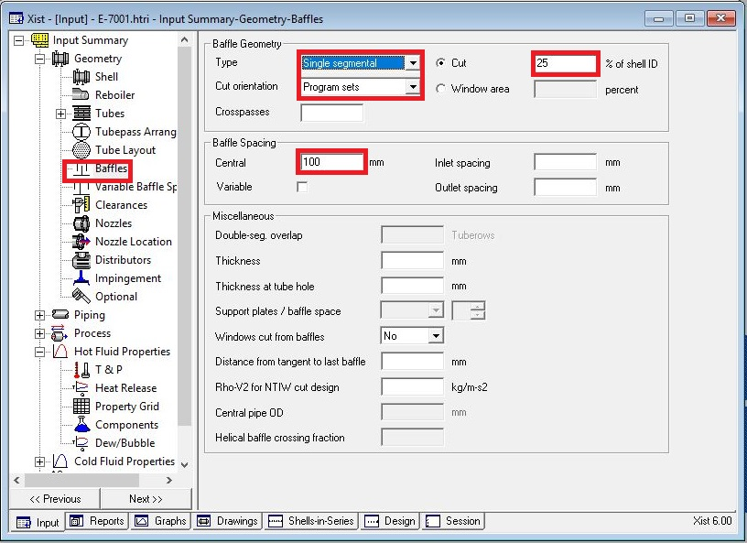
Put baffle info in baffle sheet in red areas like below

Slide 14
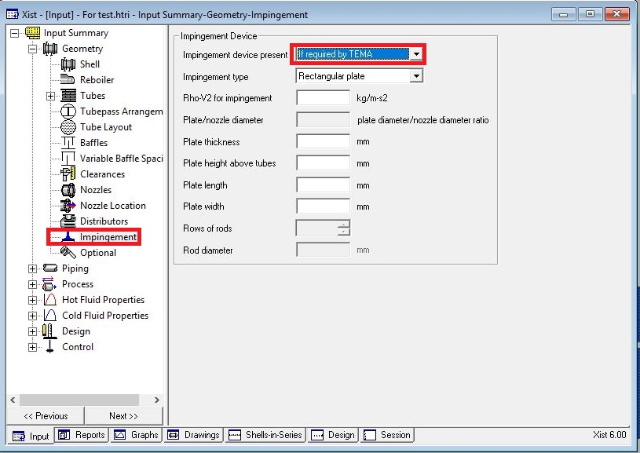
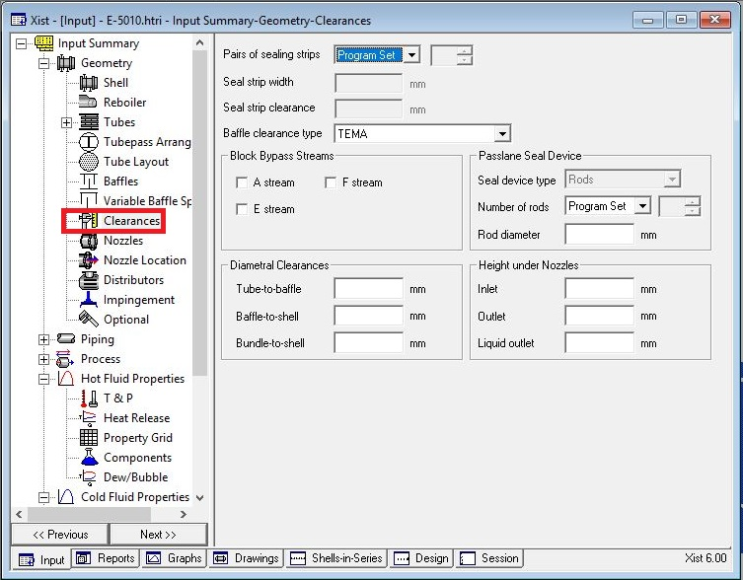
Act exactly like below for impingement sheet and Clearance

Slide 15
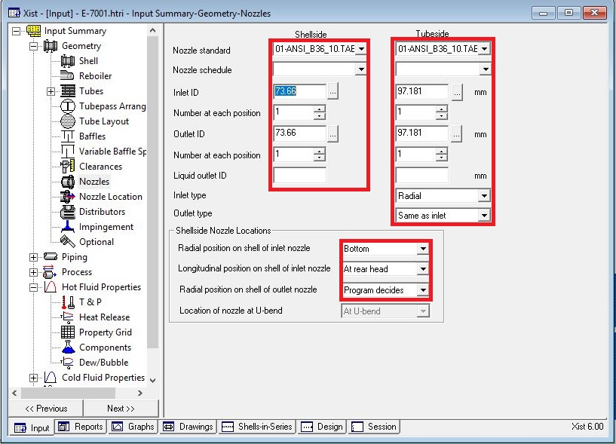
Enter nozzle info from piping info

Slide 16
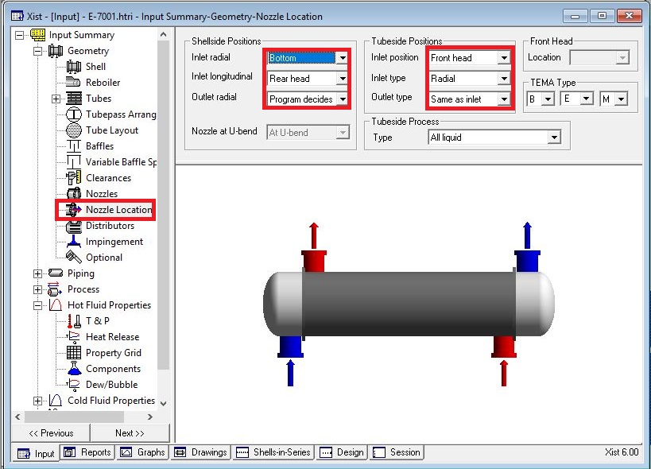
Set nozzle location

Slide 17
Results:
1.Now run it and the result is that the overdesign factor is about 9% and the dp in shell side is about 0.06
barg which is more than 0.01 barg. In PID and the relevant document it is set to zero but practically for
first scenario it is not a criterion.
2. Activate the tube-layout option and run it again. The overdesign factor reduces to 7.5%.
3. Since water velocity is less than 1 m/s so some tubes are omitted to increase water velocity in other
tubes and the reason it is done in this manner is that water velocity is about 0.92 m/s and it seems that
it could be easily increased . By doing so, the water velocity increases to 1.01 m/s but overdesign factor
reduces to 0%. So to compensate for the reduction in overdesign, tube length is increased from 6 to
6.7m and as a result, overdesign factor is increased to 9.5% and the dp is about 0.07 . In order to
increase B-stream baffle spacing was increased to 150 and 200 mm but in each trial the overdesign
factor was reduced to 7.5% and 5.5% respectively. The same was carried out for baffle cut and the same
happened. Thus, as an ultimate selection, a baffle spacing of 100 and a baffle cut of 25% were selected.

Slide 18
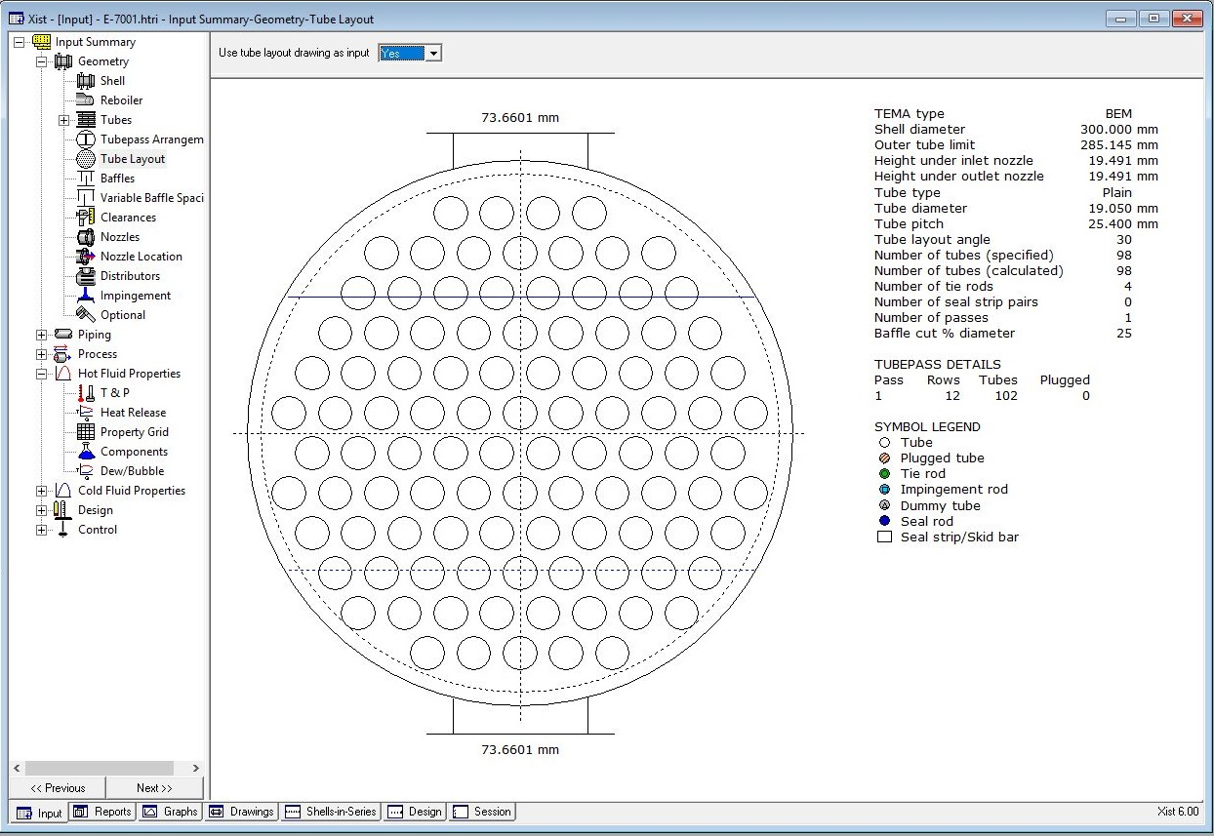
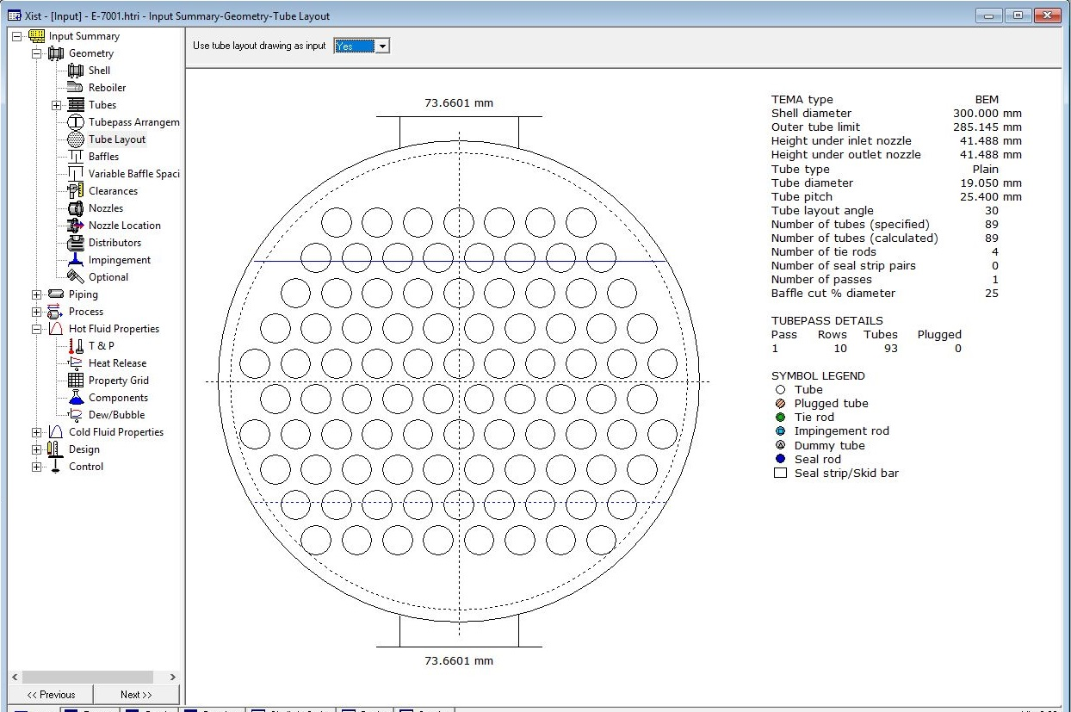
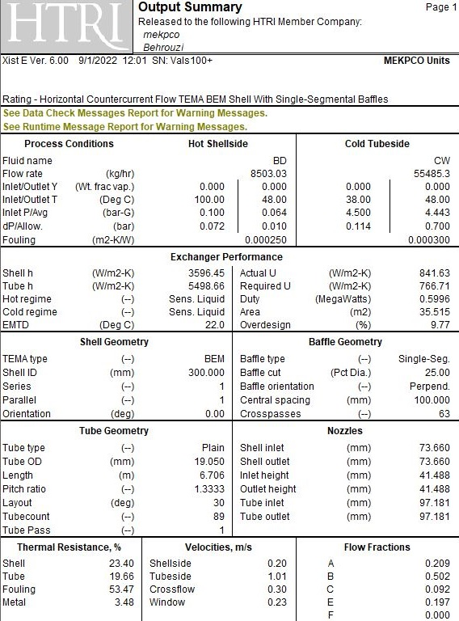
Final design // 1st scenario Before After Final results

Slide 19
Second scenario
1.Now run it and the result is that the overdesign factor is about 9% and the dp in shell side is about 0.06
barg which is more than 0.01 barg. In PID and the relevant document it is set to zero but practically for
first scenario it is not a criterion.
2. Activate the tube-layout option and run it again. The overdesign factor reduces to 7.5%.
3. Since water velocity is less than 1 m/s, tube pass is increased to double passes and the result is that the
overdesign factor is -24% and an internal temperature cross exist in the exchanger. So at first stream
direction is changed from countercurrent to concurrent to eliminate the warning regarding temperature
cross. By doing so, not only does the warning disappear, but also the overdesign factor increases to -15%
4. In order to increase overdesign factor , shell ID was increased to 350 mm and it resulted in 13.35%
overdesign factor and then baffle spacing was increased to 250 mm and the overdesign factor
became 10%.

Slide 20
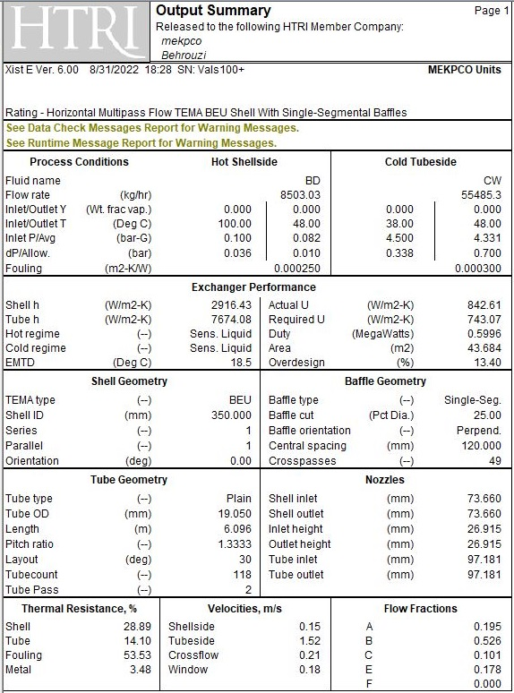

Slide 21
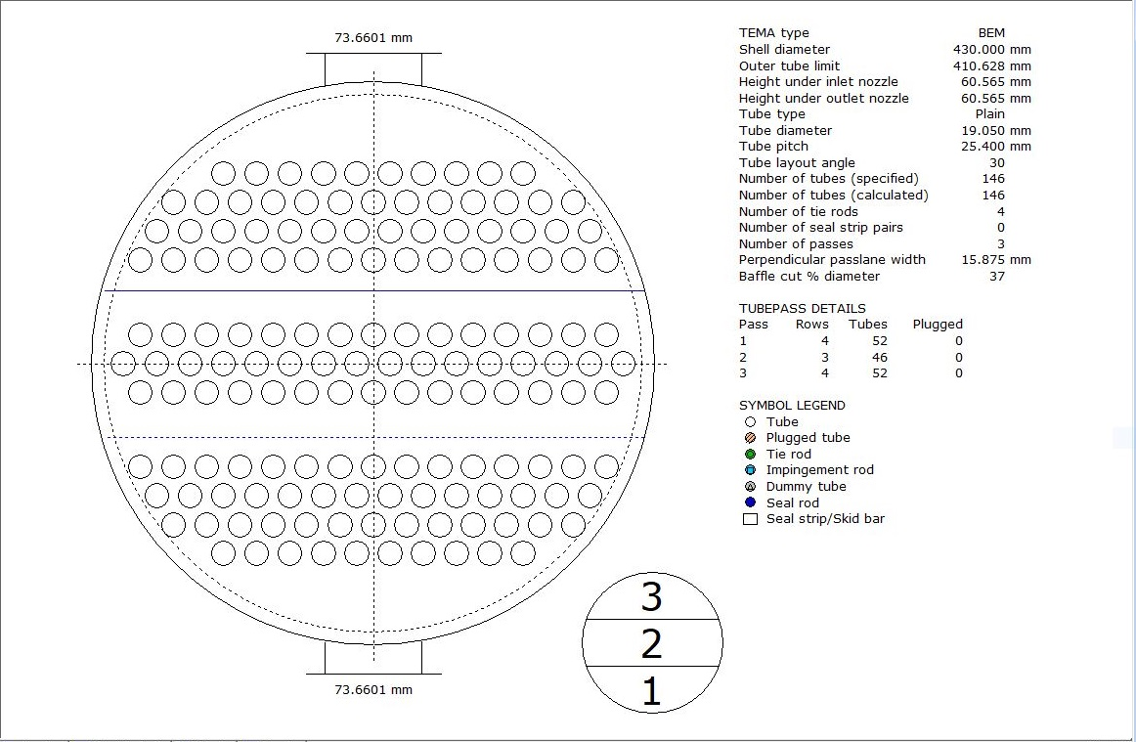
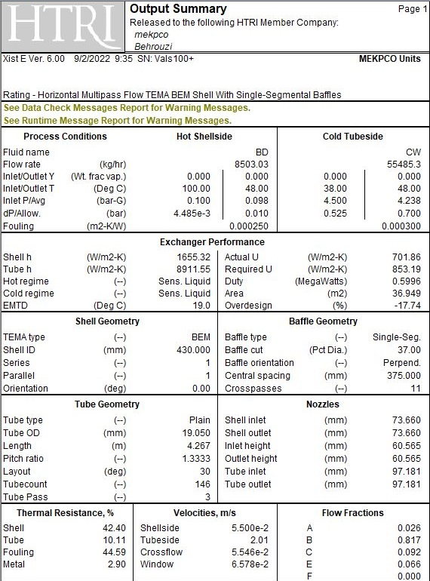
Third scenario
TOPSOE has selected a shell ID of 430 mm by doing so the overdesign factor by double pass resulted in
70% . Also in order to eliminate the warning of internal temperature cross the number of passes was
increased to 3 and as a result, the warning disappeared. In order to decrease the overdesign factor , a
number of tubes were removed and in addition to that , tube length were shortened to 4.225 m . The
overdesign factor for TOPSOE has become -17% with baffle spacing of 375 and baffle cut of 37%.

Slide 22
Comparison between different Design:
It seems that TOPSOE was more concerned about the length of the tube for this exchanger
Scenario | Overdesign | ID | Tube length | Tube number | Tube pass | Dp | U | Weight | Baffle spacing
1st | 9.77 | 300 | 6.7m | 89 | 1 | 0.07 | 861 | 1239 | 100
2nd | 9.62 | 350 | 5.9m | 118 | 2 | 0.03 | 840 | 1412 | 120
3rd | 9.5 | 430 | 4.7 | 178 | 3 | 0.01 | 750 | 1723 | 200
TOPSOE | -18% | 430 | 4.225m | 144 | 3 | 0.01 | 702 | 1478 | 325

Slide 23
Thanks for your attention
Educational Institute for Process and Equipment Design
Mohammadreza Behrouzi
+989107884134

