Slide 1
A Stepwise
Saturator thermal Design
by HTRI
In 5 minutes!!

Slide 2
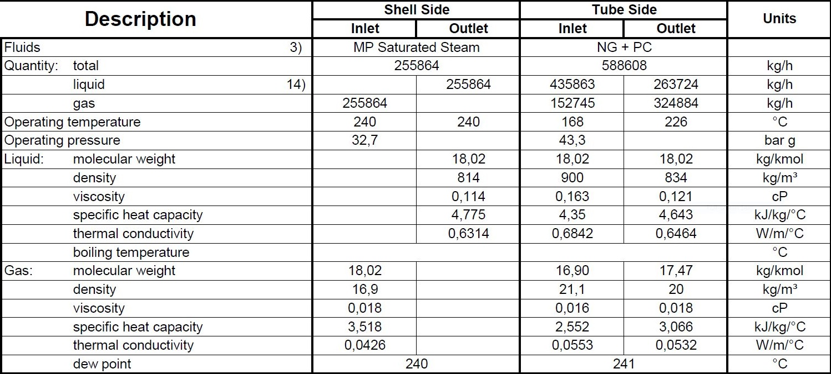
Process data

Slide 3
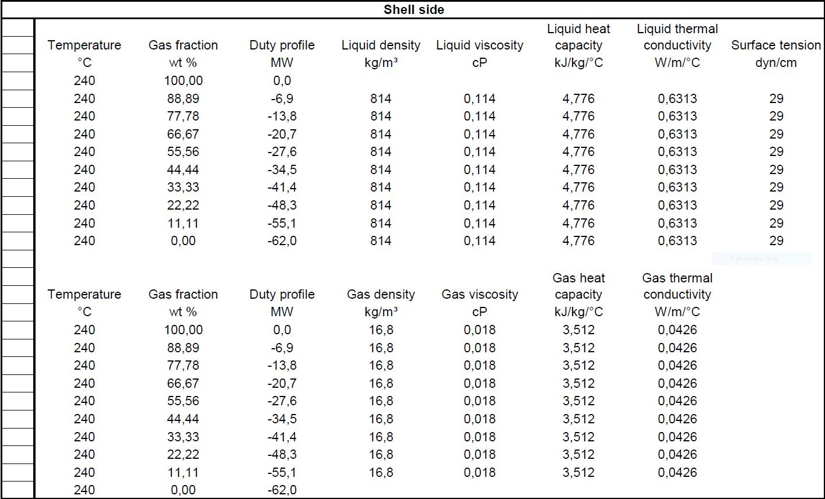
Heating and Cooling Table

Slide 4
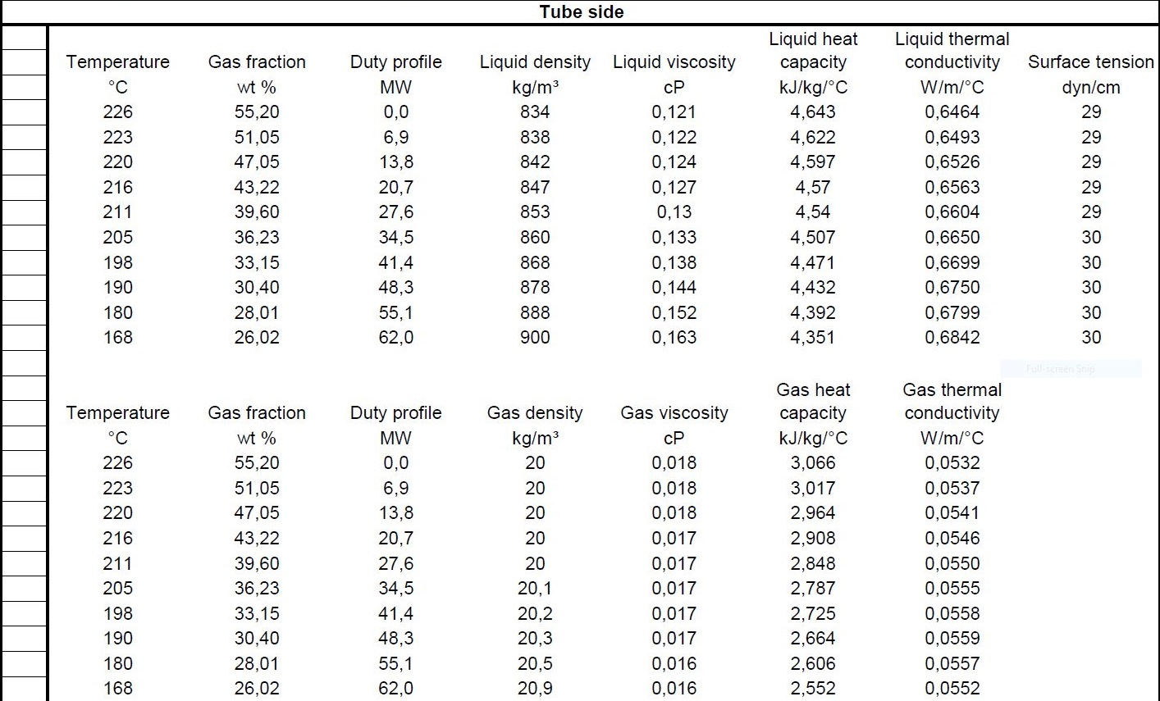

Slide 5
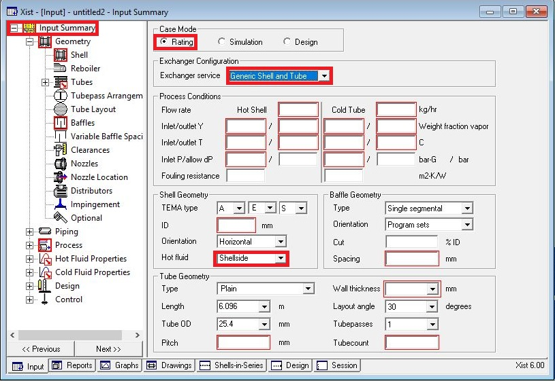
Open HTRI and Input Summery sheet and enter data in red areas

Slide 6
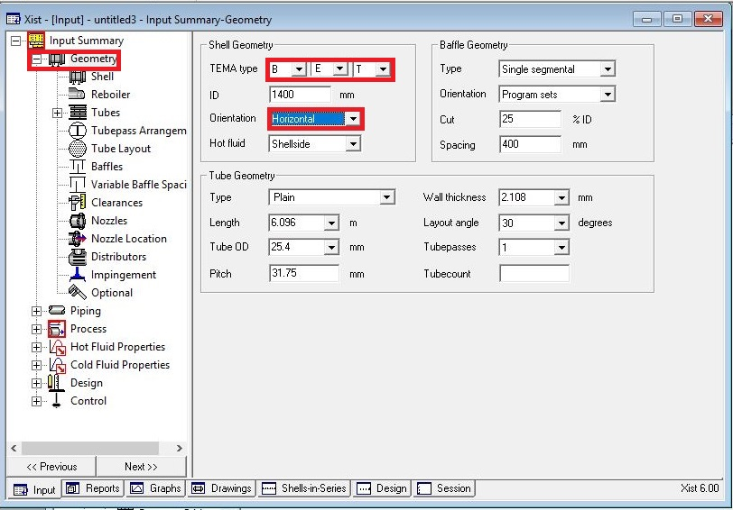

Slide 7
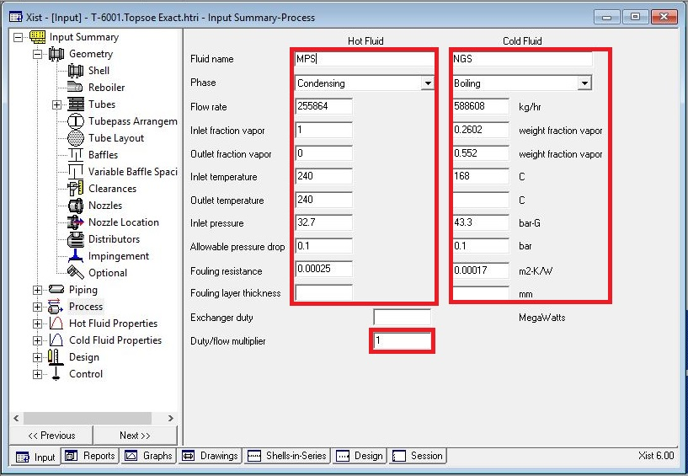
Enter operating data in process sheet in red areas

Slide 8
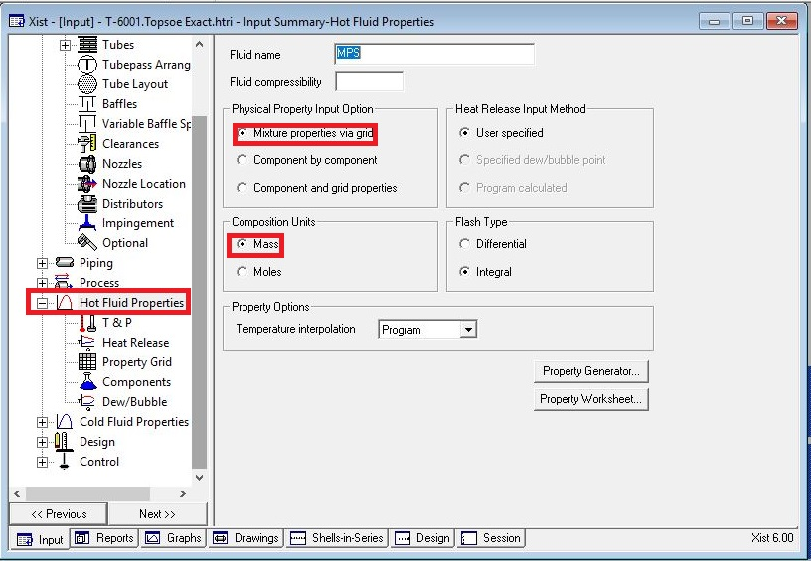
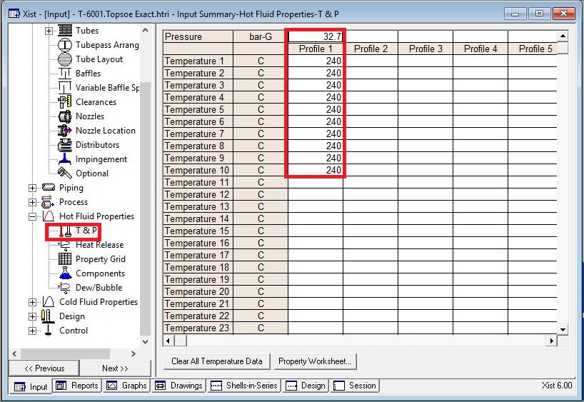
Enter heating and cooling table data in hot and cold fluid properties in red areas

Slide 9
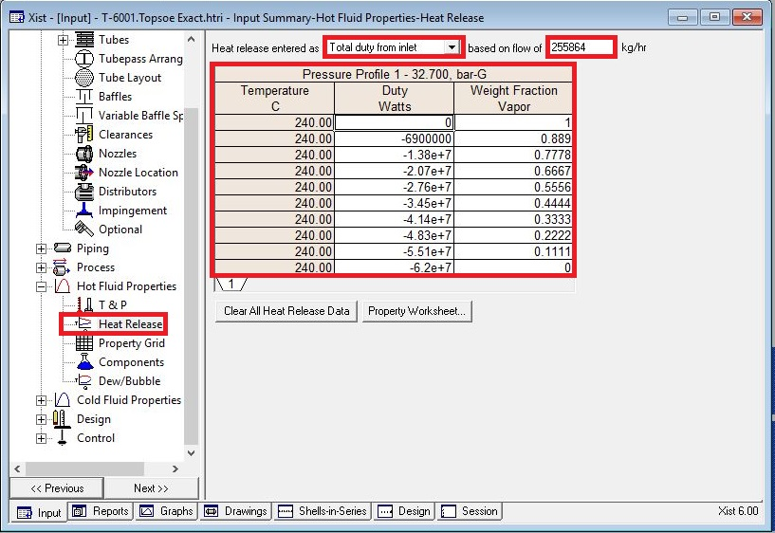

Slide 10
Put shell info in shell sheet in red areas
Note :
1. Initially estimate shell ID between 1.5-3 times tube-side pipeline ID, here it is 18 inch so first estimation would be 55 inch.
2. Because of its capacity two heat exchangers in parallel are selected.
3. Cocurrent direction is considered as flow direction since the orientation is vertical it is solely viable for
MPS to enter from top to be condensed at bottom and the same happens to water in tube to be
flowed because of gravity

Slide 11
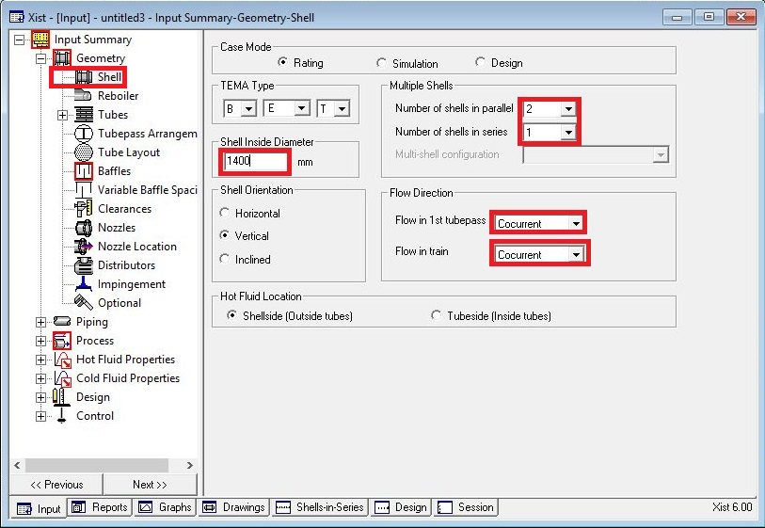

Slide 12
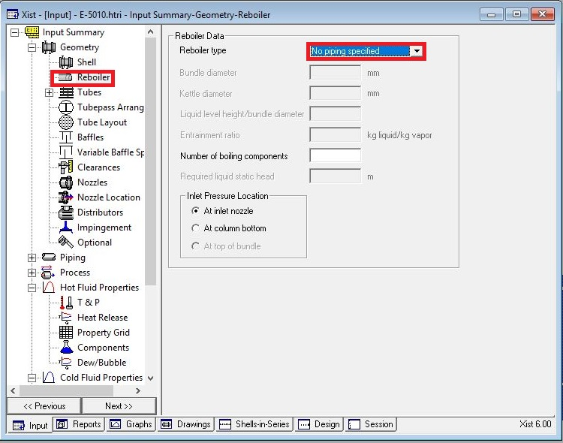
In Reboiler Sheet do not enter an input

Slide 13
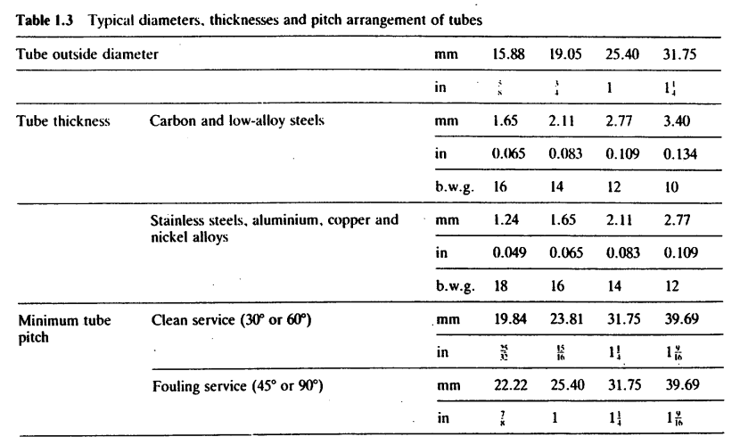
Put Tube mechanical data
Note that since mixing between water and natural gas is going to happen, tube with 25.4 OD is
selected
Since Tube material is SS due to presence of CO2, Tube thickness 2.11 is selected according to table
below
Select Pitch 31.7 to pass TEMA R.2.5

Slide 14
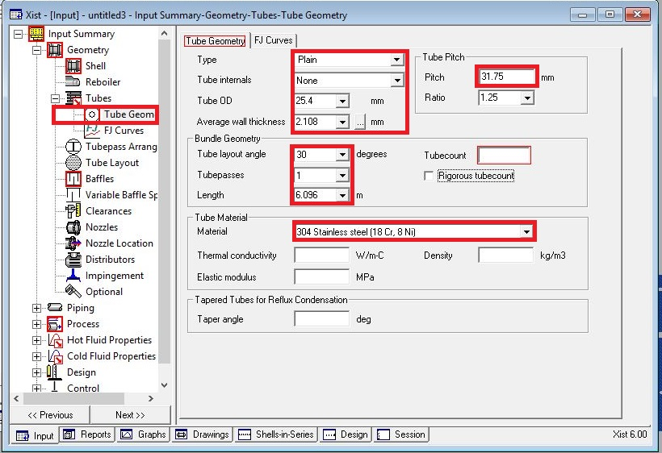

Slide 15
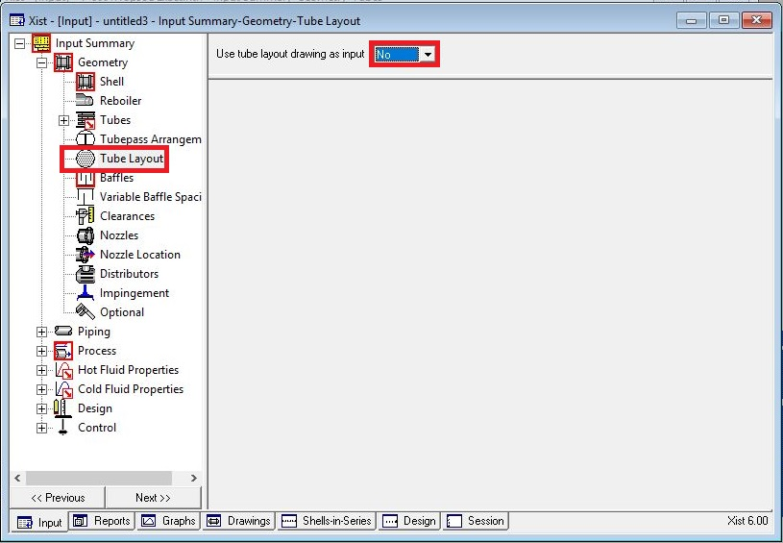
Act like below

Slide 16
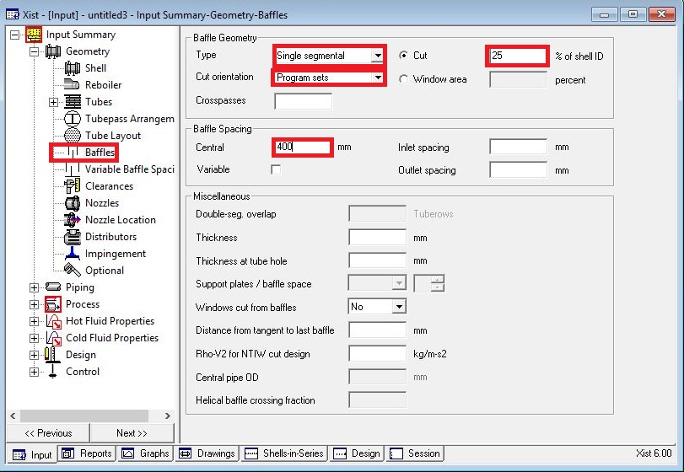
Put baffle info in baffle sheet in red areas like below

Slide 17
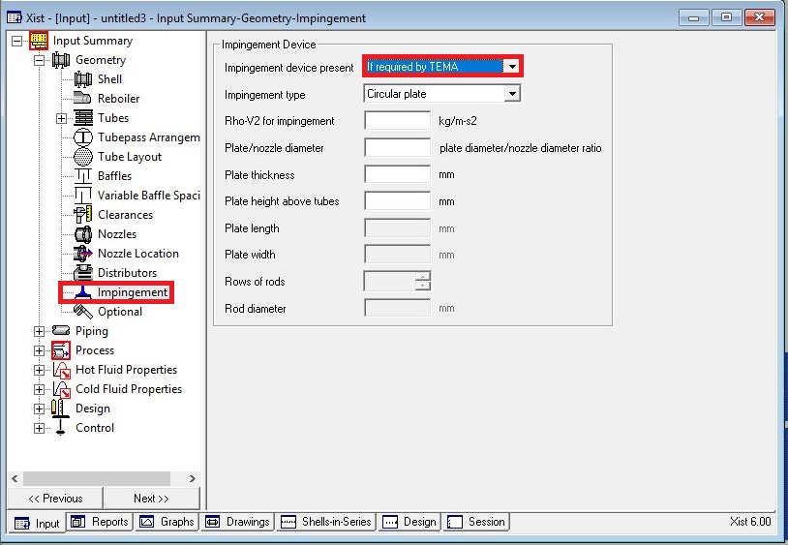
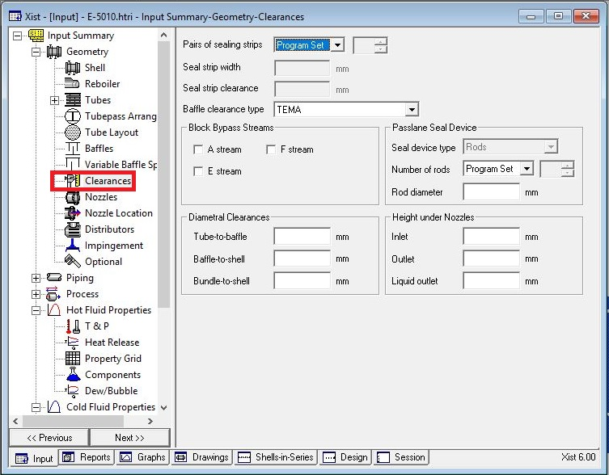
Act exactly like below for impingement sheet and Clearance

Slide 18
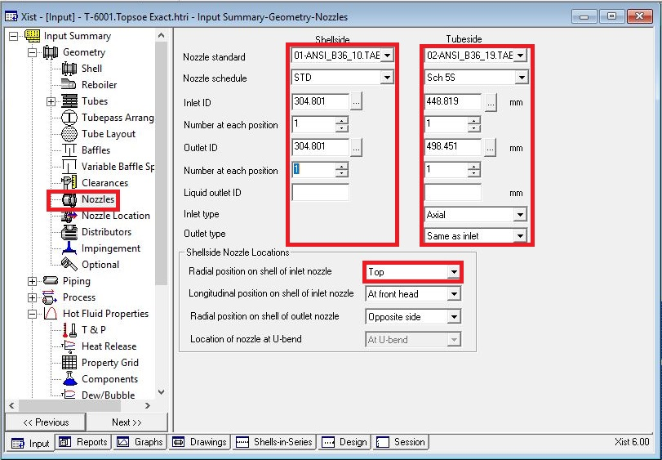
Enter nozzle info from piping info

Slide 19
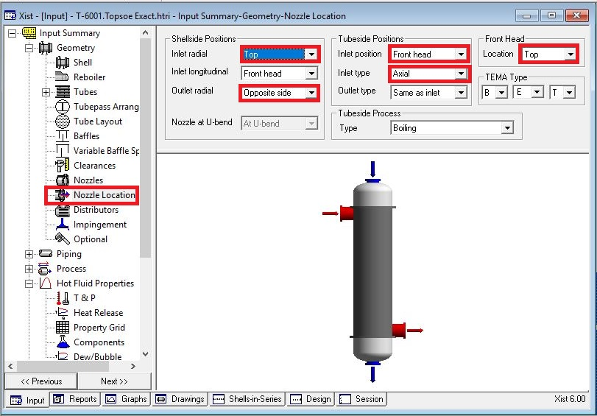
Set nozzle location
Remember that first sketch is horizontal one but due to some warnings vertical one is selected and
therefor the last sketch is put below.

Slide 20
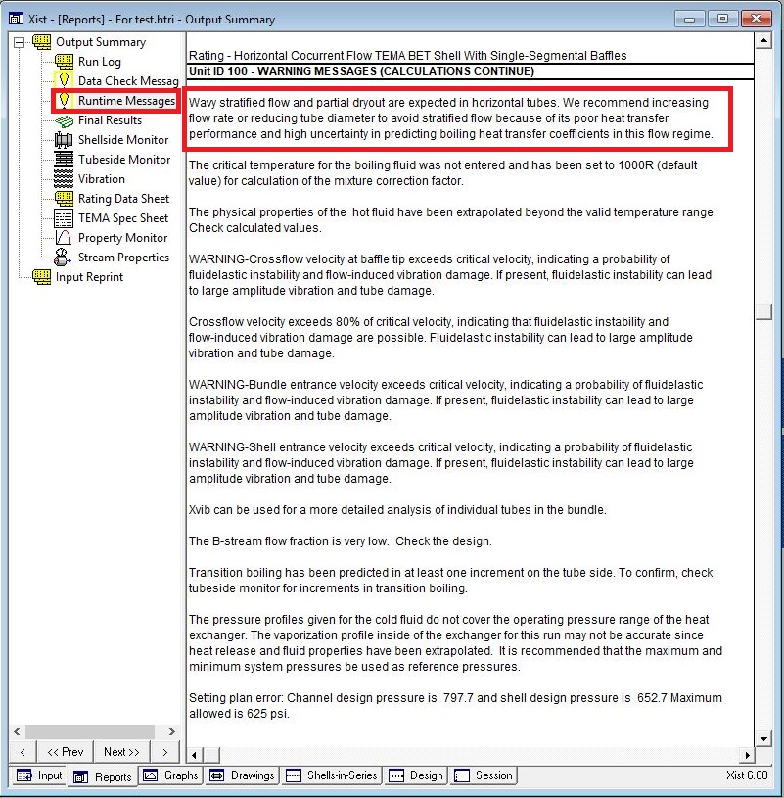
Results:
1. Now run and it results with following run messages

Slide 21
Due to flow regime vertical orientation is selected and the warning disappears.
By looking at overdesign factor and dp around shell side it appears that shell ID should be increased.
At first it is increased to 1700 mm and then to 2000. The resultant is that dp decreases to a good point
but not satisfactory but overdesign factor reaches to -30 % . For now it seems better to increase tube
length 9.75m which results in an increase in oversize factor by 32.5 % but dp increases to 0.25. As for
next step the segmental baffle is changed to double segmental baffle to decrease dp to 0.07.
Cross-pass is decreased from 25 to 20 to not only pass minimum TEMA baffle spacing limit but also
increase B-stream
Now it is time to increase overdesign factor. For doing so at first shell ID is increased to 2150 and as a
result overdesign factor increases to 4.5% . So tube length is increased to 12.1 m to increase its
overdesign factor and this results in 17% overdesign factor.
In order to eliminate two warnings in next pages about 800 tubes were eliminated and during
elimination since the surface area is reduced the overdesign factor is also reduced therefore tube
length is increased to 13m to counteract that.

Slide 22
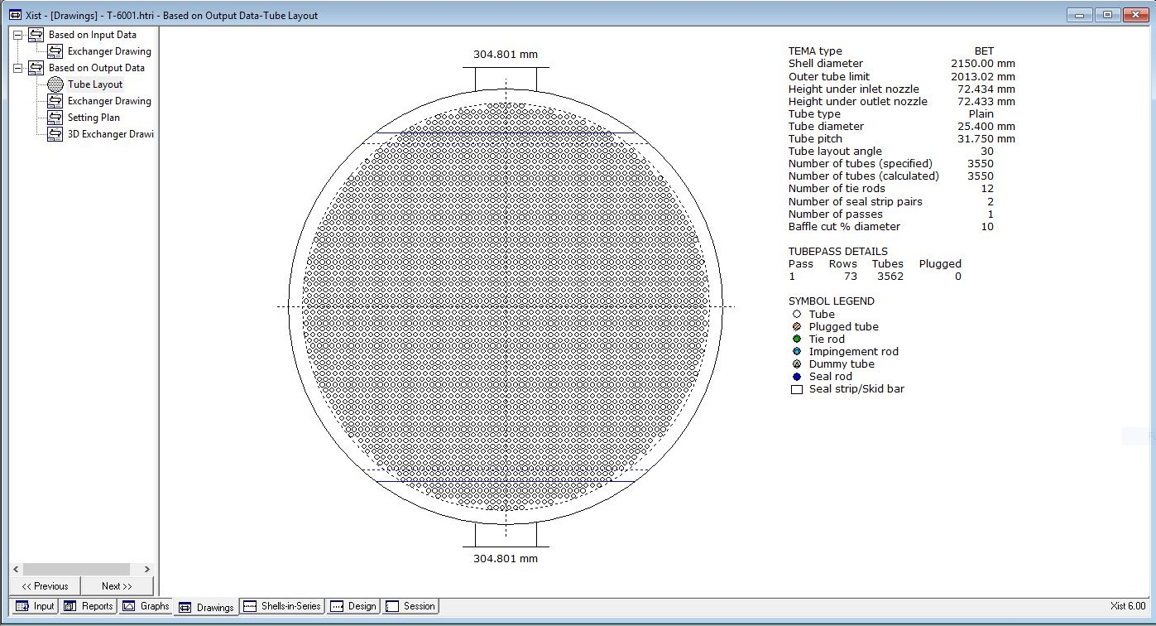

Slide 23
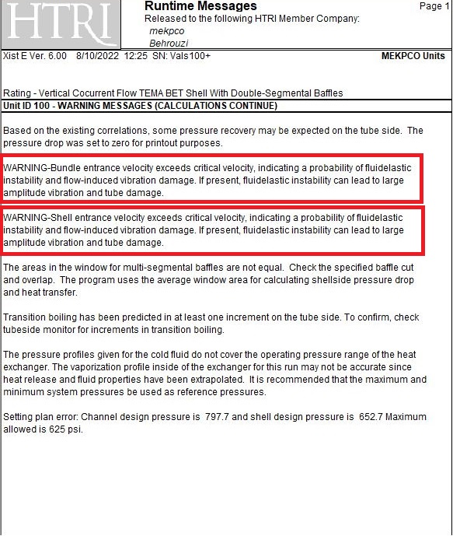
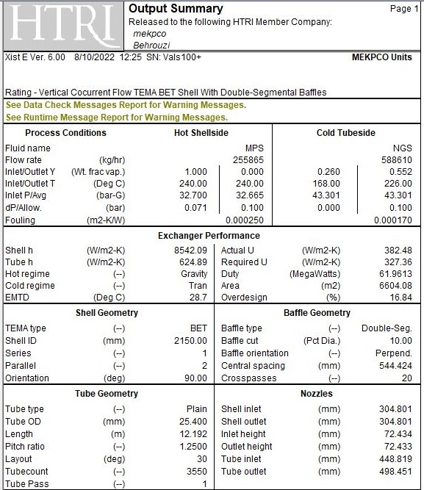

Slide 24
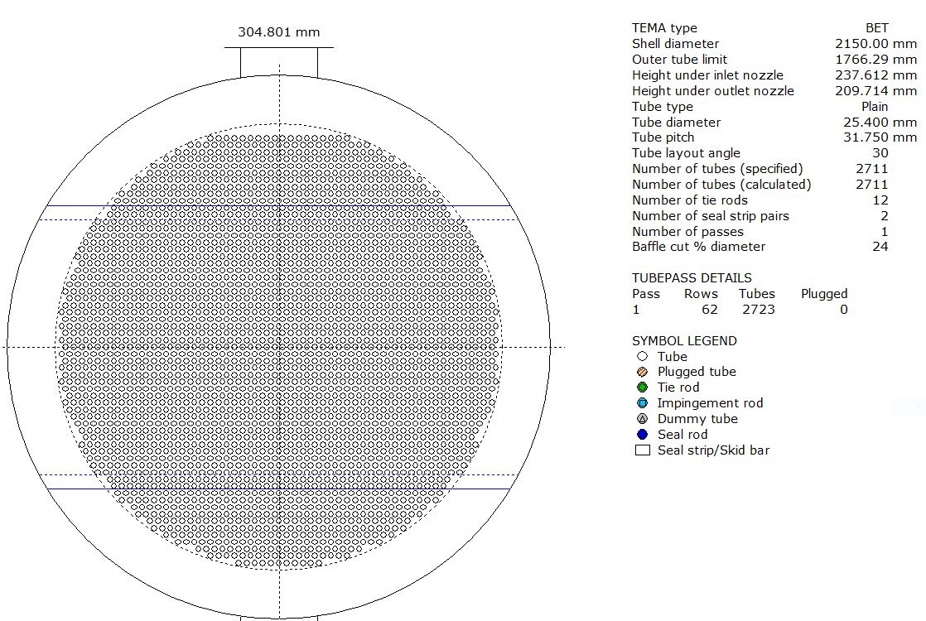
After eliminations of tubes it results like below:

Slide 25
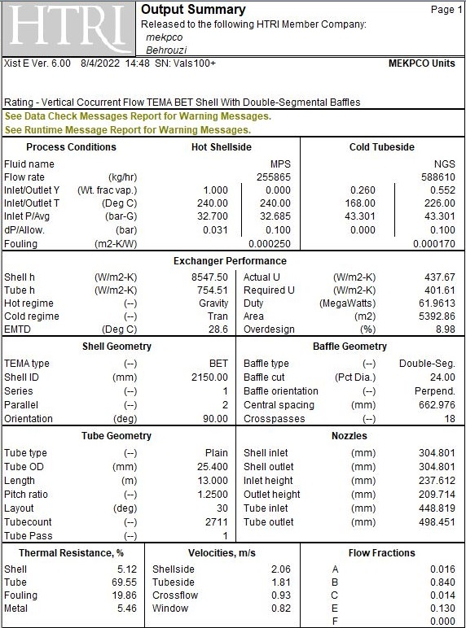

Slide 26
Thanks for your attention
Educational Institute for Process and Equipment Design
Mohammadreza Behrouzi
+989107884134

