Slide 1
A Stepwise
Saturator thermal Design
by HTRI
In 5 minutes!!

Slide 2
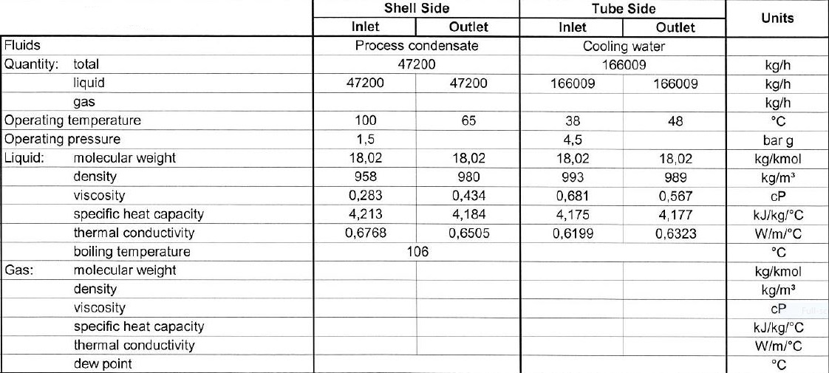
Process data

Slide 3
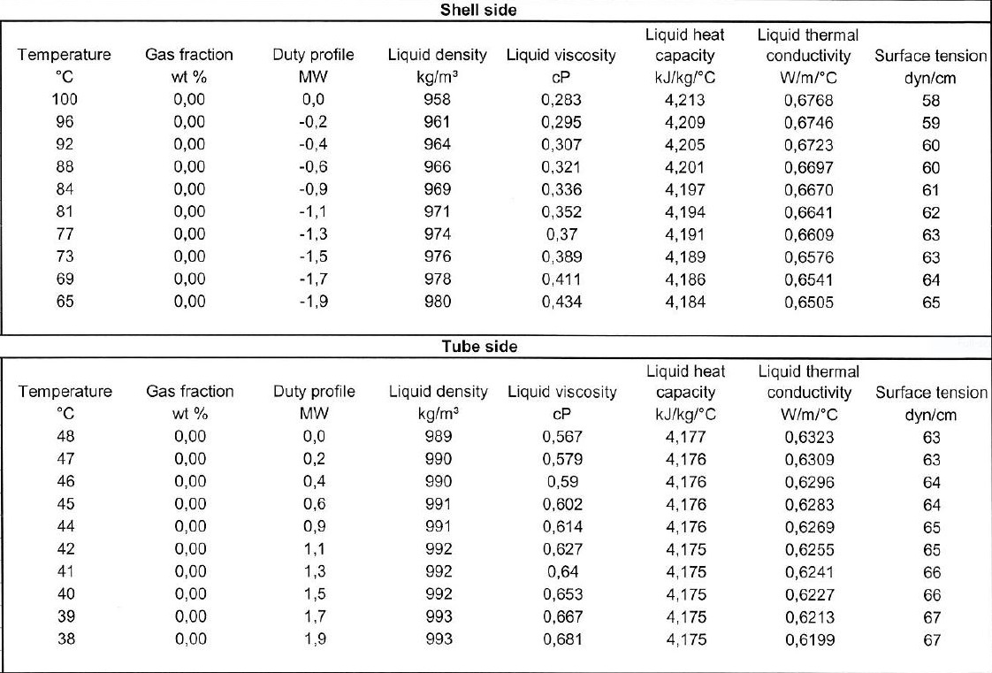
Heating and Cooling Table

Slide 5
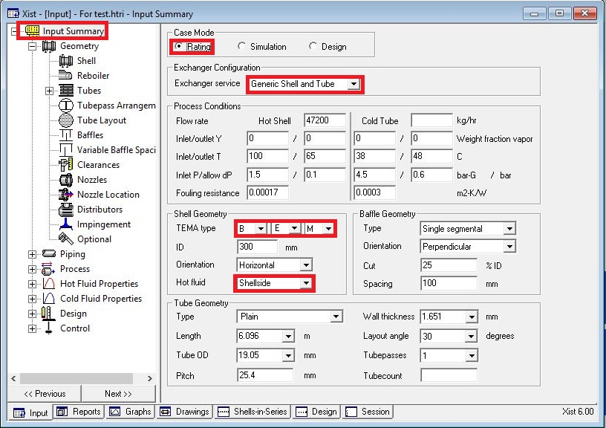
Open HTRI and Input Summery sheet and enter data in red areas

Slide 6
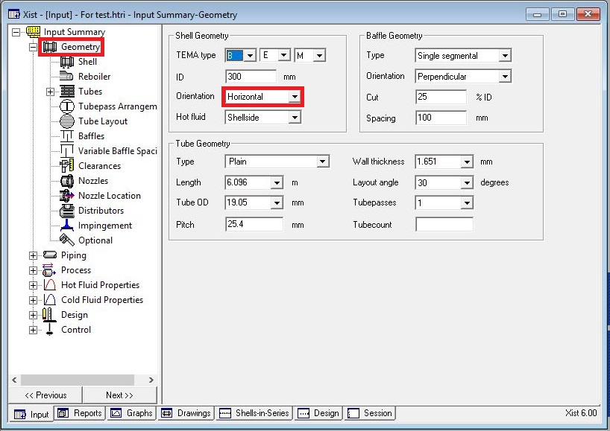

Slide 7
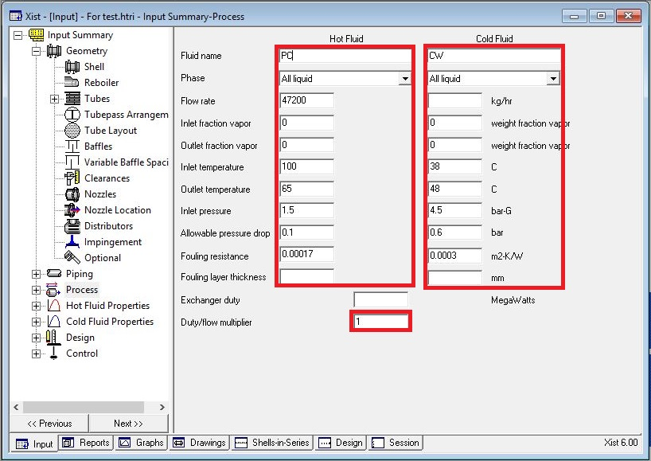
Enter operating data in process sheet in red areas

Slide 8
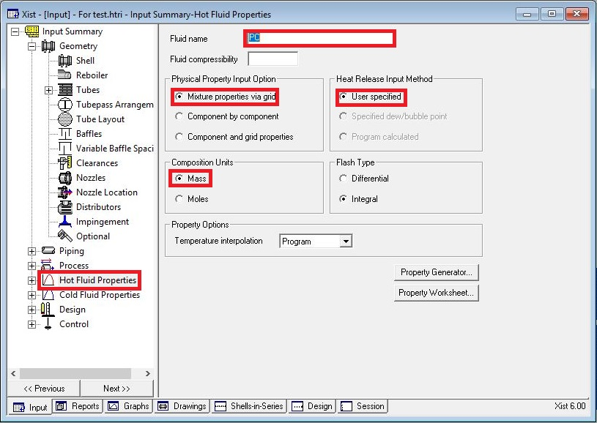
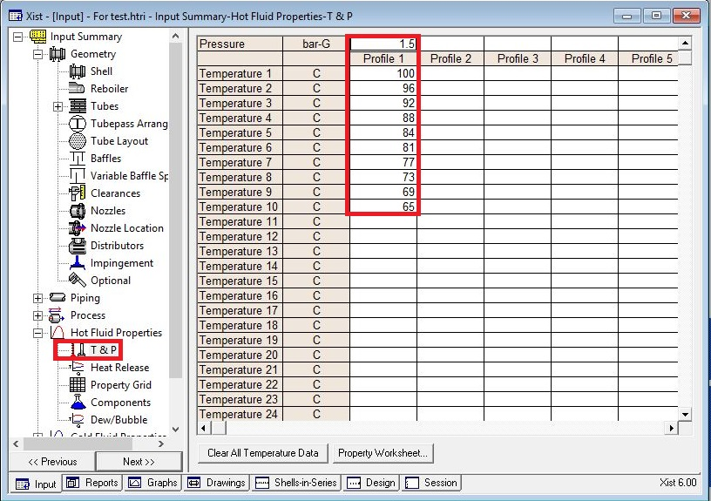
Enter heating and cooling table data in hot and cold fluid properties in red areas

Slide 9
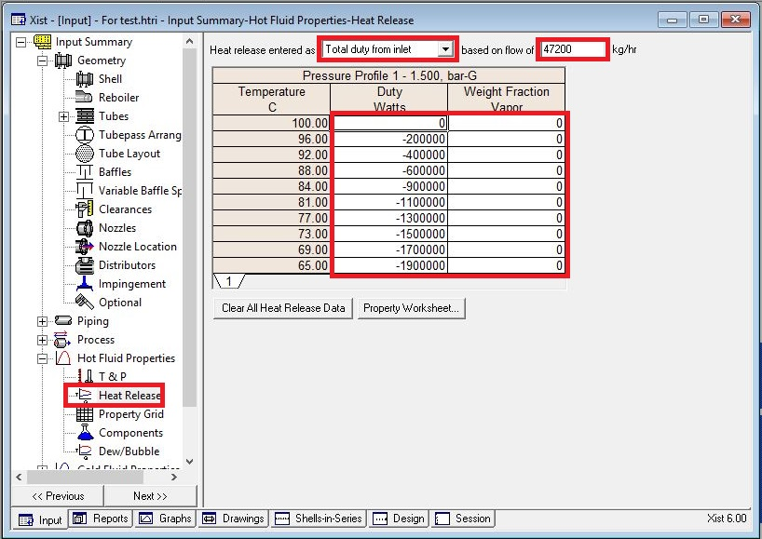
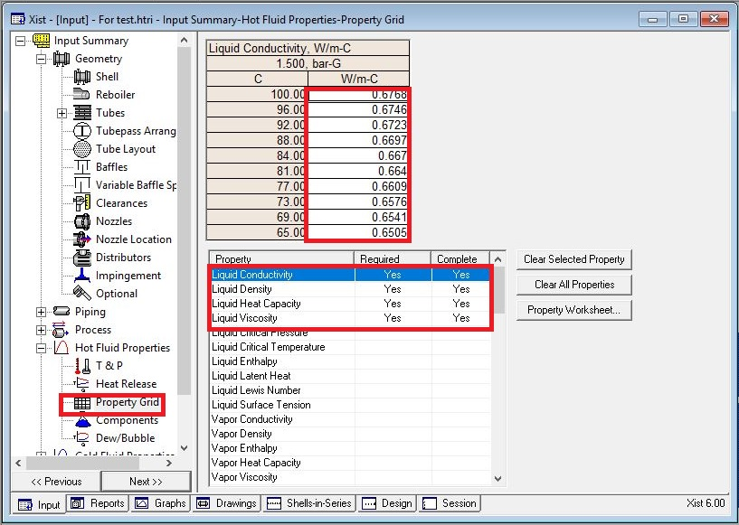

Slide 10
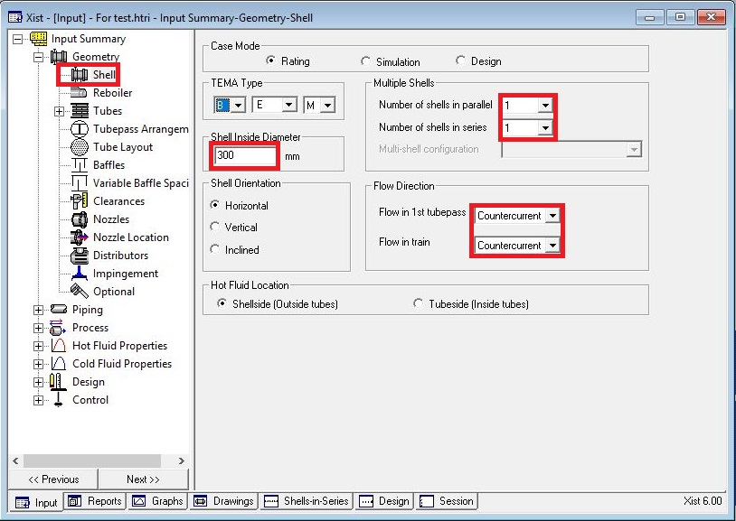
Put shell info in shell sheet in red areas
Note :
1. Initially estimate shell ID between 1.5-3 times tube-side pipeline ID, here it is 6 inch so first estimation would be 12 inch.

Slide 11
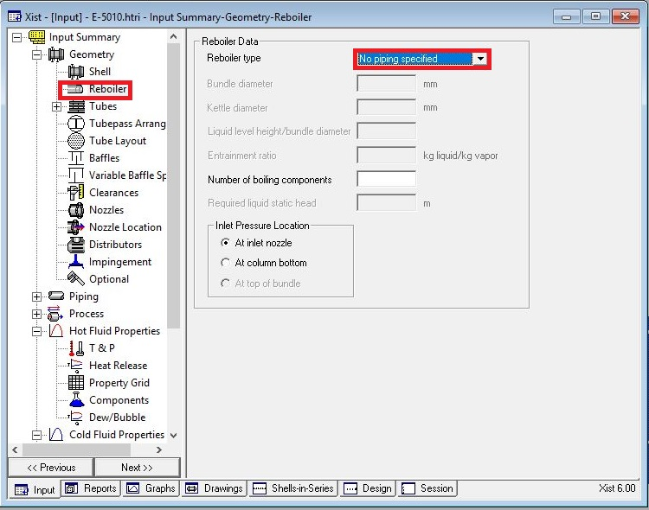
In Reboiler Sheet do not enter an input

Slide 12
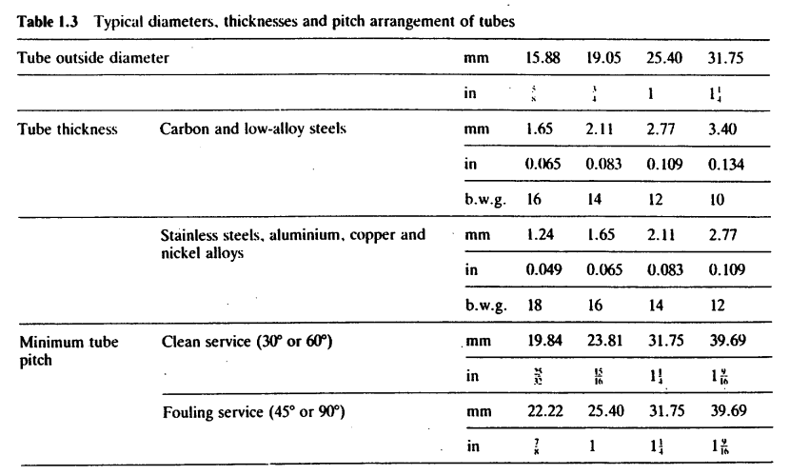
Put Tube mechanical data
Since it is cooling water, 19.05 is selected and thanks to presence of CO2 and Ammonia in the water Duplex
SS is selected.
According to table below tube thickness of 1.65 is chosen.

Slide 13
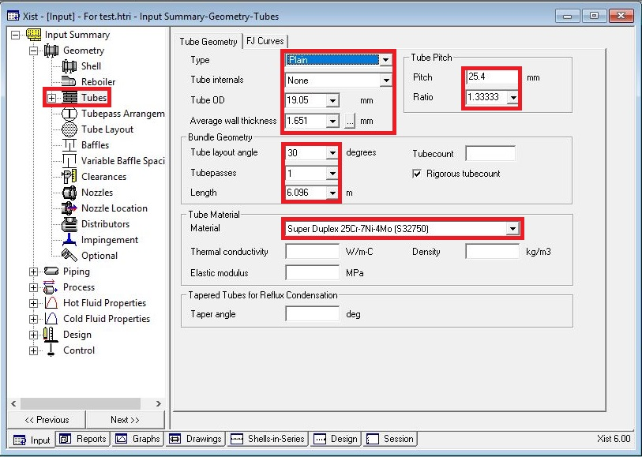

Slide 14
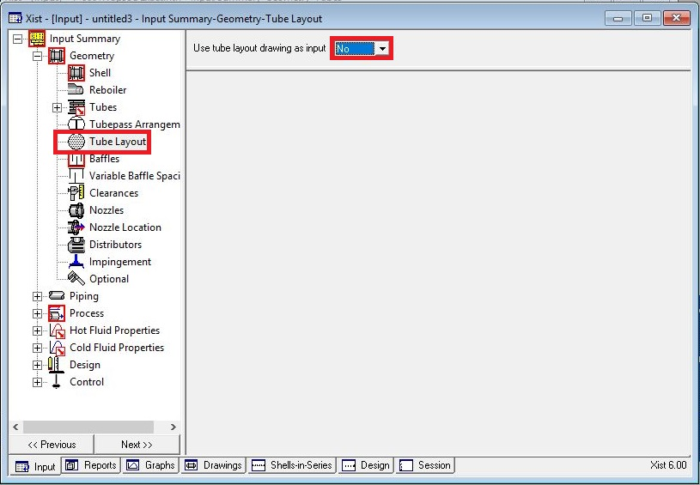
Act like below

Slide 15
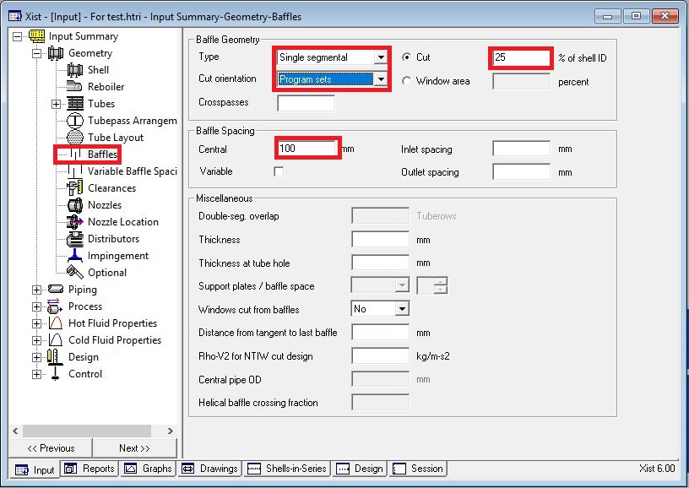
Put baffle info in baffle sheet in red areas like below

Slide 16
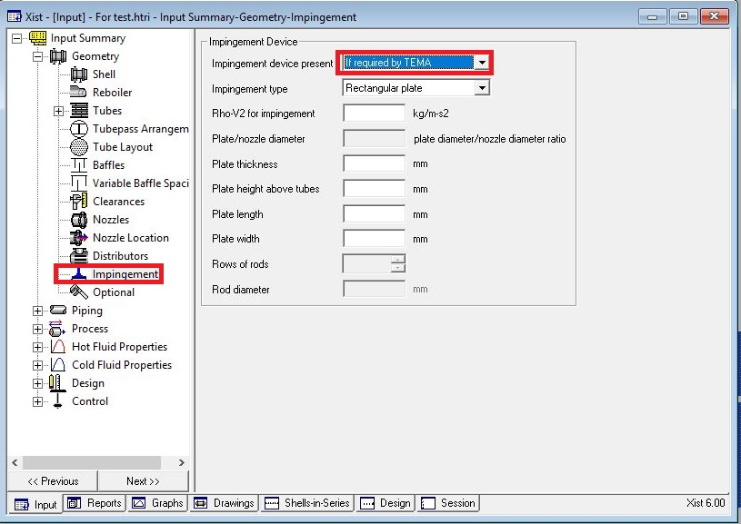
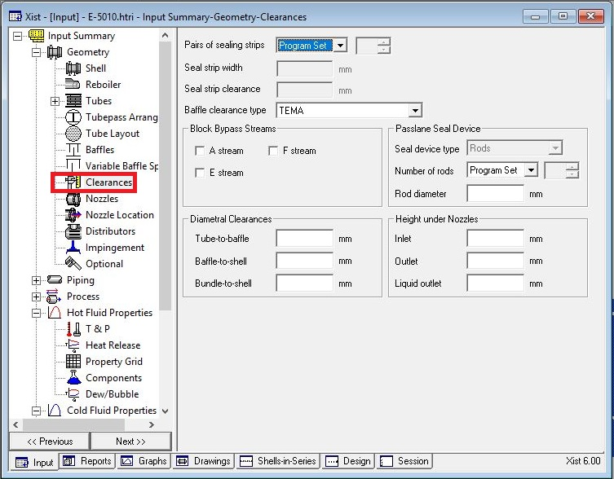
Act exactly like below for impingement sheet and Clearance

Slide 17
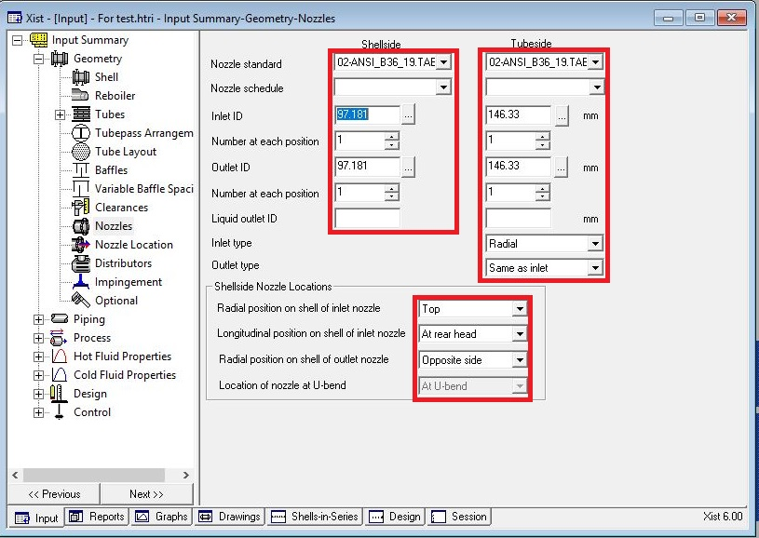
Enter nozzle info from piping info

Slide 18
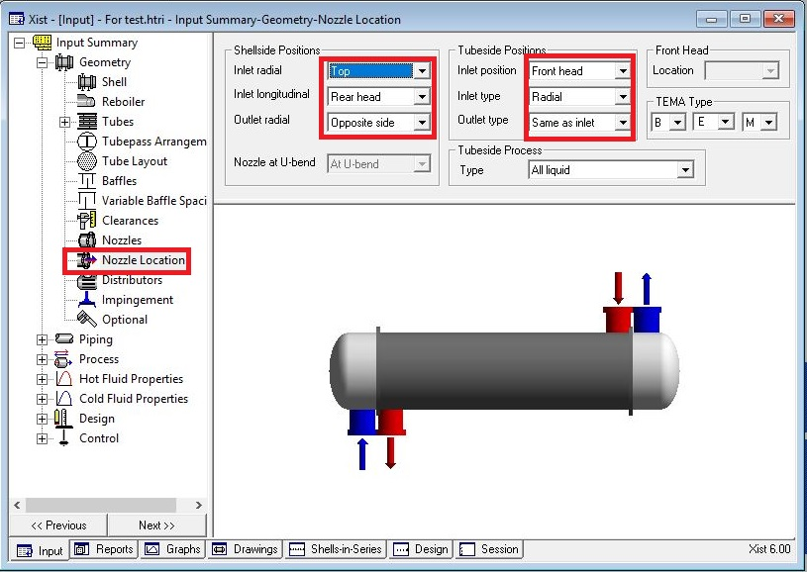
Set nozzle location

Slide 19
Results:
1. Now run and the dp in hot shell side becomes 1.62 bar and overdesign factor becomes -22%
2. Now increase the shell ID and overdesign factor becomes 35% and dp reduces to 0.89 bar
3. Now increase baffle spacing to 250 mm and run it again. Dp reduces to 0.215 and overdesign factor
to 33%.
4. Now decrease tube length to 4.87 to reduce oversize factor and run it and oversizing factor becomes
5.54%. As a result, dp also reduces to 10.17
5. Now increase Shell ID to 450mm and reduce Tube length to 4.27m simultaneously and the result is that
dp becomes 0.138 bar and overdesign factor 14%
Spacing | Oversizing
100 | 35
250 | 33
300 | 31
350 | 31
400 | 30.5

Slide 20
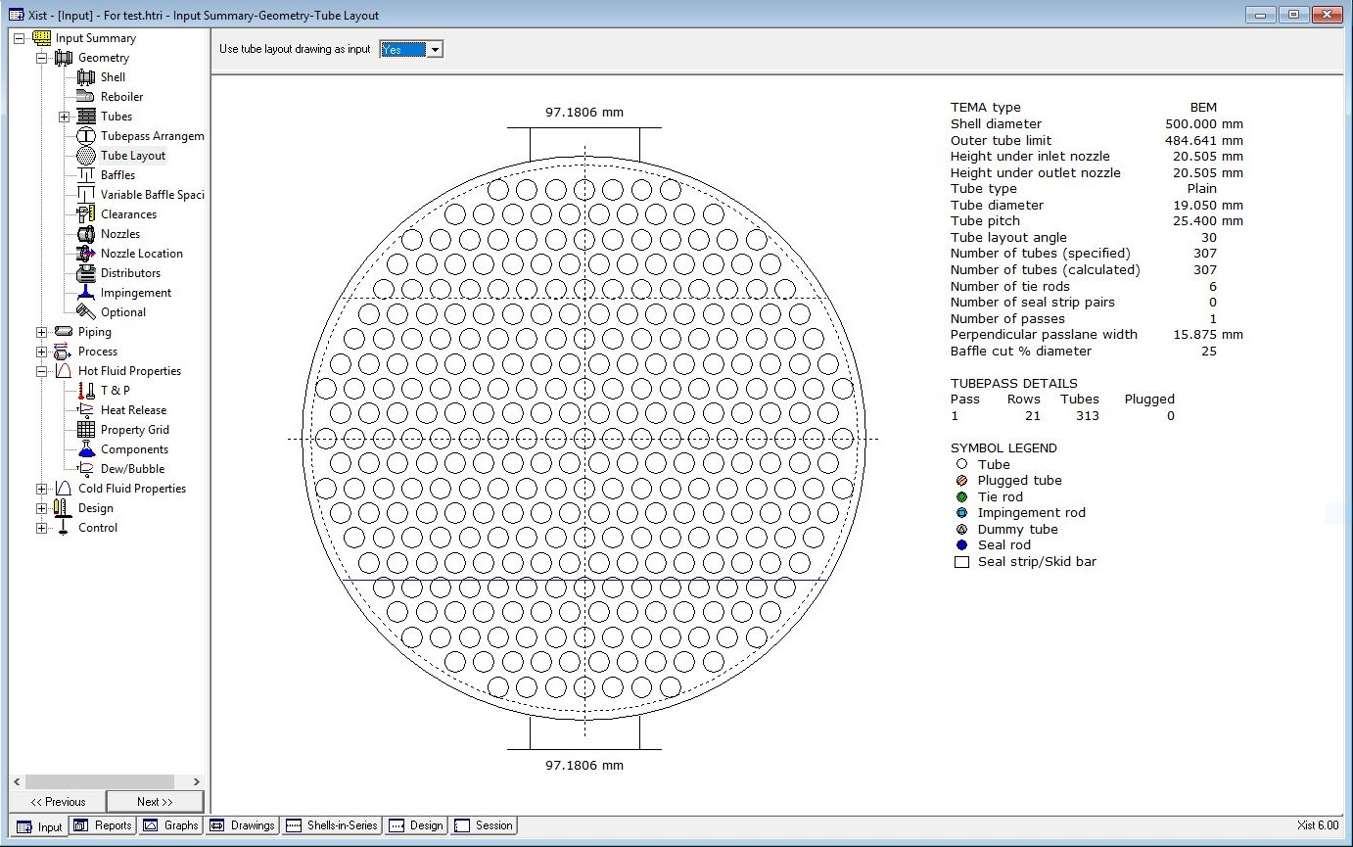
6. Now increase Shell ID to 500 mm and activate tube layout and run it and the overdesign factor
becomes 40%

Slide 21
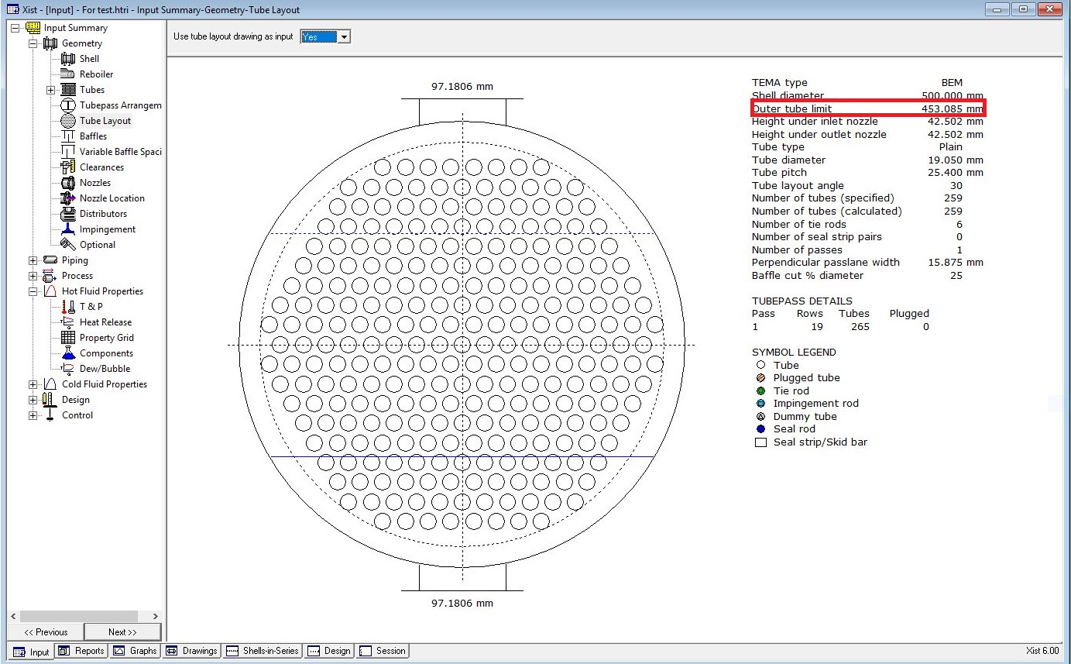
7. Now omit some tube like below and run it and the overdesign becomes 21%

Slide 22
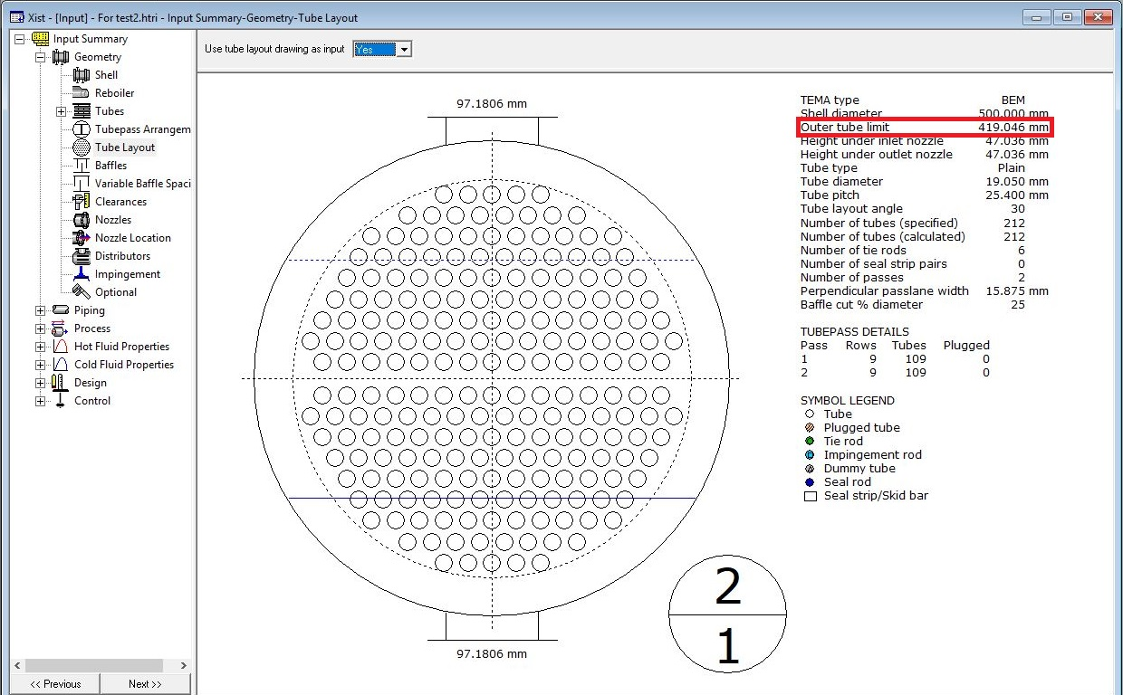
But after doing so, the water velocity in tube side reaches less than 1 m/s so we try to use double pass
and by doing so, dp in tube side goes from 0.11 to 0.39 bar and tube side h goes from 5426 to 9898 and
the velocity goes from 0.98 to 2.11.
8. Now omit some tubes like below and run it and overdesign factor becomes 7%

Slide 23
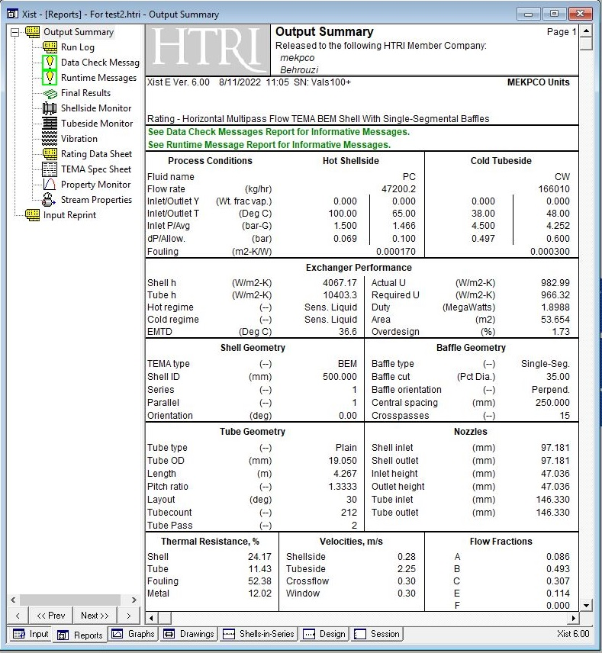
Now the only fly in the ointment is that B stream is low so different cut and spacing for baffle is tested
and baffle cut of 35% is tested and the overdesign factor becomes 1.73% and B-stream increase to 50%

Slide 24
If baffle cut of 25% is selected then B-stream be as low as 41% but overdesign factor is about 7%

Slide 25
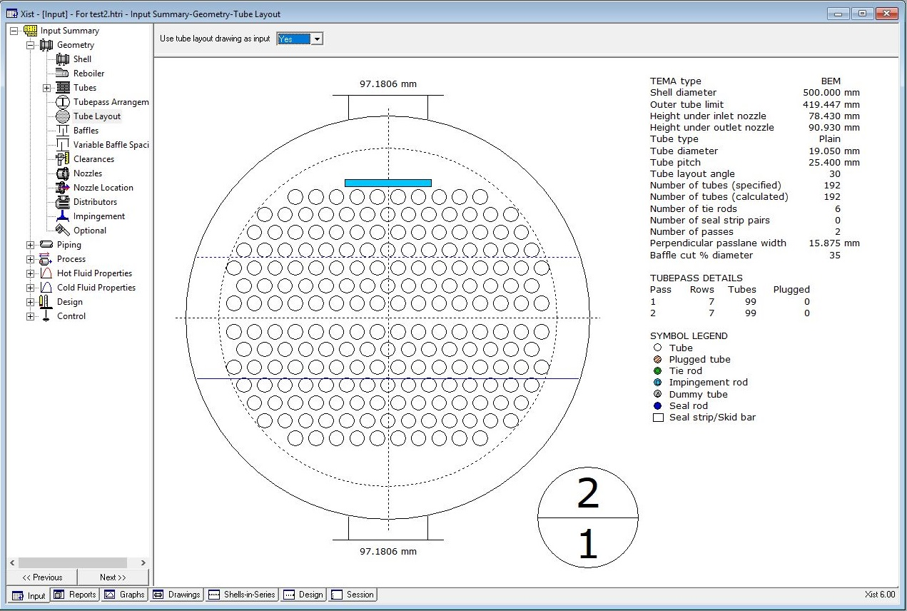
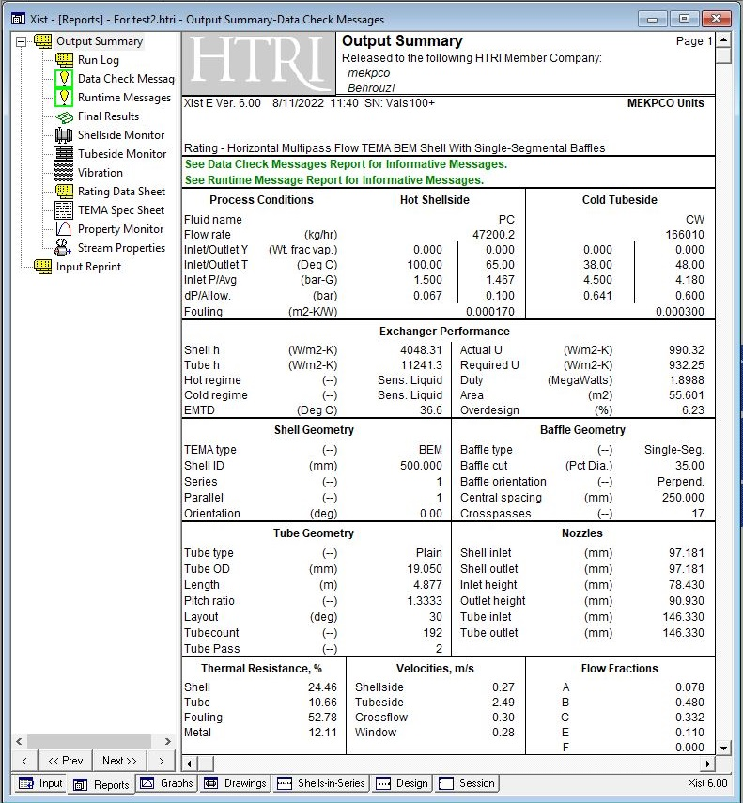
Now if the baffle cut 35% and increase tube length to 4.87 and run it. This results in overdesign factor of
16% and so reduce the number of tubes till the overdesign factor becomes 10%. Then activate
impingement plate and omit some tubes and run it .

Slide 26
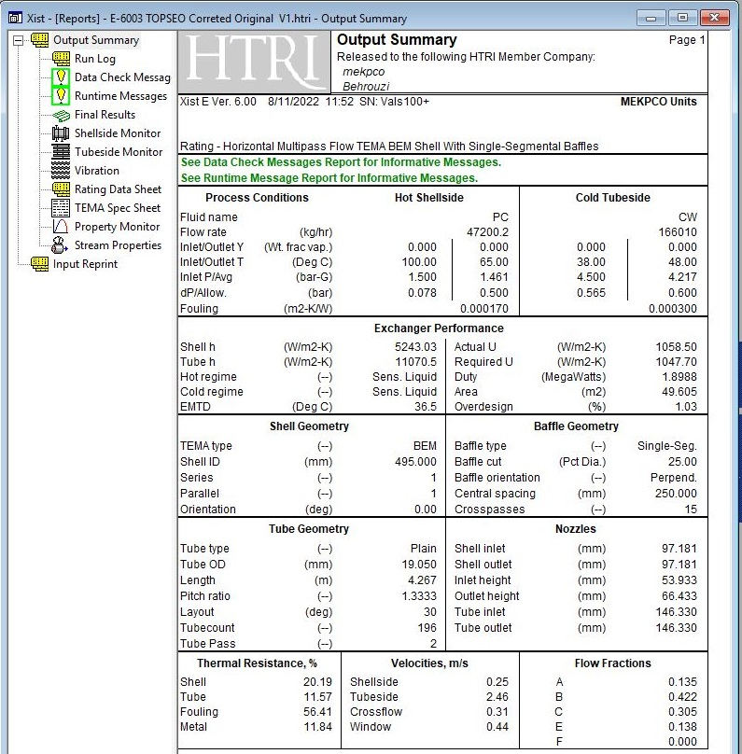
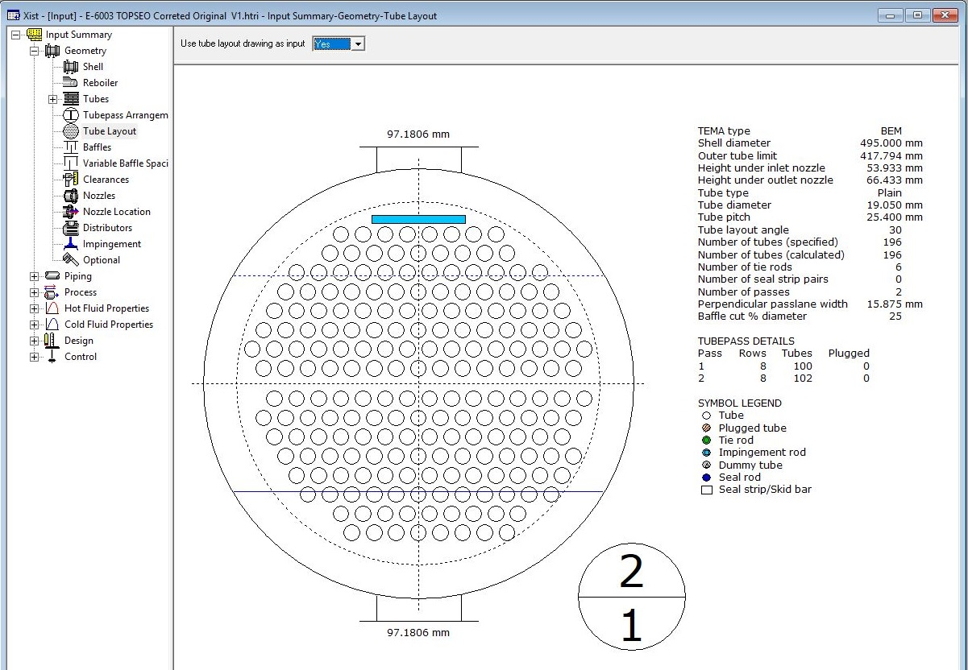
Topsoe Design

Slide 27
Which one should be selected ?
While Topsoe design offers a heat exchanger with lower weight, that of mine offers a heat exchanger
with higher overdesign factor .
By the way Topsoe configuration was also tested on my design and my configuration was slightly higher
than that of Topsoe design.

Slide 28
Thanks for your attention
Educational Institute for Process and Equipment Design
Mohammadreza Behrouzi
+989107884134

