Slide 1
A Stepwise
E-6002 thermal Design
by HTRI
In 5 minutes!!

Slide 2
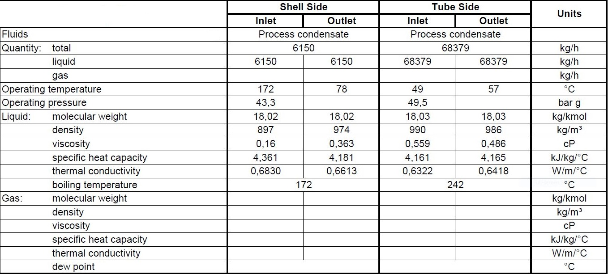
Process data

Slide 3
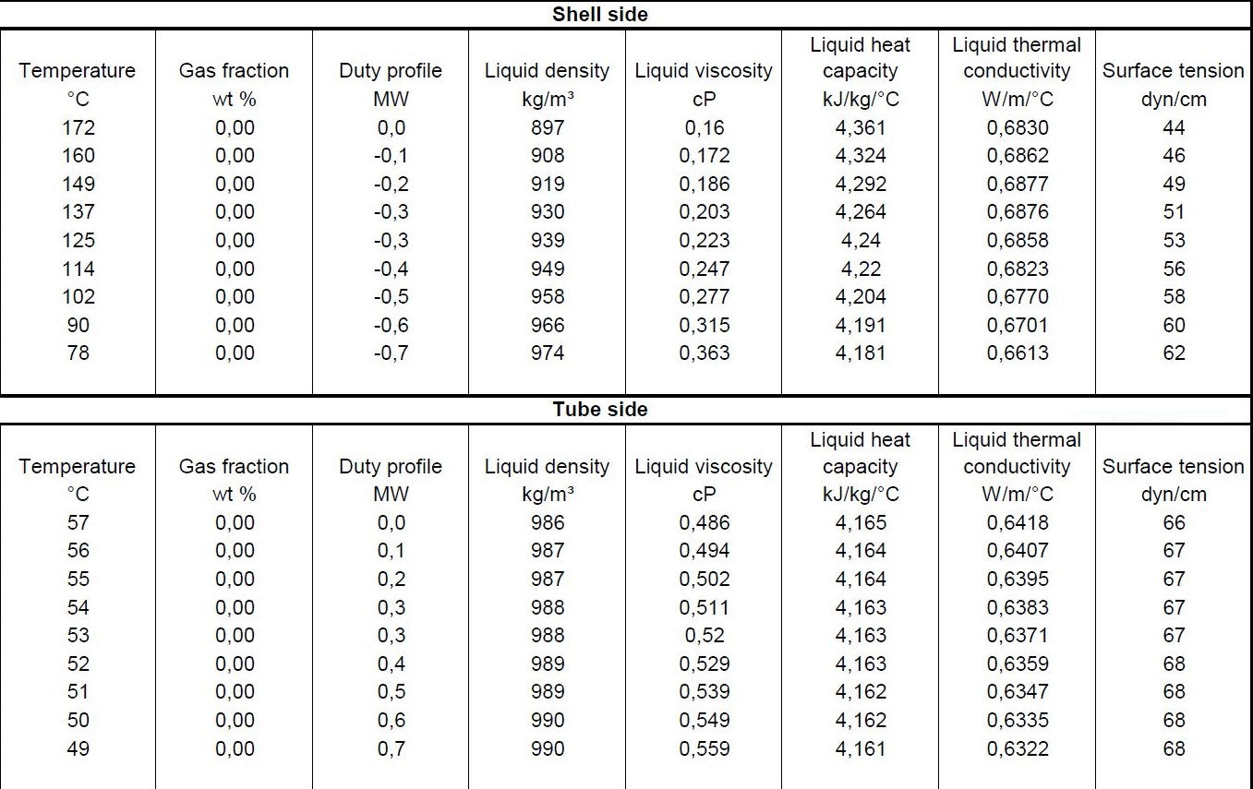
Heating and Cooling Table

Slide 4
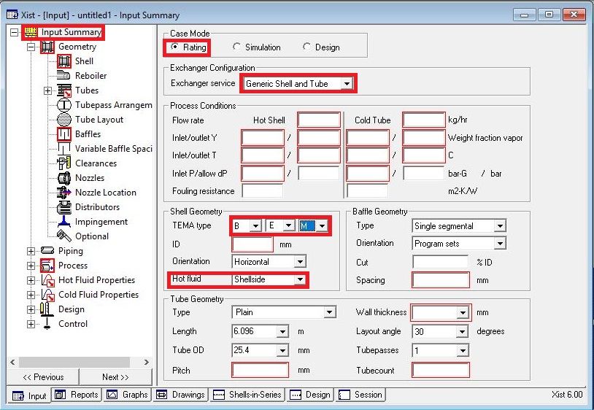
Open HTRI and Input Summery sheet and enter data in red areas

Slide 5
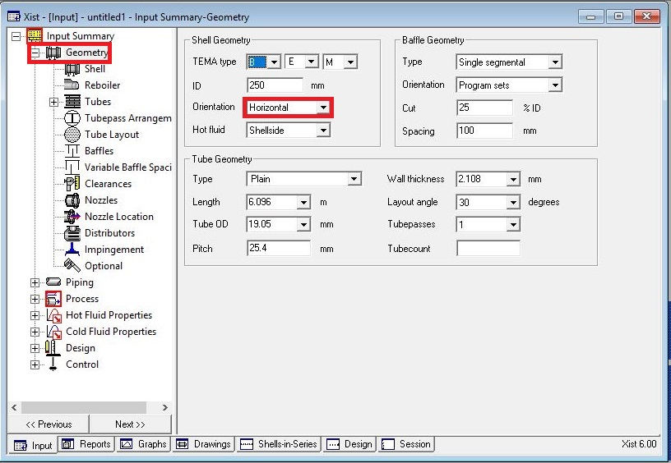

Slide 6
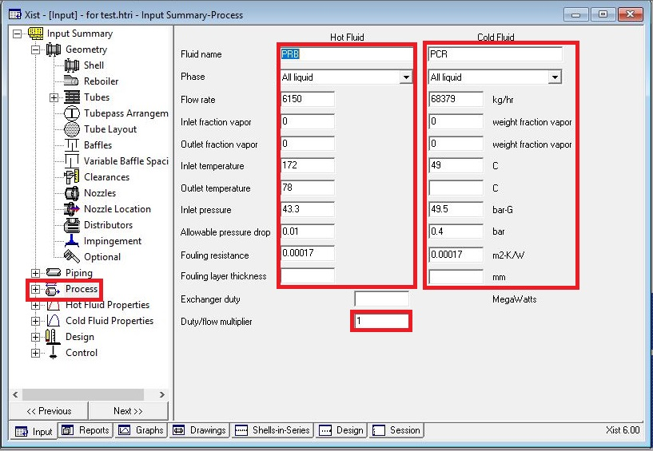
Enter operating data in process sheet in red areas

Slide 7
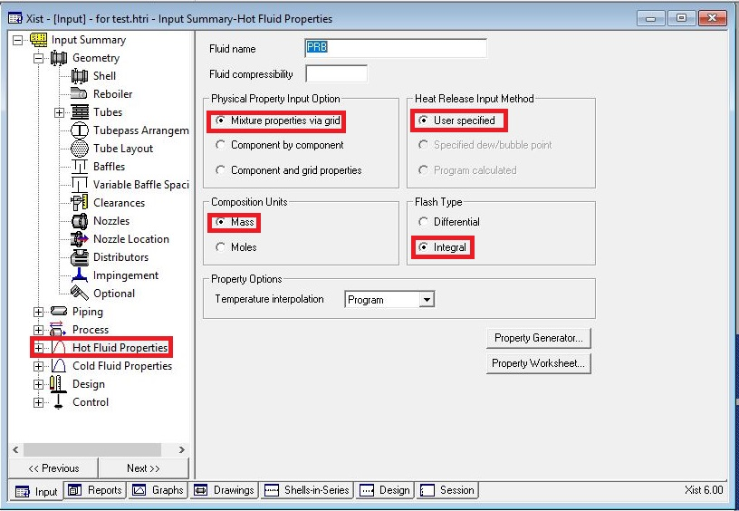
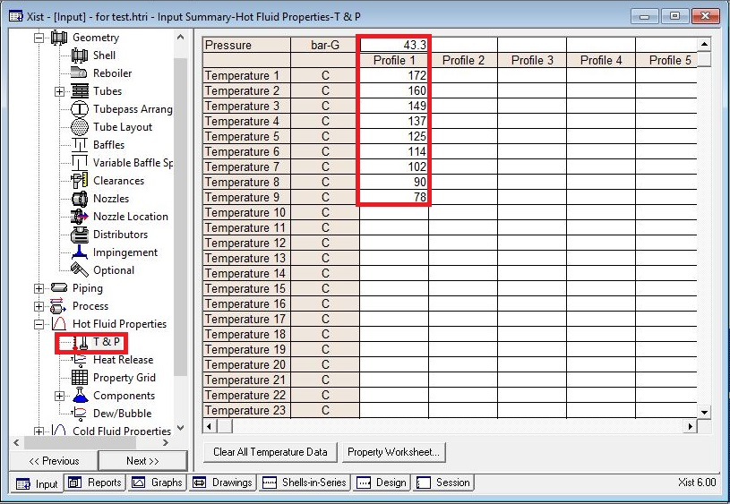
Enter heating and cooling table data in hot and cold fluid properties in red areas

Slide 8
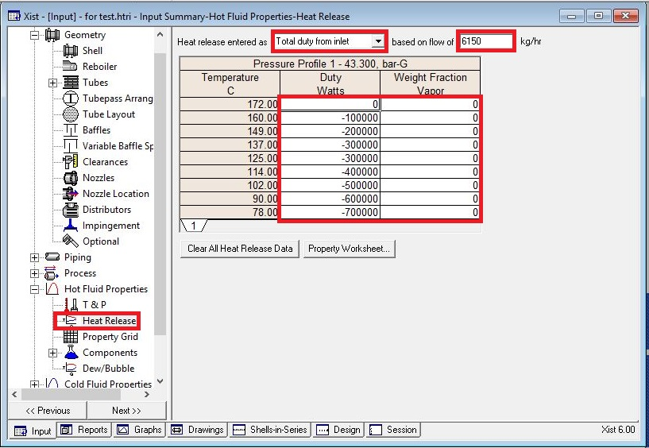
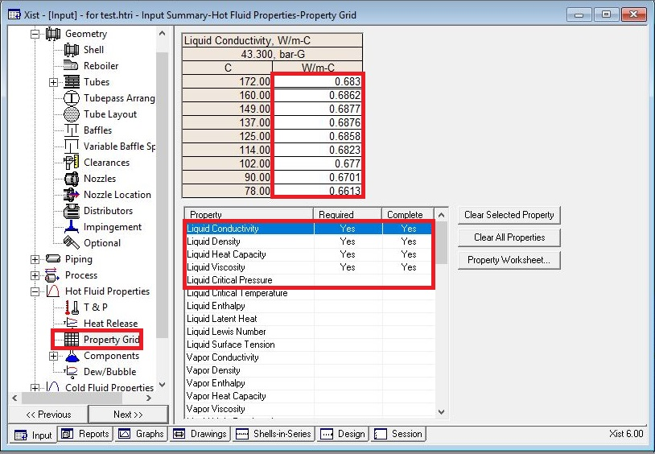

Slide 9
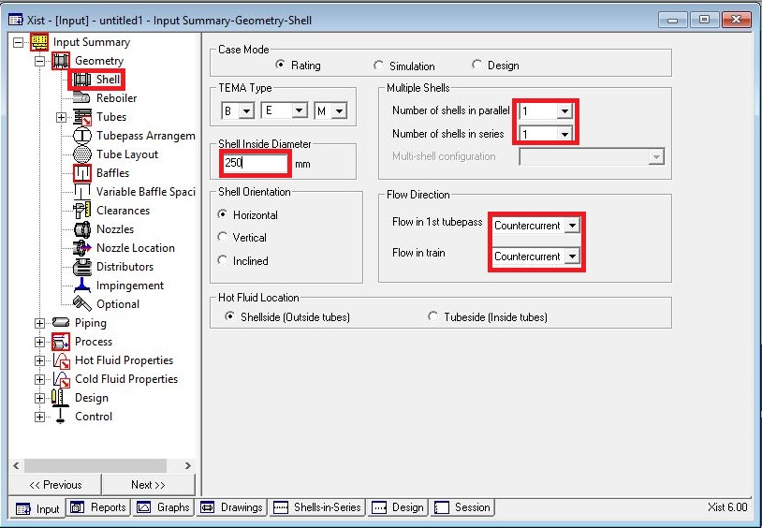
Put shell info in shell sheet in red areas
Note :
1. Initially estimate shell ID between 1.5-3 times tube-side pipeline ID, here it is 4 inch so first estimation would be 250mm

Slide 10
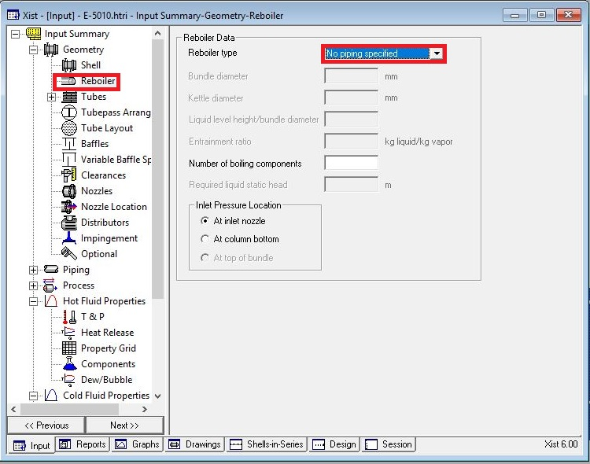
In Reboiler Sheet do not enter an input

Slide 11
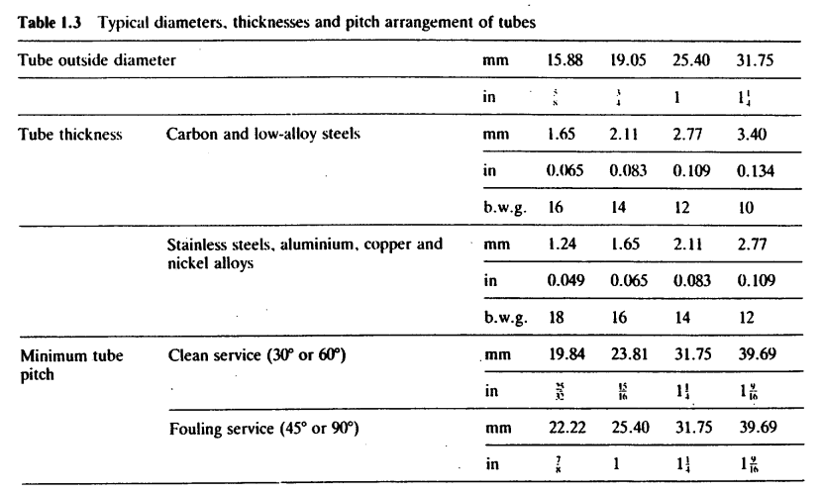
Put Tube mechanical data
Since it is water, due to velocity criteria , 19.05 is selected and thanks to presence of CO2 and Ammonia in the water SS is selected.
According to table below tube thickness of 1.65 is chosen.

Slide 12
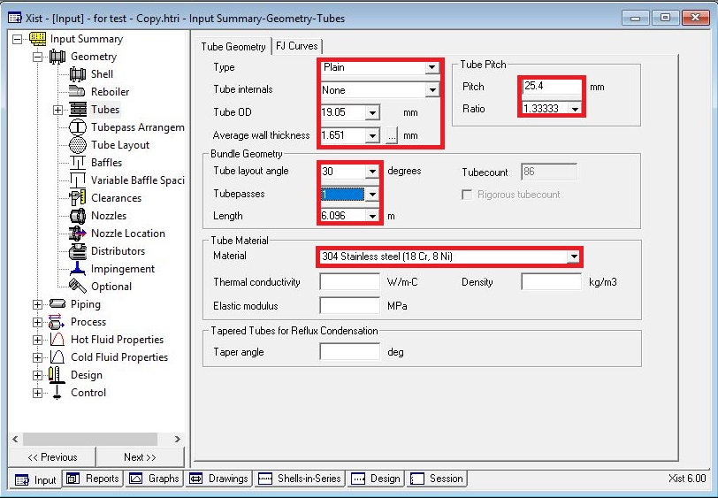

Slide 13
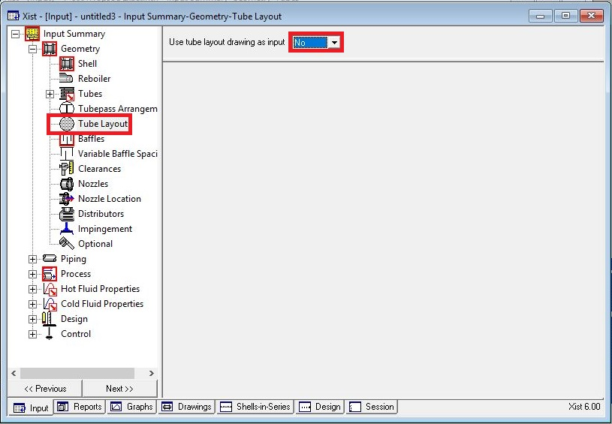
Act like below

Slide 14
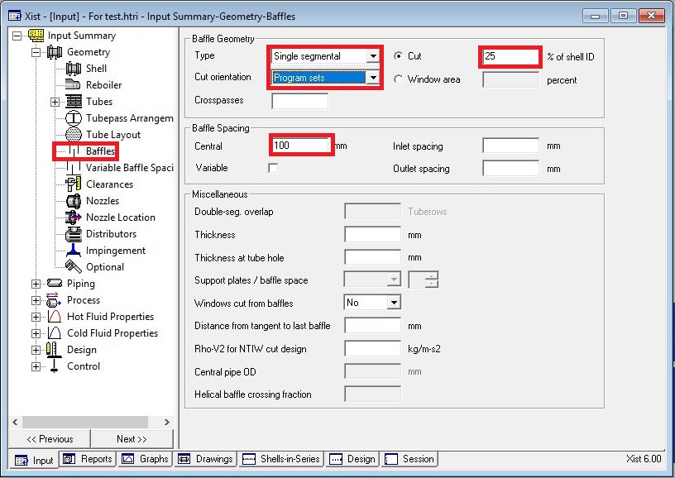
Put baffle info in baffle sheet in red areas like below

Slide 15
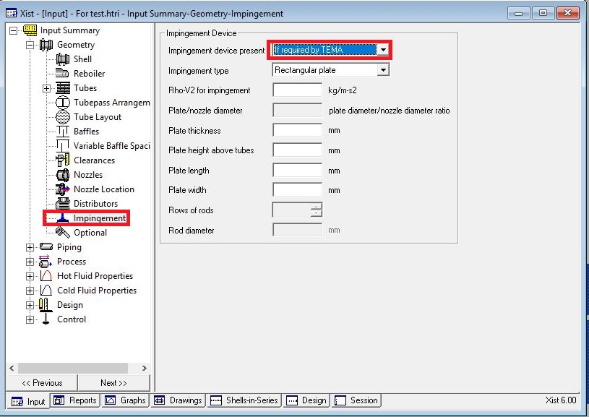
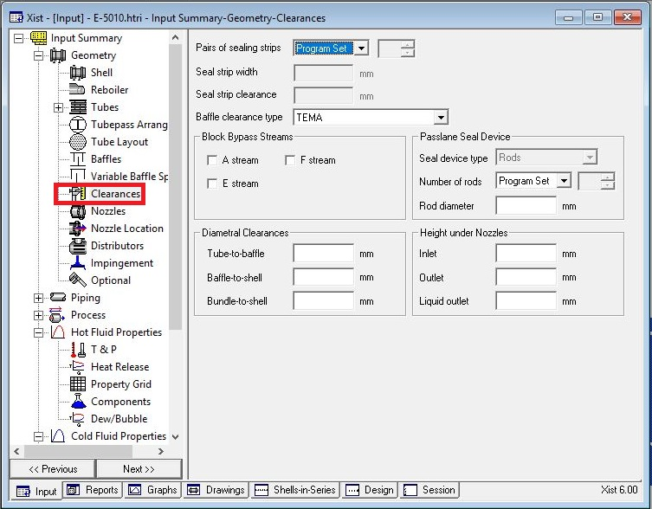
Act exactly like below for impingement sheet and Clearance

Slide 16
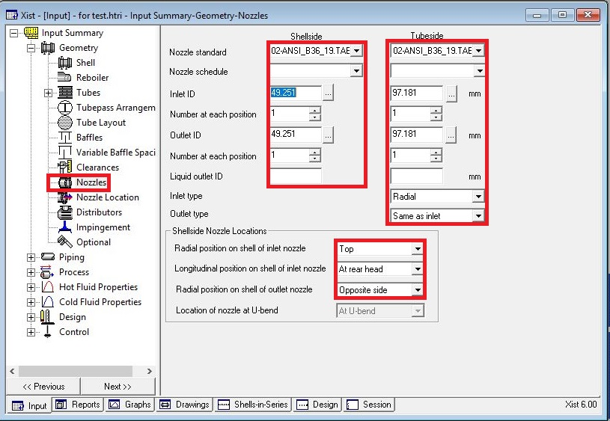
Enter nozzle info from piping info

Slide 17
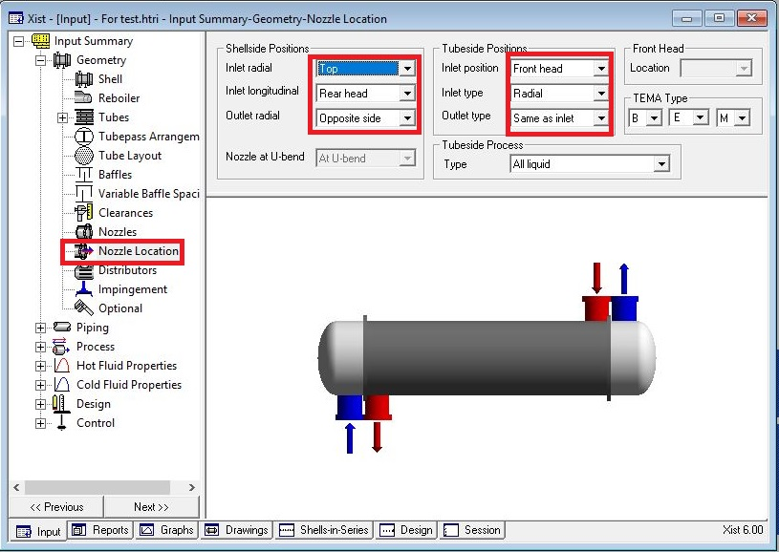
Set nozzle location

Slide 18
Results:
1. Now run and this results in 129% overdesign factor and shell dp of 0.06 bar. Just remember there is no
need to take any action for below warning sometimes, because later you see that after activation of
tube layout option this will disappear. So from this result we realize that the diameter due to dp I shell
side should be increased and in order to decrease the overdesign factor tube length is decreased in
stepwise manner to 4.27m and after run, the result is that alongside with decrease in overdesign factor
to 59%, dp reduces to 0.04 bar. Repeat it and reduce the tube length to 3m and run it and as a result
the overdesign factor reduces to 11% and dp becomes 0.03 bar.
2. Now before increase shell ID please play with baffle spacing to reduce dp in shell side.
Spacing | Dp | Overdesign | B-stream
100 | 0.034 | 11.7
150 | 0.023 | 9.58 | 57
200 | 0.019 | 7.41 | 62
250 | 0.017 | 6.25 | 65
300 | 0.016 | 4.86 | 67

Slide 19
3. Increase the baffle spacing to 250
4. Activate tube layout option and increase the shell ID to 300 mm and run it. Dp reduces to 0.015 and
overdesign factor to 43%.
5. Since water velocity is at minimum, we double pass the tube side and run it. Notice that controlling
side is the shell side and by doing so , tube side h increases from 6224 to 11792 , overdesign factor
decreases from 34 to 26 due to decrease in surface area , dp in shell side increases from 0.098 to 0.42
bar and velocity from 1 to 2.4 m/s
6. by checking Vibration page for pv2 in bundle entrance we perceive that there is no need to have
impingement plate.
7. for dp reasons we increase the shell side ID and to keep overdesign factor constant then omit some
tubes . Dp reduces to 0.011 and overdesign factor to 40%. Then some tubes were omitted but dp
criteria not met. So Shell ID was increased to 350 and tube length reduced to 2.8 m. and after some
tube omission final sketch is reached with overdesign factor of 7.25%.
Please notice that changing direction of concurrent or countercurrent in this case study does not
have any substantial impact on overdesign factor. However, Topsoe proposed concurrent direction is
preffered

Slide 20
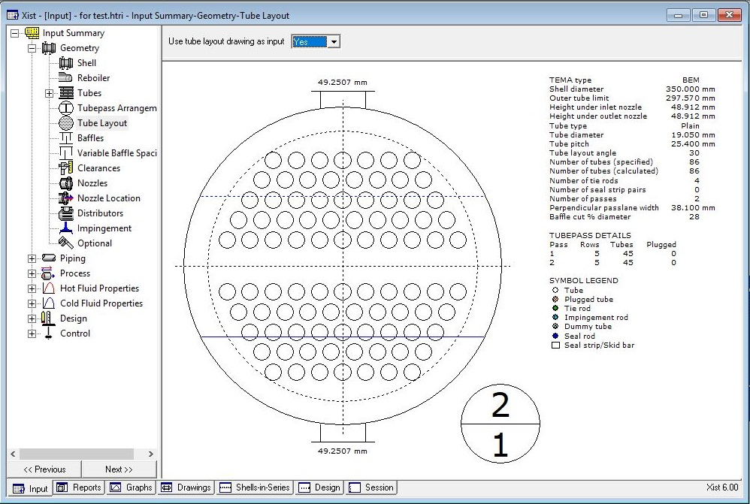
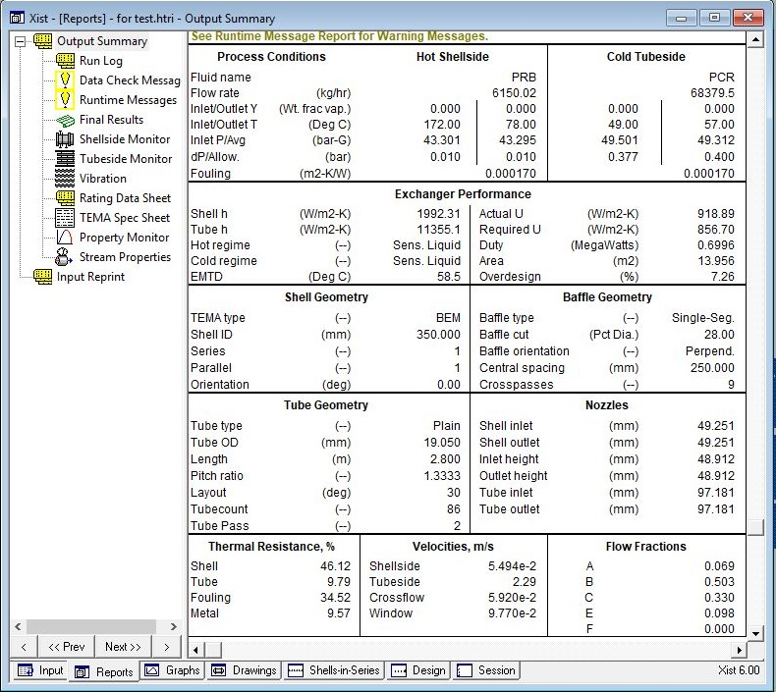
My Design

Slide 21
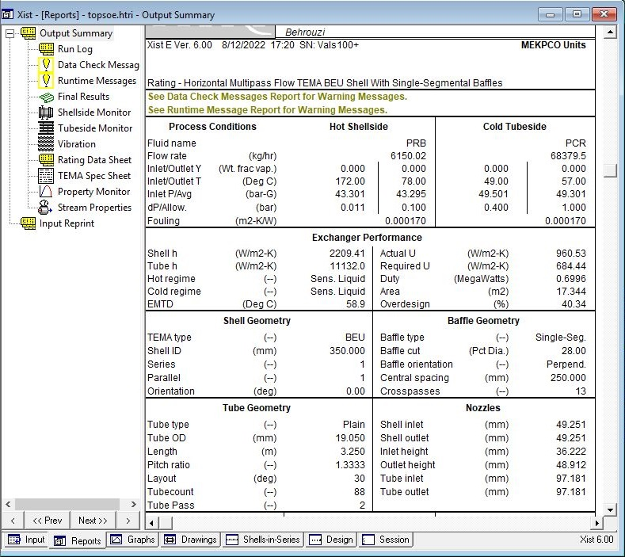
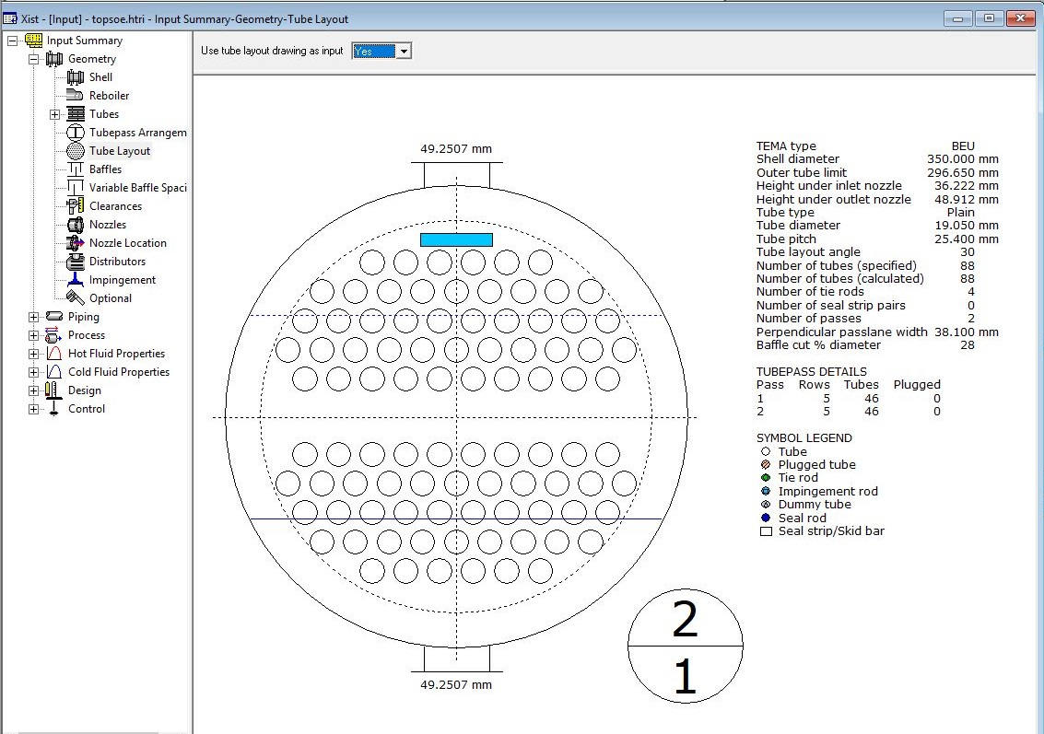
Topsoe Design

Slide 22
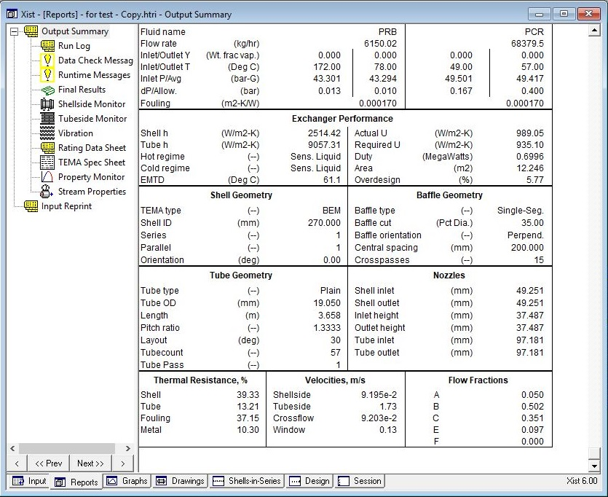
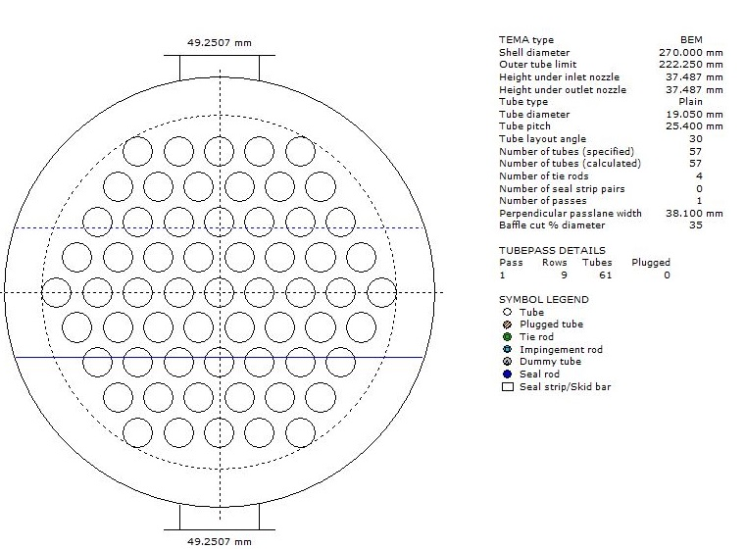
From process perspective it is nod needed to have such heat exchanger with such low dp design .
therefore in my perspective following design with following result could be used.
Parameters | Value
Shell ID | 270
Tube length | 3.65
Baffle Spacing | 200
Baffle cut | 35

Slide 23
Comparison between different Design:
While Topsoe design offers a heat exchanger with 40% overdesign and 844 kg weight and my design
gives 7% overdesign and 823 kg weight , process design gives an overdesign of 5% and 620 kg weight.

Slide 24
Thanks for your attention
Educational Institute for Process and Equipment Design
Mohammadreza Behrouzi
+989107884134

