Slide 1
A Stepwise
E-6002 thermal Design
by HTRI
In 5 minutes!!

Slide 2
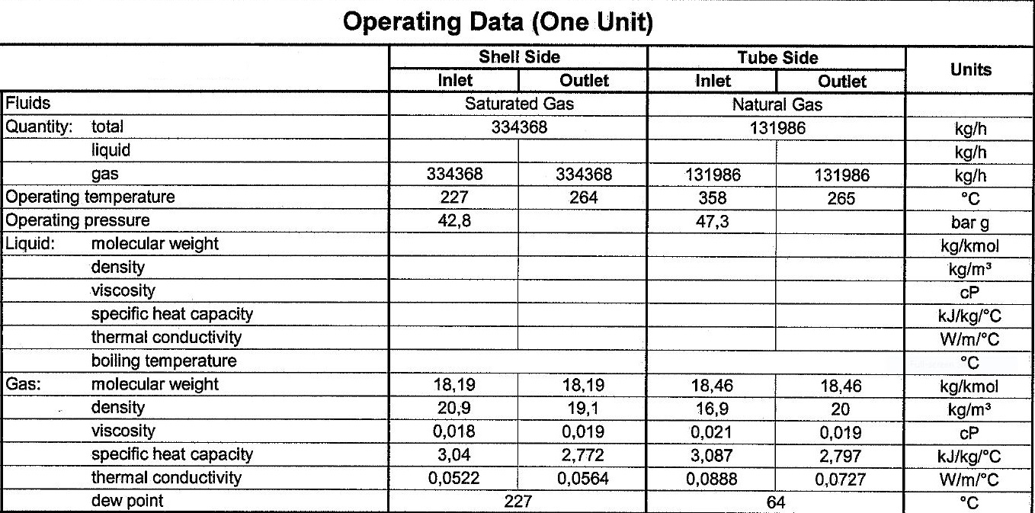
Process data

Slide 3
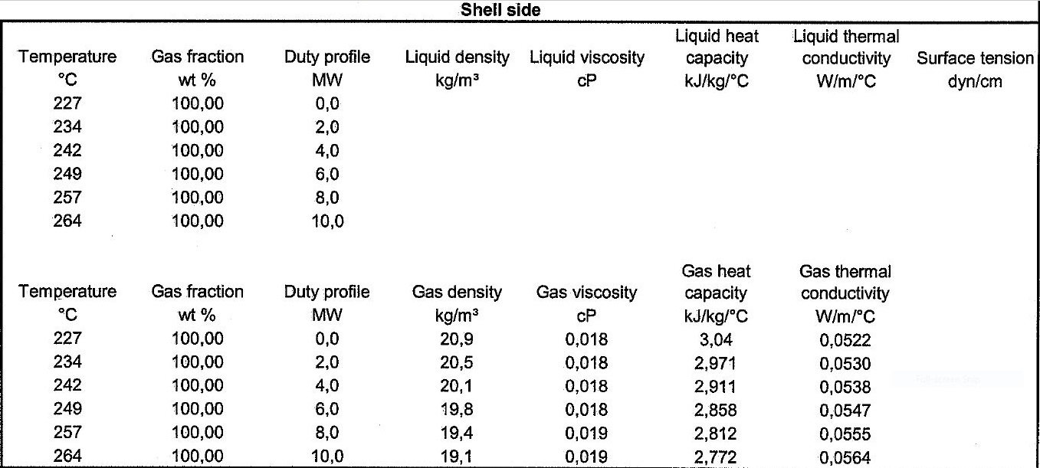
Heating and Cooling Table

Slide 4
Heating and Cooling Table

Slide 5
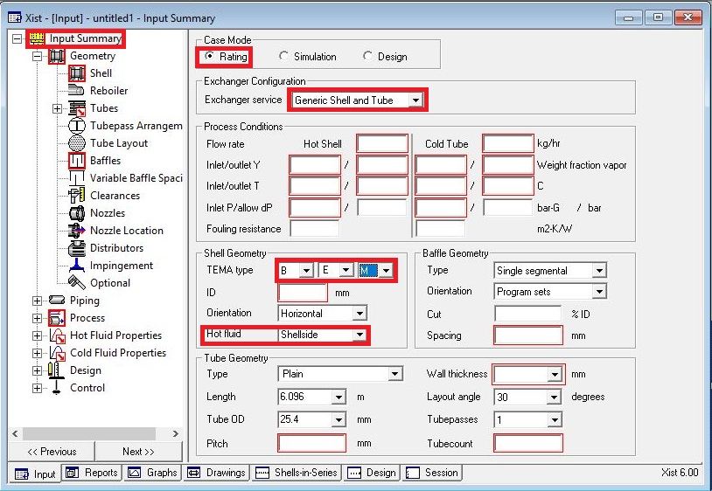
Open HTRI and Input Summery sheet and enter data in red areas

Slide 7
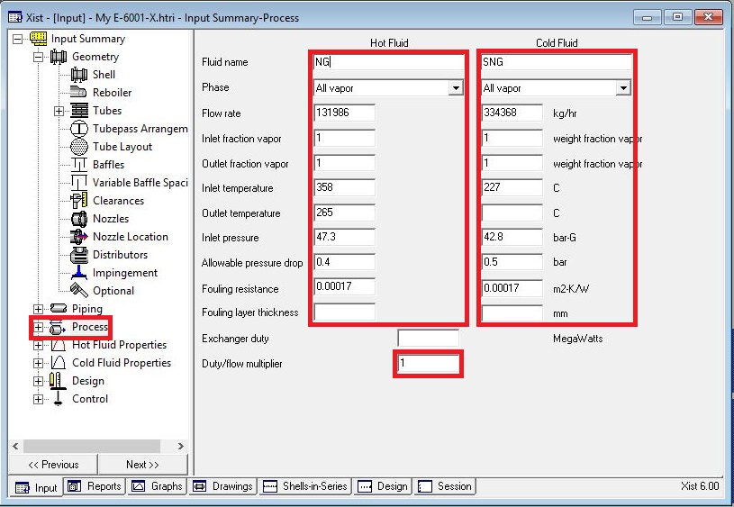
Enter operating data in process sheet in red areas

Slide 8
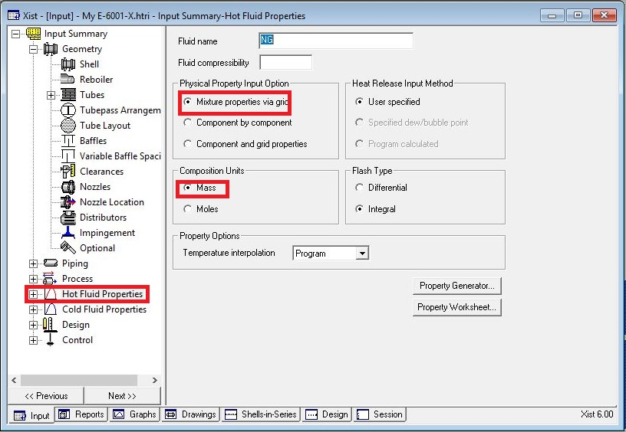
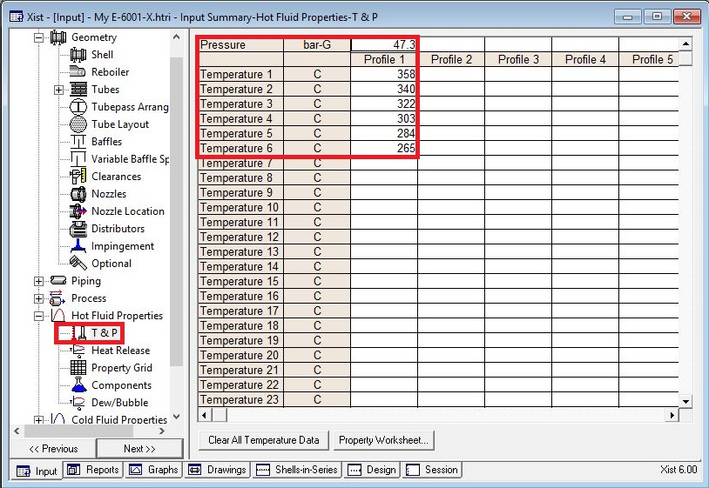
Enter heating and cooling table data in hot and cold fluid properties in red areas

Slide 9
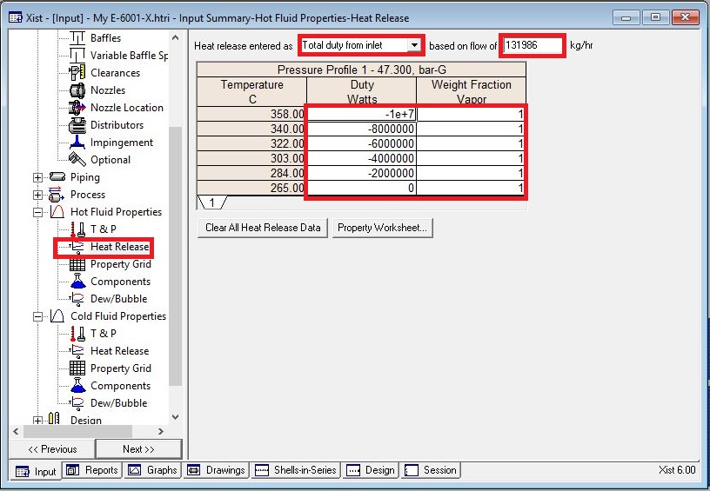
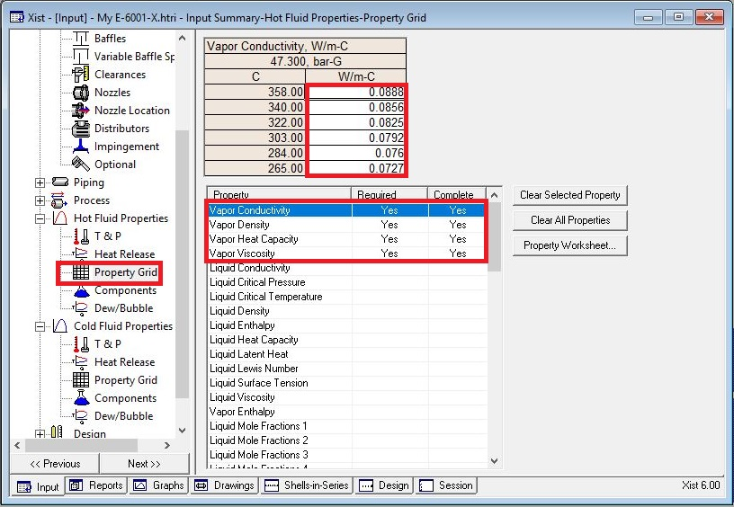

Slide 10
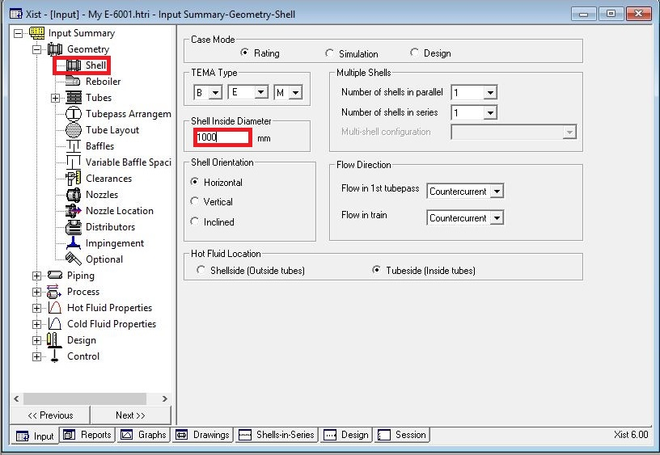
Put shell info in shell sheet in red areas
Note :
1. Initially estimate shell ID between 1.5-3 times tube-side pipeline ID, here it is 16 inch so first estimation would be 1000 mm.

Slide 11
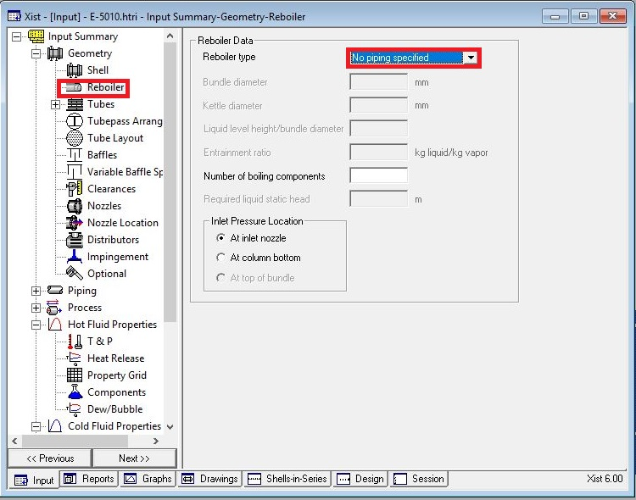
In Reboiler Sheet do not enter an input

Slide 12
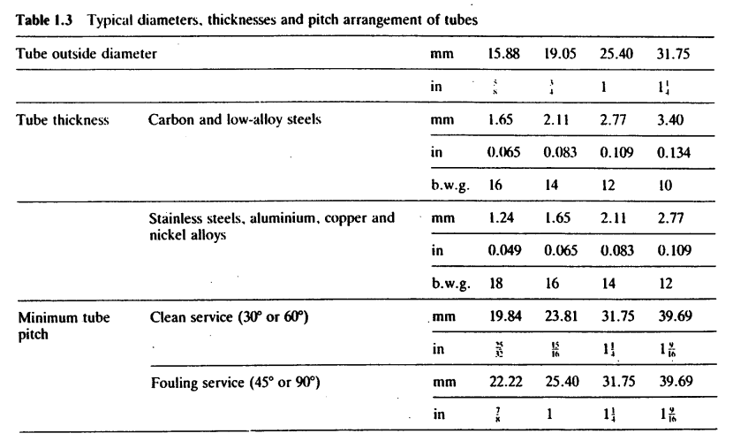
Put Tube mechanical data
25.4 OD is selected and since it is NG, CS is selected.
According to table below tube thickness of 2.77 should be selected but Topsoe has selected 2.11 which I think is better selected than what is selected in Table.

Slide 13
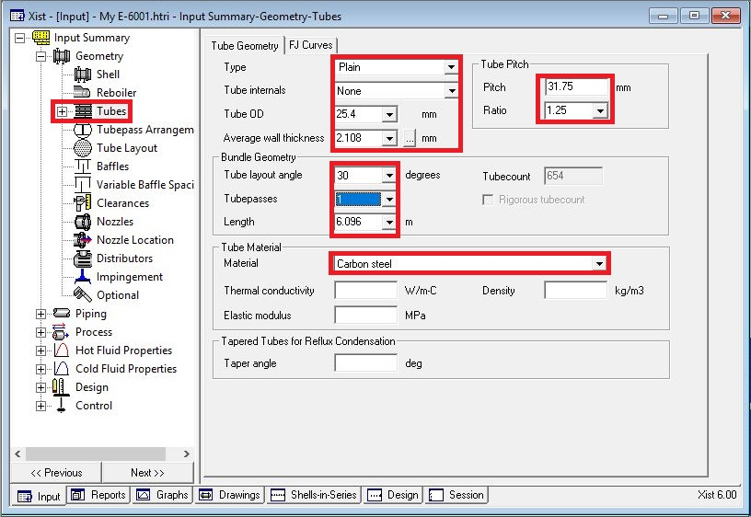

Slide 14
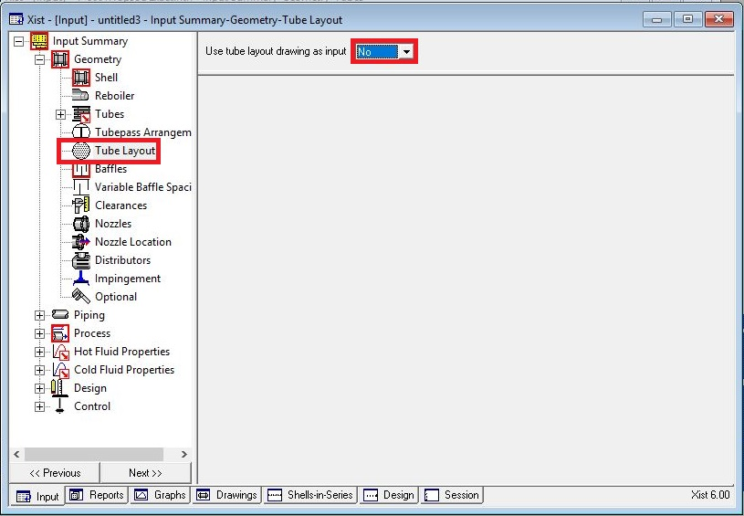
Act like below

Slide 15
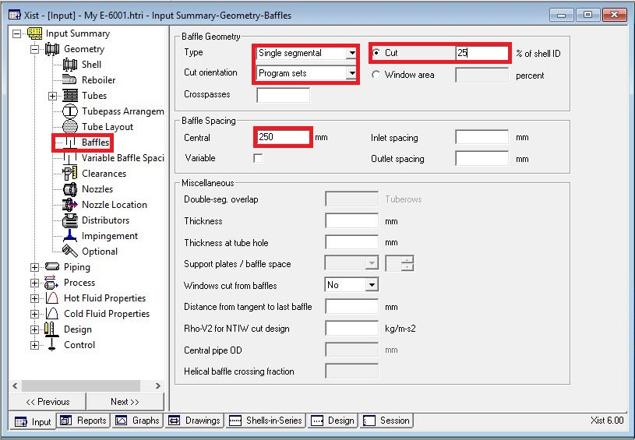
Put baffle info in baffle sheet in red areas like below

Slide 16
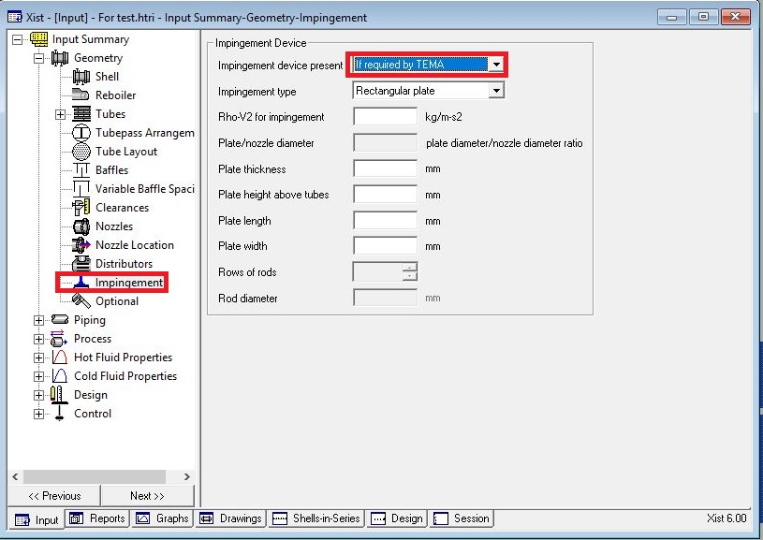
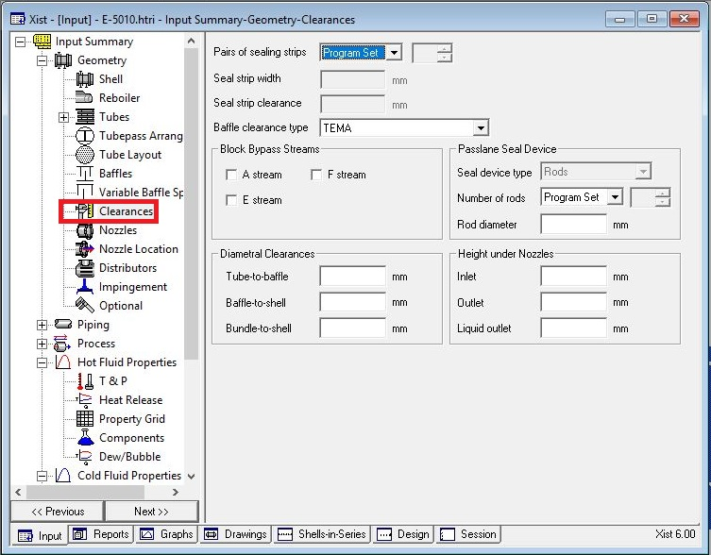
Act exactly like below for impingement sheet and Clearance

Slide 17
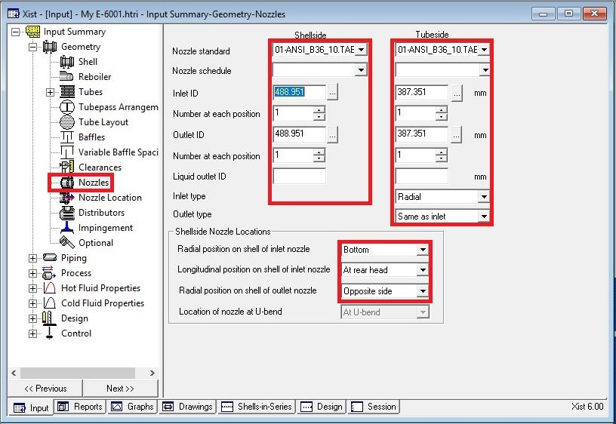
Enter nozzle info from piping info

Slide 18
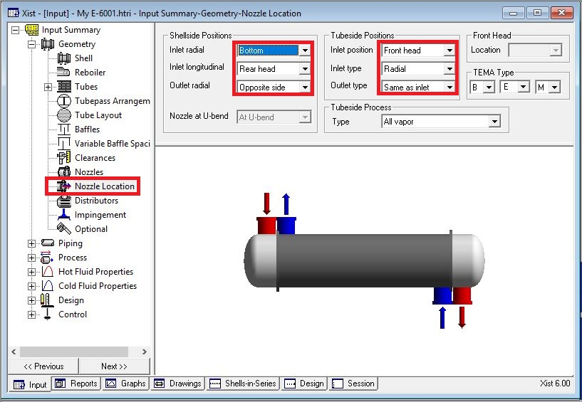
Set nozzle location

Slide 19
Results:
1. Now run and the result is that the dp around shell side is about 23.7 bar and the overdesign factor is
about -5%, so in first step shell ID is increased to 1100 mm and 1200 mm, which results in 6% and 17%
overdesign and 18.9 and 14.5 bar dp respectively. Now instead of increasing more the shell ID, baffle
spacing is increased. Baffle spacing was increased till the warning of exceeding TEMA baffle spacing
limit was activated. For both single segmental and double segmental baffle the trial and error was
performed
Single Segmental Double Segmental
Baffle Spacing | dp
250 | 14.5
300 | 11
350 | 8
400 | 6
450 | 4.5
500 | 5.5
550 | 5.1
650 | 3.2
Baffle Spacing | dp
250 | 5
500 | 1.19
600 | 0.67

Slide 20
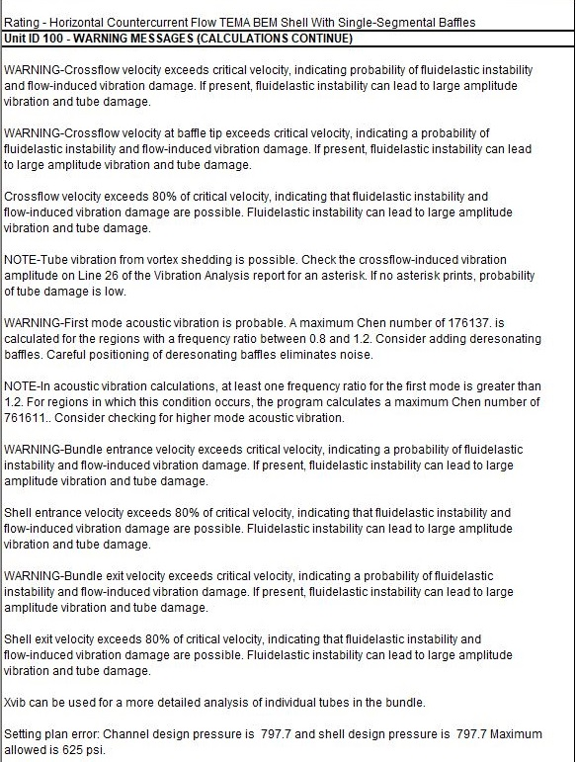

Slide 21
2. Now change heat exchanger type to both X and H type . When changing type to X type, then the
pressure drop reduces to 0.17 and many of the warnings vanishes. HTRI also recommends adding
3 support baffles and the same is done. Then tube layout option is activated and run it again and the
result is that dp becomes 0.3 and overdesign factor becomes -10% but more support baffle is added,
eliminating some of the warnings. But by comparing tube h with shell h we realize that making tube pass
double and run it , this results in h changes from 735 to 1339 , overdesign factor from -10 to 20 % and dp
in tube side from 0.06 to 0.26, tube side velocity from 5 m/s to 10 m/s .
3.Now in order to eliminate shell side flow maldistribution more nozzles are added but other warnings were
eliminated.

Slide 22
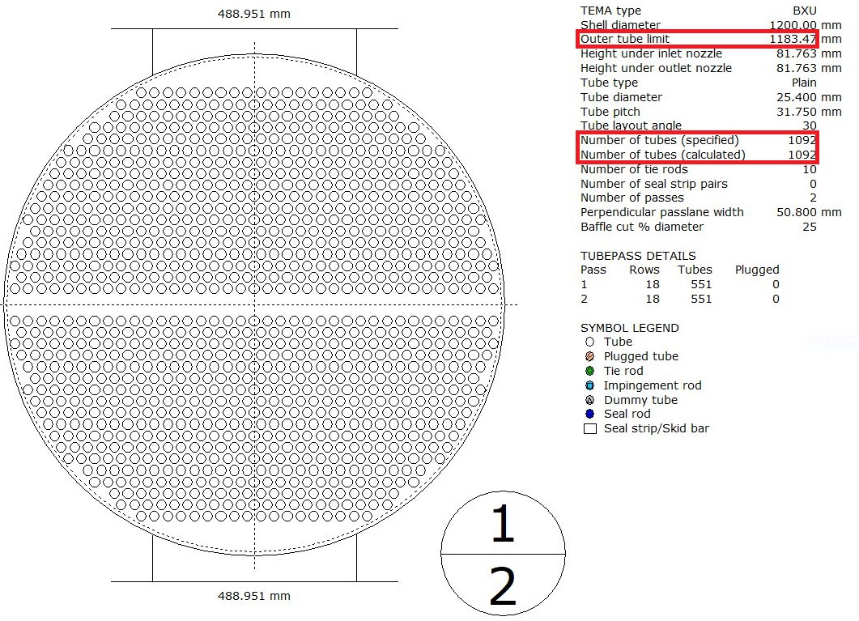
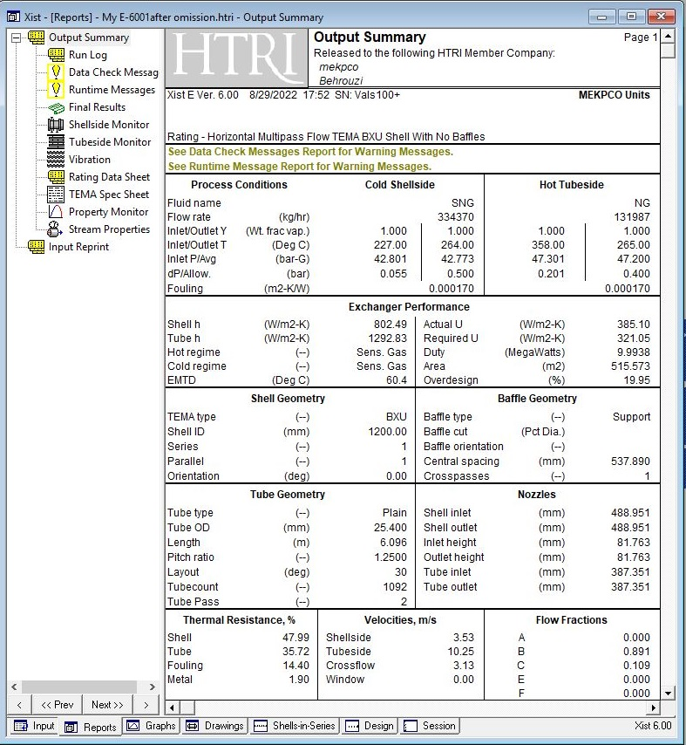
4. Now reduce tube number to adjust overdesign factor.
Before tube omission

Slide 23
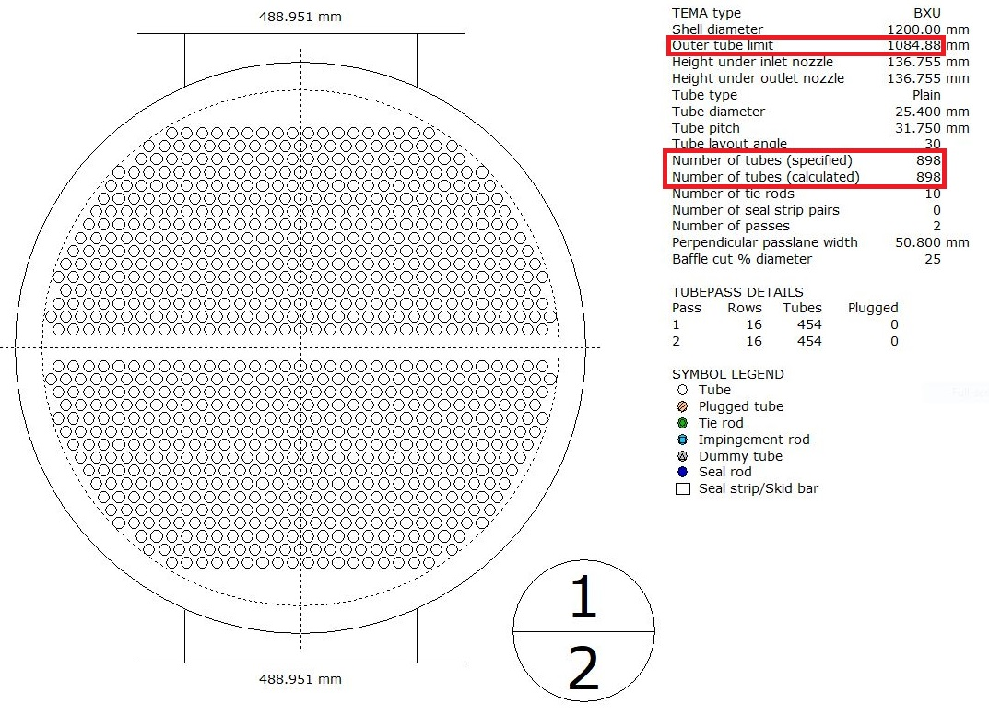
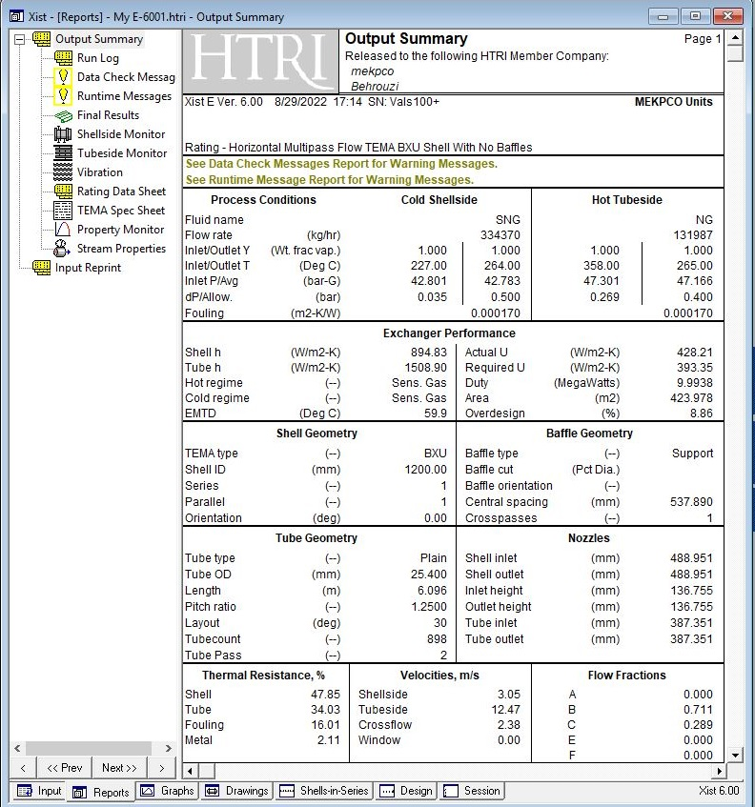
After tube omission

Slide 24
Thanks for your attention
Educational Institute for Process and Equipment Design
Mohammadreza Behrouzi
+989107884134

