Slide 1
A Stepwise
Shell and Tube H.E thermal Design
by HTRI
In 5 minutes!!

Slide 2
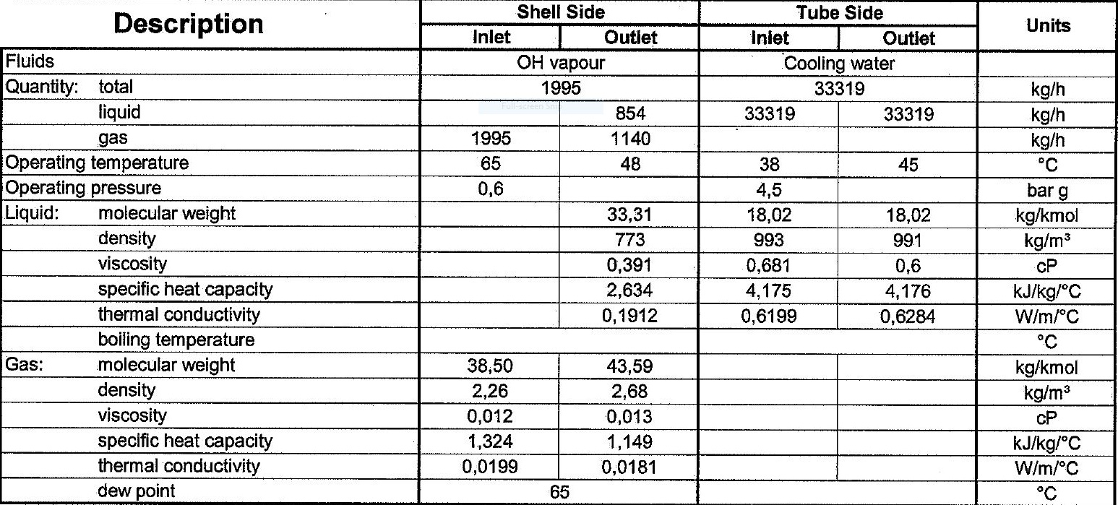
Process data

Slide 3
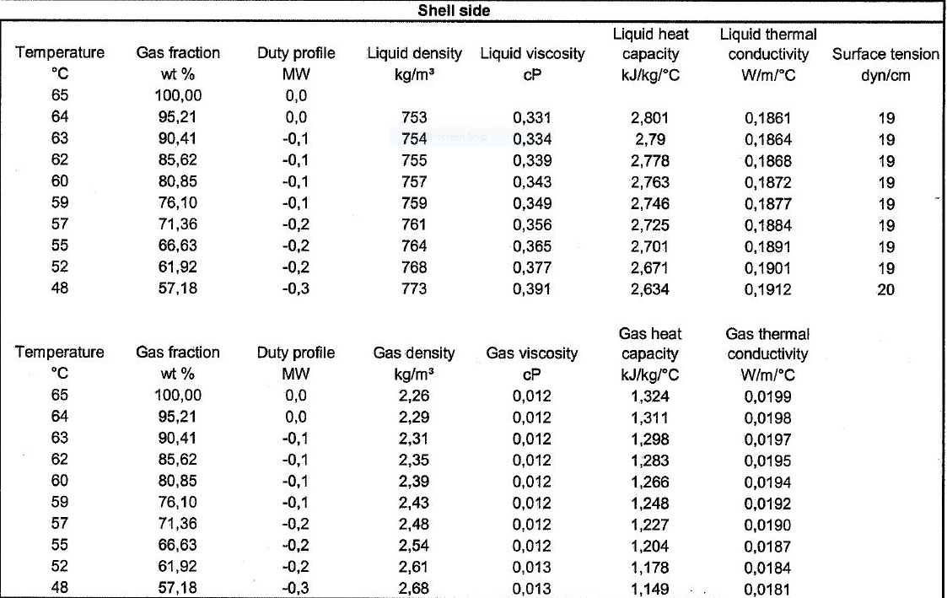
Heating and Cooling Table

Slide 5
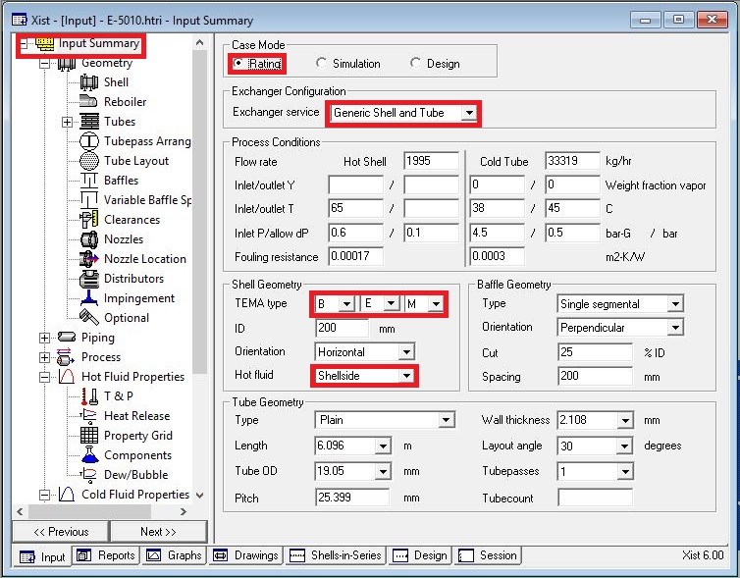
Open HTRI and Input Summery sheet and enter data in red areas

Slide 6
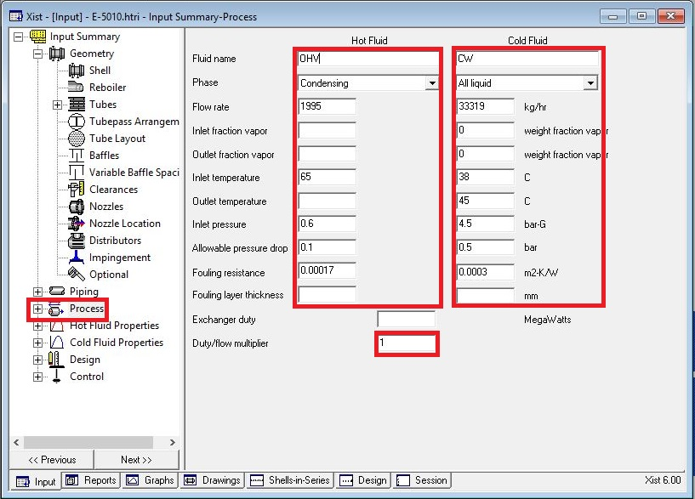
Enter operating data in process sheet in red areas

Slide 7
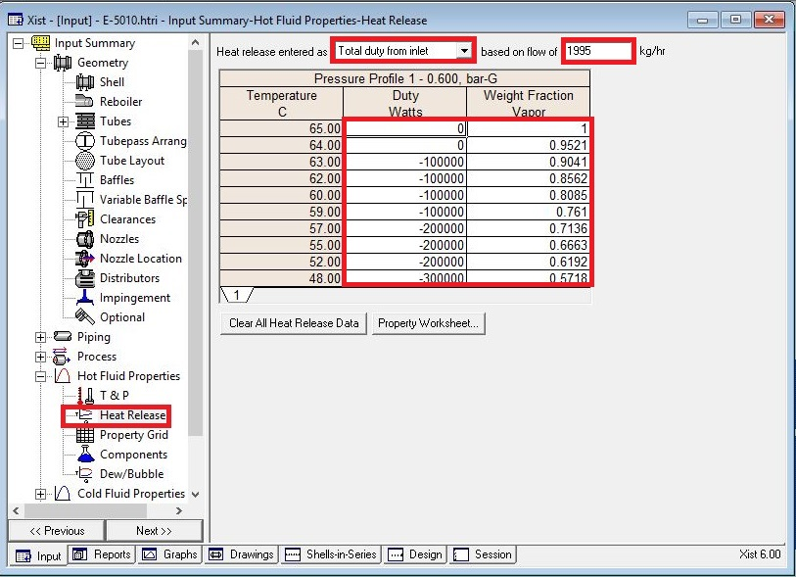
Enter heating and cooling table data in hot and cold fluid properties in red areas

Slide 8
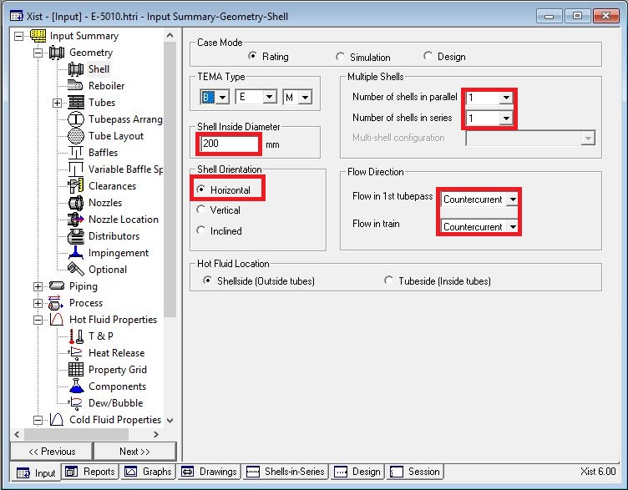
Put shell info in shell sheet in red areas
Note :
1. Initially estimate shell ID between 1.5-3 times tube-side pipeline ID, here it is 3 inch so first estimation would be 9 inch.
2. If there is one heat exchanger act like the rest.

Slide 9
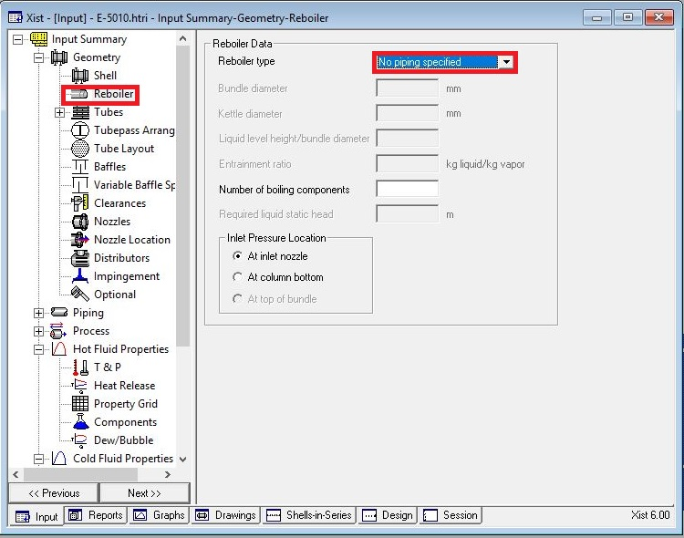
In Reboiler Sheet do not enter an input

Slide 10
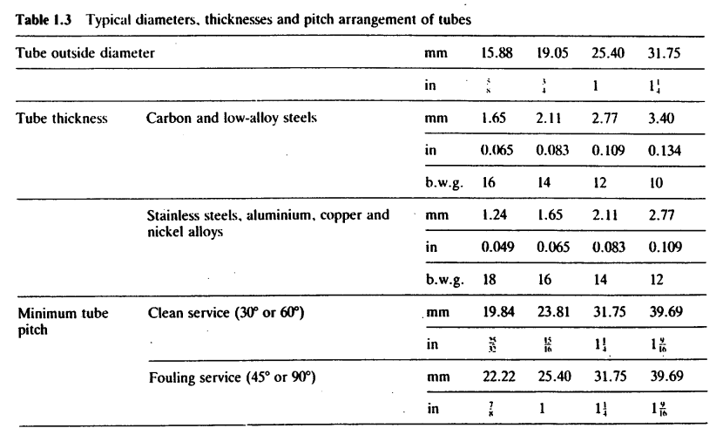
Put Tube mechanical data
Note that since it is cooling water, tube OD 19.05 is selected
Since Tube material is CS, Tube thickness 2.11 is selected according to table below
Select Pitch 25.4 to pass TEMA R.2.5

Slide 12
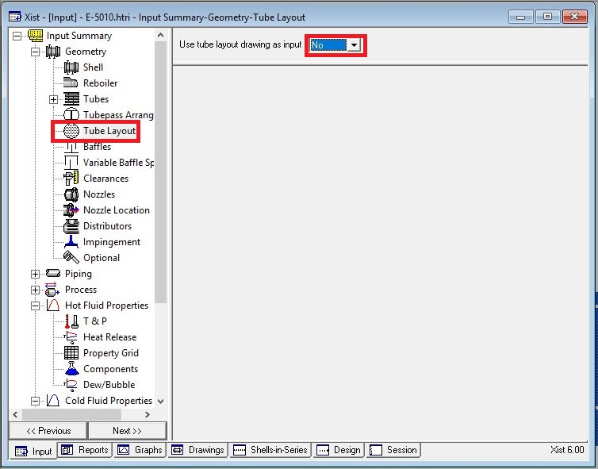
Act like below

Slide 13
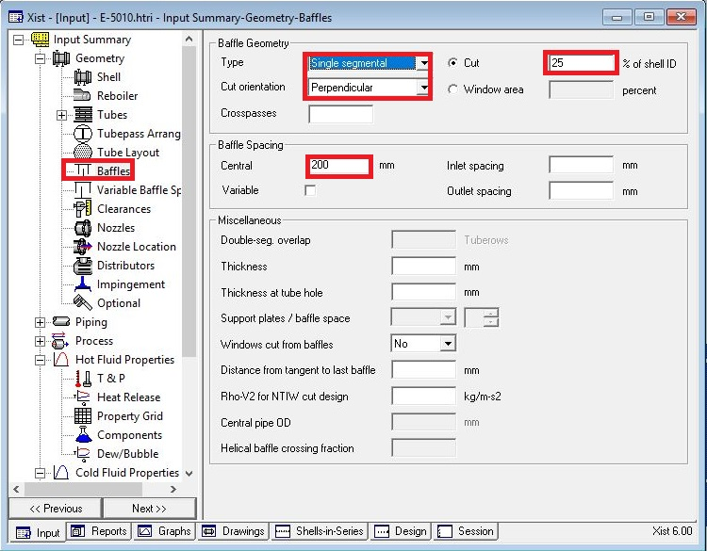
Put baffle info in baffle sheet in red areas like below

Slide 14
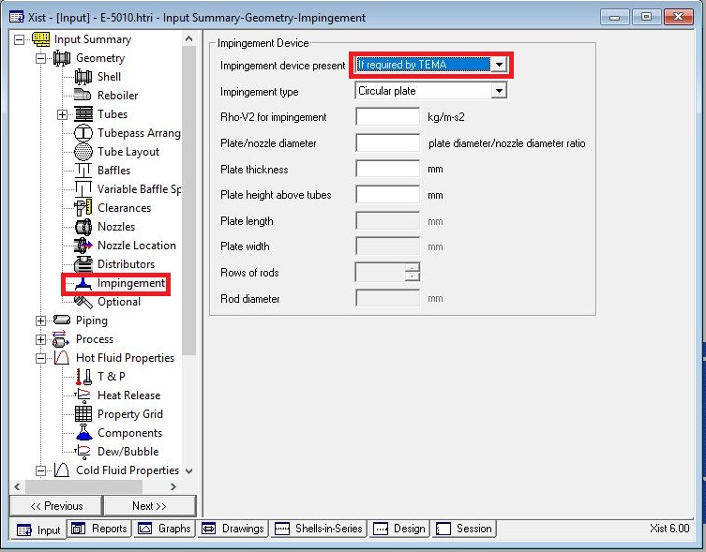
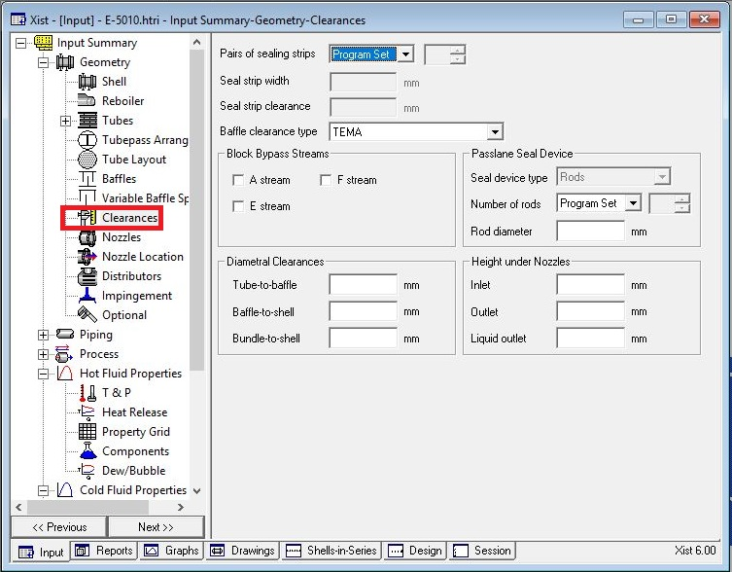
Act exactly like below for impingement sheet and Clearance

Slide 15
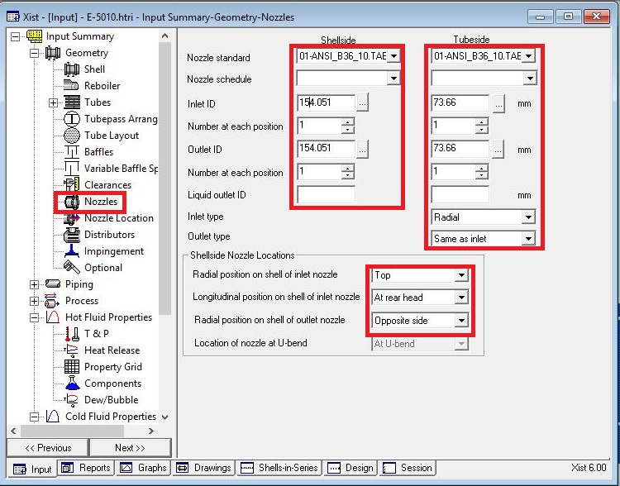
Enter nozzle info from piping info

Slide 16
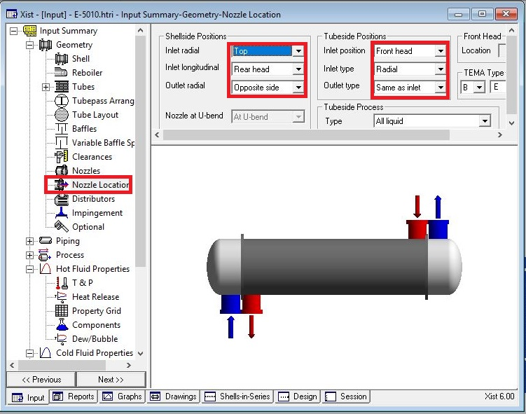
Set nozzle location

Slide 17
Results:
1. Now run and it results that dp in shell-side is 0.28 which is more that 0.1. In addition , overdesign factor is -61%.
2. Now increase shell ID to 300 mm and the dp reduces to 0.16. Moreover, overdesign factor increase.
3. Now increase baffle spacing from 200 to 300 mm and then run it and dp reduces to 0.08 which is less than 0.1 . Thus it is acceptable for now.
4. Next step is to check Runtime messages for any warnings . There is no warning.
5. Now look at water velocity. It is 0.6 m/s and less than 1.05 m/s required by TEMA.
6. In order to increase water velocity , increase tube pass to 2 and as a result, velocity increases to 1.32 but overdesign factor decreased to -25.73% and dp in tube side increased to 0.3. this is due to direct impact of v2 on dp.
7. Now to satisfy overdesign factor, increase shell ID to 350 mm and as a result, not only overdesign factor increases to 1.4 but also dp in tube side reduces to 0.17 but simultaneously, water velocity decreases to 0.9 m/s which is below 1.05 m/s .
8. Increase tube pass to 3 and run. The result is that water velocity became 1.46 m/s and overdesign factor reaches 21%
9. Since shell-side is controlling it is better now to play with baffle spacing and when different baffle spacing is tested, according to table below

Slide 18
Baffle cut | Overdesign factor
25 | 21
27 | 22
29 | 23
31 | 23.5
33 | 24.3
35 | 27
38 | 27
40 | 25.5

Slide 19
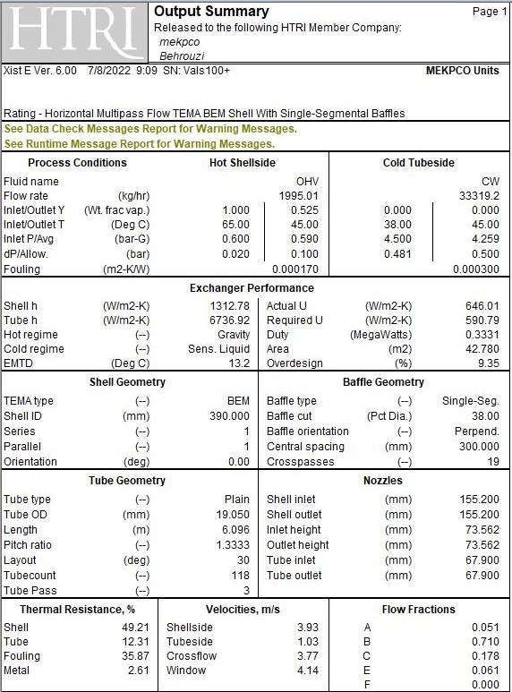
10.Now activate tube layout option and run it again. By doing so, overdesign factor reduces to 8% and water velocity reduces to 1.11 m/s. and dp increases in tube side.
11. Now increase the shell ID to 390 mm and satisfy dp factor. Then eliminate 4 tubes to reduce overdesign factor to 10%.

Slide 20
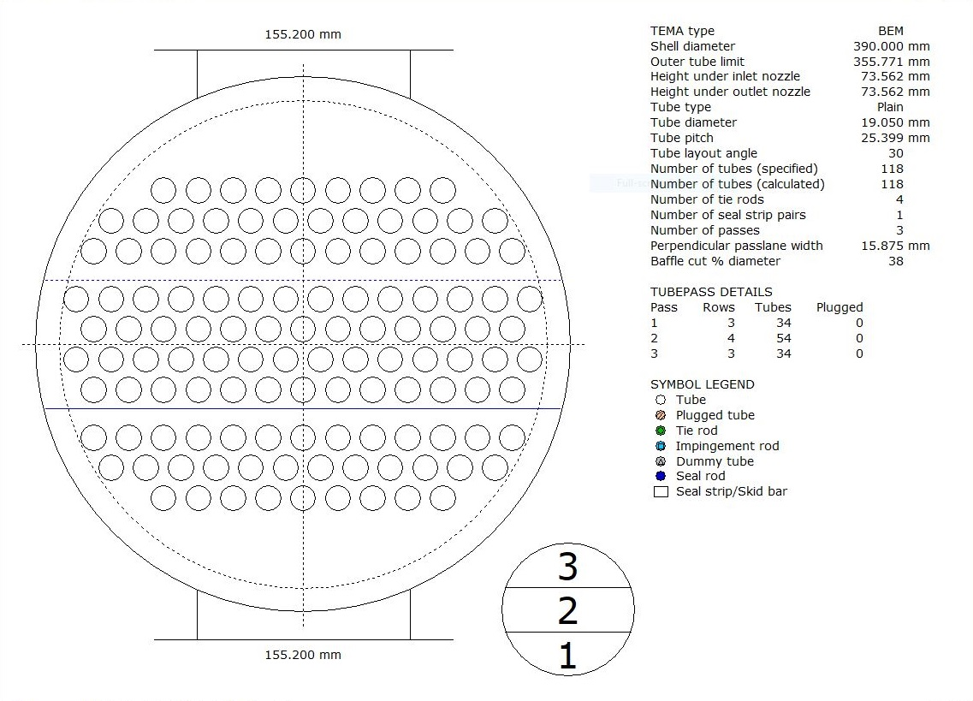

Slide 21
Thanks for your attention
Educational Institute for Process and Equipment Design
Mohammadreza Behrouzi
+989107884134

