Slide 1
A Stepwise
Reboiler thermal Design
by HTRI
In 5 minutes!!

Slide 2
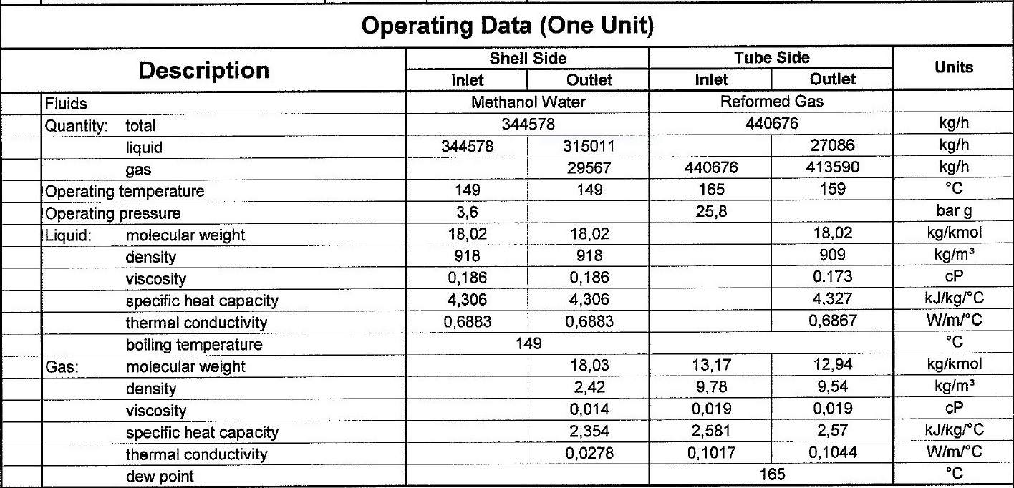
Process data

Slide 3
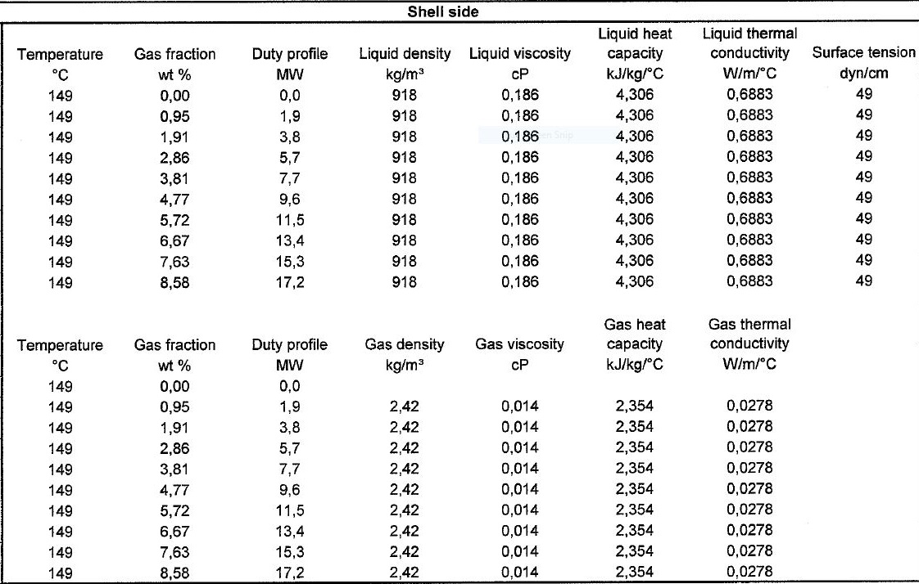
Heating and Cooling Table

Slide 5
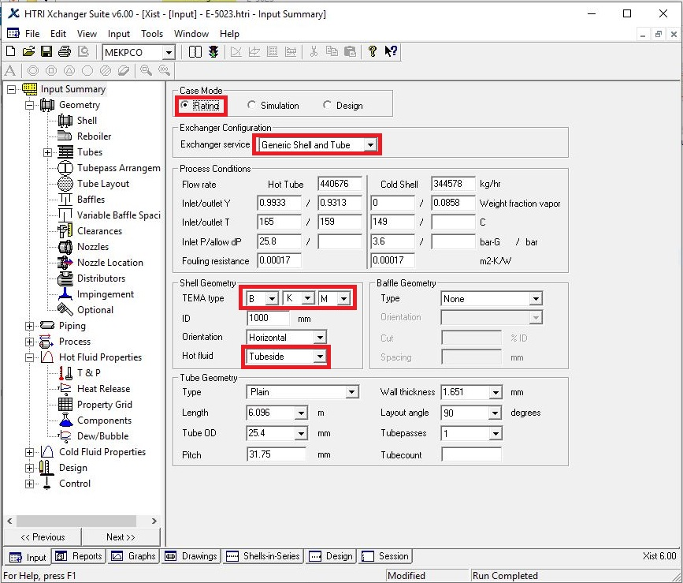
Open HTRI and Input Summery sheet and enter data in red areas

Slide 6
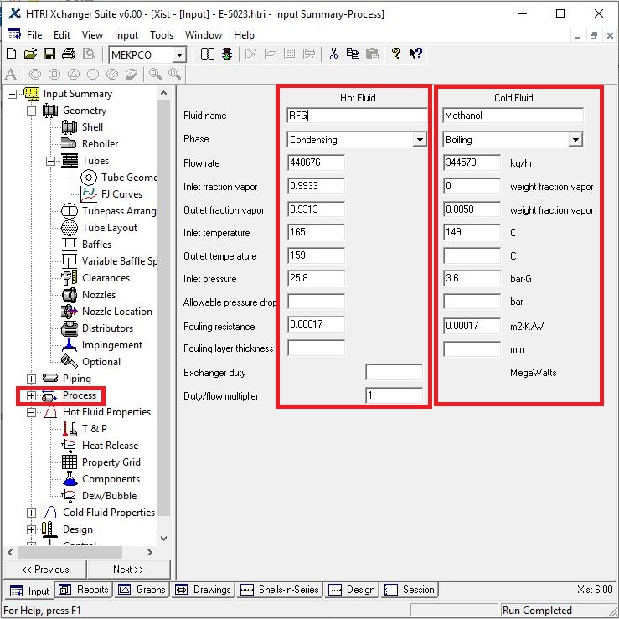
Enter operating data in process sheet in red areas

Slide 7
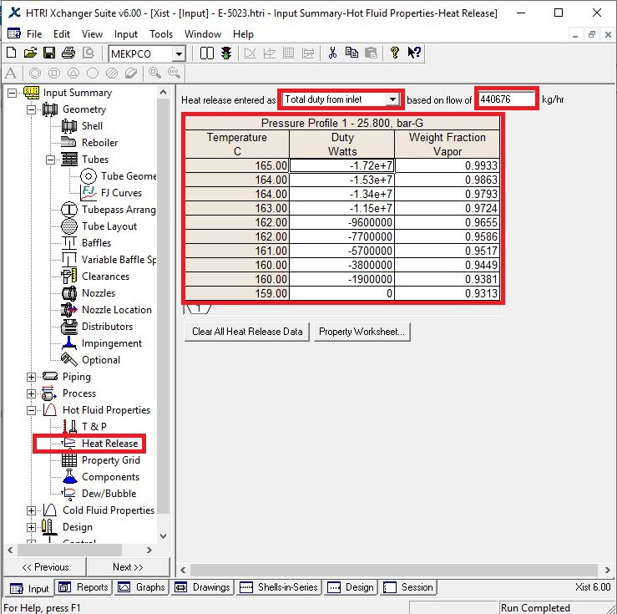
Enter heating and cooling table data in hot and cold fluid properties in red areas

Slide 8
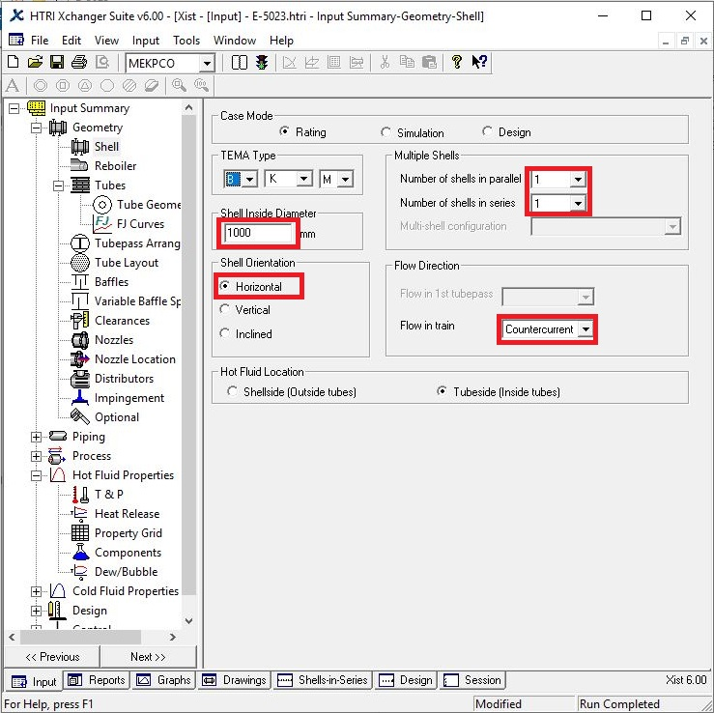
Put shell info in shell sheet in red areas
Note :
1. Initially estimate shell ID between 1.5-3 times tube-side pipeline ID, here it is 34 inch so first estimation would be 1000 mm.
2. If there is one heat exchanger act like the rest.

Slide 9
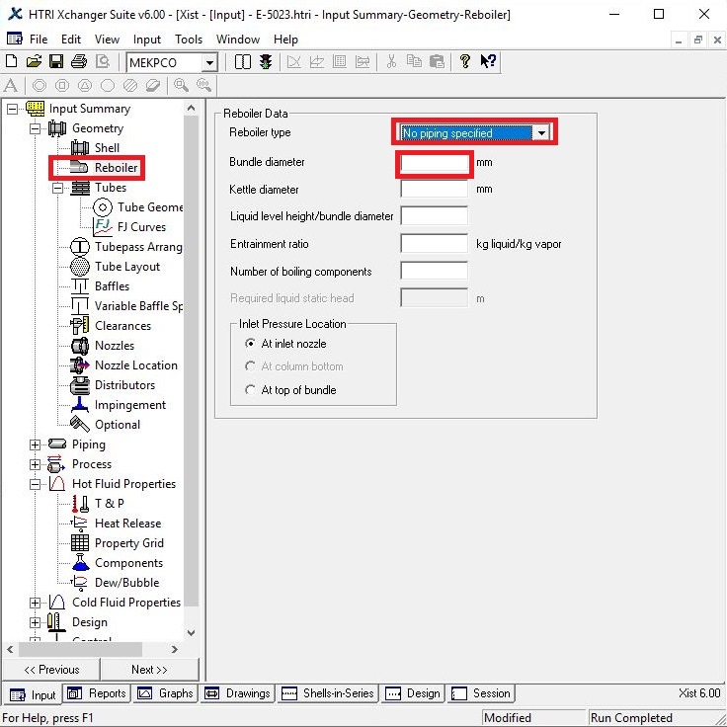
In Reboiler Sheet do not enter an input and let the HTRI calculate bundle ID

Slide 10
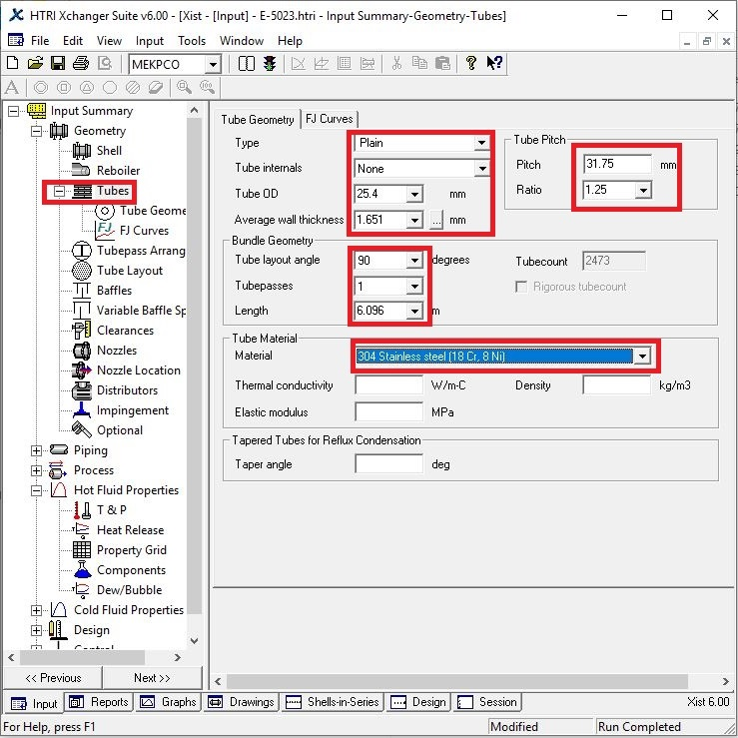
Put Tube mechanical data
Note that since it is a reformed gas, tube OD 25.4 is selected
Since Tube material is SS304, Tube thickness 1.65 is selected.
Select Pitch 31.75 to pass TEMA R.2.5
Due to RCB.2.4.1 in TEMA, which is about SQUARE pattern and states that In removable bundle units, when mechanical cleaning of the tubes is specified by the purchaser, tube lanes should be continuous, 90 for tube layout angle is selected.

Slide 11
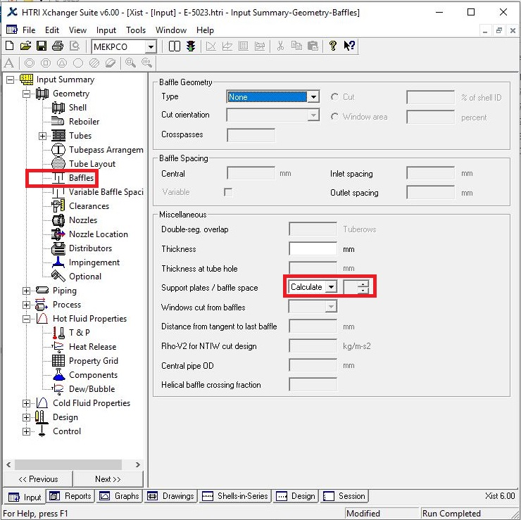
Put baffle info in baffle sheet in red areas like below

Slide 12
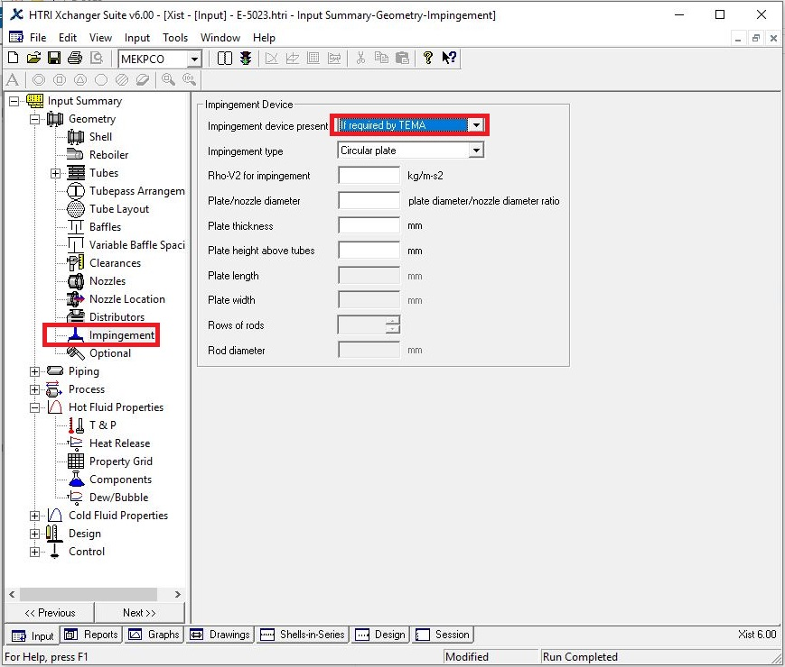
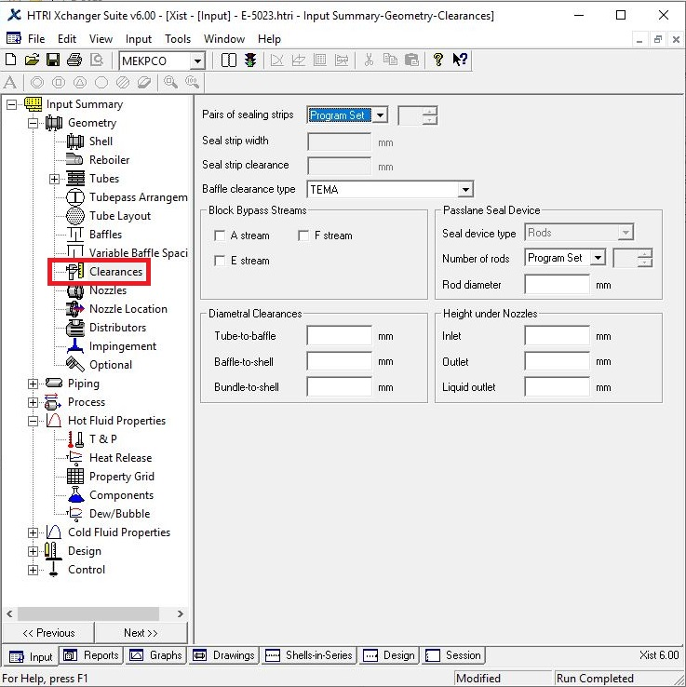
Act exactly like below for impingement sheet and Clearance

Slide 13
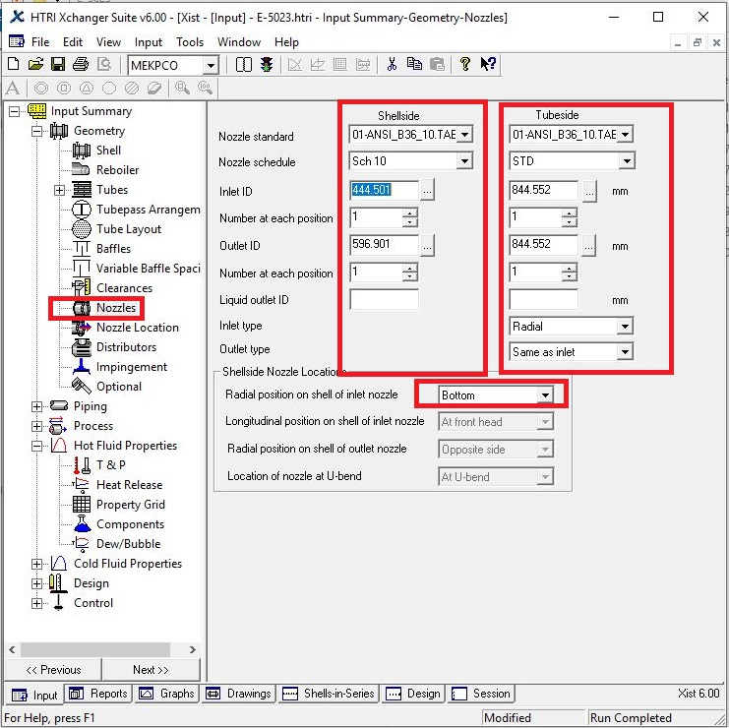
Enter nozzle info from piping info

Slide 14
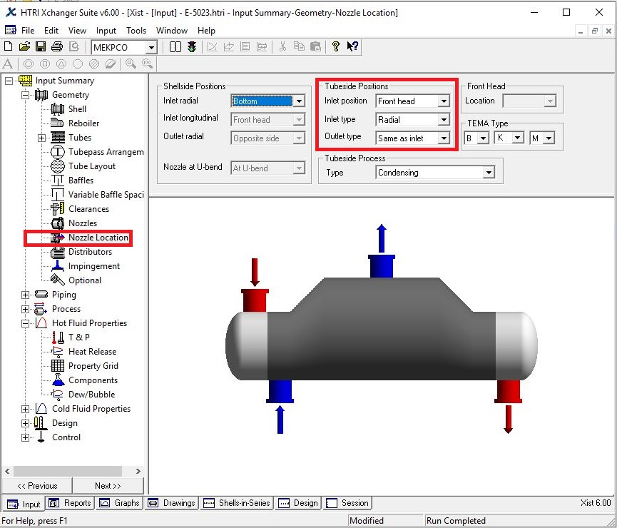
Set nozzle location

Slide 15
Results:
1. Now run and it results that dp is 0.98 which is more that 0.15. In addition , there are a number of flow-induced and velocity-related problem.
2. Now increase shell ID to 1400 mm and the dp reduces to 0.28. Moreover, overdesign factor increase.
3. Now increase shell ID to 1600 and then 1800 and 1850mm. Now the dp factor is in range.
4. Next step is to check Runtime messages for any warnings . There is the warning concerning crossflow velocity and fluid-elastic-instability vibration. In order to resolve the problem, listen to HTRI advice and go to Baffle Sheet and add increase baffle support to 4 and the problem goes away.
Now look at the final results in next pages.

Slide 16
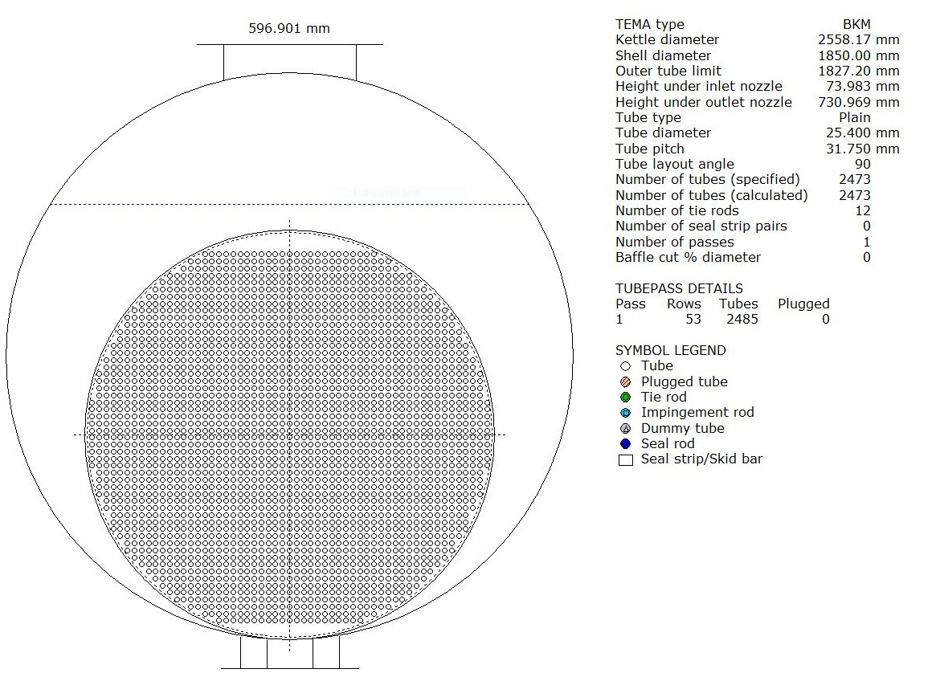

Slide 18
Thanks for your attention
Educational Institute for Process and Equipment Design
Mohammadreza Behrouzi
+989107884134

