Slide 1
PSV SIZING in 5 minutes!!

Slide 2
1. Heat Exchanger Data Input
High pressure side | Reformed Gas
Low pressure side | Cooling Water
Design Pressure of high pressure side | 29 barg
Design Pressure of low pressure side | 7.5 barg
Operating Pressure | 24.2 barg
M | 11.24
Cp/Cv | 1.39
Z | 1
Relieving Temperature | 56.4
Tube OD | 19.05
Tube Thk. | 2.11

Slide 3
2. Check if a PSV is needed In order to perform this step, do the calculation below: multiply design pressure of high pressure side by 10/13: 29 * 10/13 = 22.3 barg So, design pressure of low pressure side should be at least 22.3 barg in order not to need a PSV. Here it is 7.5 bars, thereby requiring a PSV.

Slide 4
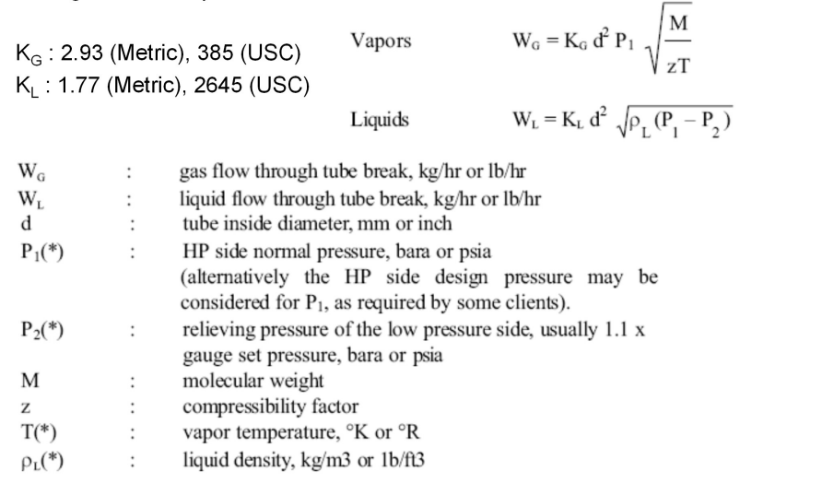
3. Use the formula below to calculate Relief Load

Slide 5
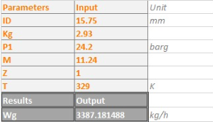
4. Relief Load Result

Slide 6
5. Use the formula below to calculate orifice area

Slide 7
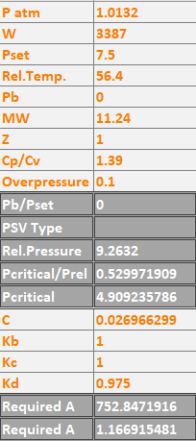
6. Results Note that since the PSV outlet is discharged to atmosphere, a Conventional type is selected.

Slide 8
Thank you for your attention Education Institute for Process and Equipment Design Mohammadreza Behrouzi +989107884134

