Slide 1
Tube Rupture Scenario E-3003

Slide 2
1. Heat Exchanger Data Input
High pressure side | Syngas
Low pressure side | CW
Design Pressure of high pressure side | 99 barg
Design Pressure of low pressure side | 7.5 barg
Operating Pressure | 83.7 barg
M | 10.07
Cp/Cv | 1.37
Z | 1
Relieving Temperature | 41.8
Tube OD | 25.4
Tube Thk. | 1.65

Slide 3
2. Check if a PSV is needed In order to perform this step, do the calculation below: multiply design pressure of high pressure side by 10/13: 99 * 10/13 = 76.15 barg So, design pressure of low pressure side should be at least 76.15 barg in order not to need a PSV. Here it is 7.5 bars, thereby requiring a PSV.

Slide 4
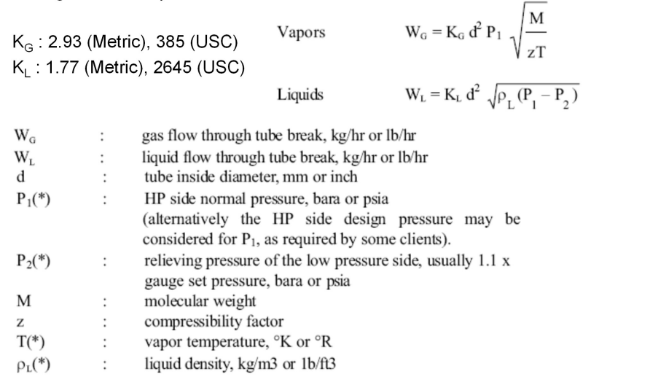
3. Use the formula below to calculate Relief Load

Slide 5
4. Relief Load Result
Standard | API-521 | Topsoe | TCC
Wg | 21675 kg/h | 19680 kg/h | 20309 kg/h

Slide 6
5. Use the formula below to calculate orifice area

Slide 7
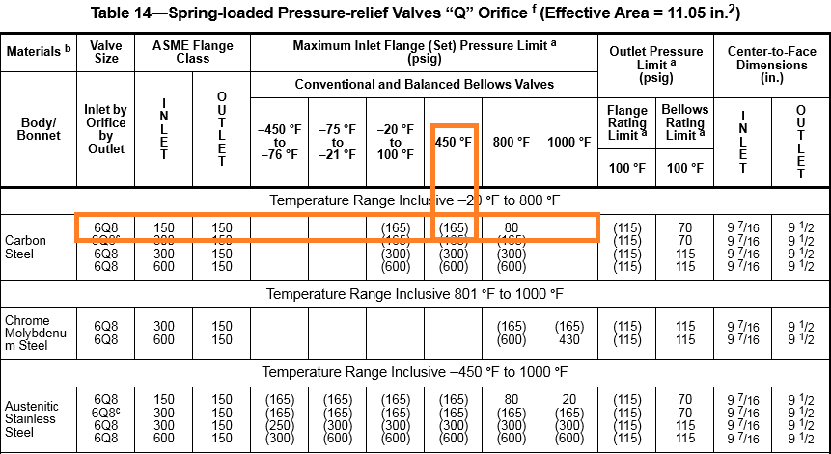
6. Results According to table above 6Q8 is selected .Due to low Pb/Pset conventional type can be selected
Standard | API-521 | Topsoe | TCC
Orifice area | 50 cm2 | 45.28 cm2

Slide 8
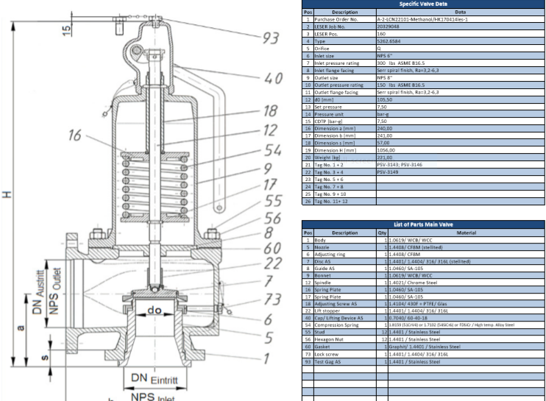

Slide 9
Thank you for your attention Education Institute for Process and Equipment Design Mohammadreza Behrouzi +989107884134

