Slide 1
Tube Rupture Scenario
E-2025

Slide 2
1. Heat Exchanger Data Input
High pressure side | Reformed Gas
Low pressure side | CW
Design Pressure of high pressure side | 29 barg
Design Pressure of low pressure side | 7.5 barg
Operating Pressure | 24.2 barg
M | 11.24
Cp/Cv | 1.39
Z | 1
Relieving Temperature | 56.4
Tube OD | 19.05
Tube Thk. | 1.65

Slide 3
2. Check if a PSV is needed
In order to perform this step, do the calculation below: multiply design pressure of high pressure side by 10/13:
29 * 10/13 = 22.3 barg
So, design pressure of low pressure side should be at least 22.3 barg in order not to need a PSV. Here it is 7.5 bars, thereby requiring a PSV.

Slide 4
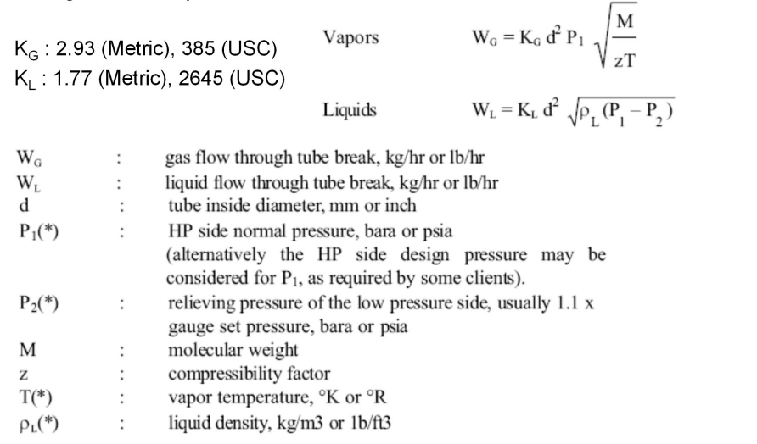
3. Use the formula below to calculate Relief Load

Slide 5
4. Relief Load Result
Standard | API-521 | Topsoe | TCC
Wg | 3387 kg/h | 3011 kg/h | 3011 kg/h

Slide 6
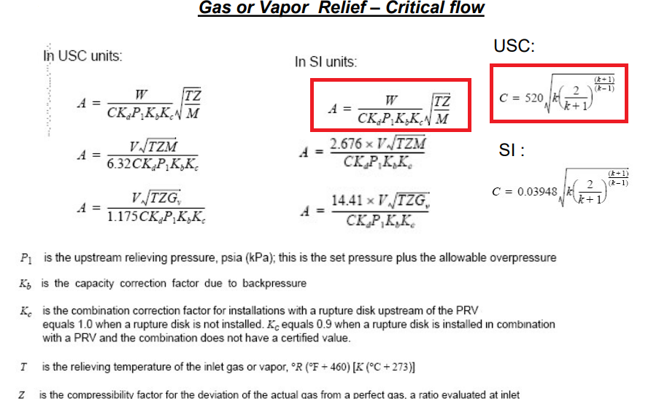
5. Use the formula below to calculate orifice area

Slide 7
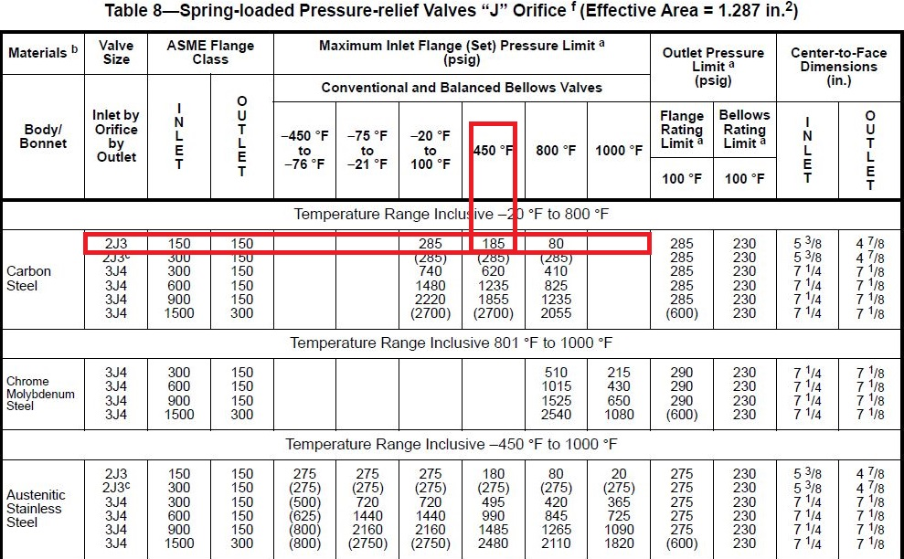
6. Results
According to table above 2J3 is selected but Topsoe has selected 3J4
Due to low Pb/Pset conventional type can be selected
Standard | API-521 | Topsoe | TCC
Orifice area | 7.52 cm2 | 6.68 cm2

Slide 9
Thank you for your attention
Education Institute for Process and Equipment Design
Mohammadreza Behrouzi
+989107884134

