Slide 1
Hydraulic Expansion Scenario
E-6003
PSV-6085

Slide 2
1. Use the formula below to calculate Relief Load

Slide 3
Relief Load Calculation
Parameters | value
av ( 1/k ) | 0.000454
duty (watts) | 1900000
specific gravity | 0.99
c ( J/kg.K) | 4176
Q (lit/m) | 12.51
Q (kg/h)-API521 | 750
Q (kg/h)-Topsoe | 705

Slide 4
2. Calculate orifice area

Slide 5
Orifice area calculation
Q | 12.51
G | 0.99
P1 | 8.25 barg
P2 | 0 barg
Kw | 1
Kc | 0.65
Kd | 1
Kv | 1
Calculated Orifice Area-API521 | 0.078cm2
Calculated Orifice Area-Topsoe | 0.08cm2

Slide 6
3. Kv calculation
1. Estimate Kv=1
2. Calculate Orifice area
3. Calculate Reynold’s Number according to the following equation :
4. Calculate new Kv
5. Divide calculated orifice area in step 2 by new Kv
6. Check API-526 for nearest orifice area

Slide 7
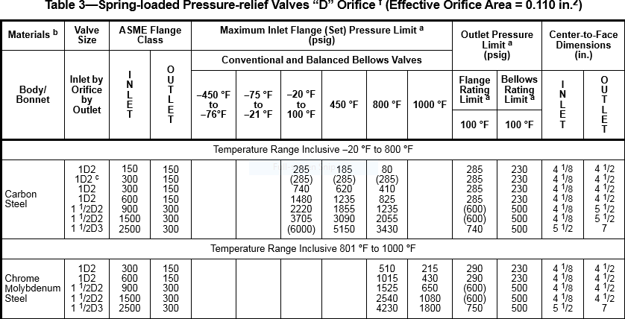
Results
Kv | 0.98
Re | 48523
Selected orifice area | 0.11 inch
PSV Designation | ¾” D 1”

Slide 8
