Slide 1
PSV-6027
Fire Scenario
wetted Surface

Slide 2
PSV SIZING PROCEDURE FOR UNWETTED FIRE SCENARIO
1.Determine the scenario, using API-521
2.Calculate the relief load, using API-520 Part1
3.Calculate the orifice area, using API-520 Part1
4.Select proper PSV type by checking backpressure
5.Use API-526 to determine the designation and the inlet and outlet sizing
6.Use API-520 Part2 to detail its construction

Slide 3
1.Determine the scenario, using API-521
Since it is T-6001 and exposed to fire then a fire scenario is defined.
Parameters | Value | Parameters | Value
Diameter | 2.150 m | M | 18.02
Height | 2.5 m | Set Pressure | 45 barg
Fluid | Steam | Relieving Pressure | 55.45 bara
Z | 0.78 | Accumulation | 0.21
Cp/Cv | 1.09 | Material | CS

Slide 4
2.Calculate the relief load, using API-520 Part1
Where adequate drainage and firefighting equipment do not exist, Equation (8) should be used

Slide 5
Calculation
Parameters | Value
Aw | 21.91 m2
C2 | 70900
F | 1
λ | 2620
Relief load | 1234 kg/h

Slide 6
3.Calculate orifice area
Determine if it is in critical flow:
If so, then :

Slide 9
5.Use API-526 to determine the designation and the inlet and outlet sizing
Since it is less than 0.11 inch then D is selected. Also, by checking its rating and temperature
limitation, 11/2G3 is selected. But TOPSOE has selected 1E2 in site .

Slide 10
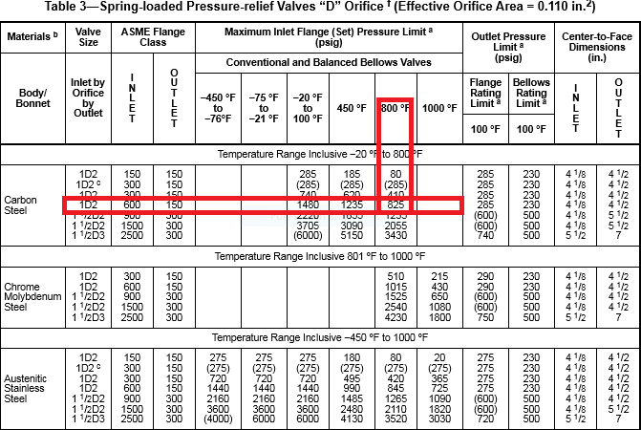

Slide 11
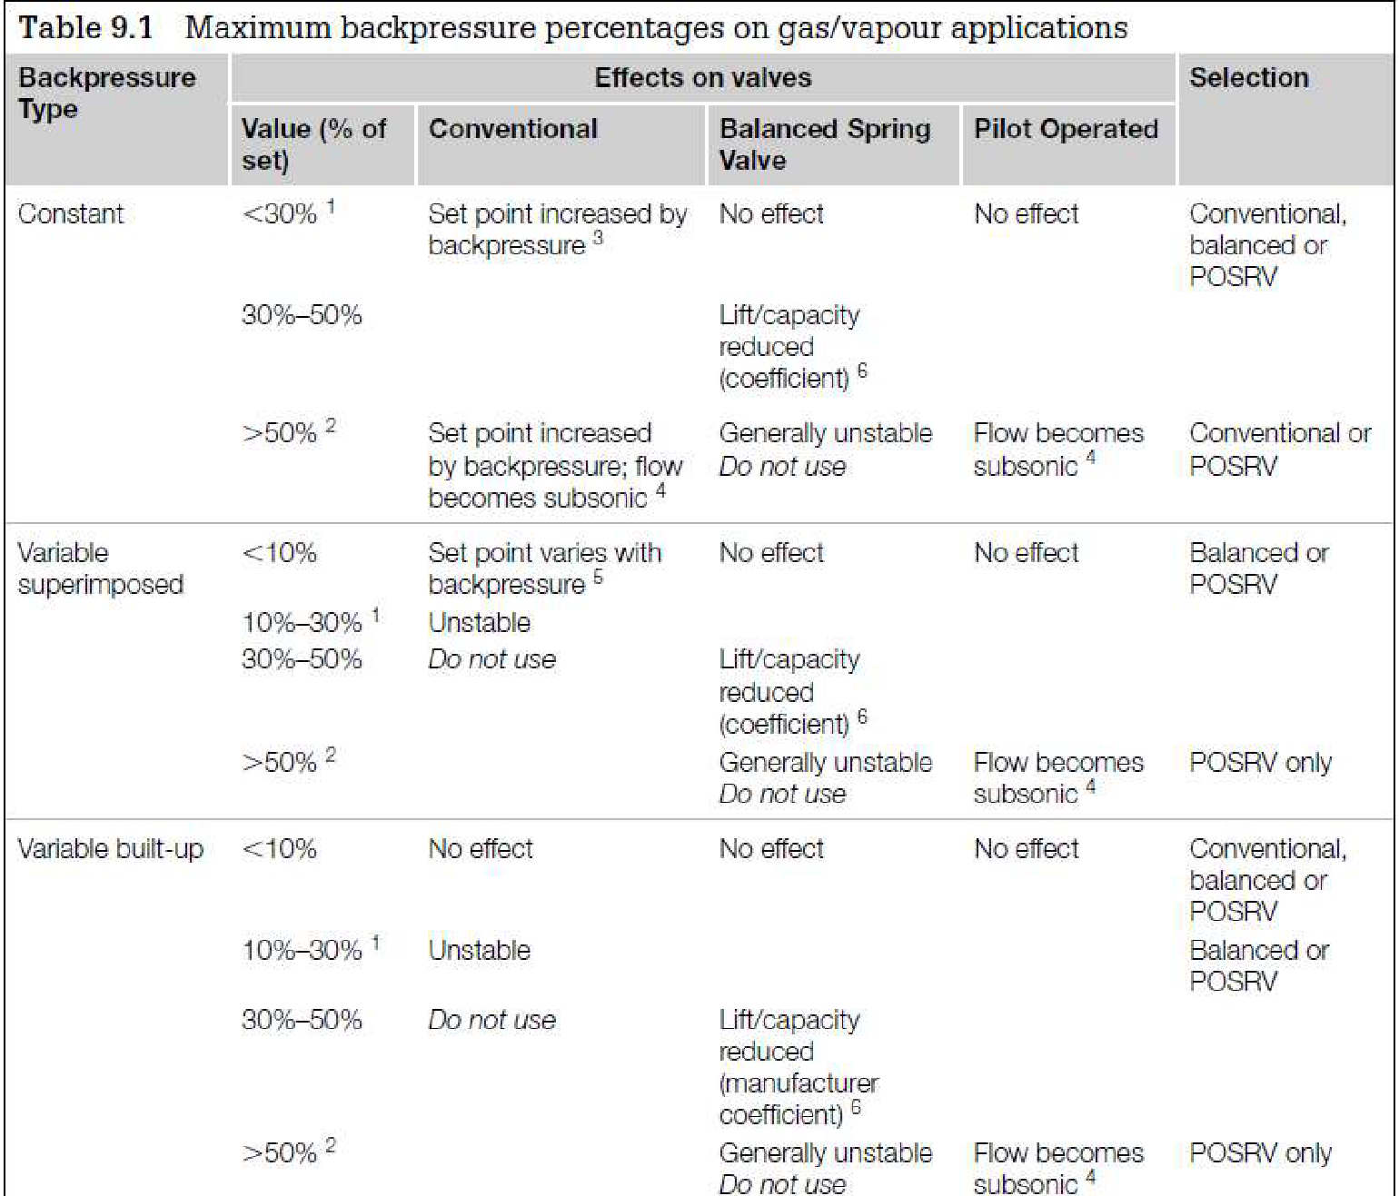
Select proper PSV type by checking backpressure
According to licensor data, superimposed and build-up backpressure are max 21barg. Even though selecting Conventional type is not recommended, Conventional type has been selected by LESER.
superimposed | Build-up | Total
0 barg | 21 barg | 21 barg
0% | 46% | 46%

Slide 12
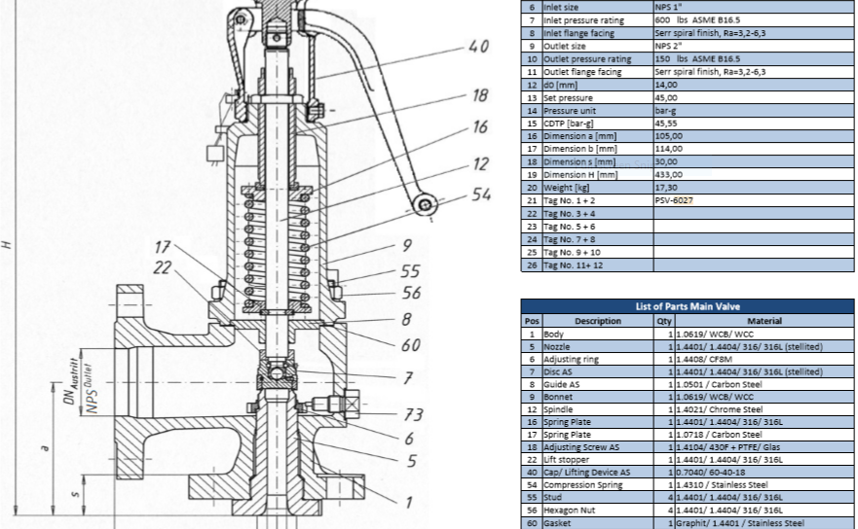
Material Selection

Slide 13
Discussion
The relief load calculated by TOPSOE is 2560 , by TCC is 1824 and by me is 1234 kg/h. In this
case the main difference stems from heating value difference between TOPSOE , TCC and me.
2. Due to relief load differences, orifice area differs as a result. For TOPSOE E designation is suitable
while for me D designation is ok.

