Slide 1
PSV-5384-5386
Fire Scenario
wetted Surface

Slide 2
PSV SIZING PROCEDURE FOR UNWETTED FIRE SCENARIO
1.Determine the scenario, using API-521
2.Calculate the relief load, using API-520 Part1
3.Calculate the orifice area, using API-520 Part1
4.Select proper PSV type by checking backpressure
5.Use API-526 to determine the designation and the inlet and outlet sizing
6.Use API-520 Part2 to detail its construction

Slide 3
1.Determine the scenario, using API-521
Since it is K.N Drum and exposed to fire then a fire scenario is defined.
Parameters | Value | Parameters | Value
Diameter | 3.9m | M | 32
Height | 4.555 m | Set Pressure | 19 barg
Fluid | Methanol | Relieving Pressure | 23.99 bara
Z | 0.8 | Accumulation | 0.21
Cp/Cv | 1.1 | Material | CS

Slide 4
2.Calculate the relief load, using API-520 Part1
Where adequate drainage and firefighting equipment do not exist, Equation (8) should be used

Slide 5
Calculation
Parameters | Value
Aw | 72.4 m2
C2 | 70900
F | 1
λ | 832 kj/kg
Relief load | 10269 kg/h

Slide 6
3.Calculate orifice area
Determine if it is in critical flow:
If so, then :

Slide 9
5.Use API-526 to determine the designation and the inlet and outlet sizing
Since it is more than 0.78 inch then J is selected. Also, by checking its rating and temperature
limitation, 2J3 is selected. But Topsoe has selected 2H3 in site .

Slide 10
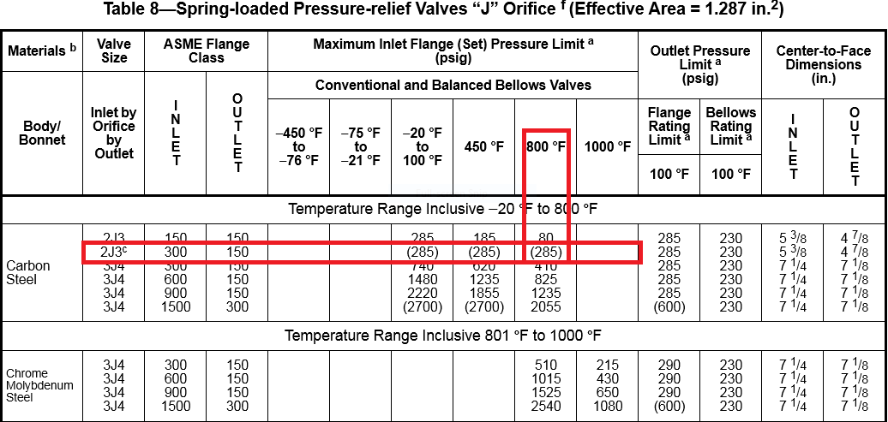

Slide 11
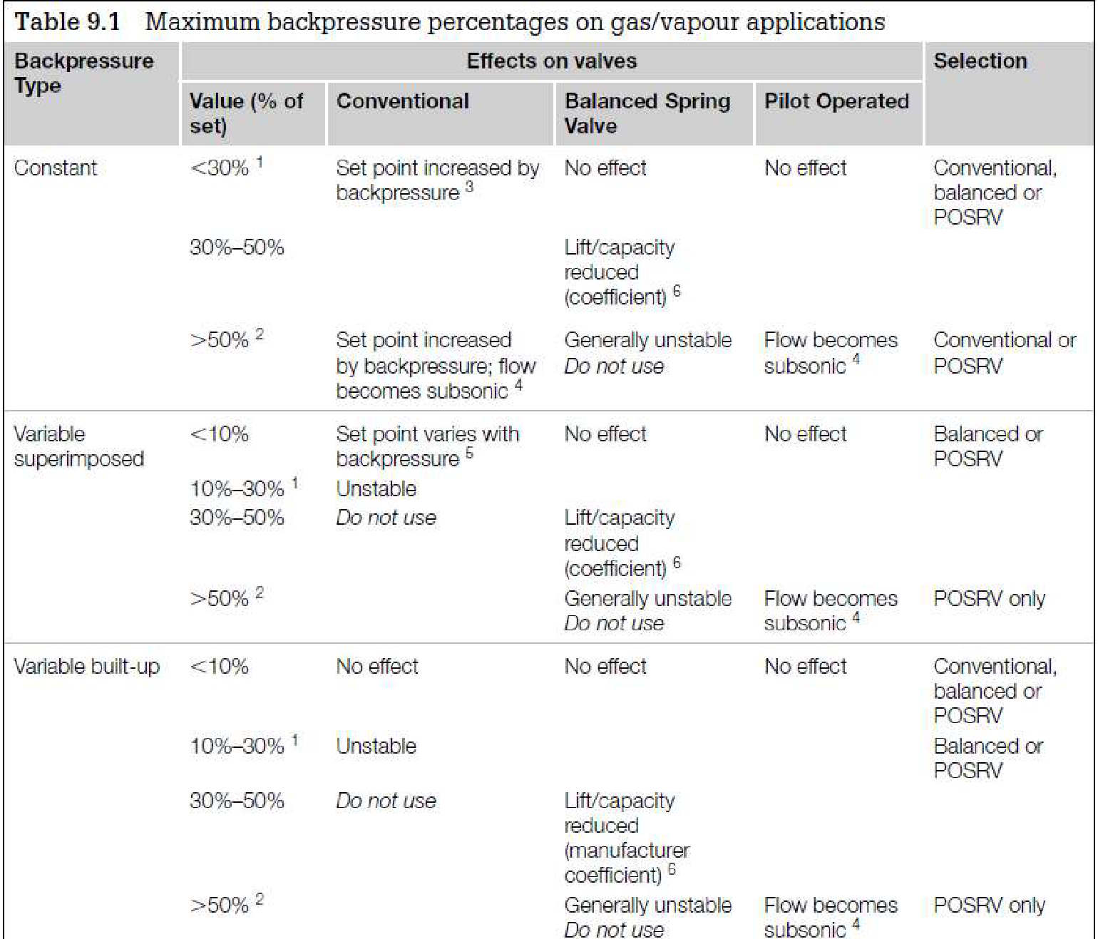
Select proper PSV type by checking backpressure
According to licensor data, superimposed and build-up backpressure are max 21barg. Even though selecting Conventional type is not recommended, Conventional type has been selected by LESER.
superimposed | Build-up | Total
1.5 barg | 13 barg | 14.5 barg
8% | 68% | 76%

Slide 12
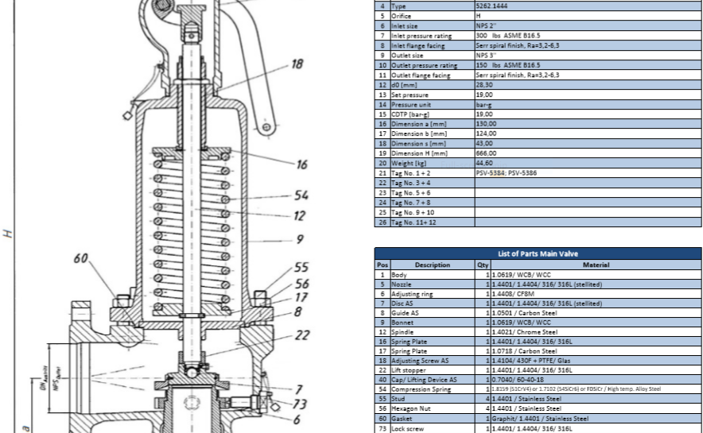
Material Selection
Since it is methanol then A-216 WCB is selected for its body

Slide 13
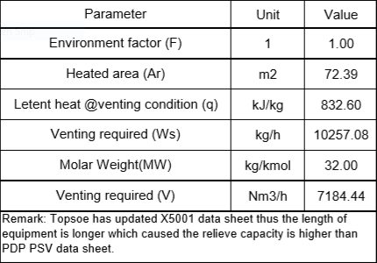
Discussion
The relief load calculated by TOPSOE greatly differs by my calculation and that of TCC which is due to change in X-5001 height later in project.
Another thing is that by my calculation 2J3 is suitable for this but TOPSOE has selected 2H3.
TCC Calculation

