Slide 1
PSV-6053
Fire Scenario
wetted Surface

Slide 2
PSV SIZING PROCEDURE FOR UNWETTED FIRE SCENARIO
1.Determine the scenario, using API-521
2.Calculate the relief load, using API-520 Part1
3.Calculate the orifice area, using API-520 Part1
4.Select proper PSV type by checking backpressure
5.Use API-526 to determine the designation and the inlet and outlet sizing
6.Use API-520 Part2 to detail its construction

Slide 3
1.Determine the scenario, using API-521
Since it is D-6001 and exposed to fire then a fire scenario is defined.
Parameters | Value | Parameters | Value
Diameter | 3.4 m | M | 18.02
Height | 5.6 m | Set Pressure | 55 barg
Fluid | Saturated NG | Relieving Pressure | 67.55bara
Z | 0.75 | Accumulation | 0.21
Cp/Cv | 1.08 | Material | SS

Slide 4
2.Calculate the relief load, using API-520 Part1
Where adequate drainage and firefighting equipment do not exist, Equation (8) should be used

Slide 5
Calculation
Parameters | Value
Aw | 72.37 m2
C2 | 70900
F | 1
λ | 1500
Relief load | 5697 kg/h

Slide 6
3.Calculate orifice area
Determine if it is in critical flow:
If so, then :

Slide 9
5.Use API-526 to determine the designation and the inlet and outlet sizing
Since it is more than 0.3 inch then G is selected. Also, by checking its rating and temperature
limitation, 11/2G3 is selected. But TOPSOE has selected 1E2 in site .

Slide 10
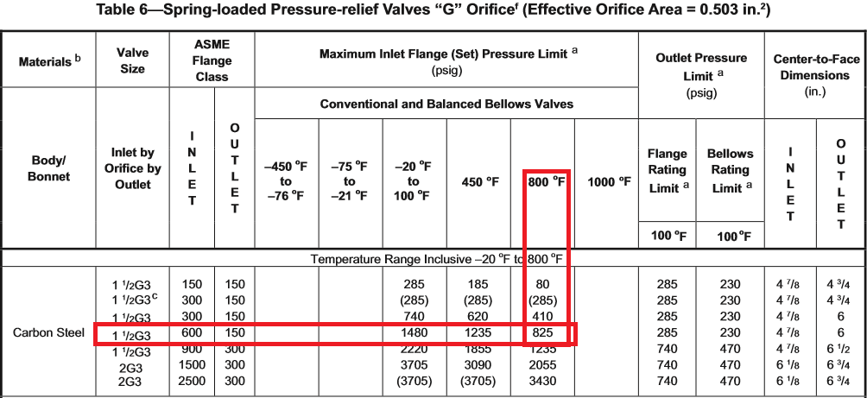

Slide 11
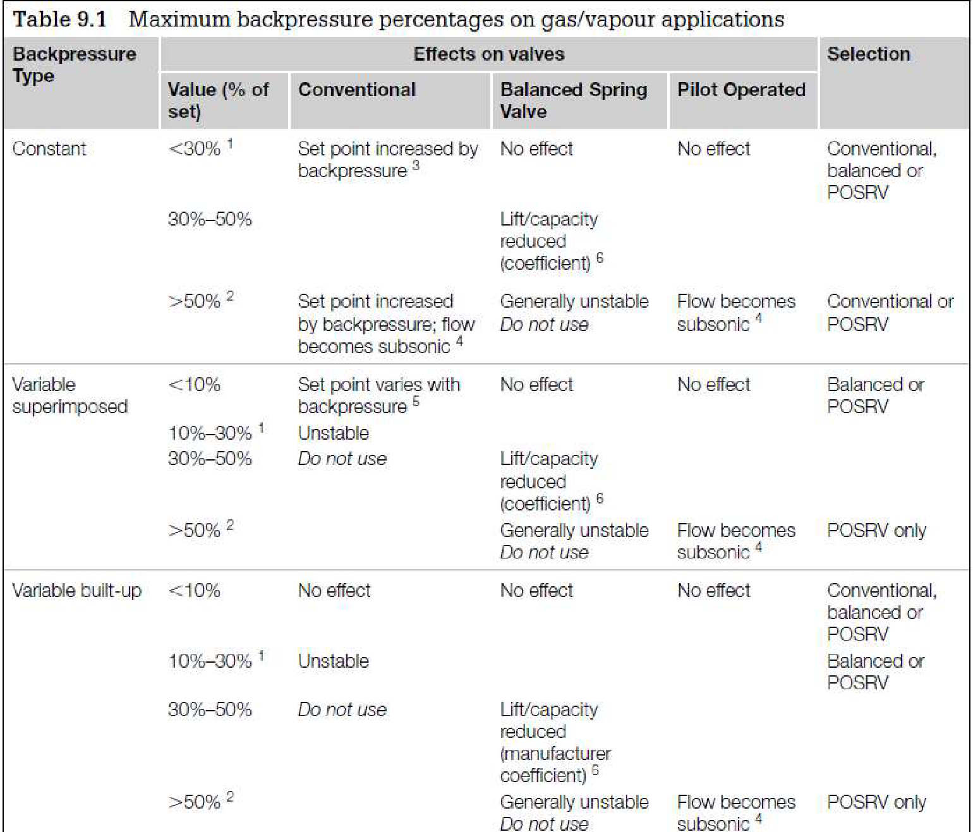
Select proper PSV type by checking backpressure
According to licensor data, superimposed and build-up backpressure are max 21barg. Even though selecting Conventional type is not fully recommended, Conventional type has been selected by LESER.
superimposed | Build-up | Total
0 barg | 21 barg | 21 barg
0% | 38% | 38%

Slide 12
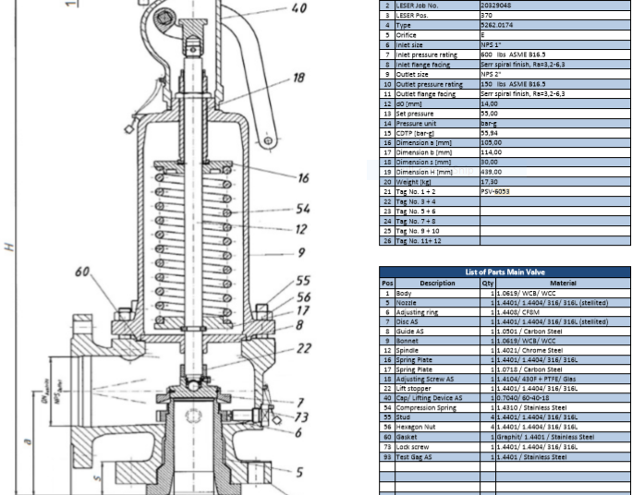
Material Selection

Slide 13
Discussion
The relief load calculated by TOPSOE, TCC and I are 3800, 4881and 5691 kg/h respectively which is probably
due to exposed area consideration. TCC equation and that of mine are the same but the only difference is
about exposed area ; for TCC 60 and for me 73m2
2. Based on his previous calculation TOPSOE has selected 1E2 which is correct but based on new calculation
11/2G3 should be selected.
3. Also, TOPSOE has stated 280 as relieving temperature but based on API it might reach 400 but it does not
impact final results of orifice effective area.

