Slide 1
PSV-3163
Fire Scenario
Unwetted Surface

Slide 2
PSV SIZING PROCEDURE FOR UNWETTED FIRE SCENARIO
1.Determine the scenario, using API-521
2.Calculate the relief load, using API-520 Part1
3.Calculate the orifice area, using API-520 Part1
4.Select proper PSV type by checking backpressure
5.Use API-526 to determine the designation and the inlet and outlet sizing
6.Use API-520 Part2 to detail its construction

Slide 3
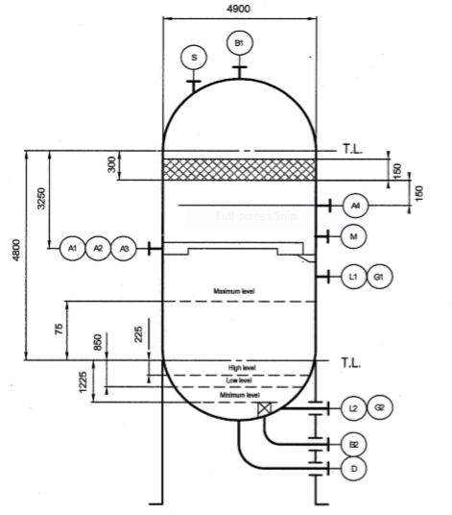
1.Determine the scenario, using API-521
Since it is D-3001 and exposed to fire then a fire scenario is defined.
Parameters | Value | Parameters | Value
Diameter | 4.9 m | M | 9.37
Height-TT | 4.8 m | Set Pressure | 99 barg
Fluid | Methanol + Syng | Relieving Pressure | 120.79 bara
Z |  | Accumulation | 0.21
Cp/Cv | 1.37 | Material | SS

Slide 4
2.Calculate the relief load, using API-520 Part1

Slide 7
Calculation
Parameters | Value | Parameters | Value
Aw | 100 m2 | KD | 0.975
C9 | 0.2772 | F’ | 350
C10 | 0.0395 | Relief Load | 13236 kg/hr
C | 0.026 | Relieving T | 205 / 229 by TCC
Relief load | API-521 | Topsoe | TCC
Value | 13236 | 19000 | 14269

Slide 8
3.Calculate the orifice area, using API-520 Part1
Use the following formula to calculate orifice area :
By setting F’, Aw, p1 to 350, 100 and 12079 kpa, we obtain 0.49 inch^2

Slide 9
5.Use API-526 to determine the designation and the inlet and outlet sizing
Since it is more than 0.11 inch and less than 0.196 , then E is selected. Also, by checking its rating and temperature limitation, 1E2 is selected.

Slide 10
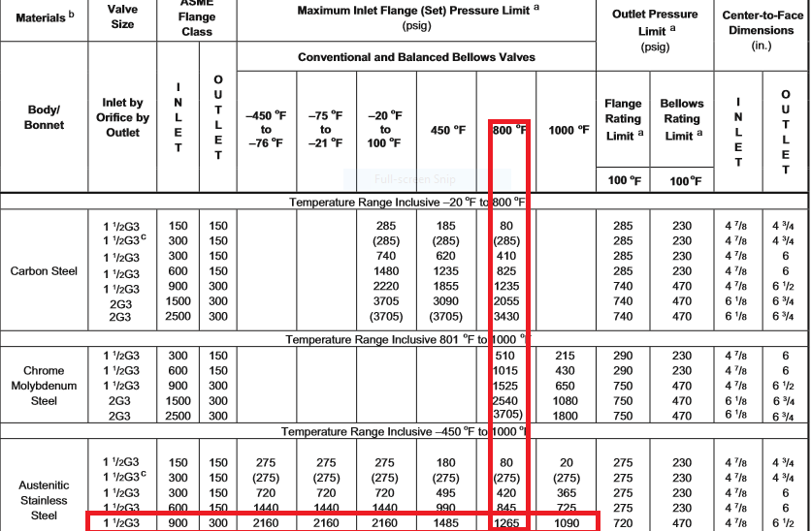

Slide 11
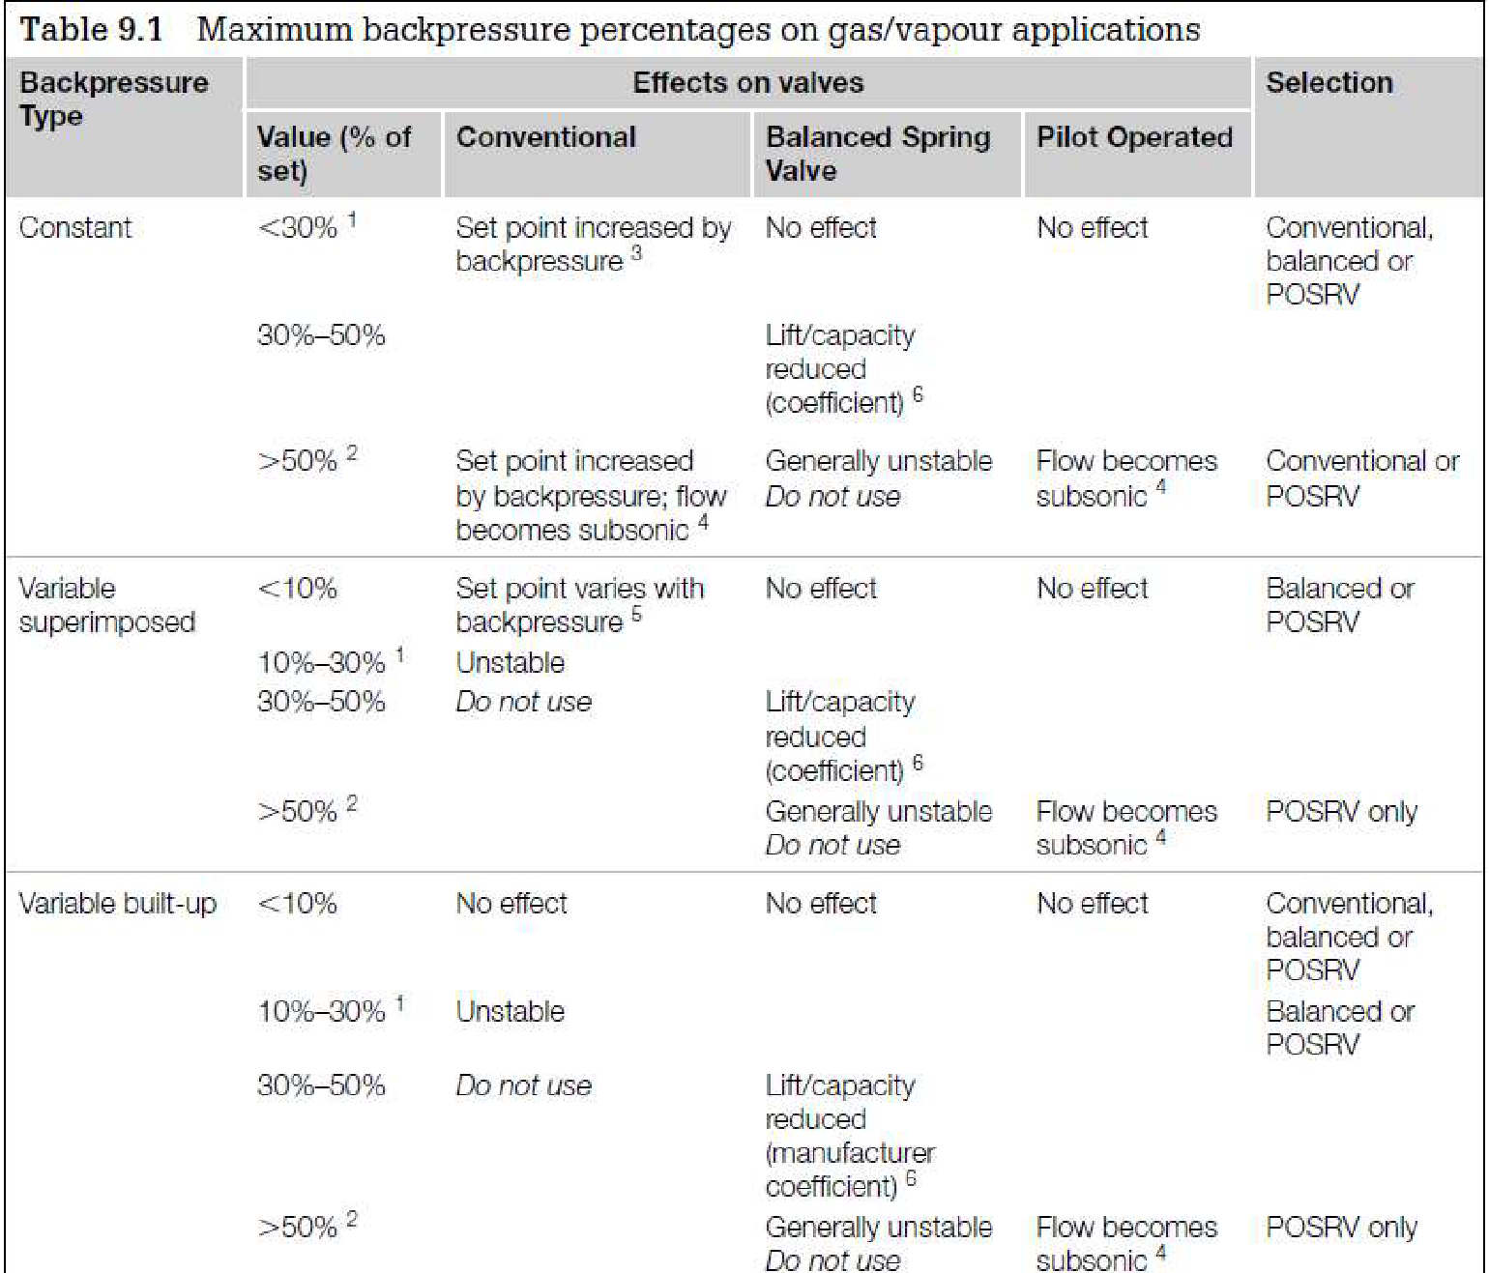
Select proper PSV type by checking backpressure
According to licensor data, superimposed and build-up backpressure are max 1.5 and 19.4 barg. Since the backpressure is constant and the maximum backpressure is 21% a conventional type could be selected.
superimposed | Build-up | Total
1.5 barg | 19.4 barg | 21barg
1.5% | 19.5% | 21%

Slide 12
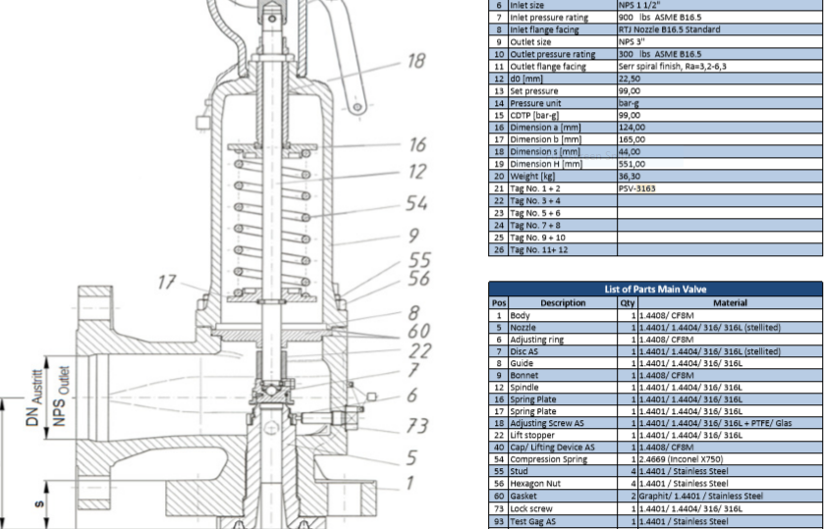
Material Selection
Since it is Syngas , A351 could be used for its body

Slide 13
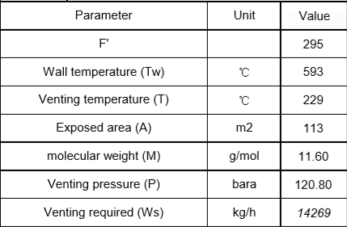
Discussion
Topsoe has calculated 19000 kg/hr for its relief loading but my calculation and that of TCC show otherwise.
Also notice that the exposed height for reactor, TT has been taken into account and the higher the height, the
higher the relief load. So it depends on how exposed area is selected , relief load can vary.
TCC Calculation

