Slide 1
PSV-2019
Fire Scenario
wetted Surface

Slide 2
PSV SIZING PROCEDURE FOR UNWETTED FIRE SCENARIO
1.Determine the scenario, using API-521
2.Calculate the relief load, using API-520 Part1
3.Calculate the orifice area, using API-520 Part1
4.Select proper PSV type by checking backpressure
5.Use API-526 to determine the designation and the inlet and outlet sizing
6.Use API-520 Part2 to detail its construction

Slide 3
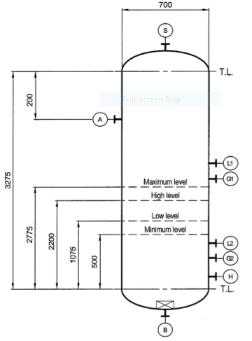
1.Determine the scenario, using API-521
Since it is K.N Drum and exposed to fire then a fire scenario is defined.
Parameters | Value | Parameters | Value
Diameter | 0.7 m | M | 18.02
Height | 3.275 m | Set Pressure | 52 barg
Fluid | SteamCondensat | Relieving Pressure | 63.9 bara
Z | 0.78 | Accumulation | 0.21
Cp/Cv | 1.09 | Material | CS

Slide 4
2.Calculate the relief load, using API-520 Part1
Where adequate drainage and firefighting equipment do not exist, Equation (8) should be used

Slide 5
Calculation
Parameters | Value
Aw | 7.73 m2
C2 | 70900
F | 1
λ | 2880
Relief load | 474 kg/h

Slide 6
3.Calculate orifice area
Determine if it is in critical flow:
If so, then :

Slide 9
5.Use API-526 to determine the designation and the inlet and outlet sizing
Since it is less than 0.11 inch then D is selected. Also, by checking its rating and temperature
limitation, 1D2 is selected. But Topsoe has selected 1E2 in site .

Slide 10
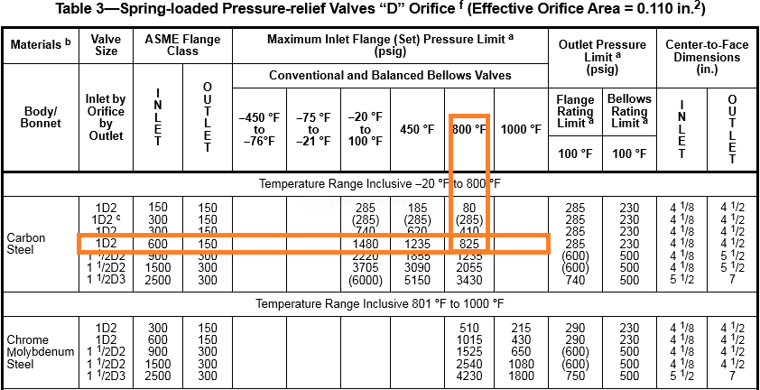

Slide 11
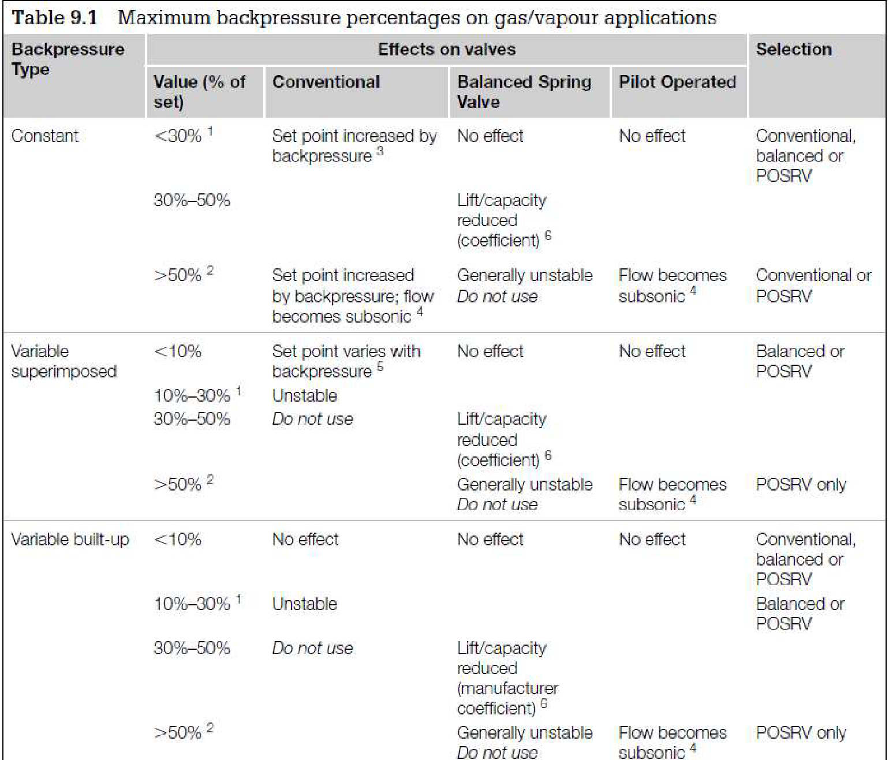
Select proper PSV type by checking backpressure
According to licensor data, superimposed and build-up backpressure are max 21barg. Even though selecting Conventional type is not fully recommended, Conventional type has been selected by LESER.
superimposed | Build-up | Total
0 barg | 21 barg | 21 barg
2.5% | 30% | 40%

Slide 12
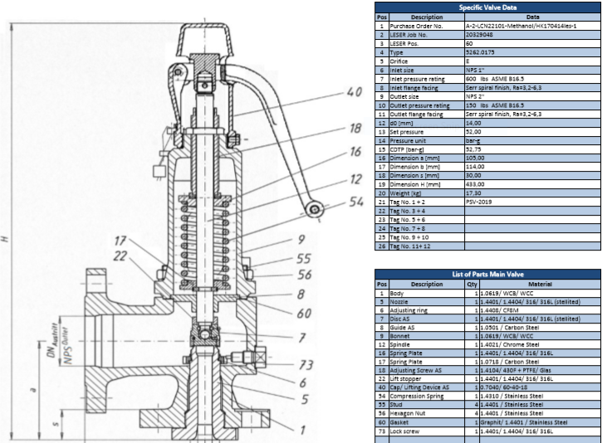
Material Selection
Since it is steam condensate then A-216 WCB is selected for its body

Slide 13
Discussion
1.The relief load calculated by TCC greatly differs by that of TOPSOE and that of mine which stems from
λ value in calculation . The λ value for TCC is 1600 kj/kg while it is 2880 kj/kg.
2. Another matter is orifice designation dedicated. TOPSOE has selected 1E2 but it appears that 1D2
is also suitable.
3. According to total backpressure calculation, it seems that if balanced type had been selected, it
would have more promising performance

