Slide 1
PSV-1031-1038-1043
Fire Scenario
Unwetted Surface

Slide 2
PSV SIZING PROCEDURE FOR UNWETTED FIRE SCENARIO
1.Determine the scenario, using API-521
2.Calculate the relief load, using API-520 Part1
3.Calculate the orifice area, using API-520 Part1
4.Select proper PSV type by checking backpressure
5.Use API-526 to determine the designation and the inlet and outlet sizing
6.Use API-520 Part2 to detail its construction

Slide 3
1.Determine the scenario, using API-521
Since it is R-1001 and exposed to fire then a fire scenario is defined.
Parameters | Value | Parameters | Value
Diameter | 4.45 m | M | 16.54
Height | 3.1 m | Set Pressure | 55 barg
Fluid | Natural Gas | Relieving Pressure | 67.55 bara
Z | 1.01 | Accumulation | 0.21
Cp/Cv | 1.18 | Material | CS

Slide 4
2.Calculate the relief load, using API-520 Part1

Slide 7
Calculation
Note that since F’ is less than 182 the corresponding equation has been used in
which F’ is set to 182. Remember that in F’ calculation T1 is set to max 400 C
Parameters | Value | Parameters | Value
Aw | 65 m2 | KD | 0.975
C9 | 0.2772 | F’ | 131
C10 | 0.0395 | Relief Load | 3874 kg/hr
C | 0.0254
Relief load | API-521 | Topsoe | TCC
Value | 3874 | 1200 | 3825

Slide 8
3.Calculate the orifice area, using API-520 Part1
Use the following formula to calculate orifice area :
By setting F’, Aw, p1 to 132, 65 and 67500 kpa, we obtain 0.16 inch^2

Slide 9
5.Use API-526 to determine the designation and the inlet and outlet sizing
Since it is more than 0.11 inch and less than 0.196 , then E is selected. Also, by checking its rating and temperature limitation, 1E2 is selected.

Slide 10
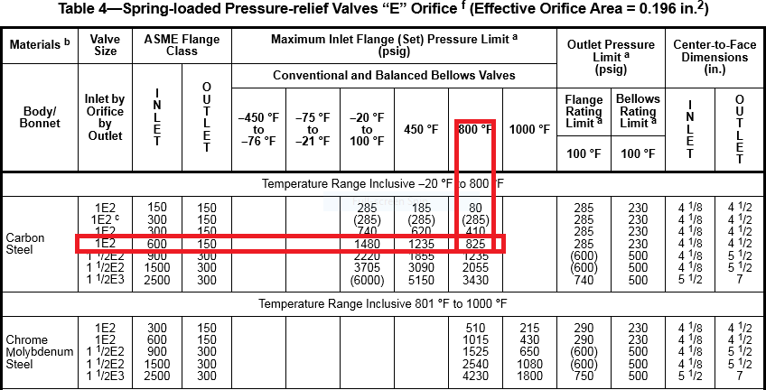

Slide 11
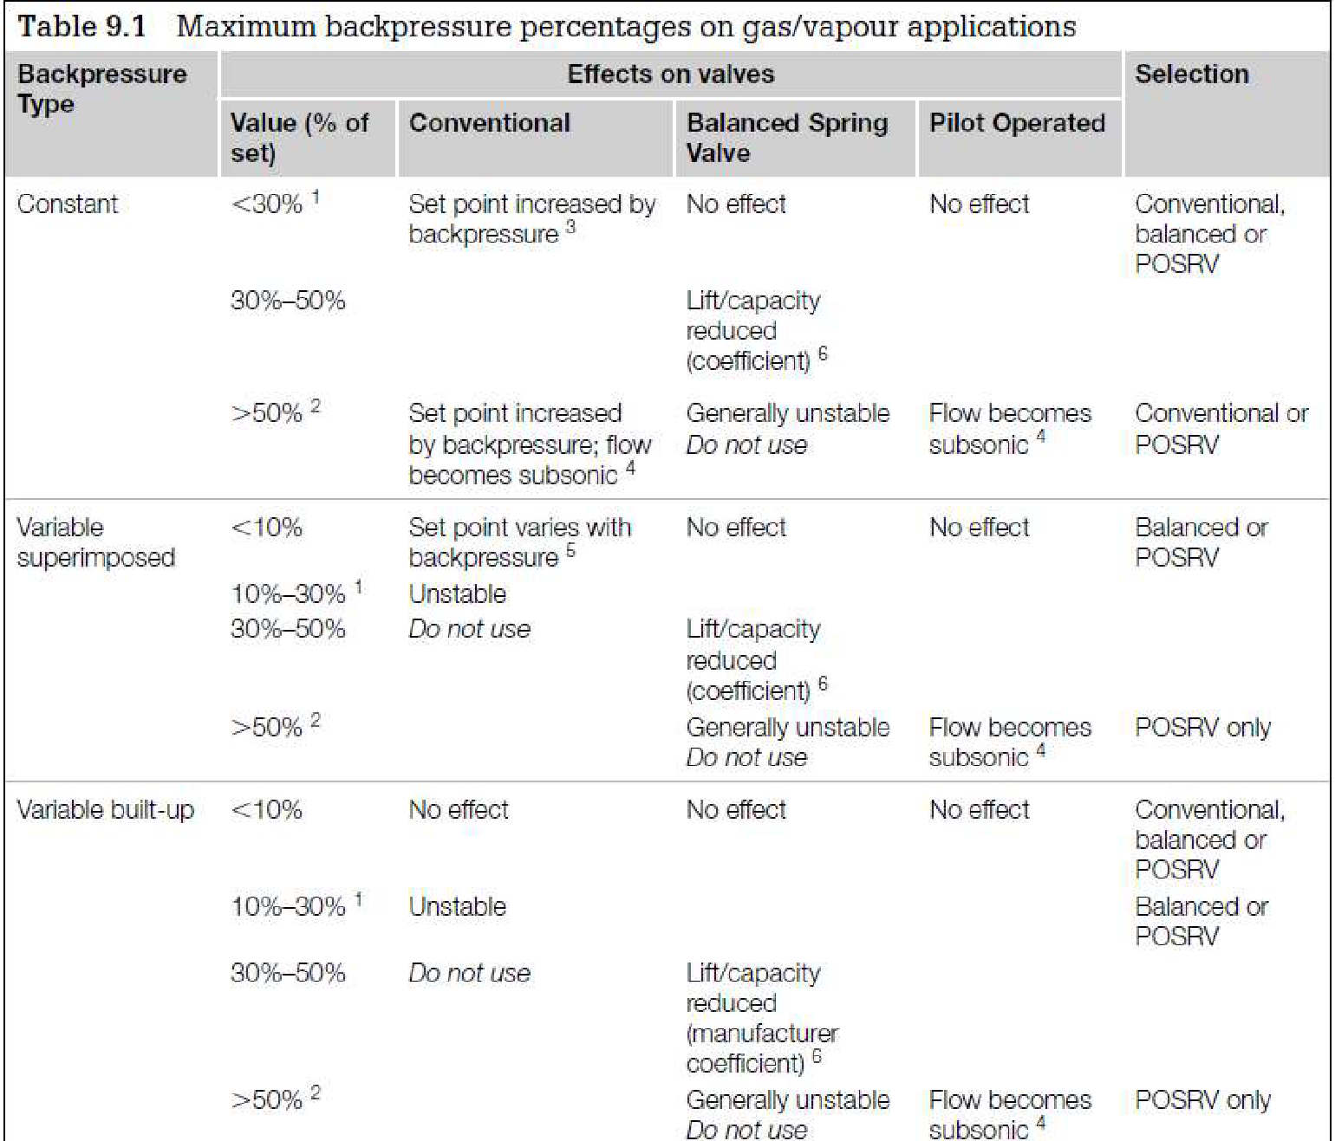
Select proper PSV type by checking backpressure
According to licensor data, superimposed and build-up backpressure are max 1.5 and 18.5 barg. Since the backpressure is constant and the maximum backpressure is 36% a balanced type could be selected.
superimposed | Build-up | Total
1.5 barg | 18.5 barg | 20 barg
2.7% | 33.6% | 36%

Slide 12
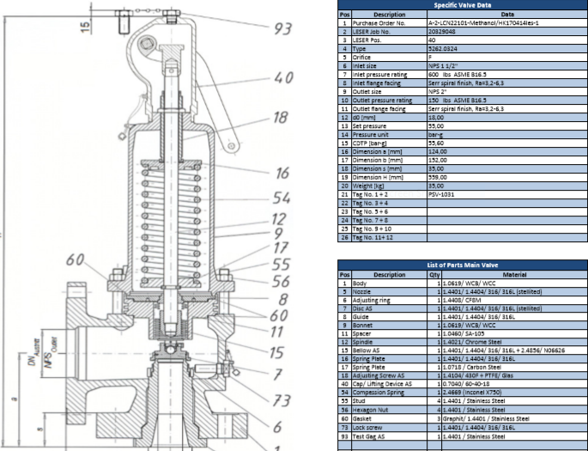
Material Selection
Since it is NG, A216 WCB could be used for its body

Slide 13
Discussion
The selected PSV in site is 11/2F2 but calculation shows that it should be 1E2, then what is the cause?
Topsoe has calculated 1200 kg/hr for its relief loading but my calculation and that of TCC show otherwise.
Remember that according to API526 1E2 should be selected but TOPSOE has selected 11/2F2

