Slide 1
PSV-1015
Fire Scenario
Unwetted Surface

Slide 2
PSV SIZING PROCEDURE FOR UNWETTED FIRE SCENARIO
1.Determine the scenario, using API-521
2.Calculate the relief load, using API-520 Part1
3.Calculate the orifice area, using API-520 Part1
4.Select proper PSV type by checking backpressure
5.Use API-526 to determine the designation and the inlet and outlet sizing
6.Use API-520 Part2 to detail its construction

Slide 3
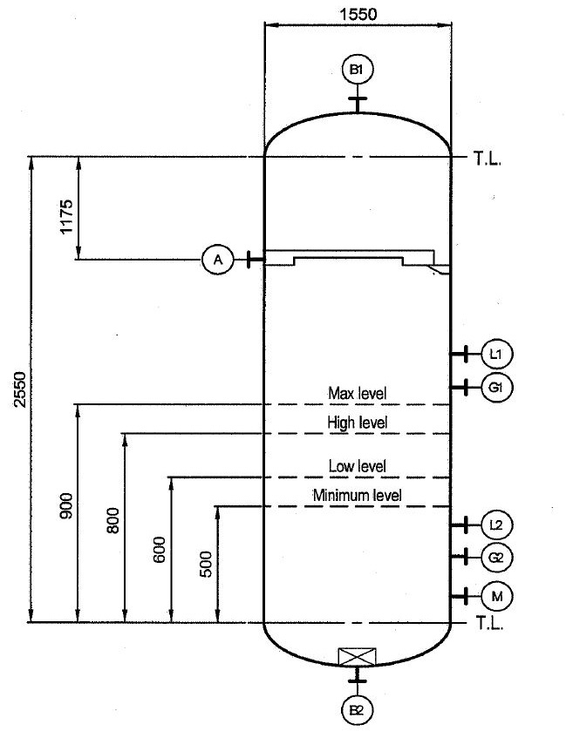
1.Determine the scenario, using API-521
Since it is K.N Drum and exposed to fire then a fire scenario is defined.
Parameters | Value | Parameters | Value
Diameter | 1.55 m | M | 16.74
Height | 2.55 m | Set Pressure | 60 barg
Fluid | Natural Gas | Relieving Pressure | 73.6 bara
Z | 0.95 | Accumulation | 0.21
Cp/Cv | 1.26 | Material | CS

Slide 4
2.Calculate the relief load, using API-520 Part1

Slide 7
Calculation
Note that since F’ is less than 182 the corresponding equation has been used in
which F’ is set to 182. Remember that in F’ calculation T1 is set to max 400 C
Parameters | Value | Parameters | Value
Aw | 15 m2 | KD | 0.975
C9 | 0.2772 | F’ | 128
C10 | 0.0395 | Relief Load | 964 kg/hr
C | 0.026

Slide 8
3.Calculate the orifice area, using API-520 Part1
Use the following formula to calculate orifice area :
By setting F’, Aw, p1 to 128, 15 and 73600 kpa, we obtain 0.034 inch^2

Slide 9
5.Use API-526 to determine the designation and the inlet and outlet sizing
Since it is less than 0.11 inch then D is selected. Also, by checking its rating and temperature
limitation, 1D2 is selected

Slide 10
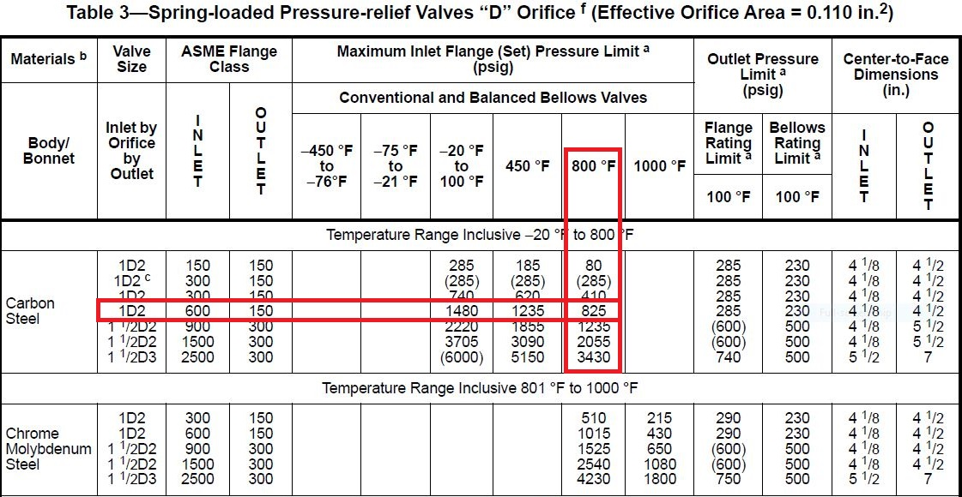

Slide 11
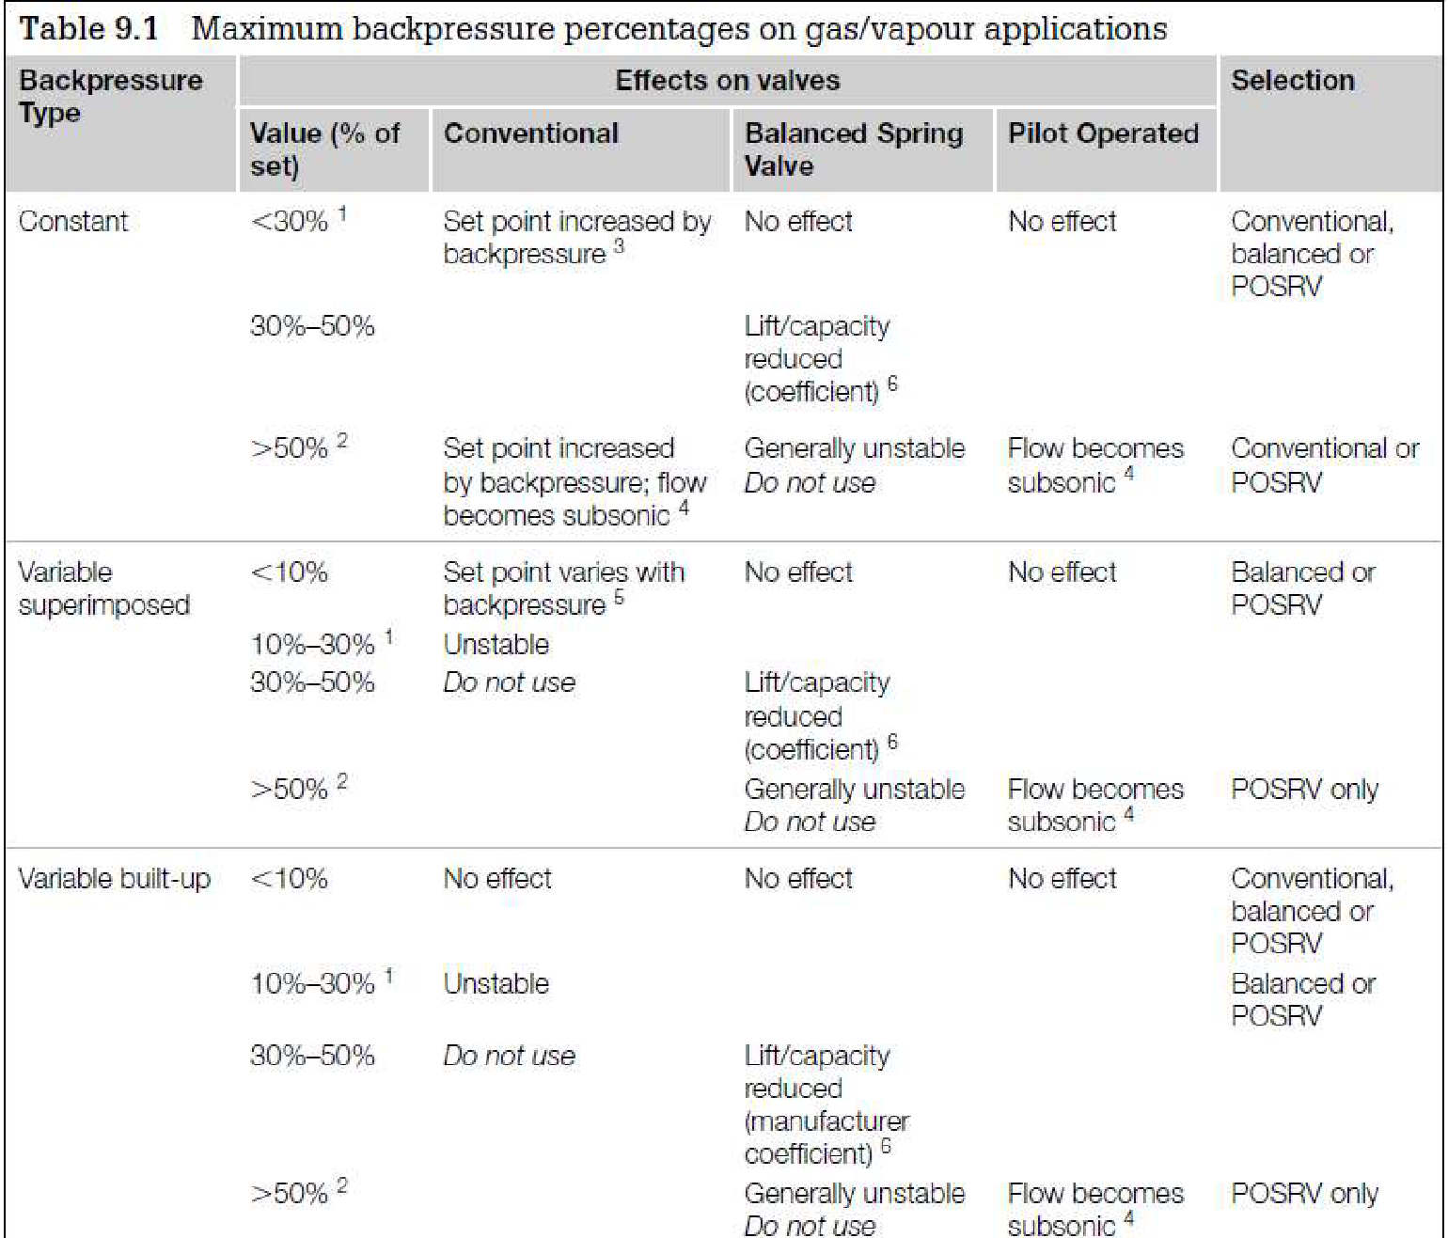
Select proper PSV type by checking backpressure
According to licensor data, superimposed and build-up backpressure are max 1.5 and 18.5 barg. Even though selecting Conventional type is not fully recommended, Conventional type has been selected by LESER.
superimposed | Build-up | Total
1.5 barg | 18.5 barg | 20 barg
2.5% | 30% | 33.3%

Slide 12
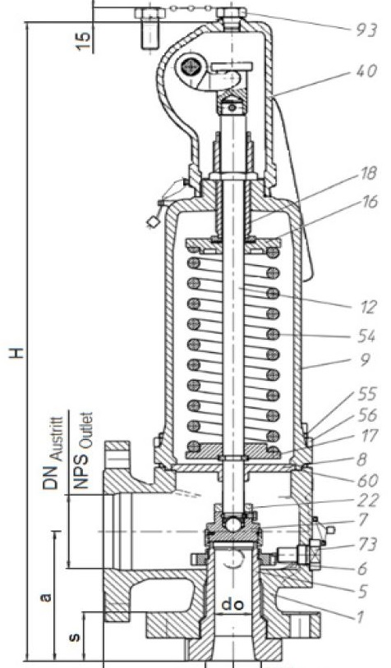
Material Selection
Since it is Natural Gas then A-216 WCB is selected for its body

Slide 13
Discussion
The selected PSV in site is 1E2 but calculation shows that it should be 1D2, then what is the cause?
TCC has selected T1 equal to 87C or 360K which is the design temperature of knockout Drum, thanks to which
the calculated F’ becomes 590 and if you set Aw equal to 16 m2 it becomes 560 .
The resultant relief load and effective area become 3600 kg/h and 0.17 inch respectively, which means that
type 1E2 is selected

