Slide 1
PSV-7253-7254
Blocked Outlet Scenario

Slide 2
Determine relief load
The Steam rated for this scenario reported by TOPSOE is 3700 and the normal flow is 1900 kg/h.
I do not know the reason why it is 3700 kg/h

Slide 3
2.Calculate orifice area
Determine if it is in critical flow:
If so, then :

Slide 6
Results
Note that the relieving temperature is obtained from TOPSOE EXCEL
T | 459 K | W | 3700 kg/h
Z | 0.92 | A | 7.92 cm2
M | 18.02 | A | 1.22 in2
C | 0.025 | Accumulation | 10%

Slide 7
5.Use API-526 to determine the designation and the inlet and outlet sizing
Since it is less than 1.28inch, then J is selected. Also, by checking its rating and temperature limitation, 6Q8 is selected.

Slide 8
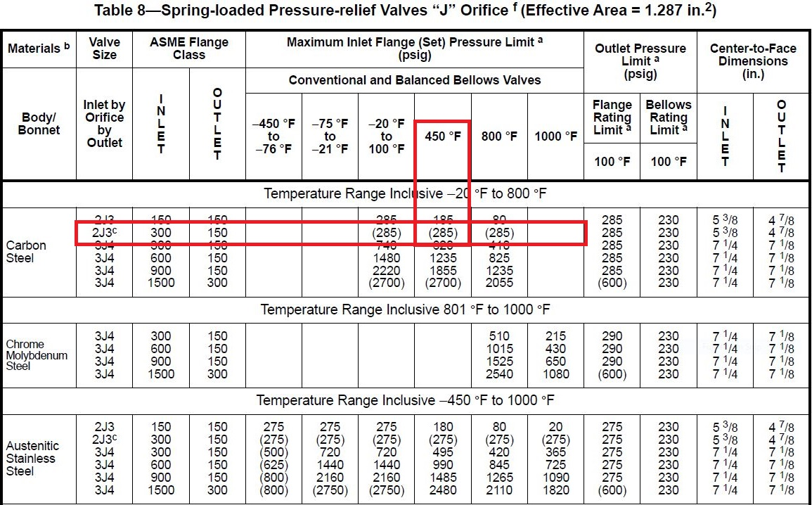

Slide 9
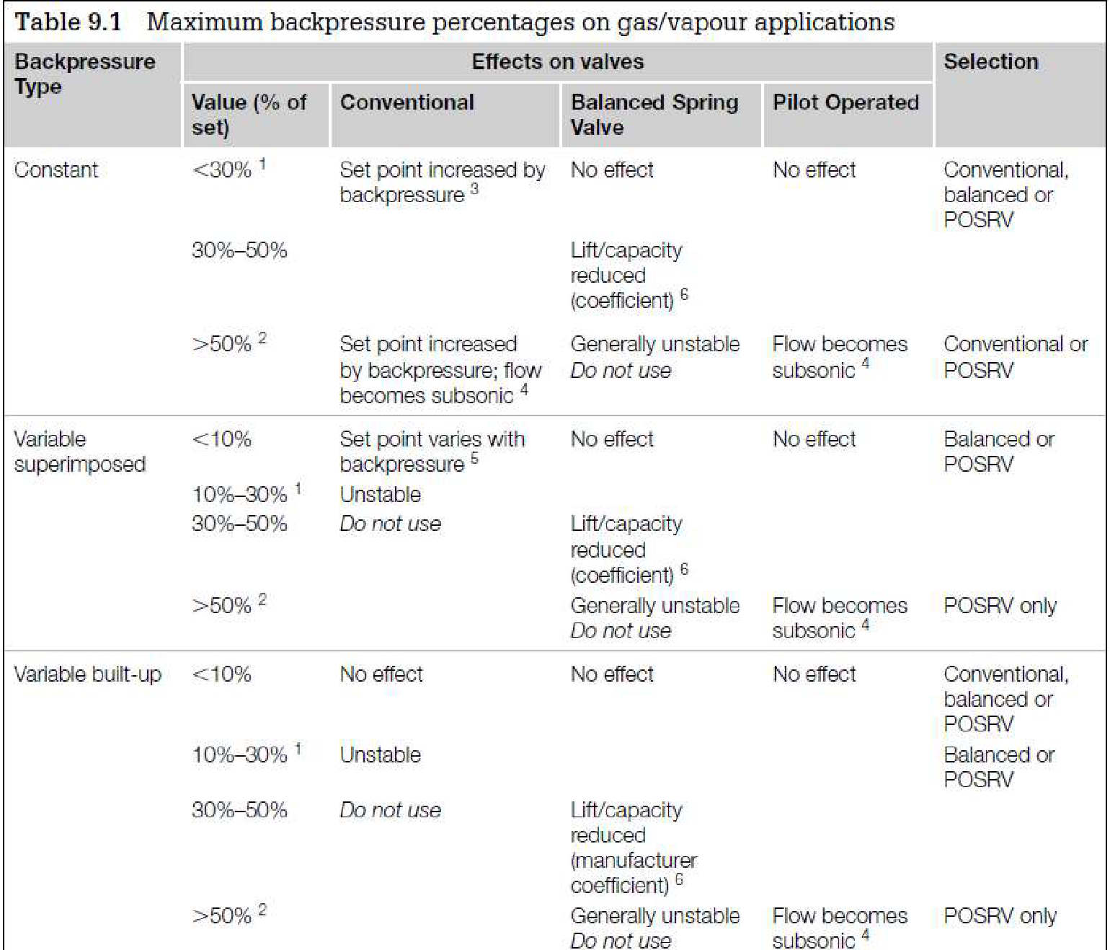
Select proper PSV type by checking backpressure
According to licensor data, superimposed and build-up backpressure are max 1 barg. Since the backpressure is constant and it is discharged to atmosphere then a conventional type could be selected
superimposed | Build-up | Total
0 barg | 1 barg | 1 barg
0% | 22% | 22%

Slide 10
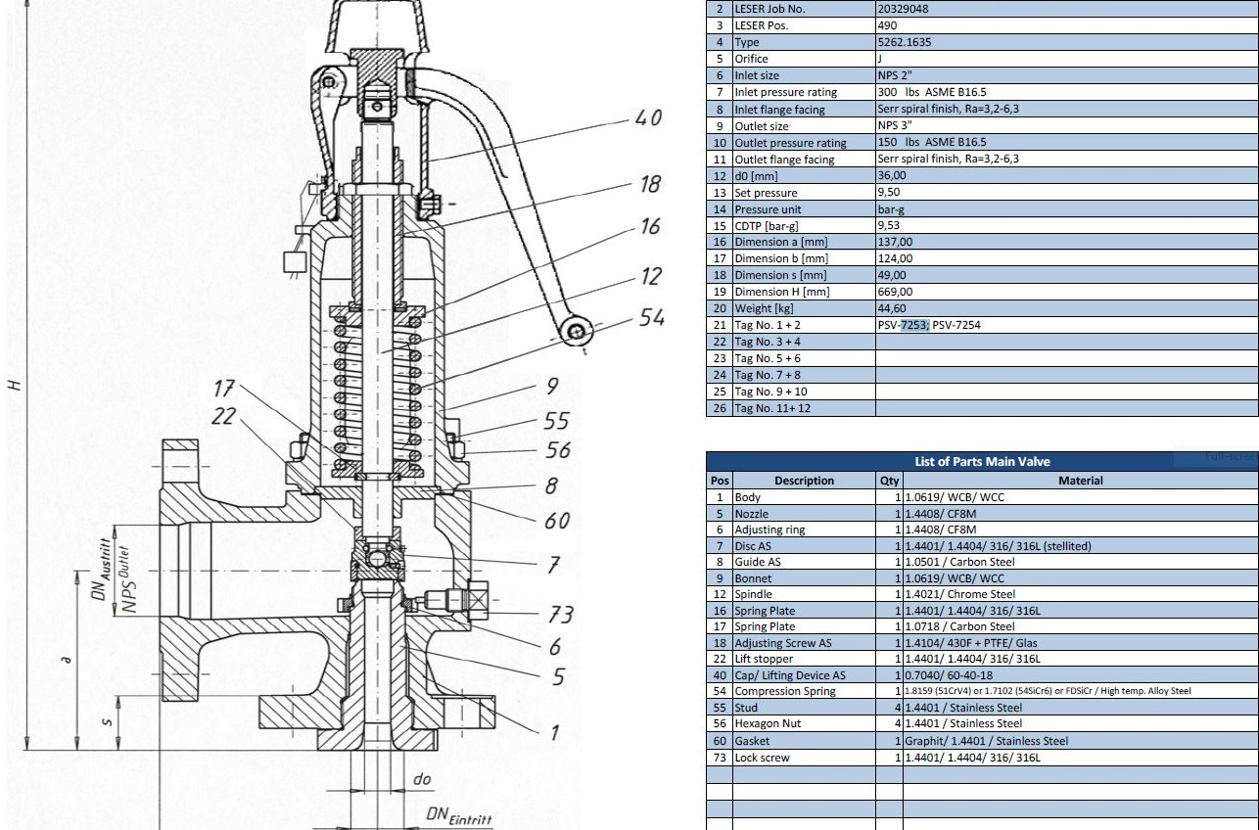
Material Selection
Since it is Steam , A216 WCB could be used for its body

Slide 11
Discussion
In PID TOPSOE has selected 2D3 but in LESER manual, 2J3 has been selected, which is according to my calculation

