Slide 1
PSV-7130-7131-7135
Blocked Outlet Scenario

Slide 2
Determine relief load
The rated capacity of P-7001 is 282000kg/h , so the relief load is 10% of that which is
28200kg/h.

Slide 3
2.Calculate orifice area
Determine if it is in critical flow:
If so, then :

Slide 6
Results
Note that the relieving temperature is obtained from TOPSOE EXCEL
For calculation of orifice area , the formula for hydraulic calculation is taken.
T | 393 K | W | 28200 kg/h
Z |  | A | 4.41 cm2
M | 18.02 | A | 0.68 in2
C |  | Accumulation | 10%

Slide 7
5.Use API-526 to determine the designation and the inlet and outlet sizing
Since it is more than 0.5inch, then H is selected. Also, by checking its rating and temperature limitation, 6Q8 is selected.

Slide 8
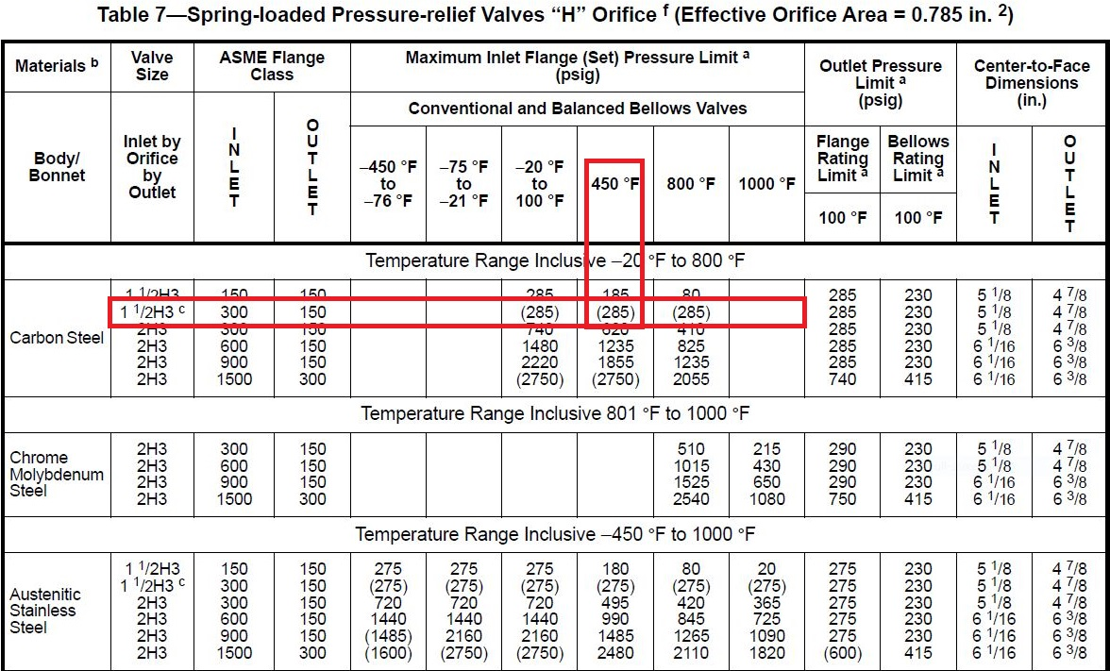

Slide 9
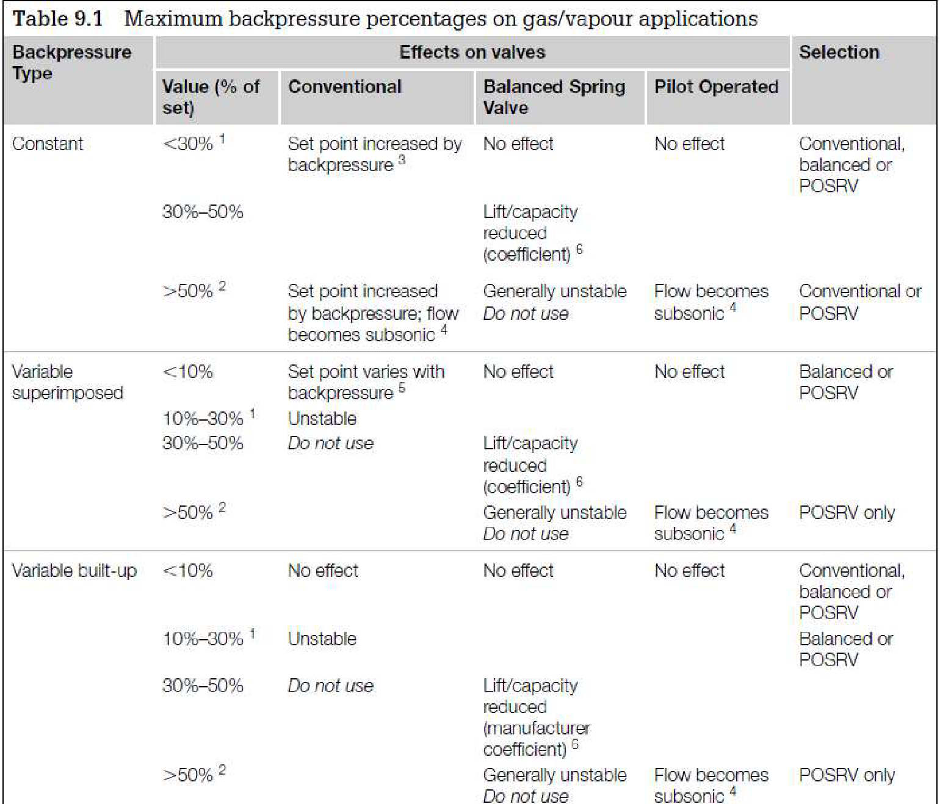
Select proper PSV type by checking backpressure
According to licensor data, superimposed and build-up backpressure are max 1 barg. Since the backpressure is constant and it is discharged to atmosphere then a conventional type could be selected
superimposed | Build-up | Total
0 barg | 1 barg | 1 barg
0% | 22% | 22%

Slide 10
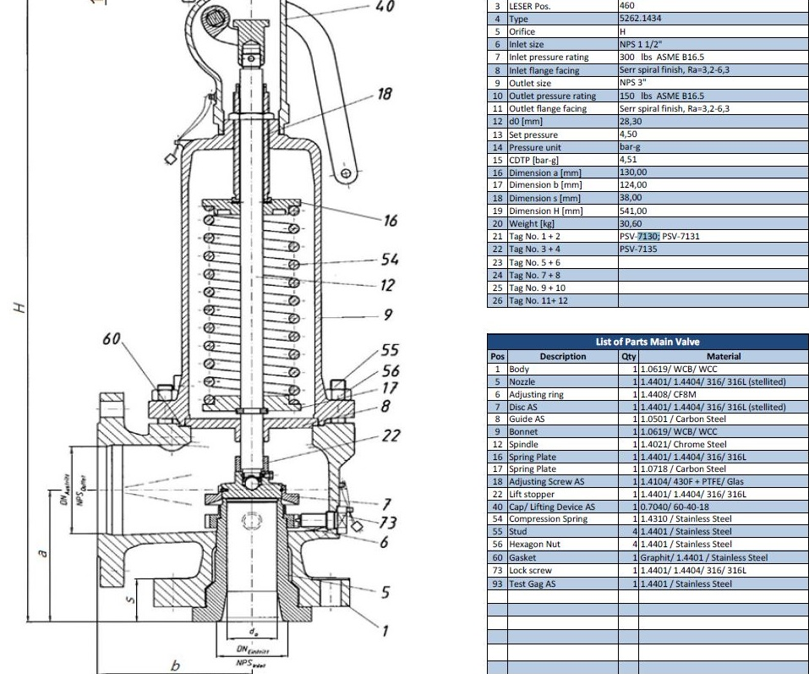
Material Selection
Since it is Water , A216 WCB could be used for its body

Slide 11
Discussion

