Slide 1
PSV-3047-3050
Blocked Outlet Scenario

Slide 2
Determine relief load
The normal capacity of steam is about 251000 kg/h and the rated capacity is
achieved by multiplying the normal capacity by 1.1 which equals to 276000 kg/h.
The total orifice area needed for this case is about 21.74 in2 , which means PSV with T
designation could be used but unfortunately they are not able to withstand such temperature
and pressure rating.
First relief device | Additional relief devices | Accumulation
45barg | 46.8 | 48.7
100% | 103%

Slide 3
2.Calculate orifice area
Determine if it is in critical flow:
If so, then :

Slide 6
Results
Note that the relieving temperature is obtained from TOPSOE EXCEL
T | 535K | W | 276000kg/h
Z | 0.8 | A | 140.29cm2
M | 18.02 | A | 21 in2
C | 0.0242 | Accumulation | 6%

Slide 7
5.Use API-526 to determine the designation and the inlet and outlet sizing
TOPSOE has divided the load between 2 PSV with the designation of 3Q6
but I have selected 4 PSV with 4P6 designation .

Slide 8
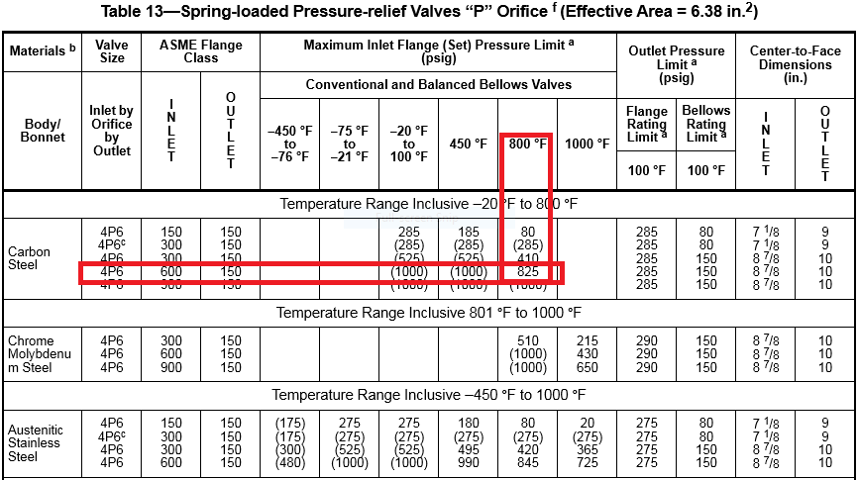

Slide 9
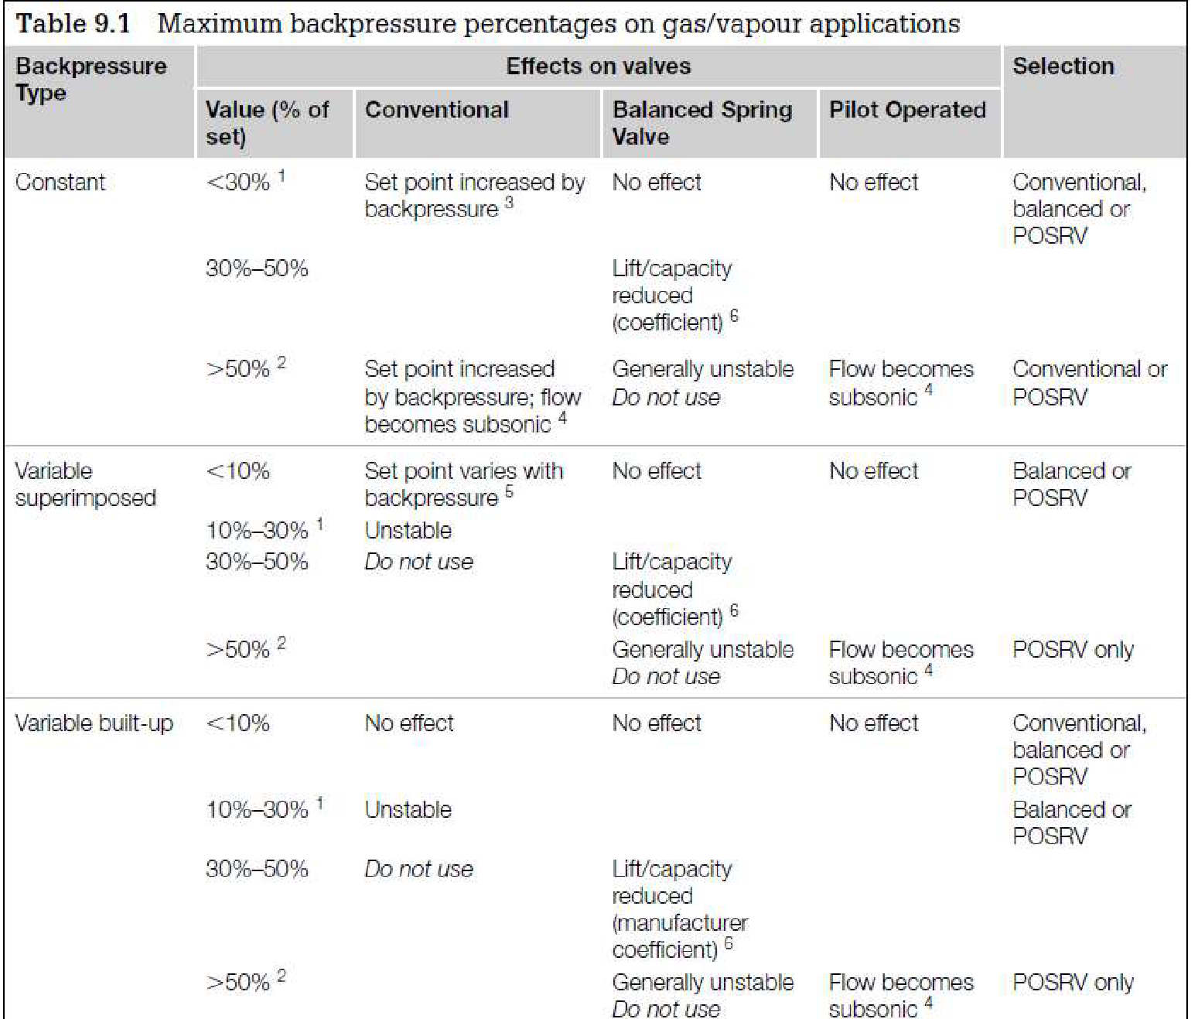
Select proper PSV type by checking backpressure
According to licensor data, superimposed and build-up backpressure are max 3 barg. Since the backpressure is constant and and less than 30 % and is discharged to atmosphere a conventional type is selected.
superimposed | Build-up | Total
0 barg | 3 barg | 3barg
0% | 6.6% | 6.6%

Slide 10
Discussion
TOPSOE has selected 2 PSV with 3Q6 designation. Since Q designation with such T and P rating could not withstand 661 psi (max 600 psi with 800F) I think it is not the right type and smaller size such as P should be selected since upper limit is about 825 psi.

