Slide 1
PSV-2581
Blocked Outlet Scenario

Slide 2
Determine relief load
The rated capacity of C-2001 is 39000 kg/h , so the relief load is 39000 kg/h.

Slide 3
2.Calculate orifice area
Determine if it is in critical flow:
If so, then :

Slide 6
Results
Note that the relieving temperature is obtained from TOPSOE EXCEL
T | 311 K | W | 39000 kg/h
Z | 1 | A | 53.65 cm2
M | 28 | A | 8.31 in2
C | 0.027 | Accumulation | 10%

Slide 7
5.Use API-526 to determine the designation and the inlet and outlet sizing
Since it is more than 6.38 inch, then Q is selected. Also, by checking its rating and temperature limitation, 6Q8 is selected.

Slide 8
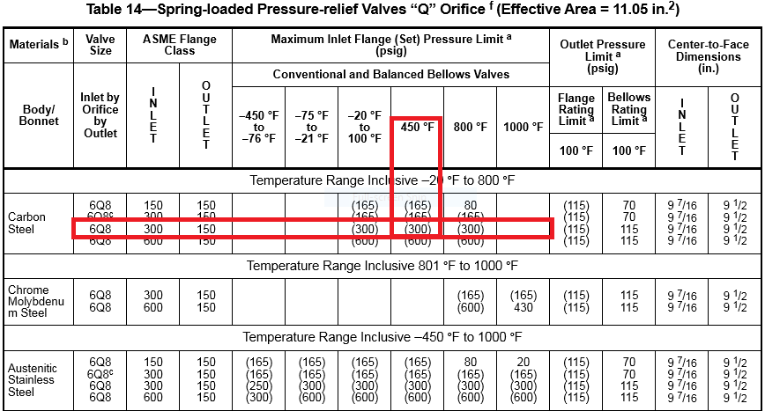

Slide 9
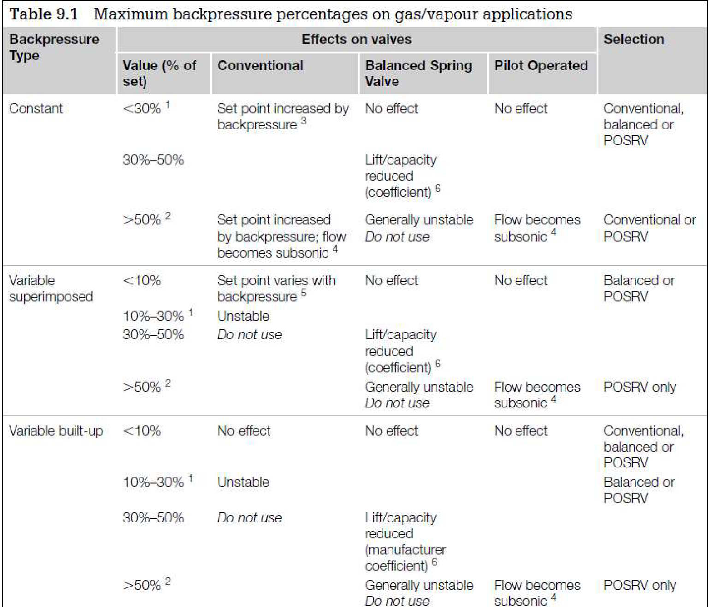
Select proper PSV type by checking backpressure
According to licensor data, superimposed and build-up backpressure are max 10 barg. Since the backpressure is high, a conventional type is not recommended but LESER has selected a conventional type.
It seems that it is the maximum built up pressure reported
superimposed | Build-up | Total
0 barg | 10 barg | 10 barg
0% | 100% | 100%

Slide 10
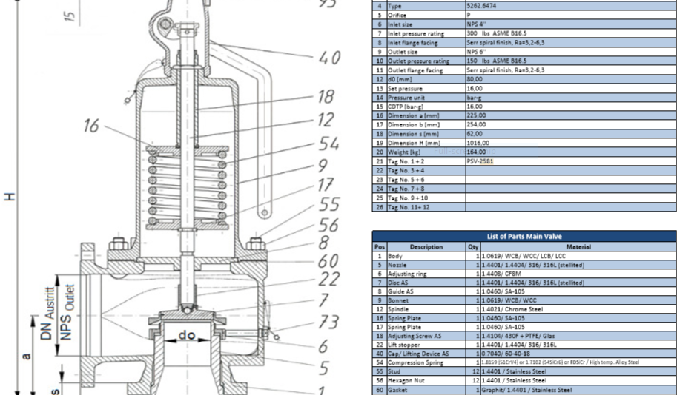
Material Selection
Since it is Steam , A216 WCB could be used for its body

Slide 11
Discussion
TOPSOE has selected 4P6 and I, have selected 6Q8 . If such relief load is real then according to API 6Q8 should be selected . Perhaps perhaps subcritical phase plays a role here.

