Slide 1
PSV-2354-2360
Blocked Outlet Scenario

Slide 2
Determine relief load
The normal capacity of steamis about 388000 kg/h and the rated capacity is
achieved by multiplying the normal capacity by 1.1 which equals to 430000 kg/h.
The total orifice area needed for this case is about 11.75 in2 , which means PSV with Q or R
designation could be used but unfortunately they are not able to withstand such temperature
and pressure rating.
First relief device | Additional relief devices | Accumulation
112barg | 115.2 | 119.66
100% | 103% | 106%

Slide 3
2.Calculate orifice area
Determine if it is in critical flow:
If so, then :

Slide 6
Results
Note that the relieving temperature is obtained from TOPSOE EXCEL
T | 597K | W | 430000kg/h
Z | 0.62 | A | 75.84 cm2
M | 18.02 | A | 11.75 in2
C | 0.0242 | Accumulation | 16%

Slide 7
5.Use API-526 to determine the designation and the inlet and outlet sizing
TOPSOE has divided the load between 4 PSV with the designation of 3L6
and I would do the same.

Slide 8
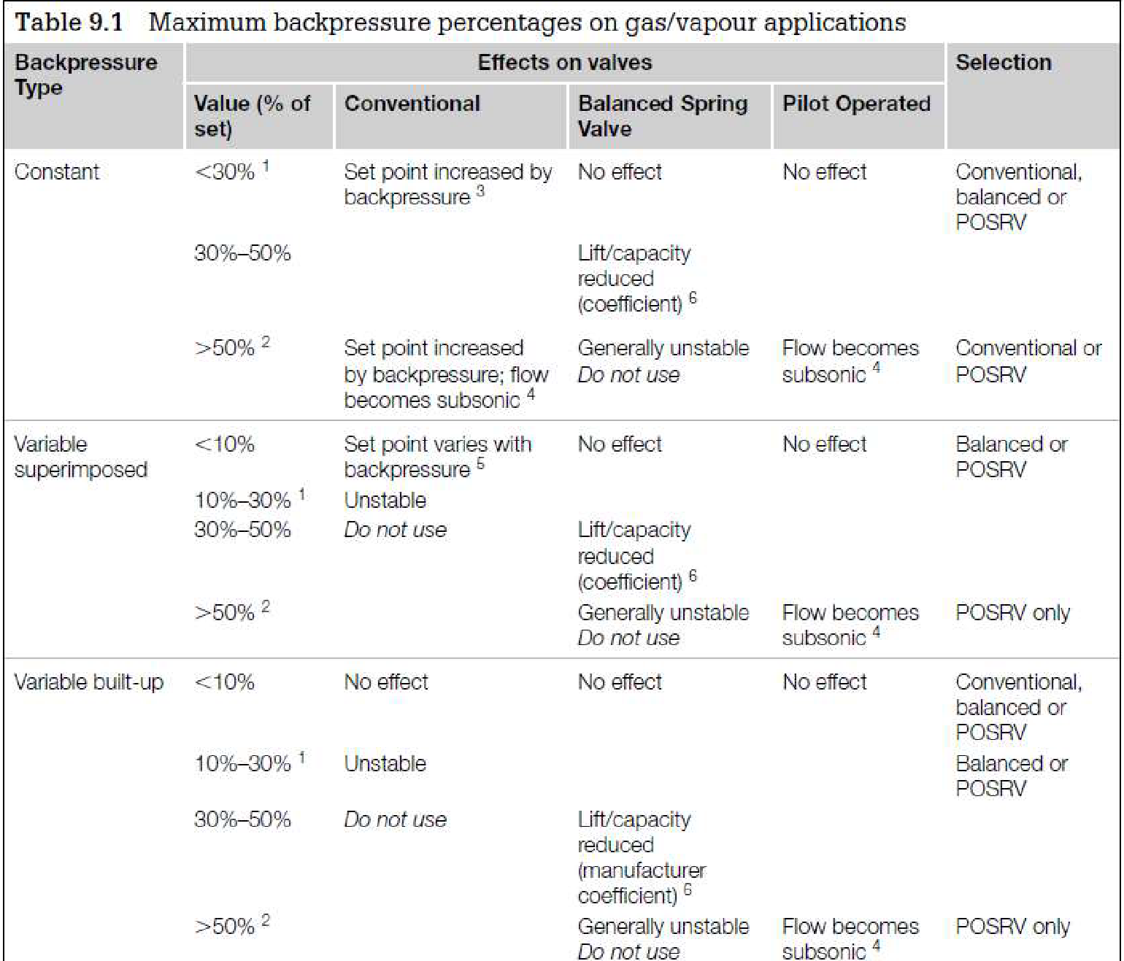
Select proper PSV type by checking backpressure
According to licensor data, superimposed and build-up backpressure are max 12 barg. Since the backpressure is constant and and more than 30% a balanced type could be selected
superimposed | Build-up | Total
0 barg | 3 barg | 3barg
0% | 2.6% | 2.6%

Slide 9
Discussion
TOPSOE has selected 4 PSV with 3L6 designation. Why other bigger designations are not selected?
Simply L designation is the first to withstand such temperature and pressure rating .

