Slide 1
PSV-2354-2360
Blocked Outlet Scenario

Slide 2
Determine relief load
The normal capacity of reformed gas is about 456508 kg/h and the rated capacity is
achieved by multiplying the normal capacity by 1.1 which equals to 502159 kg/h.
Remember since no PSV can discharge such load it is clear that more than 1 PSV is needed
So, accumulation of 16% is considered.
First relief device | Additional relief devices | Accumulation
29barg | 31.4 | 16%
100% | 105% | 116%

Slide 3
2.Calculate orifice area
Determine if it is in critical flow:
If so, then :

Slide 6
Results
Note that the relieving temperature is obtained from Licensor EXCEL
Remember since no PSV can discharge such load it is clear that more than 1 PSV is needed
So, accumulation of 16% is considered.
T | 633K | W | 502159 kg/h
Z | 1 | A | 464 cm2
M | 13.14 | A | 72 in2
C | 0.0265 | Accumulation | 16%

Slide 7
5.Use API-526 to determine the designation and the inlet and outlet sizing
Licensor has divided the load between 6 PSV with the designation of 6Q8

Slide 8
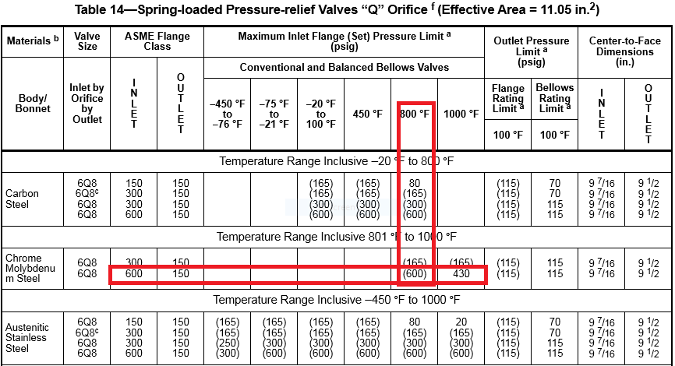

Slide 9
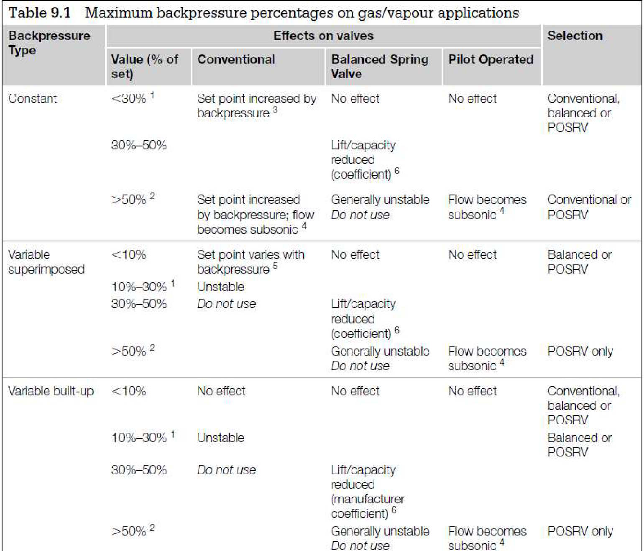
Select proper PSV type by checking backpressure
According to licensor data, superimposed and build-up backpressure are max 12 barg. Since the backpressure is constant and and more than 30% a balanced type could be selected
superimposed | Build-up | Total
1.5 barg | 10.5 barg | 12barg
5% | 36% | 41%

Slide 10
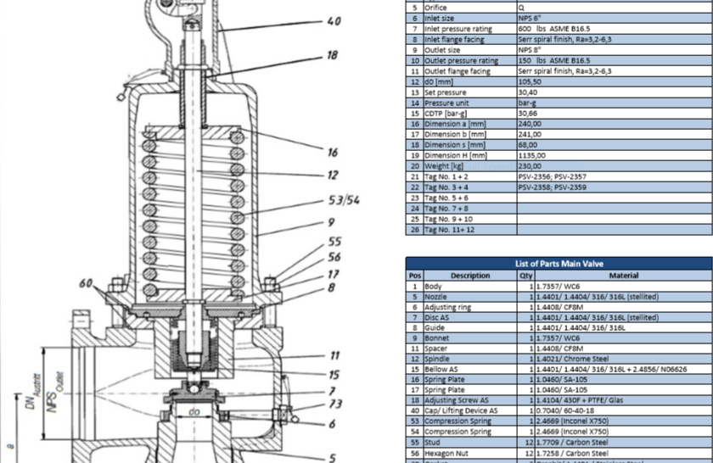
Material Selection

Slide 11
Discussion
Licensor has selected 6 PSV with 6Q8 designation to handle such load to flare system. The Licensor could have selected 5 PSV with 6R10 designation with total fluid of 550000 kg/h . Remember PSV with T designation could not be selected since there is no rating for 600 Pound for this PSV.

