Slide 1
PSV-2171-2172
Blocked Outlet Scenario

Slide 2
Determine relief load
The rated capacity of FT-2001 is 48000 kg/h , so the relief load is 48000 kg/h.

Slide 3
2.Calculate orifice area
Determine if it is in critical flow:
If so, then :

Slide 6
Results
Note that the relieving temperature is obtained from TOPSOE EXCEL
T | 467 K | W | 48000 kg/h
Z | 0.93 | A | 121.89 cm2
M | 18.02 | A | 18.89 cm2
C | 0.0256 | Accumulation | 10%

Slide 7
5.Use API-526 to determine the designation and the inlet and outlet sizing
Since it is more than 16 inch, then T is selected. Also, by checking its rating and temperature limitation, 6Q8 is selected.

Slide 8
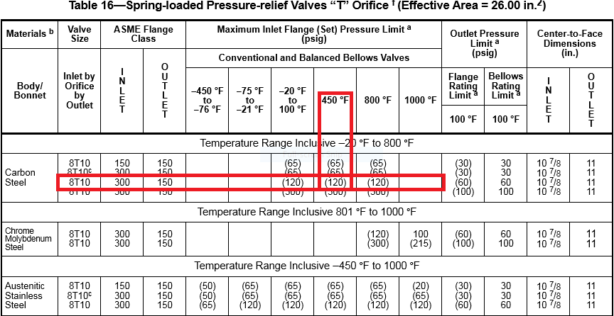

Slide 9
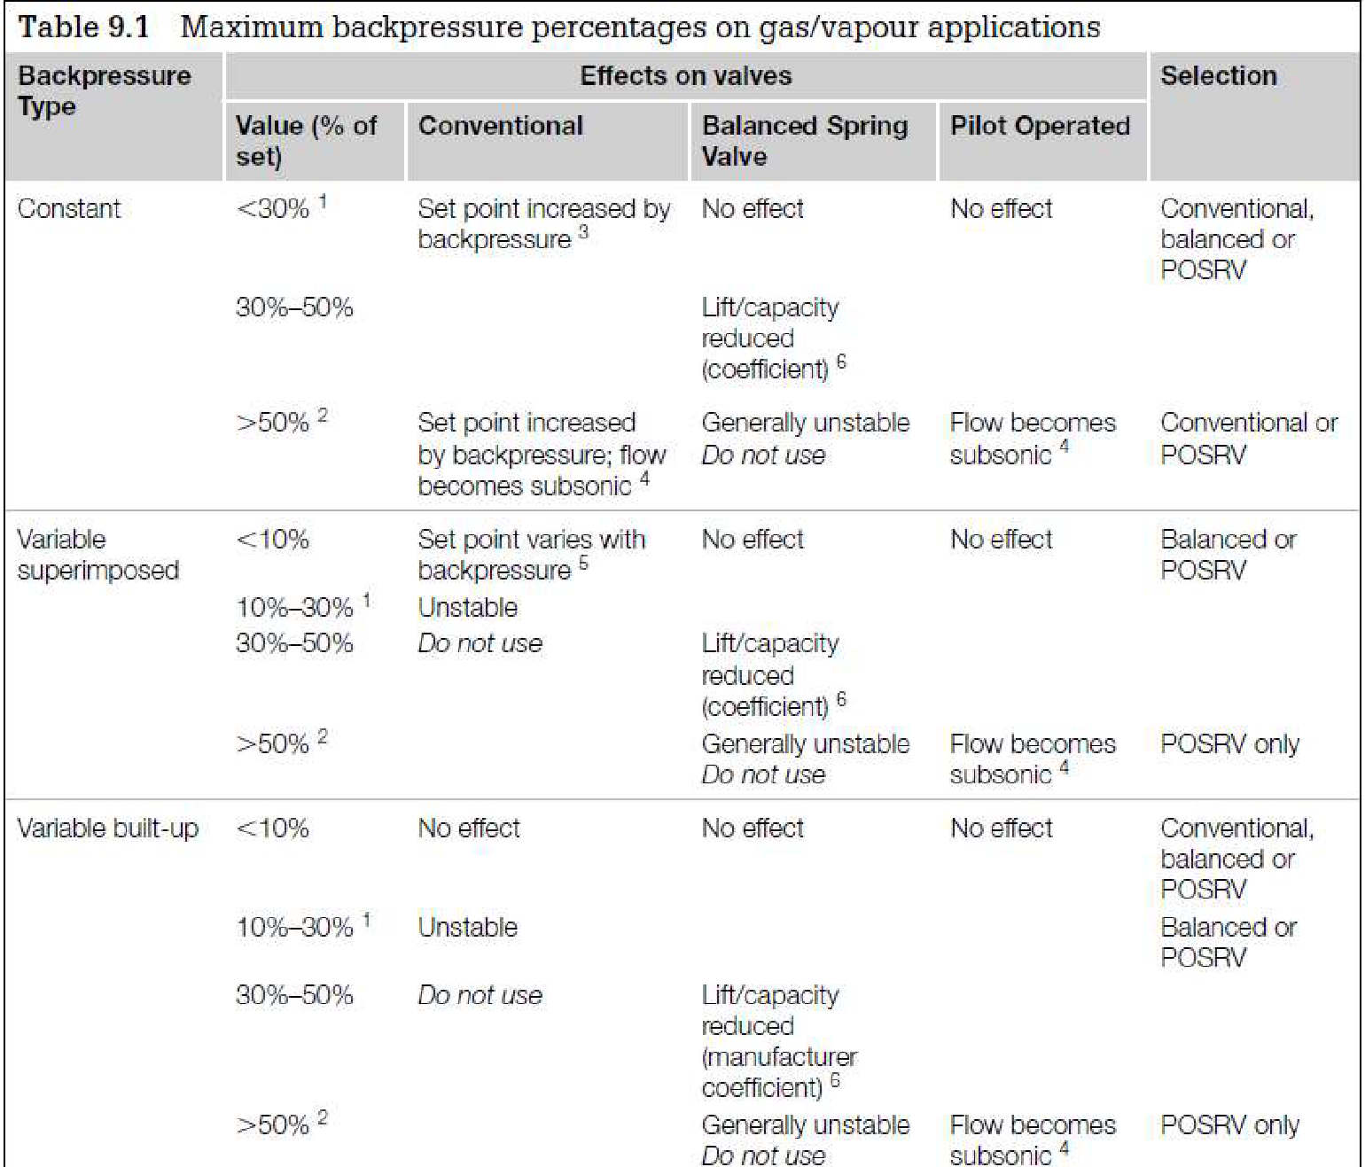
Select proper PSV type by checking backpressure
According to licensor data, superimposed and build-up backpressure are max 10 barg. Since the backpressure is constant and it is discharged to atmosphere then a conventional type could be selected even though the percentage is high
superimposed | Build-up | Total
0 barg | 10 barg | 10 barg
0% | 100% | 100%

Slide 10
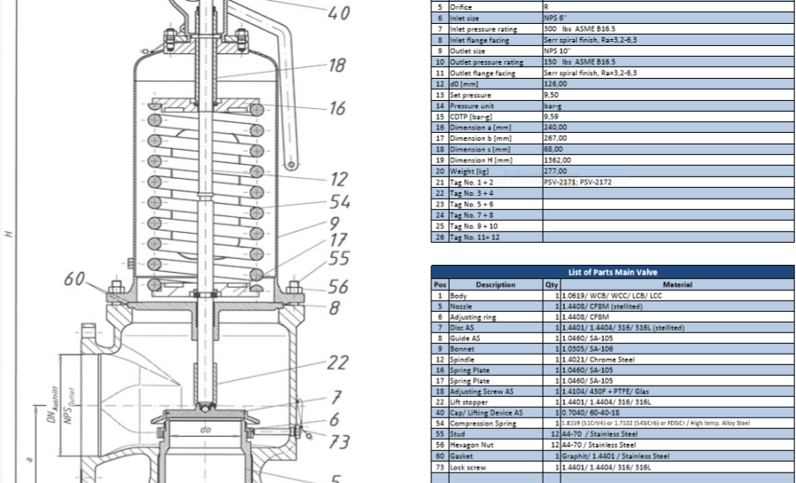
Material Selection
Since it is Steam , A216 WCB could be used for its body

Slide 11
Discussion
TOPSOE has selected 6R10 and I, according to rated steam consumption has selected 8T10, which is really big
Hence I think TOPSOE is right and TCC has reported overrated steam consumption which should be lower.

