Slide 1
MEKPCO FLARE NETWORK DESIGN
ASPEN FLARENET

Slide 2
Flare System Design Procedure
In order to design a flare package , the following procedure is taken :
Determination of worst case scenarios
Flare network line sizing using Aspen flarenet and API-527
Flare K.O.D sizing using API-527 excel sheet
Stack height and diameter calculation by API-527

Slide 3
System Description
The overall Flare system consists of three parts:
The first part is made of flare network and K.O.D inside MEKPCO plant. The second part is made of
flare main pipes between the tie-in point of the plant and flare area at the northeast. The third part
consists of flare stack package which will be located on the north mountain. The stack will be located at
X:652388 , Y:3051685 , Z:135 .
2. The flare main header approximate length is considered 2715 for hydraulic analysis implementation,
including the flare piping length 305m between the starting point and the tie-in point in methanol
plant and the flare piping length 2410 between the tie-in point and the actual flare site.
3. For the flare piping routing , one stress expansion loop is set at about 60 m distance , about 27 stress
expansion loops between the tie-in point and the flare stack.

Slide 4
4. For the flare piping routing , the elevation change between the tie-in location of methanol plant and
the actual flare site is about 111m.
5. The backpressure at the flare stack is 1.4 bara
The Whole Plot In Site Flare Header

Slide 5
Criteria and Design Basis
The sizing of relief discharge piping can usually be simplified by starting at the system outlet, where
the pressure is known, and working back through the system to verify acceptable backpressure at
each PRD Calculations are performed in a stepwise manner for each pipe segment of constant
diameter.
Several methods for calculating the size of discharge piping have been developed using isothermal or
adiabatic flow equations. Actual flow conditions in relief systems are normally somewhere between
isothermal and adiabatic conditions. For most cases, the slightly more conservative isothermal
equations are recommended.
For both header and tailpipes the Mach number of both 0.1 and 0.5 are taken into account.
The maximum ρν2 for the whole piping should be 150000 kg/m/s2
The sound/ noise level should not exceed the recommended value of 100 DBA

Slide 6
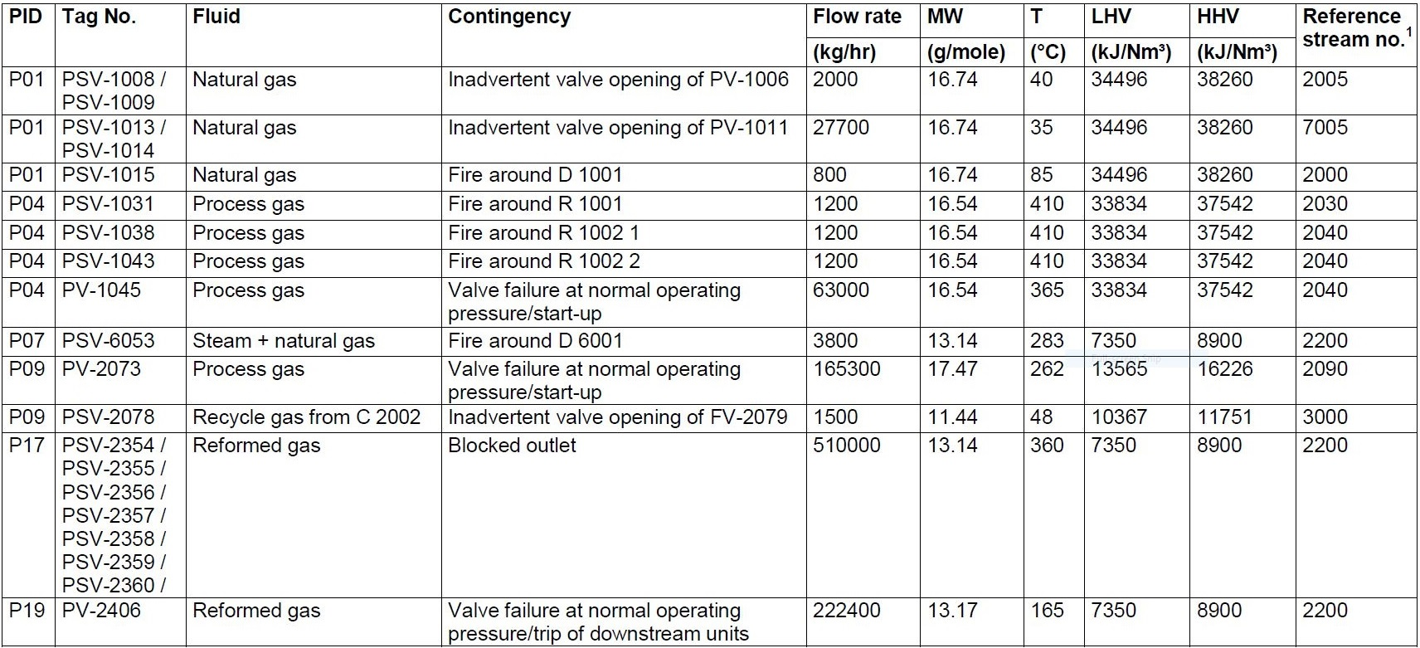
Determination of worst case scenario
All possible sources of relief load are summarized below and the worst case scenario is detected.

Slide 7
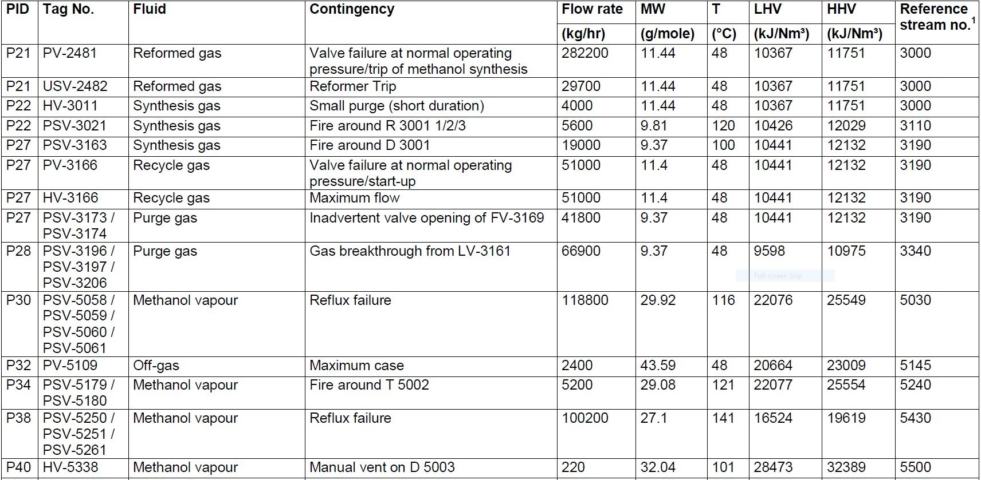

Slide 9
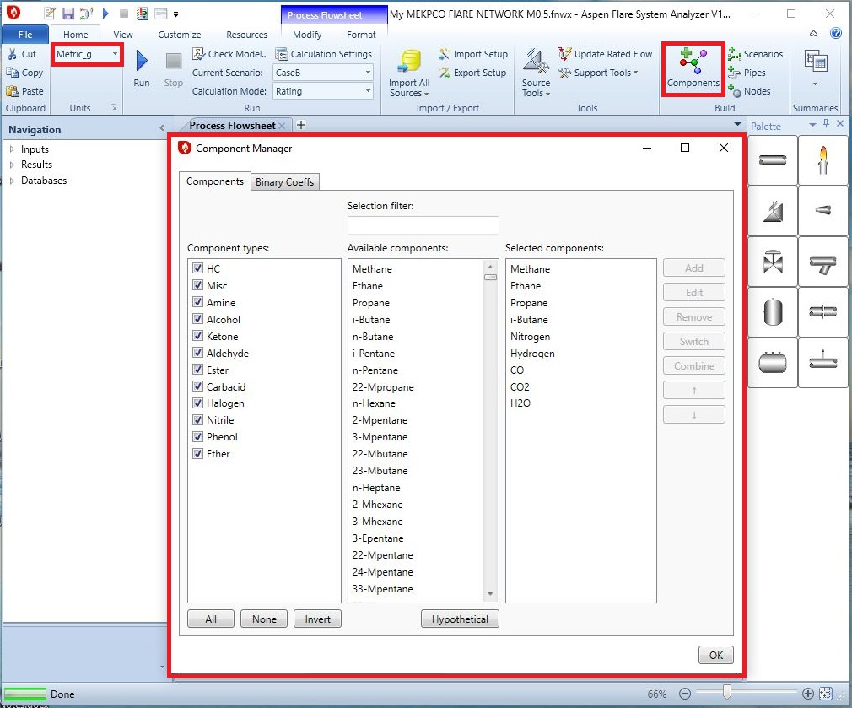
Flare network line sizing using Aspen flarenet and API-527
Procedure : The discharge load of each release point , the backpressure of flare stack, the diameter and
length of each pipe segment is given to seek the Mach number and backpressure alongside each pipe
segment. 1st Step: Create the component and set the unit

Slide 10
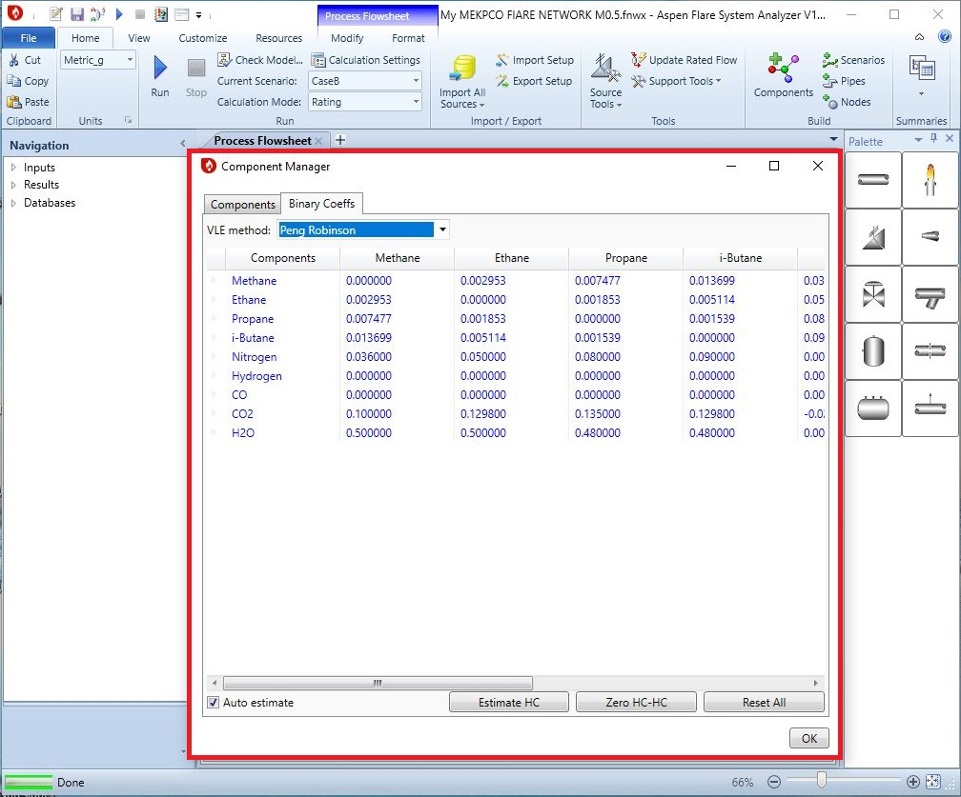

Slide 11
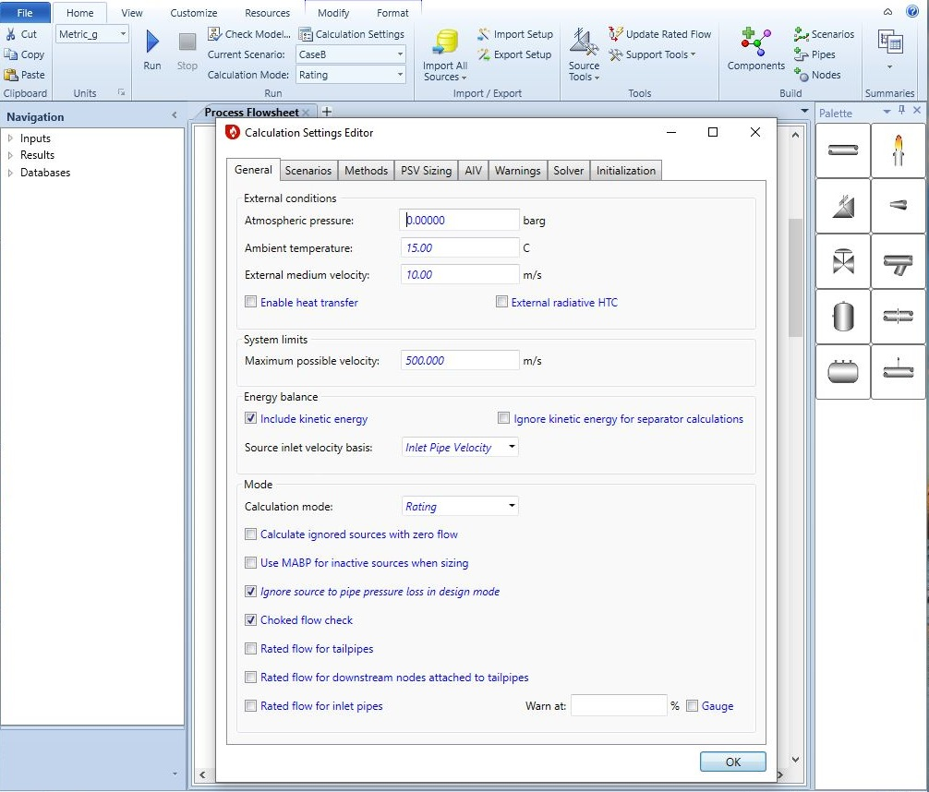
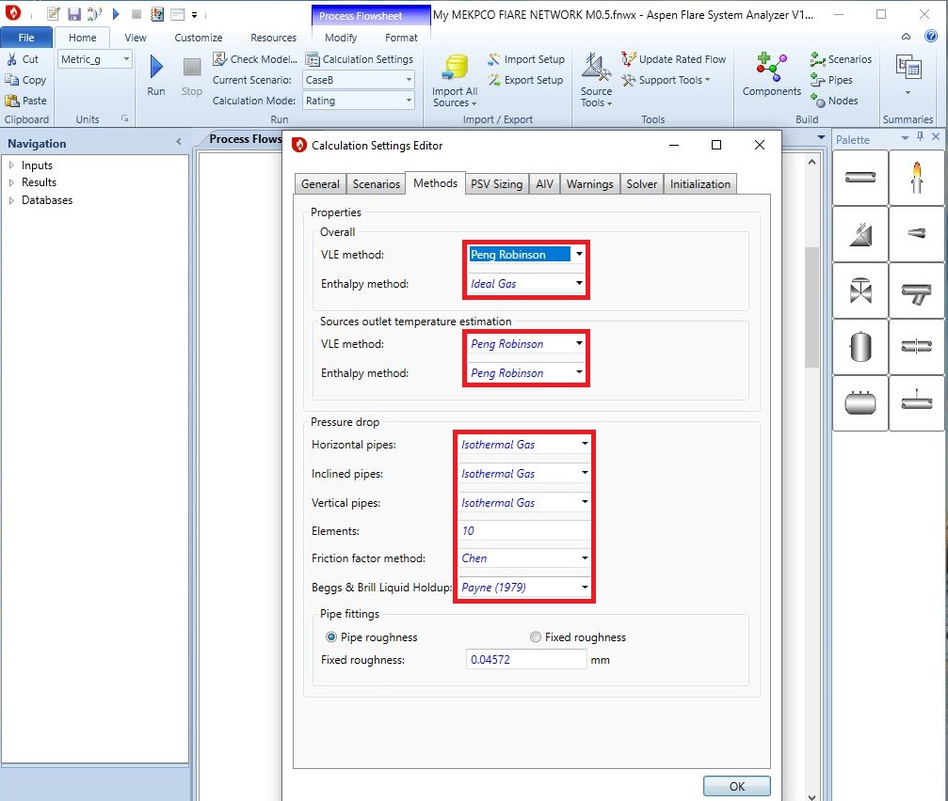
2nd Step: Checking “Calculation Setting”

Slide 12
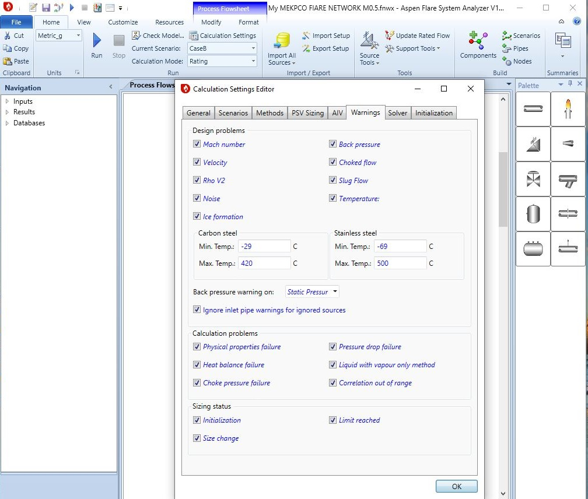
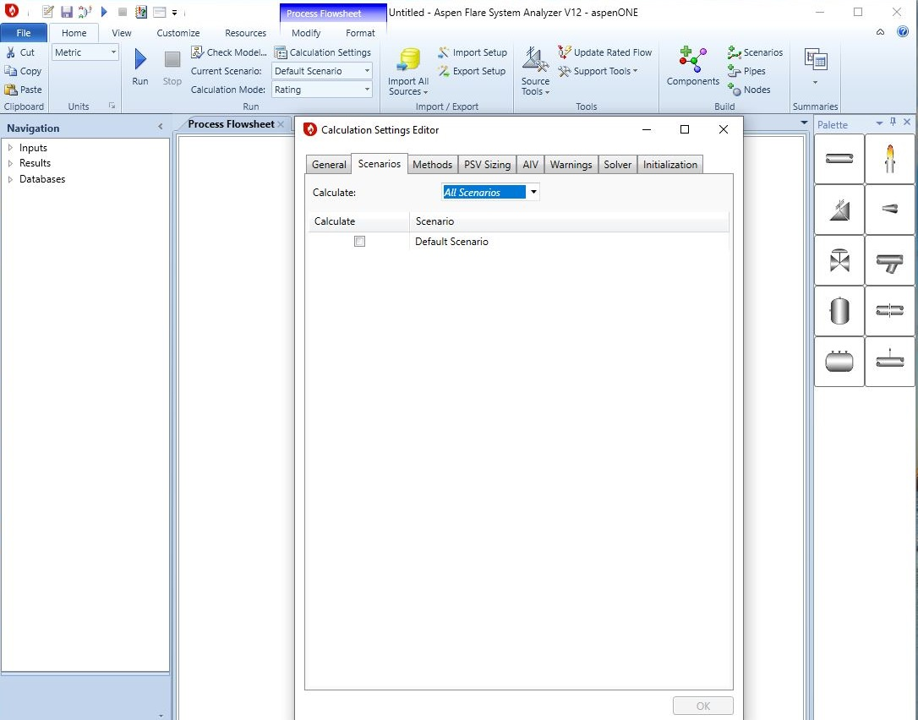
Note : There is no need to change PSV sizing , Solver, Initialization and AIV tabs in calculation setting.

Slide 13
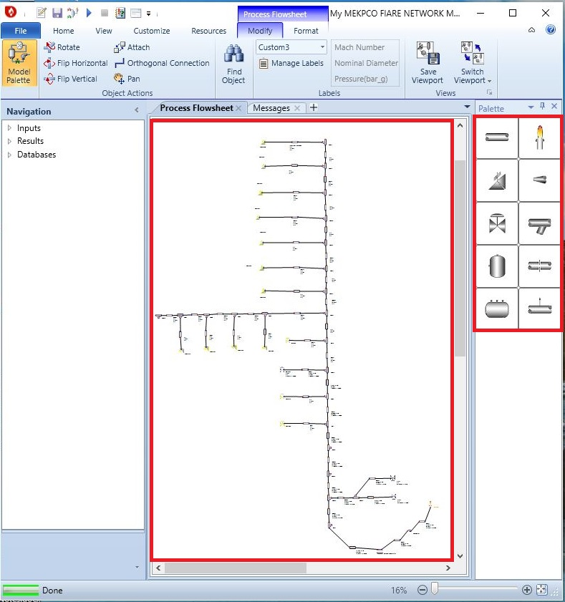
3rd Step : Create the layout

Slide 14
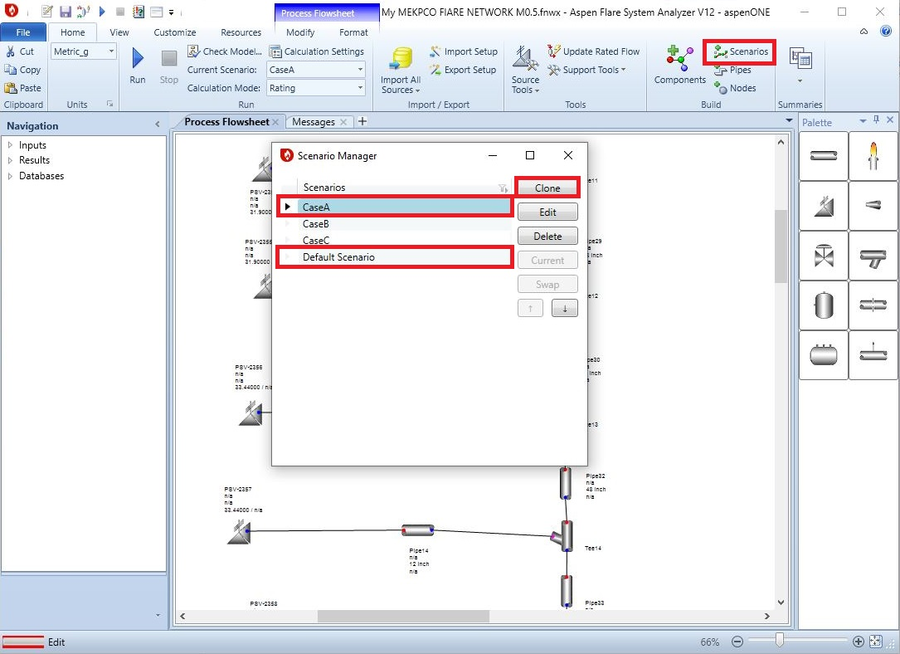
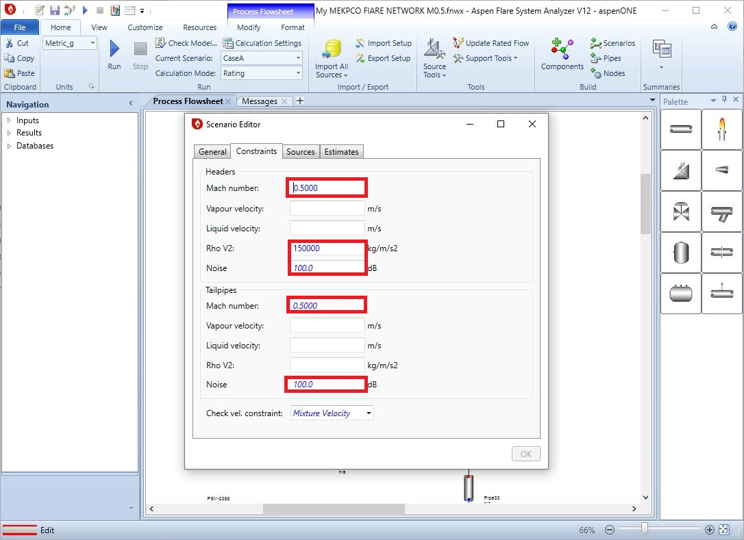
4th Step: Definition of Scenarios

Slide 15
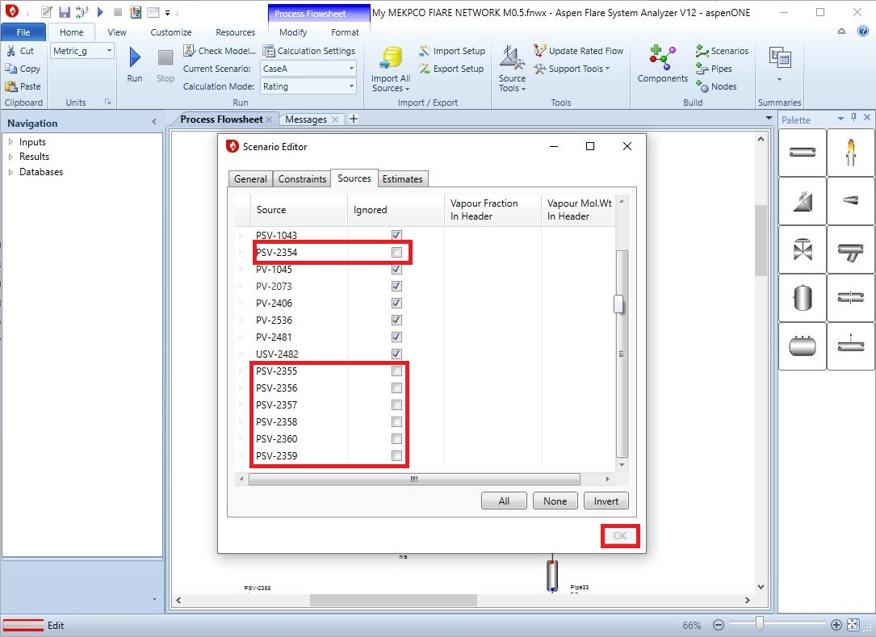
In order to define a scenario, at first “clone” a new scenario from default scenario and then complete the
Scenario. Also in “sources” tab, do not select the PSVs included in the scenario.

Slide 17
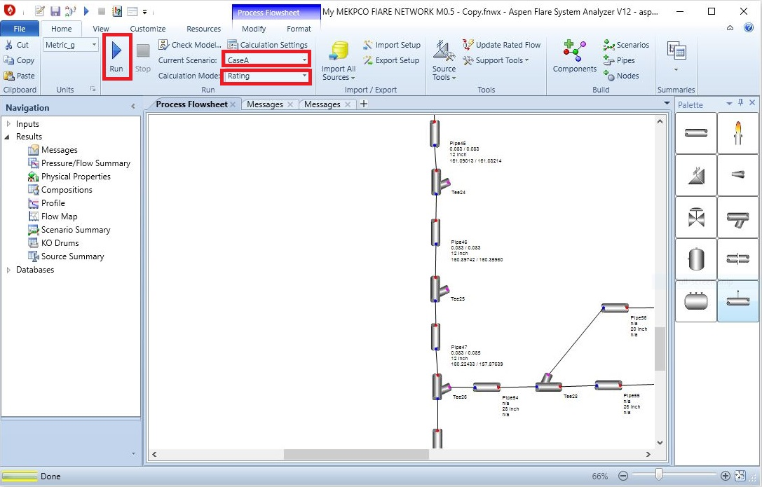
5th Step: Act accordingly and Run the software

Slide 18
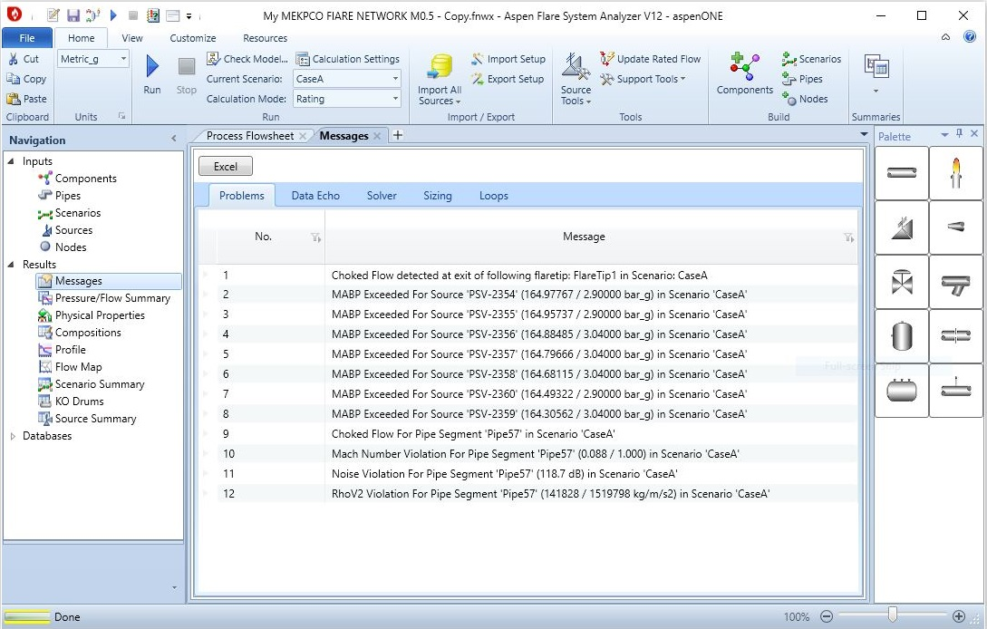
Results

Slide 19
Solution
In order to resolve the warnings, pipe diameters are increased till the constrains are met. The starting
point is from last pipe segment. When the pipe ID is increased to 54’ then the Mach number for last
segment is decreased to 0.46. it was observed that only last pipe has experience Mach number violation.
This could be justified by the fact that the pressure in other pipe is too high that the volumetric flow
has reduced dramatically in a way that Mach number is not a problem for these pipes. Interesting!!
Then other pipe segment diameter were increased and when other pipe ID, one by one, reached 46’, the
whole header and tail pipes Mach number met the constraints . By the way for smaller diameter like
42’ the test ere carried out but the pipes in the middle of header could not bear and Mach number
criterion was not met.
Also, tail pipe ID were increased to 20’ but the backpressure on PSV-2356-60 was higher than the set
value, therefore, the PSV type were changed to balanced type and their compatibility to system
backpressure was increased and as a result, the warning disappeared. The final diameter for tail pipes
were 12’ and smaller diameter were tested but the Mach number criterion failed. So 12’ was selected.

Slide 20
Also case B and C were tested and for PV-2481 , the pipe ID of 28’ was suitable . For PV-2536B the pipe
ID of 8’ was found suitable.

Slide 21
Case A
Case B
PSV-2354 | PSV-2355 | PSV-2356 | PSV-2357 | PSV-2358 | PSV-2359 | P-52-in | P-52-out | P-57-in Mach | P-57-ou Mach
2.836 | 2.837 | 2.838 | 2.845 | 2.849 | 2.85 | 2.474 | 2.427 | 0.11 | 0.129
2.02 | 2.05 | 2.12 | 2.17 | 2.17 | 2.13 | 1.55 | 1.48 | 0.18 | 0.33
PV-2481 | USV-2482 | PV-2536 | P-52-in | P-52-out | P-57-in Mach | P-57-out Mach
1.37 | 1.36 | 1.34 | 1.22 | 1.20 | 0.08 | 0.09
0.87 | 0.99 | 0.78 | 0.67 | 0.65 | 0.11 | 0.14

Slide 22
Discussion
It sounds that TCC has set Mach number of 0.1 as the criterion in order to have noise level within
reasonable limits. Furthermore, Implant and Aspen Flarenet results are compared which shows good
Compatibility.
Also the deviation might stem from different composition because in absence of exact composition , MW
Of each source were given to Aspen Flarenet and aspen flarenet estimates the composition.

